Slide 1
269202 Algorithms for iSNE
Dr. Kenneth Cosh
Week 4

Slide 2
Review
Stacks
Queues
Priority Queues

Slide 3
This week
Binary Trees
  Implementing Binary Trees
  Searching
  Traversing
  Insertion
  Deletion
  Balancing
  Self-Adjusting

Slide 4
Linked Lists
Over previous weeks we have investigated Linked Lists
  A linear data structure, used to implement queues or stacks etc.
Stacks and Queues do represent a hierarchy, it is however a one dimensional hierarchy.
Many fields contain hierarchical data structures, so this week we begin to investigate a new data structure called Trees.
  Examples include
    Genealogical Trees
    Grammatical Structure of Sentences
    Taxonomic structure of organisms, plants etc.

Slide 5
Trees
Trees can be pictured like upside down trees;
  With a root at the top
  Branches pointing downwards
  And leaves at the bottom.
A tree consists of nodes and connecting arcs
  For each node there is a unique path from the root.
  The number of arcs in this sequence is known as the length of the path
  The level of the node is the length of the path + 1.
  The height of the tree is the same as the highest length.

Slide 6
Trees
The Root node is the only node which has no parent
The Leaf nodes are nodes with no children
A tree could be an empty structure (just the same as an empty list)
A tree could be a single node
  In which case the node is both the root and a leaf

Slide 7
A Tree

Slide 8
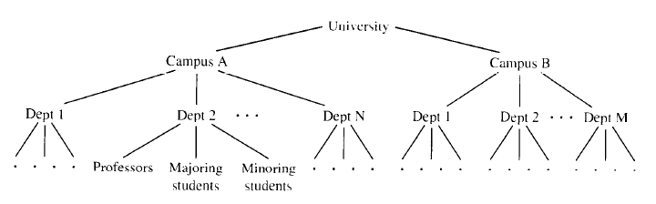
Tree Example
In this example the university has 2 campuses, but each campus can have a different number of departments

Slide 9
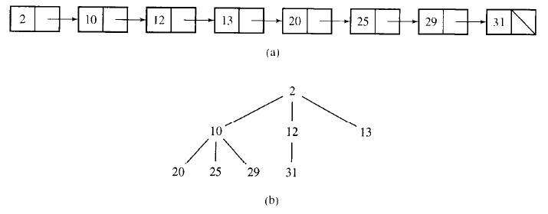
From a List to a tree
This slide demonstrates how a linked list could be represented as a tree
One of the key benefits of trees is improving search
  To find 31 in the linked list we must traverse the whole list
  Would it be any quicker in the tree?

Slide 10
From a list to a Tree
Technically NO!
  The criterion used to create this tree doesn’t help us search it as 31 could be a child of 10, 12 or 13!

Slide 11
Binary Trees
A binary tree is a tree whose nodes have a maximum of 2 children – i.e. 0, 1 or 2 branches coming from any node.
  The trees on the previous slides is not a binary tree, the following slide gives some binary tree examples.
When dealing with binary trees it is worth considering how we have used ‘If-Else’ statements in the past.

Slide 12
Binary Trees

Slide 13
Binary Trees
The final example on the previous slide was an unbalanced binary tree.
  The left hand side is longer (higher) than the right hand side.
A complete binary tree is a tree where every non-terminal node has 2 branches.
  For all nonempty binary trees whose nonterminal nodes have exactly 2 nonempty children, the number of leaves (m) is greater than the number of nonterminal nodes (k), and m=k+1.

Slide 14
Binary Search Trees
A Binary Search Tree (or an ordered binary tree) has an extra property.
  For each node in the tree
    All the values stored in its left sub-tree (the tree whose root is the left child) are less than the value v stored in n
    And all the values stored in its right sub-tree are greater than v.
Remember the game of pick a number between 1 and 10?

Slide 15
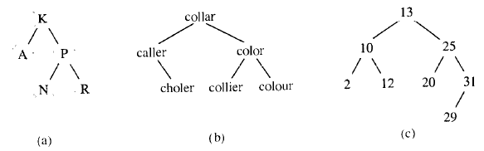
Binary Search Trees

Slide 16
Implementing Binary Trees
We can represent each node in a binary tree as a structure, with a data element and 2 pointers (to left and right children).
template<class T>
struct Node {
T key;
Node *left, *right;
};
We could then create an array (or better a vector) of these structures.

Slide 17
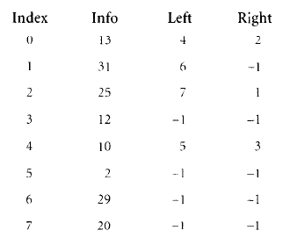
Binary Tree as an Array
What do you think?

Slide 18
Array Implementation
Implementing as an array is inconvenient as adding and removing nodes from a tree would leave a poorly structured array.
  Deleting a node would leave empty cells
  Inserting a node could mean nearby nodes are stored distinctly.

Slide 19
Node class
template<class T>
class BSTNode {
public:
BSTNode() { left = right = 0; }
BSTNode(const T& el, BSTNode *l =0, BSTNode *r = 0)
{ key = el; left = l; right = r;}
T key;
BSTNode *left, *right;
};
Notice that all members are public, this is so they can be accessed by a further class which controls the entire tree.

Slide 20
Tree Class
template<class T>
class BST {
public:
BST() { root = 0; }
protected:
BSTNode<T>* root;
};
Further member functions from this class can then perform various tasks on the BSTNode. Next we will discuss the kind of tasks we need to perform.

Slide 21
Searching a Binary Tree
For a well structured binary tree, searching it should be straightforward.
  Start at the root.
  If the value we are searching for is higher, follow the right pointer,
  If the value we are searching for is lower, follow the left pointer,
  If we find our value, stop searching,
  If we are pointing at NULL, value isn’t in the tree.

Slide 22
Searching a Binary Tree
5
3
8
2
4
6
9
1
7

Slide 23
Searching a Binary Tree
template<class T>
T* BST<T>::search(BSTNode<T>* p, const T& el) const {
while (p != 0)
if (el == p->key)
return &p->key;
else if (el < p->key)
p = p->left;
else
p = p->right;
return 0;
}

Slide 24
Searching Worst Case
In the previous example, if we were searching for ‘0’, as this would require 4 tests.
Therefore searching complexity can be measured in terms of the number of nodes encountered between the root and the node searched for (+1).
The worst case is therefore when the tree takes the form of a linked list, and a search could take O(n)

Slide 25
Searching Average Case
The Internal Path Length is the sum of all path lengths for all nodes in the tree.
Therefore the average case is;
  IPL / n
The average case of course depends on the shape of the tree, and so the average case depends on the IPL.
  The best average case is when using a complete binary tree.
  The worst case as seen is when using a linked list.

Slide 26
Efficient searching
Searching for a particular node is more efficient when using a complete tree
  We will investigate creating a complete tree further later.
Maintaining a complete tree
  Involves investigating efficient insertion and deletion algorithms
  We investigate insertion and deletion later
  As well as self adjusting trees
But first, another application of binary trees – traversal.

Slide 27
Tree Traversal
Tree traversal is the process of visiting each node in the tree exactly once.
Nodes can be visited in any order, which means for a tree with n nodes, there are n! different traversal patterns
  Most of these are not practical
Here we investigate different traversal strategies.

Slide 28
Tree Traversal Strategies
Breadth First
  Starting at either the highest or lowest node and visiting each level until the other end is reached.
    Lowest to Highest
    Highest to Lowest
Depth First
  Proceeding as far as possible to the right (or left), and then returning one level, stepping over and stepping down.
    Left to Right
    Right to Left

Slide 29
Breadth First Traversal
Top Down, left to right
Top Down, right to left
Bottom up, left to right
Bottom up, right to left

Slide 30
Breadth First Traversal
Consider Top Down, left to right traversal.
  Here we start with the root node and work downwards
    The node’s children are placed in a queue.
    Then the next node is removed from the front of the queue

Slide 31
Breadth First Traversal
template<class T>
void BST<T>::breadthFirst() {
Queue<BSTNode<T>*> queue;
BSTNode<T> *p = root;
if(p != 0) {
queue.enqueue(p);
while (!queue.empty()) {
p = queue.dequeue();
visit(p);
if (p->left != 0)
queue.enqueue(p->left);
if (p->right != 0)
queue.enqueue(p->right);
}
}
}

Slide 32
Depth First Traversal
V = visiting a node
L = traversing the left subtree
R = traversing the right subtree
Options
  VLR (Pre Order Tree Traversal)
  VRL
  LVR (In order Tree Traversal)
  RVL
  LRV (Post order Tree Traversal)
  RLV

Slide 33
Depth First Traversal
These Depth first traversals can easily be implemented using recursion;
  In fact Double Recursion!

Slide 34
In Order
template<class T>
void BST<T>::inorder(BSTNode<T> *p) {
if (p!=0) {
inorder(p->left);
visit(p);
inorder(p->right);
}
}

Slide 35
Pre Order
template<class T>
void BST<T>::preorder(BSTNode<T> *p) {
if (p!=0) {
visit(p);
preorder(p->left);
preorder(p->right);
}
}

Slide 36
Post Order
template<class T>
void BST<T>::postorder(BSTNode<T> *p) {
if (p!=0) {
postorder(p->left);
postorder(p->right);
visit(p);
}
}

Slide 37
Recursion
These doubly recursive functions obviously make extensive use of the runtime stack, so it is worth investigating a non-recursive option.

Slide 38
Nonrecursive Pre Order
template<class T>
void BST<T>::iterativepreorder() {
Stack<BSTNode<T>*> travStack;
BSTNode<T> *p = root;
if(p != 0) {
travStack.push(p);
while(!travStack.empty()) {
p = travStack.pop();
visit(p);
if (p->right != 0)
travStack.push(p->right);
if (p->left != 0)
travStack.push(p->left);
}
}
}

Slide 39
Nonrecursive
Obviously the non-recursive code is longer, but is it more efficient?
  There is no double recursion
  There is extensive use of a stack (in opposed to the runtime stack).
  Support Stack functions are needed
  Up to 4 calls per iteration.
  In short no.
Similar nonrecursive functions can be produced for the other tree traversal strategies.

Slide 40
Stackless Traversal
The recursive and nonrecursive functions discussed so far have both made extensive use of a stack
  To store info about nodes which haven’t yet been processed.
To enable a stackless traversal, we can encorporate the stack within the tree, creating a threaded tree.
  Threads are implemented using extra pointers – pointers to the next node in a traversal.
  4 pointers may be needed to be maintained
    Left Child, Right Child, Predecessor, Successor
  Or, pointers can be overloaded, to either point to Left and Right child, OR to Predecessor and Successor
    But in this case, an extra data member is needed to indicate which!

Slide 41
Threaded Trees
5
In this example, threads are the pointers.
Left nodes point to their predecessors, right nodes point to their successors.
Would this really save space?
3
8
2
4
6
9
1
7

Slide 42
Efficiency
Creating threaded tree is an alternative to the recursive, or iterative use of the stack.
  However the stack still exists, though now incorporated into the tree
So how efficient are the different approaches?
  All are O(n) for time.
  But when the recursive version is so much more intuitively simple, why not use it?
The issue with stack usage concerns space, rather than time.
  But can we find a solution which uses less space?

Slide 43
Traversal through Tree Transformation
Yes!
An alternative to using the stack to store tree movements, is to transform the tree to make it easier to traverse.
Obviously a tree with no left nodes is easy to traverse by stepping to the right.
Morris’s algorithm makes use of this by changing LVR to VR (no need to step left).

Slide 44
Morris’s Pseudo-code
MorrisInOrder()
while not finished
if node has no left decendant
visit it;
go to the right;
else
make this node the right child of the rightmost node in its left descendent;
go to this left descendent;

Slide 45
Morris’s Algorithm
5
3
2
3
6
2
4
1
3
p
2
4
1
5
4
p
1
6
5
1
2
What happens next?
Notice the moved nodes retain their
left pointers so the original shape can be regained
6
3

Slide 46
Morris’s Algorithm
Notice that with Morris’s algorithm, time depends on the number of loops.
The number of loops depends on the number of left pointers.
  Some trees will be more efficient than others using this algorithm
Tests on 5,000 randomly generated trees showed a 5-10% saving, but a clear space saving.

Slide 47
Changing a Binary Tree
Searching or Traversing a binary tree doesn’t affect the structure of a tree, unless instructed through the function visit().
There are several operations required which may change the structure of a tree, such as inserting or deleting nodes, merging or balancing trees.

Slide 48
Node Insertion
Inserting a node into a tree means finding a node with a ‘dead-end’ or empty child node.
To find the appropriate node, we can following the searching algorithm.
  If element to be inserted (el) is greater than the root, move right, if less than the root move left.
  If the node is empty, insert el.
Obviously over time this could lead to a very unbalanced tree.

Slide 49
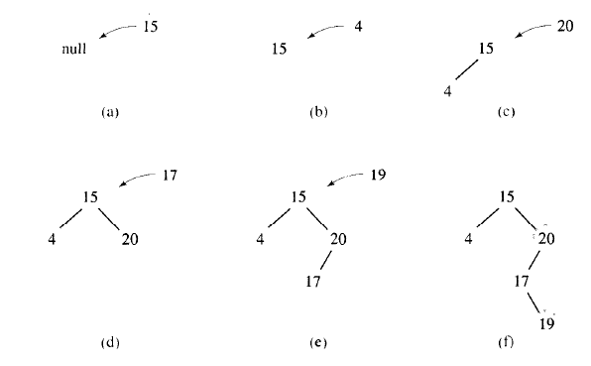
Node Insertion

Slide 50
Node Insertion (Threaded Tree)
If we are using a threaded tree, a further complication is set;
  Adding the threads.
For each added node a thread pointer has to be included, which means;
  For a left node, a pointer to the parent
  For a right node, the node inherits its successor from its parent.

Slide 51
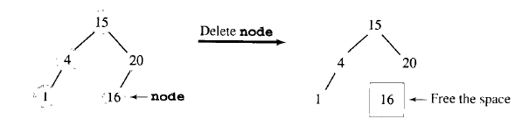
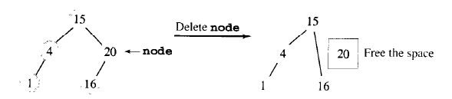
Deletion
The complexity of deletion can vary depending on the node to be deleted.
Starting simply;
  A node with no children (i.e. a leaf).
    The node can be deleted, and the parent will point to null.
  A node with one child.
    The node can be deleted, and the parent will point to the former grandchild.

Slide 52
Deleting a node with 2 children
In this case there are 2 alternatives to deletion
  Deletion by Merging
    The two child trees are considered as separate trees which require merging.
  Deletion by Copying

Slide 53
Deletion by Merging
When a node with two children is deleted, 2 subtrees are created, with the 2 children each becoming roots.
  All values in the left subtree are lower than all values in the right subtree.
  In deletion by merging, the root of the left tree replaces the node being deleted.
  The rightmost child of this tree then becomes the parent of the right tree.

Slide 54
Deletion by Merging
5
3
3
8
2
4
2
4
6
9
1
8
3
8
Delete Node 5.
1
7
6
9
2
4
6
9
2 subtrees
7
1
7

Slide 55
Deletion By Merging
When deleting by merging, the resulting tree may gain height, as in the previous example.
Or it may lose height.
The algorithm may produce a highly unbalanced tree, so while it isn’t inefficient, it isn’t perfect.

Slide 56
Deletion By Copying
Again 2 subtrees are created.
  This time, we notice that the leftmost node of the right subtree is the immediate successor of the rightmost leaf of the left subtree (and vice versa).
  Ergo, we could replace the root of the new tree, with the rightmost leaf of the left subtree (or with the leftmost leaf of the right subtree).
  This will not extend the height of the tree, but may lead to a bushier left side.
  To avoid this, we can alternate between making the root the predecessor or successor of the deleted node.

Slide 57
Deletion by Copying
3
8
2
4
6
9
4
6
2 subtrees
1
7
3
8
3
8
2
6
9
2
4
7
9
1
7
1

Slide 58
Balancing a Tree
We have seen the searching benefits of a balanced tree, but how to we balance a tree?
Consider a tree with 10,000 nodes.
  At its least efficient (linked list) at most 10,000 elements need to be tested to find an element.
  When balanced, just 14 tests need be performed.
    The height of the tree is lg(10,001) = 13.289 = 14.

Slide 59
Creating a balanced tree
Assume all the data is in a sorted array.
  The middle element becomes the root.
  The middle element of one half becomes a child.
  The middle element of the other half becomes the other child.
  Recurse…

Slide 60
Balance
template<class T>
void BST<T>::balance(T data[], int first, int last) {
if (first <= last) {
int middle = (first + last)/2;
insert(data[middle]);
balance(data, first, middle-1);
balance(data, middle+1, last);
}
}

Slide 61
Weakness
This algorithm is quite inefficient as it relies on using extra space to store an array of values, and all values must be in this array (perhaps by an inorder traversal).
Lets look at some alternatives.

Slide 62
The DSW Algorithm
The DSW algorithm was devised by Day, and improved by Stout and Warren.
In this algorithm first the tree is stretched into a linked list like tree.
Then it is balanced.
The key to the operation comes from a rotation function, where a child is rotated around its parent.

Slide 63
Rotation
G
G
C
P
X
C
Y
P
This is Right Rotation, the reverse is Left Rotation
X
Y

Slide 64
Create Backbone (Linked list like tree)
createBackbone(root, n)
{
tmp = root;
while(tmp!=0)
if(tmp has left child)
rotate left child around tmp;
set tmp = new parent;
else
set tmp = right child.
}

Slide 65
Phase 2
Phase 2 is to turn the linked list like tree into a perfectly balanced tree, once again using the rotate function.
Here every other node is rotated around its parent.
This process is repeated down the right branch until a balanced tree is reached.

Slide 66
Balancing
1
2
3
2
4
4
1
4
2
8
5
3
6
1
3
6
9
6
8
7
5
5
7
7
9
8
9

Slide 67
DSW Algorithm
The DSW Algorithm is effective at balancing an entire tree. (Actually O(n))
Sometimes trees need only be balanced periodically, in which case this cost can be amortised.
Alternatively the tree may only become unstable after a series of insertions and deletions, in which case a DSW balancing may be appropriate.

Slide 68
Alternatives
While the DSW is effective at rebalancing the whole tree, sometimes rebalancing only need affect a portion of the tree.
An alternative approach is to ensure the tree remains balanced by incorporating balancing into any insertion / deletion algorithms.
  In an AVL insertion and deletion considers the structure of the tree.
    All nodes have a balance factor – i.e. a difference between the height of the right subtree and the height of the left subtree. This difference must remain at +1, 0 or -1.
      Balance(tree) = HeightOf(tree.Left) – HeightOf(tree.Right)
    An AVL tree may not appear completely balanced as after the DSW algorithm.

Slide 69
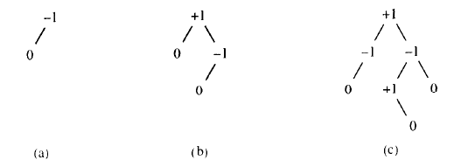
AVL Trees
Named after Adel’son-Vel’ski and Landis

Slide 70
AVL Trees
If the balance factor of any node in an AVL tree becomes >1 or <-1, the tree has to be balanced
An AVL Tree can become out of balance in 4 situations
  Insertion into Right Subtree of the Right Child
  Insertion into Left Subtree of the Left Child
  Insertion into Right Subtree of the Left Child
  Insertion into the Left Subtree of the Right Child
There are therefore 4 rotations which can rebalance the tree
  RR, LL, RL, LR

Slide 71
LL Rotation
Node | Balance Factor
3 | 0
4 | 1
5 | 1
6 | 0
10 | 1
13 | -1
17 | 0
10
5
13
4
6
17
3

Slide 72
LL Rotation
10
Node | Balance Factor
2 | 0
3 | 1
4 | 2
5 | 2
6 | 0
10 | 2
13 | -1
17 | 0
5
13
Unbalanced from 4
4
6
17
3
2
Insert 2!

Slide 73
LL Rotation
10
Node | Balance Factor
2 | 0
3 | 0
4 | 0
5 | 1
6 | 0
10 | 1
13 | -1
17 | 0
5
13
3
6
17
2
4
After LL Rotation

Slide 74
RR Rotation
Node | Balance Factor
4 | 0
5 | -1
6 | -1
7 | 0
10 | 1
13 | -1
17 | 0
10
5
13
4
6
17
7

Slide 75
RR Rotation
Node | Balance Factor
4 | 0
5 | -2
6 | -2
7 | -1
8 | 0
10 | 2
13 | -1
17 | 0
10
Unbalanced at 6
5
13
4
6
17
7
8
Insert 8!

Slide 76
RR Rotation
Node | Balance Factor
4 | 0
5 | -1
6 | 0
7 | 0
8 | 0
10 | 1
13 | -1
17 | 0
10
5
13
4
7
17
6
8

Slide 77
LR Rotation
Node | Balance Factor
2 | 0
4 | 1
5 | 1
6 | 0
10 | 1
13 | -1
17 | 0
10
5
13
4
6
17
2

Slide 78
LR Rotation
10
Node | Balance Factor
2 | -1
3 | 0
4 | 2
5 | 2
6 | 0
10 | 2
13 | -1
17 | 0
5
13
Unbalanced from 4
4
6
17
2
3
Insert 3!

Slide 79
LR Rotation
10
Node | Balance Factor
2 | 0
3 | 0
4 | 0
5 | 1
6 | 0
10 | 1
13 | -1
17 | 0
5
13
3
6
17
2
4
A double rotation is necessary to rebalance the tree

Slide 80
RL Rotation
Node | Balance Factor
4 | 0
5 | -1
6 | -1
8 | 0
10 | 1
13 | -1
17 | 0
10
5
13
4
6
17
8

Slide 81
RL Rotation
Node | Balance Factor
4 | 0
5 | -2
6 | -2
7 | 0
8 | 1
10 | 2
13 | -1
17 | 0
10
Unbalanced at 6
5
13
4
6
17
8
7
Insert 7!

Slide 82
RL Rotation
Node | Balance Factor
4 | 0
5 | -1
6 | 0
7 | 0
8 | 0
10 | 1
13 | -1
17 | 0
10
5
13
4
7
17
6
8

Slide 83
Further issue!
10
Unbalanced at 5
Node | Balance Factor
4 | 0
5 | -2
6 | 0
7 | -1
8 | -1
9 | 0
10 | 2
13 | -1
17 | 0
5
13
4
7
17
6
8
9
Insert 9!

Slide 84
RRR Rebalance
10
Node | Balance Factor
4 | 0
5 | 0
6 | 0
7 | 0
8 | -1
9 | 0
10 | 1
13 | -1
17 | 0
7
13
5
8
17
4
6
9

Slide 85
Deletion
Deleting nodes can also cause the AVL tree to be unbalanced
This is also solved by rotation
But deletion is more time consuming than insertion
  When a node is deleted, all the nodes between it and the root need to be checked, and possibly rotated to rebalance the tree

Slide 86
Balancing a tree
The goal of balancing a tree is to stop them being lopsided, and to get all the leaves to occur at 1 or 2 levels.
  If a new node causes this problem, it is immediately rectified either locally (AVL) or by recreating the tree (DSW)
But the goal of a BST is to insert, retrieve and delete elements quickly – does the shape of the tree really matter?

Slide 87
Self Adjusting Trees
We have encountered some self adjustment strategies already, when dealing with linked lists. For Binary Trees self adjustment stems from an observation similar to one we encountered there.
Balancing a Binary Tree has focused on building a complete binary tree, with a view that this is the most efficient when searching for any node in it.
However, some nodes may be searched more frequently than others – so if these nodes appear near the top of a binary tree, searches become more efficient.
Strategies for self restructuring trees include; Single Rotation (rotating the node around its parent), or Move to Root.

Slide 88
Splay Trees
A Splay Tree is a special kind of self organizing Binary Search Tree
Each time an element is accessed, the tree is reorganized such that recently accessed elements are more easily located.
Insertion, Deletion and Search are all performed in O(log n) amortized time.
All normal operations on the tree are combined with one additional operation, known as splaying.

Slide 89
Splay Trees
There are 3 different cases, which have different rules:-
  Case 1 – The nodes parent is the root.
  Case 2 – Homogeneous configuration – either the node is the left child of its parent, and its parent is the left node of its grandparent, OR both are the right child.
  Case 3 – Heterogeneous configuration – either the node is the left child of its parent, and its parent is the right child of its grandparent, OR it’s the right child of its parent and its parent is the left child of the grandparent.

Slide 90
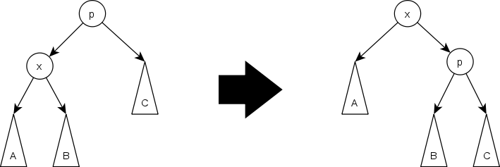
Splay Trees – Case 1
If the parent is the root, simply rotate the child around the parent.

Slide 91
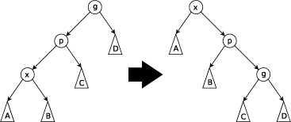
Splay Tree – Case 2
Homogeneous configuration
  First the parent is rotated around the grandparent
  Then the node is rotated around its parent

Slide 92
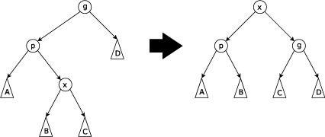
Splay Tree – Case 3
Heterogeneous configuration
  First rotate the node around its parent
  Then rotate it around the grandparent

Slide 93
BST, AVL or Self Adjusting?
Theoretically self-organizing trees perform well compared with AVL and simple Binary Search Trees.
Experimentally though, almost always the AVL tree outperforms self adjusting trees, and sometimes simple BSTs do too.
Perhaps complexity analysis and amortized analysis shouldn’t always be the way to measure algorithm performance?

Slide 94
Heaps
A (max) heap is a binary tree where the value of each node is greater than or equal to the values stored in its children, and the tree is perfectly balanced.
A min heap is the reverse, where the smaller values are stored in the parents.

Slide 95
Heaps as Priority Queues
Enqueue
  Elements are added at the bottom of the heap (as leaf nodes)
  They are then moved towards the root,
    Swapping with their parent if they are higher priority
Think about efficiency – compare with inserting into the right
position in a linked list…
9
6
7
5
3
2
4
8

Slide 96
Priority Queue – Heap Implementation
Dequeue
  Obviously the root node is removed as the highest priority
  The heap is then restored by moving the last node (4) to the root
  This node then descends towards the leaves
Consider the efficiency – compared with searching for the highest priority node in a linked list
6
7
5
3
2
4

Slide 97
Heapsort
Remember selection sort?
  We search through the data to find the lowest (or highest) value and move it to the end and do that for every element that needs sorting O(n²)
The key properties of a heap facilitate Heapsort
  The value of each node is equal or greater than its children
  (The tree is perfectly balanced, with the leaves in the leftmost positions)

Slide 98
Heapsort
Take the data and create a heap
Pop the root node and move it to its position
Make a new heap from the remaining nodes
If the data is stored in an array, we can use the existing array by swapping the positions of data.

Slide 99
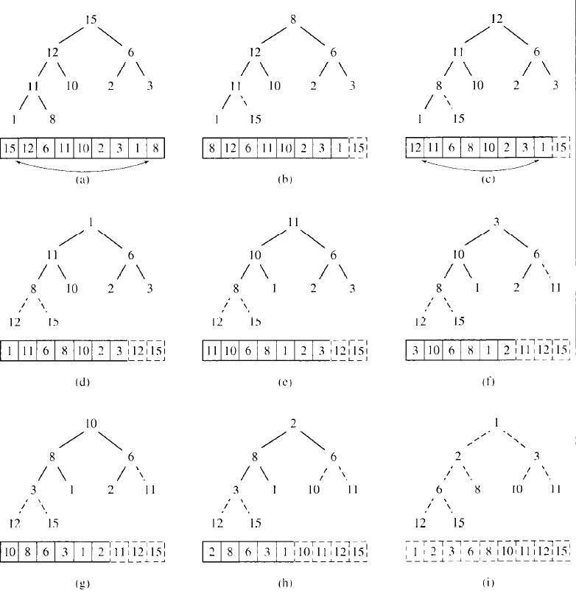
Heapsort

Slide 100
Another Tree Application
2-3*4+5 = ???
  -15?
  -9?
  -5?

Slide 101
Polish Notation & Expression Trees
+
*
-
-
5
-
+
2
+
2
*
*
5
2
3
4
5
3
4
3
4
Consider different ways of traversing these trees;
Preorder, Inorder, Postorder

