Slide 1
Web Programming Language
Chapter 12

Slide 2
HTML5
New Tags (and Deprecated Tags)
Audio & Video
The Canvas
Geolocation
Local Storage
Web Workers

Slide 3
HTML History
HTML was originally defined in 1991 (by Tim Berners-Lee), but the web has changed massively since then.
New devices, new capabilities, more powerful devices…
In 2014 a new version of HTML, known as HTML5, was introduced
All modern browsers support HTML5, but while the language is specified by W3C, some features are yet to be supported by some browsers.

Slide 4
New Tags
Simpler than previously (instructs which version of HTML is being used)
<!DOCTYPE html> <html> <head> <meta charset="UTF-8"> <title>Page Title</title> </head> <body> </body> </html>
Simpler than previously (says which character encoding is used)

Slide 5
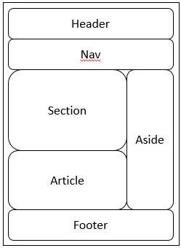
New Semantic Elements
Traditionally we break up the page using <div class=“header”> or <div class=“nav”>, but <div> doesn’t give much away about what it contains. HTML5 attempts to bring some consistency with semantic tags such as <header> and <nav>

Slide 6
New Semantic Elements
Tag | Description
<article> | For articles
<aside> | Other content apart from the page content
<details> | Additional details that can be hidden from a <summary> element
<figcaption> | A caption for a <figure> element
<figure> | A figure (diagram, photo, illustration etc.)
<footer> | The closing section of a page (or section)
<header> | The opening section of a page (or section)
<main> | For specifying the main part of a document
<mark> | For highlighting part of the text
<nav> | For navigation links
<section> | For a section in the content
<summary> | A visible heading for a <details> element
<time> | For defining dates or times

Slide 7
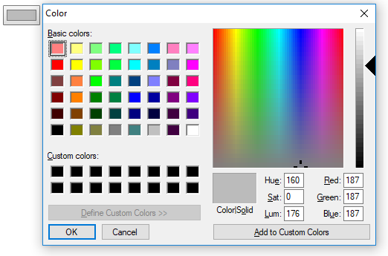
New Input Types
<input type="color" value = "#bbbbbb">

Slide 8
New Input Types
<input type="date" min="1950-01-01" max="2018-12-31">
<input type="range" name="score" min="0" max="10">

Slide 9
Deprecated Tags
Tags to do with Style & Frames are gone!
<frame>
<frameset>
<noframes>
<basefont>
<big>
<center>
<font>
<strike>
<tt>

Slide 10
Audio & Video
No need for browser plugins (i.e. Flash)
<audio controls> <source src="music.mp3" type="audio/mpeg"> <source src="music.ogg" type="audio/ogg"> Audio Not Supported. </audio>

Slide 11
Video
<video width="320" height="240" controls autoplay> <source src="movie.mp4" type="audio/mp4"> <source src="movie.ogg" type="audio/ogg"> Video Not Supported. </audio>

Slide 12
The Canvas
The canvas provides a space for graphics to be drawn onto the page (using JavaScript).
<canvas id="canvas1" width="400" height="250" style="border:1px black solid"> This is a canvas element, you need HTML5! </canvas>

Slide 13
The Canvas
<script> $(document).ready(function(){ canvas = $('#canvas1')[0]; context = canvas.getContext('2d'); context.moveTo(20,50); context.lineTo(380,150); context.stroke(); }); </script>

Slide 14
The Canvas
context.fillStyle = 'red'; context.beginPath(); context.moveTo(200, 125); context.arc(200, 125, 70, 0, Math.PI * 2, false); context.closePath(); context.fill();

Slide 15
The Canvas
$(canvas).css("background", "white"); context.fillStyle = 'red'; context.fillRect(0, 0, 400, 250); context.clearRect(0, 42, 400, 168); context.fillStyle = 'blue'; context.fillRect(0, 84, 400, 84);

Slide 16
The Canvas
gradient = context.createLinearGradient(0, 0, 400, 250); gradient.addColorStop(0, 'black'); gradient.addColorStop(1, 'white'); context.fillStyle = gradient; context.fillRect(0, 0, 400, 250);

Slide 17
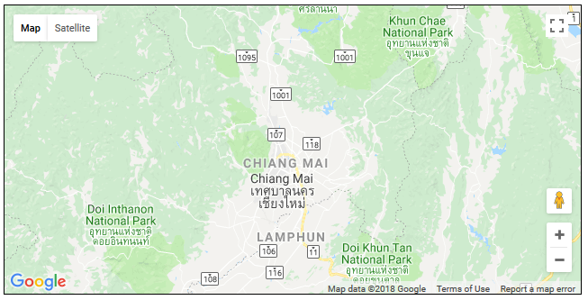
Geolocation
<!DOCTYPE html> <html><head> <meta charset="UTF-8"> <title>Geolocation</title> <script src="jquery-1.11.1.min.js"></script> <script src="https://maps.googleapis.com/maps/api/js?sensor=false"></script> </head><body> <div id='status'></div> <div id='map'></div> <script> $(document).ready(function(){ if (typeof navigator.geolocation == 'undefined') alert("Geolocation not supported.") else navigator.geolocation.getCurrentPosition(granted, denied) function granted(position) { $('#status').innerHTML = 'Permission Granted' $('#map').css("border", "1px solid black") $('#map').css("width", "640px") $('#map').css("height", "320px") var lat = position.coords.latitude var long = position.coords.longitude var gmap = $('#map')[0] var gopts = { center: new google.maps.LatLng(lat, long), zoom: 9, mapTypeId: google.maps.MapTypeId.ROADMAP } var map = new google.maps.Map(gmap, gopts) } function denied(error) { var message switch(error.code) { case 1: message = 'Permission Denied'; break; case 2: message = 'Position Unavailable'; break; case 3: message = 'Operation Timed Out'; break; case 4: message = 'Unknown Error'; break; } $('#status').innerHTML = message } }); </script> </body> </html>

Slide 18
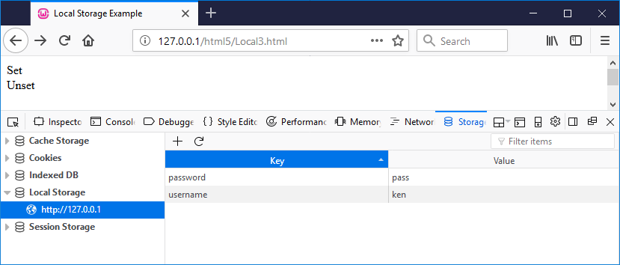
Local Storage
Cookies of the future!
<div id='set'>Set</div> <div id='unset'>Unset</div> <script> $(document).ready(function(){ $("#set").click(function() { localStorage.setItem('username', 'ken') localStorage.setItem('password', 'pass') }); $("#unset").click(function() { localStorage.removeItem('username') localStorage.removeItem('password') }); }); </script>);

Slide 19
Webworkers
Allow multiple scripts to be run concurrently
E.g. manipulate the DOM, handle UI events & process data
Webworkers can allow scripts to be run in the background
<input type="number" id="input"> <div id="answer"></div>

Slide 20
Webworkers
if(window.Worker){ var myWorker = new Worker('worker.js'); $("#input").change(function() { myWorker.postMessage($("#input").val()); }); myWorker.addEventListener('message', function(e) { $("#answer").text(e.data); }, false); }

Slide 21
Webworkers
onmessage = function(e) { var workerResult = 'Factorial: ' + fact(e.data); postMessage(workerResult); } function fact(input){ if(input<2){ return 1; } else{ return fact(input-1)*input; } }false); }

Slide 22
Key Points
HTML5 is the latest HTML specification released in 2014 – a major update intended to catch up with the way the web has evolved.
The new standard has some additional tags, including semantic tags designed to inform the machine what kind of data it is displaying, such as a header, footer, navigation, or the main section or article.
Input types have improved to support different kinds of input.
Rich media, such as audio and video, gains new support, removing the need for using browser plugins such as Flash.
The canvas provides a space where graphics can be drawn, using code.
Geolocation supports a mobile users allowing location based applications.
Local Storage has transformed how cookies are used to store data on the client machine.
Web Workers facilitate code to run in the background on the client browser.

