Slide 1
Web Programming Language
Chapter 13

Slide 2
Introducing Node.JS
PHP vs Node.js
Setting Up Node.js
Events in Node.js
Node Package Manager (NPM)
Sending Emails with Node.js

Slide 3
Node vs PHP
PHP was created in 1994, so is a well established language for the server
  Powers around 80% of the web
  Many applications built using PHP
    Wordpress, Drupal, Joomla, WooCommerce, Magento, ZenCart, Laravel, Symfony, CodeIgniter, Zend
However, Node.js (since 2009) has gained popularity, allowing “JavaScript Everywhere”

Slide 4
Standard PHP Request (Blocking)
Send the request to the server file system
Wait for the file system to open and read the file
Return the content to the client
Ready for another request

Slide 5
But, in Node.js (non-blocking)
Send the request to the server file system
Ready to handle another request
When the file system has opened the file, the server sends the content to the client

Slide 6
Setting up Node.js
Download and install Node from:-
https://nodejs.org/en/

Slide 7
Create a new file called hello.js
var http = require('http');
http.createServer(function (req, res) {
res.write('Hello World');
res.end();
}).listen(8080);

Slide 8
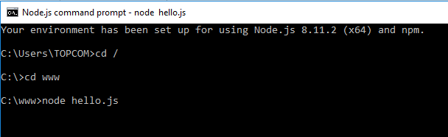
Node.js Command Prompt
Navigate to that file and add the command:-
node hello.js

Slide 9
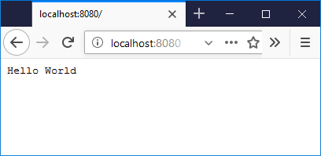
Open Browser
And go to localhost:8080

Slide 10
Hello World
var http = require('http');
http.createServer(function (req, res) {
res.write('Hello World');
res.end();
}).listen(8080);
Includes http module
Creates a server
listening on port 8080

Slide 11
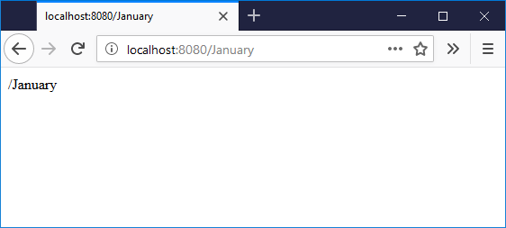
Extending
Request and Response Objects
var http = require('http');
http.createServer(function (req, res) {
res.writeHead(200, {'Content-Type': 'text/html'});
res.write(req.url);
res.end();
}).listen(8080);
Writes the request URL

Slide 12
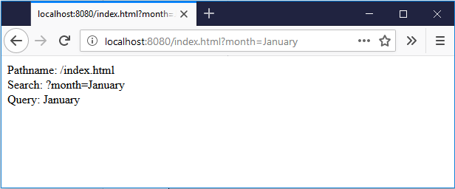
Parsing the URL
var http = require('http');
var url = require('url');
http.createServer(function (req, res) {
res.writeHead(200, {'Content-Type': 'text/html'});
var myURL = url.parse(req.url, true);
res.write("Pathname: " + myURL.pathname + "<br>");
res.write("Search: " + myURL.search + "<br>");
var myURLData = myURL.query;
res.write("Query: " + myURLData.month);
res.end();
}).listen(8080);

Slide 13

Events in Node.js
var events = require('events');
var eventEmitter = new events.EventEmitter();
var myEventHandler = function () {
console.log('Do Something');
}
eventEmitter.on('Go', myEventHandler);
eventEmitter.emit('Go');

Slide 14
The Node Package Manager (NPM)
Thousands of contributed modules to extend Node – Free!
  https://www.npmjs.com/
  For example:-
  https://www.npmjs.com/package/num2fraction
  npm install num2fraction

Slide 15
Number to Fraction
var http = require('http');
var n2f = require('num2fraction');
http.createServer(function (req, res) {
res.writeHead(200, {'Content-Type': 'text/html'});
res.write(n2f(0.5));
res.end();
}).listen(8080);

Slide 16
Sending Emails?
var http = require('http’);
var nodemailer = require('nodemailer’);
var transporter = nodemailer.createTransport({
service: 'gmail’,
auth: {
user: 'myemail@gmail.com’,
pass: 'secretpass’
}
});
var mailOptions = {
from: 'myemail@gmail.com’,
to: ' myfriend@yahoo.com’,
subject: 'Welcome to the web’,
text: 'Feel free to explore!’
};
transporter.sendMail(mailOptions, function(error, info){
if (error) {
console.log(error);
} else {
console.log('Email sent: ' + info.response);
}
});
NPM install!

Slide 17
Summary
Node.js is a popular, modern server-side runtime environment written in JavaScript, which is fast due to its ability to handle requests without blocking.
Node.js can be used to handle Http requests, by creating a server and parsing the requested URL.
Node.js can be set up as a file server to return different files depending on the Http request.
The emit() method can be used to respond to server-side events, such as when a user enters or leaves a chat room.
The Node Package Manager (or NPM) is a large collection of modules of code that are publicly available and easily installed using npm.

