Slide 1
Web Programming Language
Chapter 15

Slide 2
Express.js
“A fast, unopinionated, minimalist web framework for Node.js”
Express = Framework
JQuery = Library
Node.js = Runtime Environment

Slide 3
Framework?
“Don’t Call Us, We’ll Call You”
Generic Functionality that can be built on by the developer (rather than a collection of code to be called by the developer).
Inversion of Control
Default Behaviour
Extensible, but not Modifiable

Slide 4
Getting Started
Create new folder (perhaps expressdemo)
Open node command prompt, navigate to the folder and type:
npm init
Once Node.js creates the package.json file, type:
npm install express

Slide 5
Getting Started II
Create a new file ‘server.js’
const express = require('express'); app = express(); app.get('/', function(request,response){ response.send("Hello World!"); }); app.listen(3000, function(){console.log("Express server started")});
Initialise this file in the Node.js Terminal
node server.js
Open your browser to localhost:3000
Notice we require ‘express’ not ‘http’

Slide 6
Basic Routing
Routing is concerned with how the application endpoint handles requests from the client and the server needs to be instructed how to deal with requests correctly
Here the application handles GET requests
app.get('/', function(request,response){ response.send("Hello World!"); });
The basic syntax for each method is:-
app.METHOD(‘path’, callback);

Slide 7
Dealing with parameters
const express = require('express'); app = express(); app.get('/:month/:year', function(request, response){ response.send(request.params); }); app.listen(3000,function(){console.log('Express server started')});
localhost:3000/12/2018

Slide 8
Dealing with parameters
const express = require('express'); app = express(); app.get('/login', function(request, response){ response.send("Login Page"); }); app.get('/users/ken', function(request, response){ response.send("Ken's Home Page"); }); app.get('/users/matty', function(request, response){ response.send("Matty's Home Page"); }); app.get('/users/danny', function(request, response){ response.send("Danny's Home Page"); }); app.listen(3000,function(){console.log('Express server started')});
Nice in principle, but scalable?

Slide 9
Creating a router - /router/user_router.js
const express = require('express'); router = express.Router(); router.get('/ken', function(request,response){ response.send("Ken's Home Page"); }); router.get('/matty', function(request,response){ response.send("Matty's Home Page"); }); router.get('/danny', function(request,response){ response.send("Danny's Home Page"); }); module.exports = router;
Allows this router to be used in another file

Slide 10
New server.js
const express = require('express'); app = express(); app.use('/users',require('./router/user_router')); app.get('/login', function(request, response){ response.send("Login Page"); }); app.listen(3000,function(){console.log('Express server started.')});

Slide 11
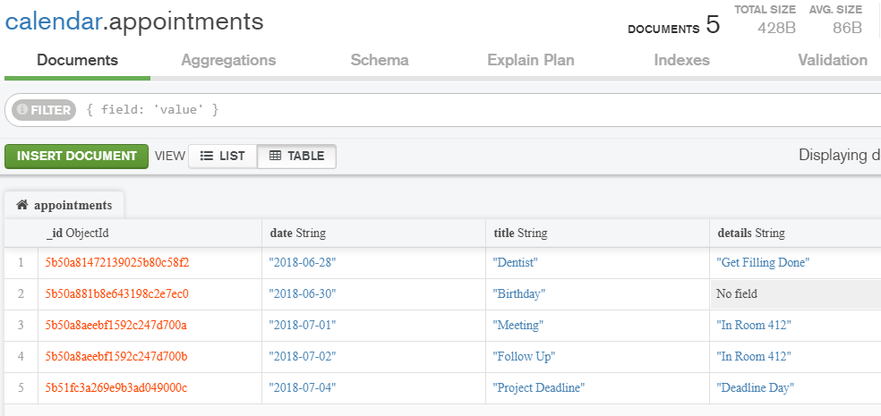
Creating an API
We can create an API to make getting data from a database more convenient.
Suppose we have calendar appointments in a mongoDB collection

Slide 12
Set up our server
To use an appointments router;
const express = require('express'); app = express(); app.use('/appointments',require('./router/appointments_router')); app.listen(3000,function(){console.log('Express server started.')});

Slide 13
Initial Appointments Router
Beginning with 3 routes
const express = require('express'); api = express.Router(); api.get('/', function(request, response){ response.send("All"); }); api.get('/:month/:year', function(request, response){ response.send(request.params); }); api.post('/', function(request, response){ response.send("Create"); }); module.exports=api;

Slide 14
Route 1
Needs to be edited to return all appointments from the database
api.get('/', function(request, response){ var MongoClient = require('mongodb').MongoClient; MongoClient.connect("mongodb://localhost:27017/calendar", function(err, db) { var myDB = db.db('calendar'); var collection = myDB.collection('appointments'); collection.find().toArray(function(err, items) { response.json(items); }); }); });

Slide 15
Route 2
Currently returns the request parameters
But this will be replaced with code to return all appointments from 7/2018

Slide 16
Route 2
api.get('/:month/:year', function(request, response){ var MongoClient = require('mongodb').MongoClient; MongoClient.connect("mongodb://localhost:27017/calendar", function(err, db) { var myDB = db.db('calendar'); var collection = myDB.collection('appointments'); var re = new RegExp('.*' + request.params.year + '-' + request.params.month + ".*"); collection.find({date: re}).toArray(function(err, items) { response.json(items); }); }); });

Slide 17
Route 3
This route is for creating appointments, so we need a simple form;
<form action="http://localhost:3000/appointments/" method="post"> Date: <input type="date" name="date"><br> Title: <input type="text" name="title"><br> Details: <input type="text" name="details"><br> <input type="submit" value="Submit"> </form>

Slide 18
Route 3
Next we need to add body-parser to be able to parse what is filled in on that form.
npm install body-parser
Next include it near the top of the appointments router
var bodyParser = require('body-parser’); app.use(bodyParser.json()); app.use(bodyParser.urlencoded({ extended: true }));

Slide 19
Route 3
The 3rd route can then be set up to insert into the mongoDB collection;
api.post('/', function(request, response){ var MongoClient = require('mongodb').MongoClient; MongoClient.connect("mongodb://localhost:27017/calendar", function(err, db) { var myDB = db.db('calendar'); var collection = myDB.collection('appointments'); collection.insert(request.body); response.send("Successfully Created"); }); });

Slide 20
Summary
Express.js is a minimalist framework for Node.js, which means it makes certain tasks such as routing URLs more straghtforward.
Express.js is unopinionated, allowing the developer choice in how to add modules to extend its functionality such as with body-parser and multer.
Express.js can be used to create a router to handle different Http methods and requests.
An API can be created to better handle access to data resources, such as in a MongoDB database, a full API will make it possible to retrieve, insert, update and delete database entries.

