Slide 1
Web Programming Language
Chapter 6

Slide 2
PHP Files & MySQL Databases
PHP and Files
Introducing MySQL and phpMyAdmin
Structured Query Language
MySQLi

Slide 3
PHP & Files
PHP can be used to work with the server’s filesystem.
It can open and close files, read, write and append to them.
<?php $file =fopen("test.txt", "w"); fwrite($file, "Hello World"); fclose($file); ?>
This example would open a file called ‘test.txt’ and write “Hello World” to it. Note the “w” parameter in the fopen() function, indicating it is open in write mode.

Slide 4
PHP File Open Modes
Mode | Description
r | Read only. Starting at the beginning of the file
r+ | Read / Write. Starting at the beginning of the file
w | Write only. Clears the file if it isn’t empty, or creates a new file if it doesn’t exist
w+ | Read / Write. Clears the file if it isn’t empty, or creates a new file if it doesn’t exist
a | Append. Writes to the end of a file, or creates a new file if it doesn’t exist
a+ | Read / Append. Keeps file content and writes to the end of the file
x | Write only. Creates a new file, and returns an error if the file exists
x+ | Read / Write. Creates a new file, and returns an error if the file exists

Slide 5
PHP – Reading from a file
Using fread() to read the whole file.
<?php $file =fopen("test.txt", "r"); $content = fread($file, filesize(“test.txt”)); fclose($file); ?>
But perhaps if the file is v. large, you might do it line by line.
<?php $file =fopen("test.txt", "r"); while(!feof($file)) { echo fgets($file) . “<br>”; } fclose($file); ?>
Not file end of file
Get a line

Slide 6
File Access Permissions
PHP has several functions for managing directories
mkdir() – Makes a new directory
rmdir() – Deletes a directory
chmod() – Changes permissions on a directory
To create a directory without any access restrictions (not a good idea!), use this;
<?php mkdir(“newfolder”, 0777); ?>
Note the 2nd parameter sets the access permissions

Slide 7
File Access Permissions
Access Permissions consist of 4 numbers:-
The first number is always 0
The second number is for permissions for the owner
The third number is for the owner’s user group
The fourth number is for everybody else
There are a variety of combinations:-
1 = execute permissions
2 = write permissions
4 = read permissions
Common combinations are:-
0644 – Read and write for the owner, but only read for anyone else
0755 – Everything for the owner, but read and execute for everyone else

Slide 8
More PHP File Functions
scandir() – returns an array of the contents of a directory
is_dir() – returns a Boolean as to whether something is a directory
is_file() – returns a Boolean as to whether something is a file
is_executable() – returns whether the file is an executable file
file_exists() – returns whether the file exists
copy() – takes two parameters, the source and destination of a file

Slide 9
MySQL
Files are ok… but databases are often a better way of managing data!
Just imagine saving calendar appointments in a file, and then searching that file to find which appointments you need to display!
MySQL is a database server that scales for small and large applications using SQL (Structured Query Language) to interact with it.
Data is stored in tables – tables store data about entities
Tables consist of rows and columns, (like spreadsheets)
Tables can be related to each other
In other courses you will learn about databases in depth, here we will look at key operations.

Slide 10
PHPmyadmin
A GUI (Graphical User Interface) allowing easy database creation and manipulation.

Slide 11
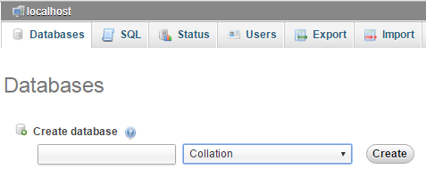
Create a Database

Slide 12
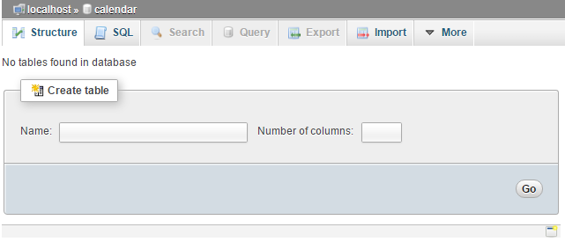
Create a Table

Slide 13
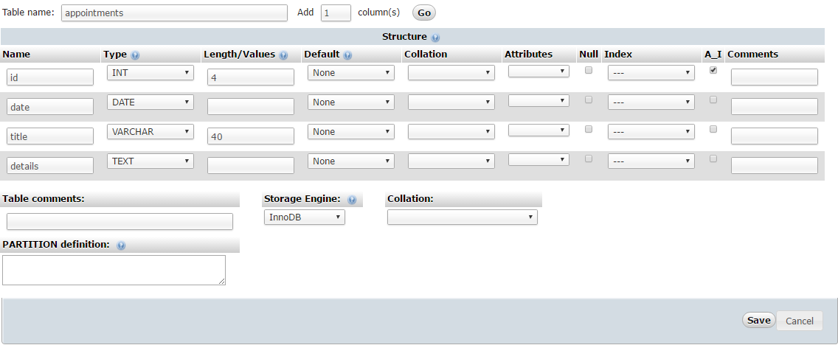
Set up the columns
To store appointments, you might want an id, a date, a title, and details.
Auto Increment
Integer
Variable Character
Text (Stored
Separately)

Slide 14
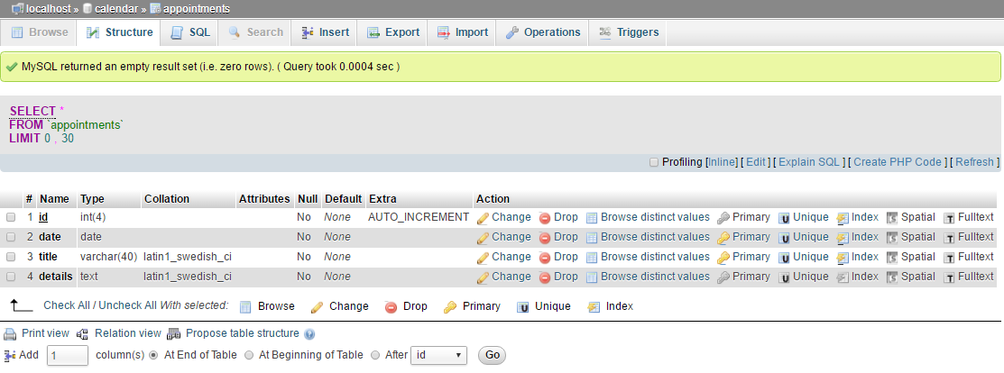
Check the Structure

Slide 15
Structured Query Language (SQL)
Database language used by a variety of databases
SELECT – for retrieving data from the database
SELECT * FROM appointments LIMIT 0 , 30;
The general syntax of a SELECT statement is as follows.
SELECT column_name1, column_name2 FROM table_name;
A WHERE clause can be added for more precise results.
SELECT * FROM appointments WHERE id=1;

Slide 16
SQL - INSERT
Basic Syntax
INSERT INTO table_name VALUES (value1, value2,…);
Specifying which columns
INSERT INTO table_name (column1, column2,…) VALUES (value1, value2,…);
Example
INSERT INTO appointments (date, title, details) VALUES ("2016-08-05", "Meeting", "All day in room 401");

Slide 17
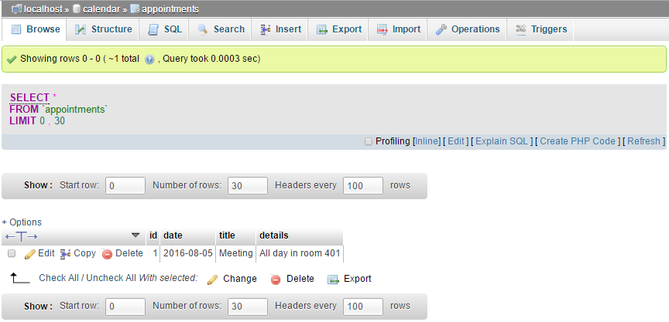
SQL INSERT

Slide 18
SQL UPDATE
Basic Syntax
UPDATE table_name SET column1=value1, column2=value2 WHERE column=value;
Example
UPDATE appointments SET details="Meet at 9AM" WHERE id = 1;

Slide 19
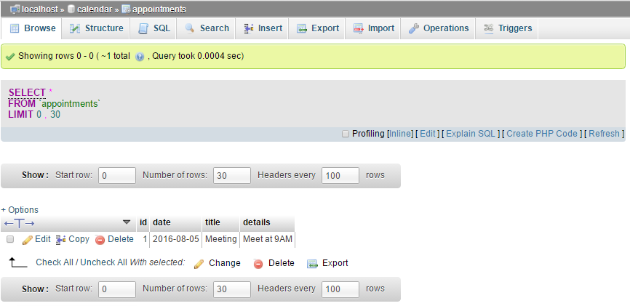
SQL UPDATE

Slide 20
SQL DELETE
Basic Syntax
DELETE FROM table_name WHERE column_name = value;
Example
DELETE FROM appointments WHERE date = "2016-08-05";

Slide 21
MySQLi
MySQLi (the i is for ‘improved’) is an API for manipulating a MySQL database using PHP.
Be careful to use MySQLi, NOT MySQL!
There are alternative to MySQLi, but we will stick with MySQLi
MySQLi offers either a procedural approach, or an object oriented approach.
We will explore both – it is your choice which to use – perhaps the OO option?

Slide 22
Connecting to the Database
Procedural
$link = mysqli_connect(“localhost",“username",“password",“databasename") or die("Error" . mysqli_error($link)); //Some Code mysqli_close($link);
OO
$mysqli = new mysqli("localhost", “username", "password", “databasename"); // Some Code $mysqli->close();
Worth moving the connection script to a separate file
Include “database.php”

Slide 23
Querying a Database
Create a variable that stores the query
$qry1 = “CREATE DATABASE calendar”; $qry2 = "CREATE TABLE users ( FirstName varchar(15), LastName varchar(15) )”; $qry3 = “INSERT INTO appointments (date, title, details) VALUES (‘2016-08-06’, ‘Exam’, ‘9AM’)”;
Use mysqli to call the query
mysqli_query($link, $qry1); //procedural approach $mysqli->query($qry3); // OO approach

Slide 24
Tip
If you have a mistake in your SQL, you may get no response, and no error.
Use the SQL option in phpMyAdmin to check and fix an error.

Slide 25
PHP and SELECT
The SELECT statement returns some results – we could check how many…
Procedural
$link = mysqli_connect(“localhost",“username",“password",“databasename"); $qry = “SELECT * FROM appointments”; if ($result = mysqli_query($link, $qry)) { echo “There are “ . mysqli_num_rows($result) . “ rows!”; mysqli_free_result($result); } mysqli_close($link);
OO
$mysqli = new mysqli("localhost", “username", "password", “databasename"); $qry = “SELECT * FROM appointments”; if ($result = $mysqli->query($qry)) { echo “There are “ . $result->num_rows . “ rows”; $result->close(); } $mysqli->close();

Slide 26
PHP and SELECT
The results are stored in a data object, and they can retrieved in different formats.
As an array
$qry = “SELECT * FROM appointments”; $result = $mysqli->query($qry); while($row = $result->fetch_array()) { print_r($row); }

Slide 27
PHP and SELECT
As an associative array
$qry = “SELECT * FROM appointments”; $result = $mysqli->query($qry); while($row = $result->fetch_assoc()) { print_r($row); }

Slide 28
PHP and SELECT
As an object
$qry = “SELECT * FROM appointments”; $result = $mysqli->query($qry); while($row = $result->fetch_object()) { print_r($row); }

Slide 29
Key Points
Because PHP is code running on the server, it can be used to read and write data from files stored on the server and there are several functions to help with that.
There are different modes when opening a file, depending on whether you intend to read, write or append the file.
Appropriate permissions should be set to limit access to files stored on the server.
MySQL is a database server that is a key part of the WAMP / LAMP stack.
Phpmyadmin is a useful tool allowing a GUI for managing databases.
Structured Query Language or SQL is a database language used to access, query, insert, update and delete from databases.
MySQLi is an improved PHP extension allowing an API for manipulating a MySQL database via PHP.
There are choices between a procedural or object-oriented approach to MySQLi.

