Slide 1
ISNE101
Week 5
Dr. Ken Cosh

Slide 2
Networks Recap
What were the features of:
Centralised Network
Decentralised Network
Distributed Network
Speeding Up the Network
Caching
Routing
Multiple Route Efficiencies

Slide 3
This Week
It's Time for a "Revolution"
The revolution of Social Networks and Social Media
So Lets talk about "Web 2.0"

Slide 4
Definitions
Social Networks
"Family, and friends and their families, that together create an interconnected system through which alliances are formed, help is obtained, information is transmitted, and strings are pulled. In an organizational setting, it usually constitutes the group of one's peers, seniors, and subordinates who provide privileged information on how to get things done, how the power structure operates, and who holds the strings at present."
BusinessDictionary.com

Slide 5
Definitions
Web Based Social Networks
"Any website designed to allow multiple users to publish content themselves. The information may be on any subject and may be for consumption by (potential) friends, mates, employers, employees, etc. The sites typically allow users to create a "profile" describing themselves and to exchange public or private messages and list other users or groups they are connected to in some way."
Dictionary.com

Slide 6
Definitions
Social Media
"participatory online media that utilizes the group to write and direct content, rather than a read-only media. Allows for direct contact between participants"
UrbanDictionary.com

Slide 7
Definitions
Web 2.0
"Web 2.0 (or Web 2) is the popular term for advanced Internet technology and applications including blogs, wikis, RSS and social bookmarking. The two major components of Web 2.0 are the technological advances enabled by Ajax and other new applications such as RSS and Eclipse and the user empowerment that they support."
Whatis.com

Slide 8
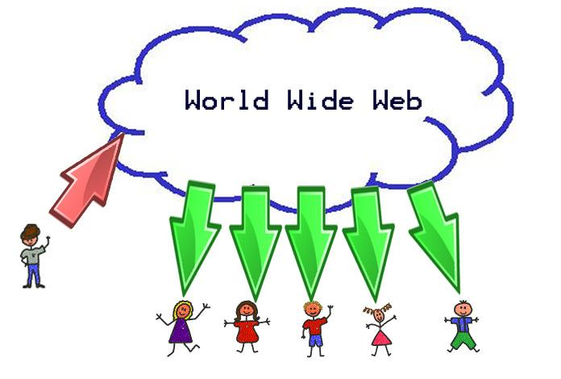
Traditional View

Slide 9
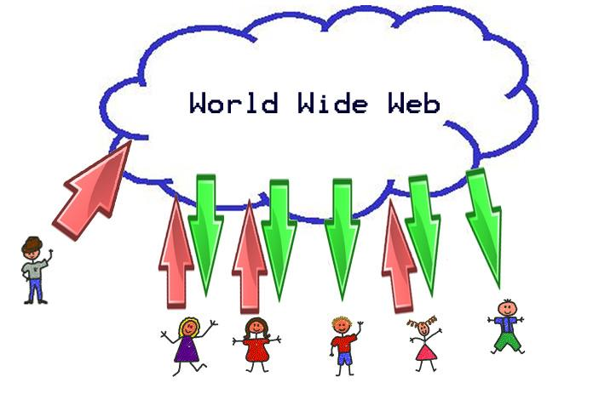
"New" View

Slide 10
Information is Changing
Information R/Evolution
Mwesch
http://www.youtube.com/watch?v=-4CV05HyAbM

Slide 11
Characteristics of Information OR
Assumptions about Information
*It is a thing
*It has a logical place
*Where it can be found
On a Shelf
In a File System
In a Category
*Managing Information is Managing Categories
*It Requires Experts
*And is still hard to find.
! ! ! Digital Information is Different ! ! !

Slide 12
It's an Information Revolution
The responsibility to
Harness
Create
Critique
Organise
Understand
is on Us
Are we Ready?

Slide 13
Information is Changing
The Machine is Us/ing Us
Mwesch
http://www.youtube.com/watch?v=NLlGopyXT_g

Slide 14
How did it happen?
XML Separates Form from Content
With Form separated from Content, users did not need to know complicated code to upload content to the web.
We'll need to rethink a few things...
copyright governance
authorship privacy
identity commerce
ethics love
aesthetics family
rhetorics ourselves

Slide 15
How has Web 2.0 forced us to rethink…
Copyright, Authorship, Identity
B) Ethics, Aesthetics, Rhetorics
C) Governance, Privacy, Commerce
D) Love, Family, Ourselves
640615017 | TEERAWIT | SINSASAI
640615025 | SITTIPAT | PALAWOOTH
640615023 | PISIT | PISUTTIPUNPONG
631615044 | ROBERT | GREGORY
640615504 | HANCHUN | WANG
640615019 | PARIPAT | YUANSEE
640615014 | NATTHARIKA | PLONGNAK
640615016 | TANUTCHA | RINKAEW
630615021 | NUTTAPONG | INKAEO
630615036 | PHEERAWADEE | CHANTAKHAT
631615045 | WATHANYU | TRAGOONRATTANAMUTCHA
640615012 | CHINNAWAT | SERMSUKRUNGSAKUN
640615026 | ARAYAWAT | HAINAK
640615018 | TEEWARA | KAPHEAK
640615011 | CHAYUT | RIANPRAKAISANG
640615013 | NATAKORN | THAMMATIWAT
640615015 | NEERANUCH | SEETHIKHAM
640615010 | JUTHALAK | WILAISON
640615030 | NITISAT | DUANGSAENG
640615021 | PIMMADA | KLUMWILAI
640615024 | WEERAPAT | KETWANG
631615041 | MAETHASITH | TRIWUTPIPATKUL
640615020 | PREMCHIT | KORSRIPONR
631615006 | JIRAPINYA | SANPAPAO

Slide 16
Early Social Networks
BBS
Bulletin Board System
Late 70s / Early 80s
Complex computer language
Breeding ground for social rejects & boring, reclusive nerds!
A central node where users could connect, communicate & download files / games etc.
Dialled up connection via phone
Usually only local people, due to phone charges
Text only exchanges @ Glacial Speed!
Slowly gained popularity through to the 90s - LUBBS

Slide 17
The internet kicks in
AOL
Member profiles
Member created communities
Messenging service
Classmates.com
Originally no profiles
But could search for old school colleagues
sixdegrees.com
Create / Surf profiles, create groups, invite friends
Inviting friends was too pushy/spammy (then)

Slide 18
2002
Friendster.com
"A dating site that isn't about dating"
Connecting people through common bonds
LinkedIn.com (2003)
Serious, sober approach
Not a playground for former classmates
A business networking resource
MySpace.com (2003)
Hipper / Cooler than Friendster
Attracting many friendster's with music & videos

Slide 19
Facebook
2004 - Harvard Only product peddling
2006 - General public
Massive investment
Easy to use
Lots of features

Slide 20
Other Sites
Orkut - (Brazil / India)
Skyrock - (France, Belgium, Switzerland)
Multiply - (Philippines)
Mixi - (Japan)
Qzone - (China)
Badoo - (Europe)
Nasza-klasa - (Poland)
Odnoklassniki - (Russia)
VKontakte - (Russia)

Slide 21
Blogging
Bebo - Blog Early Blog Often (2005)
Twitter - 2006
Do we really need to know that you are drinking coke?
But, it has handled real time search in a new unique way!

