Slide 1
261446 Information Systems
Week 10
E-Commerce: Digital Products, Digital Goods

Slide 2
Week 10 Topics
E-Commerce & The Internet
E-Commerce: Business & Technology

Slide 3
Case Studies
Case Study #1) Youtube
Case Study #2) Nasty ending for Nasty Gal

Slide 4
What is “E”-Commerce?
What does the “E” mean?
  E-Business?
  E-Learning?
  E-Governance?
  E-Mail?
  E-…

Slide 5
E-Commerce
“Digitally enabled commercial transactions between and among organisations and individuals”
  Many of which occur over the Internet and the Web
Commercial transactions?
  Exchange of value
    Money, products, services…

Slide 6
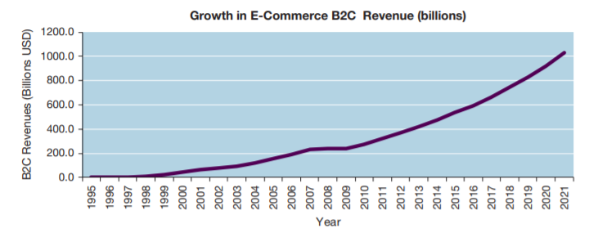
E-Commerce
Massive growth since 1995
  1995 – Netscape accepted first ads, creating the idea that the Web would be a new medium for advertising & sales.

Slide 7
E-Commerce
Fastest growing form of Commerce (compared to physical retail stores, services & entertainment)
Social & Mobile commerce fastest growing forms
Wave 1 transformed the books, music & air travel markets; Wave 2 transforms marketing & advertising, telecoms, movies, TV, jewelry, real estate, online travel, bill payments, software.
Online demographic has broadened to match ordinary shoppers
Small businesses and entrepreneurs are flooding the marketplace, using the infrastructure of E-commerce giants, such as Amazon / Google.
Mobile take advantage of location-based services

Slide 8
E-Commerce
Wireless / Ubiquitous devices & connections take off
Broadband becomes standard
Social Networking offer new platform for e-commerce
New Internet models of computing emerge
  Apps, Cloud computing, SaaS, Web 2.0

Slide 9
Why is E-Commerce Different?
Unique Nature of environment
  Ubiquity
  Global Reach
  Universal Standards
  Richness
  Interactivity
  Information Density
  Personalisation / Customisation
  Social Technology

Slide 10
Ubiquity
Technology available everywhere
  Home, Work, using desktop and mobile devices.
  The marketplace is extended beyond traditional boundaries, removed from temporal or geographic location.
    Marketplace is anytime, anywhere
    Customer convenience is enhanced, shopping costs reduced.

Slide 11
Global Reach
Technology breaches national boundaries
  Across cultural and national boundaries, seamlessly and without modification
Potentially billions of consumers and millions of businesses

Slide 12
Universal Standards
One set of technology standards
  IP
Disparate computer systems can easily communicate with each other

Slide 13
Richness
Video, audio, text messages
New media is easily integrated into a single marketing message & consumer experience

Slide 14
Interactivity
Technology works by interacting with the user
  Customers are engaged in a dialog, dynamically adjusting experiences to the individual.
  The consumer is a co-participant in the process

Slide 15
Information Density
Information costs are reduced, while quality raised
  Information processing, storage and communication costs have dramatically dropped.
  Currency, accuracy and timeliness improve.
  Information is plentiful, cheap and more accurate

Slide 16
Personalisation / Customisation
Personalised messages can be delivered to individuals and groups
  Advertising messages based on an individual’s characteristics

Slide 17
Social Technology
Content Generation and Social Networking
  User generated content, alongside distribution.

Slide 18
E-Commerce
The Internet reduces Information Asymmetry
  Where one party in a transaction has more information, relevant to the transaction, than another party.
  This information influences relative bargaining power
  How much do you know about how much products really cost?

Slide 19
E-Commerce
Digital Markets afford Dynamic Pricing
  The price of a product can vary depending on demand characteristics, or the supply situation
    Online retailers like Amazon can change prices based on time of the day, demand for the product, supply, the user’s prior visits to the site.

Slide 20
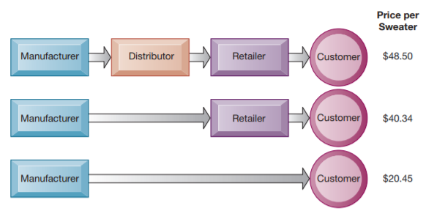
Disintermediation
Digital Markets afford suppliers to directly connect with their end-users.
  This may eliminate an intermediary

Slide 21
Digital Goods?
Marginal Costs of producing another unit is about zero
  It costs nothing to copy a music file
Cost of producing 1st unit is relatively high
  nearly the total cost of the product, as inventory & distribution is negligible
Cost of delivery very low
What is the effect?

Slide 22
Types of E-Commerce
B2C
  Business to Consumer
    Retailing products to individual shoppers
B2B
  Business to Business
    Sales of goods & services among businesses
C2C
  Consumer to Consumer
    Enabling consumers to sell goods to other consumers

Slide 23
E-Commerce Business Models
There are various business models operating in E-Commerce
  Portals
  E-tailers
  Content Providers
  Transaction Brokers
  Market Creators
  Service Providers
  Community Providers

Slide 24
Portals
Gateways to the web
  Gain income through attracting large audiences, advertising, referral fees
Include Horizontal, Vertical & Affinity Portals

Slide 25
E-tailer
Online Retail Stores
  From Amazon to small enterprises
  Some are “Bricks & Clicks” Retailers
  Others are pure virtual organisations

Slide 26
Content Providers
Providers, not necessarily the creators, of content.
Content
  Any kind of Intellectual Property
    Text, video, music, photos, artwork…

Slide 27
Transaction Brokers
Online transaction brokers take commissions for facilitating online transactions
  Such as in the travel or financial services markets
Fees are often less than the traditional versions

Slide 28
Market Creators
Provide a platform, or digital environment, upon which buyers and sellers can meet, interact, display products, search for products, establish prices.
  E-Bay, Amazon, Priceline

Slide 29
Service Providers
Hosting service providers
  For websites, or for photos on social media for example
SaaS

Slide 30
Community Providers
Platforms that create digital online environments where people can transact; share interests, phots, videos; communicate; receive information; play out fantasies
  Essentially social networking sites

Slide 31
E-Commerce Revenue Models
So, how does the firm earn revenues, generate profits and produce returns on investments?
  Advertising Revenue Model
    Eyeballs!
  Sales Revenue Model
  Subscription Revenue Model
  Freemium Revenue Model
  Transaction Fee Revenue Model
  Affiliate Revenue Model

