Slide 1
261446 Information Systems
Week 12
Enhancing Decision Making

Slide 2
Week 12 Topics
Decision Making and Information Systems
Business Intelligence in the Enterprise
Business Intelligence Constituencies

Slide 3
Case Studies
Case Study #1) Big Data & IoT
Case Study #2) Is Predix GE’s future?

Slide 4
Making Decisions
How much value is there for businesses making the right decisions?

Slide 5
Types of Decision
Structured Decisions
  Repetitive & routine following a definite procedure.
Unstructured Decisions
  Require judgment, evaluation and insight to solve a problem. Each decision is new and important, with no understood procedure for making the decision
Semistructured Decisions
  Part of the problem follows a defined procedure

Slide 6
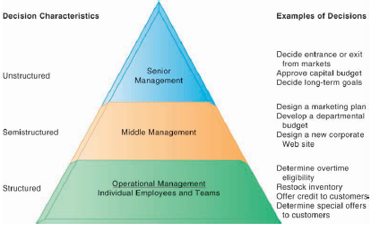
Types of Decision

Slide 7
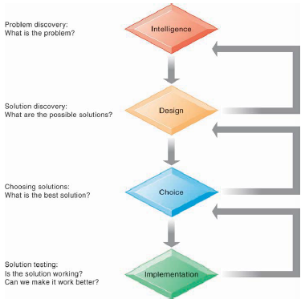
Decision Making Process

Slide 8
Managerial Roles
Classical Model of Managers (Fayol 1920-1990)
  Managers have 5 functions
    Planning
    Organising
    Coordinating
    Deciding
    Controlling

Slide 9
Managerial Roles
Behavioural Model of Management
  5 Attributes
    Managers do a lot of work, at a fast pace
    Activities are fragmented – many short duration activities
    Managers prefer current, specific, ad hoc information
    Managers prefer oral communication
    Managers maintain a diverse / complex network of contacts as an informal information system

Slide 10
Managerial Roles
Mintzberg (10 Roles in 3 Categories)
  Informational
    Monitor, Disseminator, Spokesperson
  Interpersonal
    Figurehead, Leader, Liaison
  Decisional
    Entrepreneur, Disturbance Handler, Resource Allocator, Negotiator

Slide 11
Wrong Decisions?
IT doesn’t always provide the information to make the right decision
  Information Quality
  Management Filters
  Organisational Inertia & Politics

Slide 12
Wrong Decisions?
Information Quality
  Accuracy
  Integrity
  Consistency
  Completeness
  Validity
  Timeliness
  Accessibility

Slide 13
Wrong Decisions?
Management Filters
  Even with all the right information, managers can still make the wrong decision.
  Humans interpret information through filters as we understand the world around us
    Selective Attention
    Focus on certain problems
    Focus on certain solutions
    A variety of biases to reject information that doesn’t conform to prior conception

Slide 14
Wrong Decisions?
Organisational Inertia & Politics

Slide 15
Business Intelligence
One definition of human intelligence refers to our ability to
  take data from our environment,
  understand its meaning & significance,
  and act appropriately
How about Businesses?
  Businesses are human environments, so why not Business Intelligence?

Slide 16
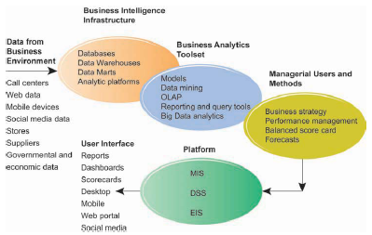
Business Intelligence Environment

Slide 17
Business Intelligence Environment
Data from Business Environment
  Structured & Unstructured data, from many sources, including Big Data
Business Intelligence Infrastructure
  Powerful database that captures all relevant data; relational or data warehouse / datamarts
Business Analytics Toolset
  Software tools to analyse data, track performance & answer ad hoc manager questions

Slide 18
Business Intelligence Environment
Managerial Users & Methods
  BI is only as intelligent as the humans using it - managers have to ask the right questions or track the right bits of data
Delivery Platform – MIS, DSS, ERP
  Layer responsible for delivering information to different people at different levels in the firm, from operational level, through middle managers to senior executives
User Interface
  Not just a spreadsheet! Visualisations available on multiple different devices

Slide 19
BI & Analytics Capabilities
Production Reports
  Predefined reports
Parameterised Reports
  User enters several parameters (e.g. region, time of day, different product sales), to produce a report, like a pivot table
Dashboards / Scorecards
  Visualisations representing specified performance data
Drill down
  The ability to move from high-level summaries to detailed view
Forecasts, Scenarios, Models
  Linear forecasting, what-if scenarios & other statistical analysis

Slide 20
Gaining BI Capabilities
Hardware Firms (IBM, HP, Oracle (Sun Microsystems))
  Want to sell a totally integrated solution – the complete deal with an integrated hardware/software solution, built to only run on their hardware
Software Firms (SAP, SAS, Microsoft)
  Encourage organisations to pick the best of each part – the best database, the best data warehouse, the best intelligence & analytics, from whichever vendor is best
What do you think?

Slide 21
Risk & Reward
Totally Integrated Solution
  Dependent on one firm & it’s pricing power
  Only need to deal with one vendor
“Best of Breed”
  Greater Flexibility & Independence
  Potential compatibility difficulties in integrating software and hardware platforms

