Slide 1
261446 Information Systems
Week 13
Building Information Systems

Slide 2
Week 13 Topics
Systems As Planned Organisational Change
Overview of Systems Development
Alternative Systems-Building Approaches
Application Development for the Digital Firm

Slide 3
Case Studies
Case Study #1) Cameron International
Case Study #2) Hitachi HR

Slide 4
Building New IS
Not just new hardware & software
  Job changes
  Skill changes
  Management & organization changes
How will a new system affect the organization?

Slide 5
Risk & Reward
High
Paradigm Shifts
Reengineering
RISK
Rationalisation
Low
Automation
Low
High
REWARD

Slide 6
Systems Development & Organisational Change
Automation
  Assisting employees performing routine tasks, efficiently & effectively.
Rationalisation
  Removing bottlenecks, streamlining of standard operating procedures
  Often included as a process of continual improvement such as in Total Quality Management (TQM) and Six Sigma.

Slide 7
Systems Development & Organisational Change
Business Process Reengineering (Redesign)
  More thorough redesign of workflows (each is analysed, simplified & redesigned)
  Requires a new vision of how processes should happen
Paradigm Shift
  Radical business change – such as moving into an online market
  Biggest risk, due to extensive organizational change, but large rewards also possible, perhaps becoming a market leader.

Slide 8
BPR Steps
Identify Processes for Change
Analyse Existing Processes
Design New Process
Implement New Process
Continuous Measurement

Slide 9
Systems Engineering
An engineering discipline that investigates the cost effective development of systems.
Concerned with all practical aspects of system production from system specification to system maintenance, including design, development and implementation.

Slide 10
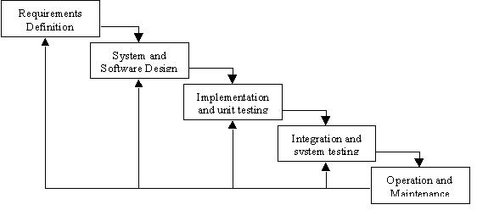
S.E. Lifecycle

Slide 11
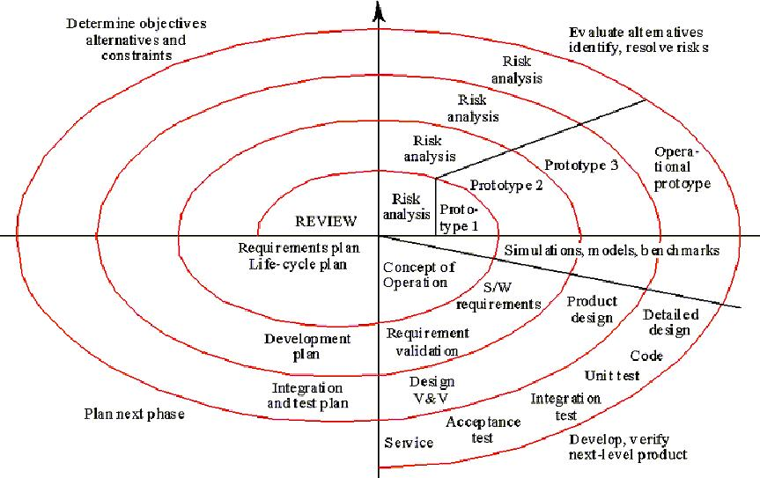
S.E. Lifecycle II

Slide 12
Feasibility Analysis
Technical Analysis
  Is it possible?
Economic Analysis
  Costs vs Benefits
  Is it worth doing?

Slide 13
Economic Evaluation
What’s it going to cost me?
  Acquisition / Development Costs
    Hardware, Software, Project Team salaries, Consultant fees.
  Implementation Costs
    Conversion, Training, Staff salaries, Design & Printing costs
  Operating Costs
    Ongoing Staff salaries, Training, Outside services, Forms, Maintenance, Upgrades/

Slide 14

Apparent / Hidden Costs
Computer Costs
Overheads
Software
Personnel
Improper use of management time
Conversion Costs
Security / Privacy
Documentation Costs
Training & Recruitment
Operations Overload
Communication Problems
Labour Division

Slide 15
Benefits
Direct Savings
  Staff reductions, Space,
Cost Avoidance
  Current system inflation (maintenance etc.), Additional Staff,
Intangible Benefits
  Productivity Improvement, Better Information & Decisions, Accuracy, More Timeliness, Reliability, Flexibility

Slide 16
Requirements Engineering
“Requirements are the things that you should discover before starting to build your product. Discovering the requirements during construction, or worse, when your client starts using your product, is so expensive and so inefficient... …A requirement is something that the product must do or a quality that the product must have.”
[Robertson & Robertson 1999]

Slide 17
The Importance of R.E.
The later in the development cycle an error is detected the more expensive it is to repair.
Davies 1993

Slide 18
Requirements Elicitation
Sources:
  Goals
  Domain Knowledge
  System Stakeholders
  Operational Environment
  Organisational Environment
Techniques:
  Interviews
  Scenarios
  Prototypes
  Facilitated Meetings
  Observation

Slide 19
Elicitation Difficulties
Communication Issues
  Management lack appreciation of IS concepts (people oriented)
  IS lack appreciation of Business functions (technology oriented)
  User disagreements / conflicts
Result - elicit requirements from many stakeholders (viewpoints) using many different techniques.

Slide 20
Eliciting Requirements
Interviewing difficulties
  Firstly, one individual person is unlikely to know everything about what a system should do.
  Secondly, the individual may not be able to articulate all the requirements coherently.
  Finally, the individual may not actually know what they do

Slide 21
Facilitated Meetings
Brainstorming
Project Scoping
Conflict discussion
However, arguments and people not really understanding what they do.

Slide 22
Observation
Ethnography
  Watching users in action to understand what they do.
But problem of creating meaningful reports. Business processes often too subtle & complex to describe easily.

Slide 23
Scenarios
Discussion of what should occur in different situations and under different conditions.
Conceptual modeling
But, can you cover all eventualities?

Slide 24
Prototypes
Present basic overview of potential solution
  Paper Mockup
  Beta test version
Potential to get carried away with how it looks.
Design Orientated.

Slide 25
Combination of Techniques
Interviewing
Facilitated Meetings
Analysis of available systems
A Good Requirements Specification
Prototypes
Scenarios
Observation
Analysis of existing systems

Slide 26
Requirements Analysis
Detecting & Resolving Conflicts between Requirements
Discovering the bounds of a system and how it interacts in it’s environment
Elaborate System Requirements to Software Requirements

Slide 27
Requirements Analysis
Classification
  Functional vs Non-functional
  Priority
  Scope
  Stability / Volatility
Conceptual Modeling
Negotiation

Slide 28
Documentation
Essential for successful system operation;
  Program Documentation
    Describes inputs, output, processing logic for all program modules. This documentation is developed right from the analysis phase of the project.
  System Documentation
    Describes the systems functions and how they are implemented, including DFD’s, Object models, screen layouts etc.
  Operations Documentation
    Documentation to assist the IT group responsible for supporting the new system. How to back up, restart etc.
  User Documentation
    Manuals, instructions and information for users of the system. Includes tutorials, FAQ’s, etc.

Slide 29
Training
All systems need an effective training plan.
  Users
    Major system functions
    Key Terms
    Icons & Shortcuts
    Menus and submenus
    FAQ’s
  Managers
    Project Origin
    Costs / Benefits
    Key IT contacts
    Major Reports
  IT Staff
    Project history
    System Architecture / Documentation
    Typical User Questions
    Logging and Resolving Questions

Slide 30
Training Plan
Vendor Training
  For purchased software, vendor training is a factor when choosing between vendors
Outside Training Packages
  Useful for COTS type systems
In-House Training
  IT staff responsible for training users

Slide 31
Data Conversion
When introducing new systems converting data from old systems is important. Wherever possible it should be automated.
Old
New
Old
New
Direct Cutover
Pilot Operation
Old
Old
New
New
Phased Operation
Parallel Operation

Slide 32
Risk / Cost of changeovers
Risk
Direct
Cutover
Pilot
Operation
Phased
Operation
Parallel
Operation
Cost

Slide 33
Operation & Maintenance
Corrective Maintenance
  Bug fixing
Adaptive Maintenance
  New technology, government regulations etc.
  External enforced changes
Perfective Maintenance
  Requested changes from the users
  Internal changes

Slide 34
Operation & Maintenance
System Support
Upgrading
Evolution
Adaptive Project Methods
  Every system is a prototype, as the system evolves.

Slide 35
Review
Systems Development
  Requirements
  Implementation
Next: Outsourcing

Slide 36
Internal vs External Service Delivery
Is External Delivery
Reliable and Lower
Cost?
NO
Does this Service
Offer a
Competitive Advantage?
YES
NO
Outsource
YES
Keep Internal

Slide 37
Internal vs External Service Delivery (extended)
Can we gain a
Competitive
Advantage
here?
NO
NO
Does this Service
Offer a
Competitive Advantage?
Is External Delivery
Reliable and Lower
Cost?
NO
YES
YES
Keep Internal
Outsource

Slide 38
Managing IT Outsourcing
Increasingly Organisations are outsourcing their IT functions.
Outsourcing can bring about many advantages, but care needs to be taken when implementing and managing outsourcing.

Slide 39
Outsourcing - Benefits
Expertise
  Give the job to the experts
Focus
  Core Competencies
Cost Reductions
  Infrastructure / Staffing
Efficiency
  Speed / Economies of Scale etc.

Slide 40
Outsourcing - Disadvantages
Loss of Control
  Reliance on outside abilities
Security
  Information
Costs
  Paying another company for services

Slide 41
Difficulties in Alliance
Step from the timescale of the alliance.
  Typically 8-10 years.
The world will change dramatically in that timescale
  Moore’s Law
  Metcalfe’s Law
  A deal that makes sense one year, might not make sense 3 years later.
Large switching costs create supplier power.
  Outsourcing is easy – Insourcing is difficult

Slide 42
Difficulties in Alliance
Perceived Benefits
Continued Income Stream
Over Maintenance Costs
vendor
Problems Delegated
Tangible Results to outlay
Aging Systems / Payments
less tied to Results
customer
High initial outlay
Responsibilities
Time

Slide 43
Changes affecting Outsourcing
Despite the potential of accessing specialised skills / capabilities cost effectively, outsourcing was generally reserved for small organisations.
More recently large scale outsourcing alliances are emerging;
  Acceptance of Strategic Alliances
  Changing IT environment

Slide 44
Strategic Alliances
The idea of alliances as a strategy is becoming more accepted.
  Organisations have developed alliances to pursue areas of ‘synergy’.
  Synergies work where there are complementary skills.
  As alliances appear in other areas of the value chain, why not with IS/IT too?
Alliances only work when both parties are ‘winners’
  Consider the customer gradually feeling they are less of a winner… (slide 2 back)

Slide 45
Changing IT environment.
Traditionally organisations developed much of their code – now the majority is COTS (Microsoft / Oracle etc.)
If the code is generic, there is no need for specialists in-house.
Outsourcing is a means to transform legacy systems
  Some outsource new systems and maintain old systems
  Some outsource old systems and develop new systems
With the changing face of organisations (as discussed throughout this course), outsourcing provides organisations the opportunity to react and adapt quicker.

Slide 46
Why outsourcing is popular
The general Cost / Quality reasons (given before);
Existing IT department failures
  Many systems fail, outsourcing removes our responsibility.
Vendor Pressure
  More vendor’s applying more pressure on organisations to outsource.
Management Agenda
  Concentrate on Core Competency / Delegate time-consuming, messy problems.

Slide 47
Why outsourcing is popular
Financial Factors
  Liquidate the intangible IT asset
    Selling existing hardware to vendor.
  Fixed Costs become Variable Costs
  IT employees leave (and often prefer working for vendor)
  Users take seriously the money spent on outsourcing over IT dept.
Corporate Culture
  Easier to make force difficult actions when ‘coming from’ Vendor (e.g. Centralisation)
Eliminates (internal) User / IT conflict

Slide 48
Structuring an Alliance
Contract Flexibility
  Change is inevitable
    There is a mutual interest in success, so a mutual interest in solving issues caused by change is necessary
  Even the best contract won’t think of every eventuality, leave some scope for adaptation.
Standards and Control
  Customers are likely to be concerned about handing over control to a 3rd party.
  Organisations already don’t have control over things like electricity / phone – why not information? What about responsibility for new service / product.
  Develop detailed levels of service (SLA) defining the standards that can be expected.

Slide 49
Structuring an Alliance
Areas to outsource
  All IS functions? Some IS functions?
    Systems Development
    Systems Support
    Data Centre
    Communications
    PC Acquisitions
    Hardware
    Software
  Can a portion of IT be isolated from the rest?
  Where are our competencies?
  Which are core activities?

Slide 50
Structuring an Alliance
Vendor Stability / Quality
  How financially stable is the vendor?
  How up to date is the vendor?
Management Fit
  What is the vendor’s corporate objectives (operations, innovation, strategy)?
  Do they fit with ours?
  What happens where there is conflict of interest?
Conversions
  New IS / IT
  Uncertainty for IS employees

Slide 51
Managing an Alliance
CIO (Central Information Officer) Role
  Ensuring IT resources are appropriate
  Contract / Partnership management
  Architecture Planning
    Systems & Human
  Emerging Technologies
  IS education.
Performance Management
  Feedback and Control Loop
  Monitoring and ensuring success
Mixing and Co-ordinating tasks
  Priorities of varying tasks
Personal Relationships
  Maintaining working relationships between Vendor and Customer

Slide 52
Ultimate responsibility…
…will always remain with the customer!

