Slide 1
261446 Information Systems
Week 5
IT Infrastructure & Emerging Technologies

Slide 2
Week 5 Topics
IT Infrastructure
Infrastructure Components
Contemporary Hardware Trends
Contemporary Software Trends
Management Issues

Slide 3
Case Studies
Case #1) PeroxyChem
Case #2) Is BYOD good for business?

Slide 4
IT Infrastructure
Technology resources providing a platform for IS applications
Hardware
Software
Services
Consulting, Education, Training
>$3.6 trillion industry (in 2012)
($3.7 trillion industry in 2018)

Slide 5
Evolution of IT Infrastructure
Mainframe Era
Personal Computer Era
Client Server Era
Enterprise Computing Era
Cloud Computing Era

Slide 6
Mainframe Era
1959 – Present
Highly centralized
Under control of professional programmers and systems operators
Technology dominated by IBM (1401, 7090, 360), until later in 1965, minicomputers developed my Digital Equipment Corporation (DEC), offering lower prices, and making decentralized computing possible.

Slide 7
Personal Computer Era
1981 – Present
DOS, and later Windows
Through 1980s and 1990s many productivity software tools developed;
Wordprocessors, Spreadsheets, Presentation software, Data management programs
To begin with, stand alone systems, until networking in the 1990s

Slide 8
Client/Server Era
1983 to Present
PCs linked to powerful servers
Often 2-tier, sometimes multitiered where the work is balanced between several levels of server;
database server, application server
The opportunity to distribute computing work across a network

Slide 9
Enterprise Computing Era
1992 to present
TCP/IP connecting separate networks allowing information sharing across the enterprise.
All different hardware devices linked together, including across public network services.
Enabled the development of Enterprise Applications
ERP, SCM, CRM, DSS…

Slide 10
Cloud (& Mobile) Era
2000 to present
Increasing bandwidth enables faster transfer of data, so data can be stored remotely from the client.
Resources (computers, storage, applications, services) are accessed on an ‘as-needed’ basis from any location

Slide 11
Drivers of Infrastructure Evolution
Moore’s Law
Things he didn’t say…
“The power of microprocessors doubles every 18 months”
“Computing power doubles every 18 months”
“The price of computing falls by half every 18 months”
No longer are transistors compared to the size of a human hair, but to the size of a virus
Nanotechnology is shrinking chips at an atomic / molecular level

Slide 12
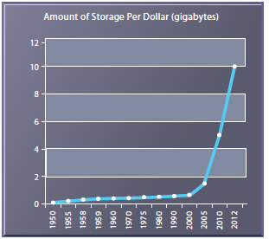
Drivers of Infrastructure Evolution
The Law of Mass Digital Storage
The amount of digital information is roughly doubling every year (Gantz & Reinsel 2011)
Fortunately the cost of storing that information is falling 100% per year

Slide 13
Drivers of Infrastructure Evolution
Metcalfe’s Law
Do you remember it?
What do you think?

Slide 14
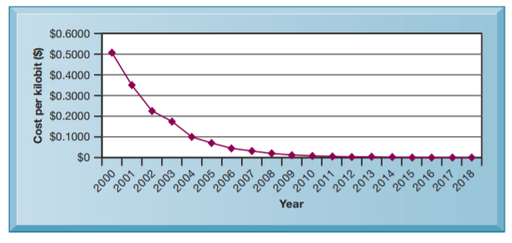
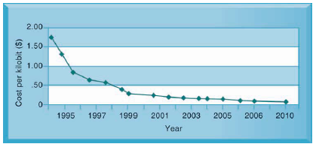
Drivers of Infrastructure Evolution
Declining Communications Costs
The Internet has been expanding, while the costs of communication decreasing

Slide 15
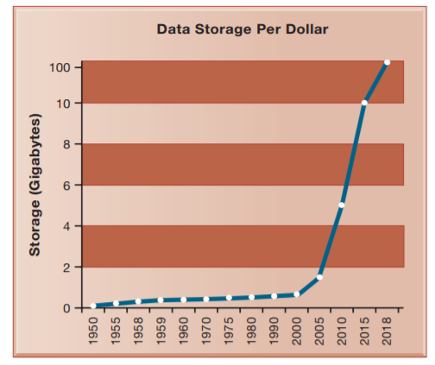
Data Storage Costs

Slide 16
Drivers of Infrastructure Evolution
Standards and Networks Effects
Various standards have been created and adopted, allowing compatibility between products and allowing communication across networks
ASCII
TCP/IP
WWW

Slide 17
Infrastructure Components
There are 7 major IT components
Hardware Platforms
Operating System Platforms
Enterprise Software Applications
Data Management and Storage
Networking / Telecommunications Platforms
Internet Platforms
Consulting & System Integration Services

Slide 18
Computer Hardware Platforms
$448 billion in 2013, between server & client devices
“Firms worldwide are expected to spend $704 billion on computer hardware devices in 2018”
Servers, largely Intel or AMD processors, along with Sun SPARC
Hardware concentrated from firms like IBM, HP, Dell & Sun Microsystems, and chip producers Intel, AMD & IBM.
Only IBM providing Mainframes, being used by banking and telecommunication networks

Slide 19
Operating System Platforms
The server market is increasingly dominated by some form of Unix or Linux (open-source)
Scalable, reliable and less expensive, running on different types of processor
On clients, Windows still dominates the market share
iOS & Android competing on mobile devices

Slide 20
Enterprise Software Applications
$301 billion in 2013
“Firms worldwide are expected to spend about $389 billion in 2018 on software for enterprise applications”
Largest providers are SAP & Oracle (which acquired Peoplesoft).

Slide 21
Data Management & Storage
Leading Database software providers are IBM (DB2), Oracle, Microsoft (SQL Server) and Sybase.
MySQL an open source relational database

Slide 22
Networking / Telecommunications Platforms
$408 billion in 2013
“Companies worldwide are expected to spend $1.43 trillion for telecommunications services in 2018”
TCP/IP is standard
Leading hardware providers are Cisco, Alcatel-Lucent, Nortel.
Telecommunications service vendors vary from country to country

Slide 23
Internet Platforms
Includes hardware & software to support a firm’s Website, including hosting services, routers, cabling, or wireless equipment.
Hardware server providers are IBM, Dell, Sun & HP.

Slide 24
Consulting & System Integration Services
Not all companies can afford to employ staff (with skills & experience) to deploy and maintain it’s IT infrastructure.
Consulting companies assist with managing changing business processes, training and software integration.
Software integration, ensuring new infrastructure works alongside legacy systems

Slide 25
Contemporary Hardware Platform Trends
Mobile Digital Platform
Phones, tablets, etc.
Consumerisation of IT and BYOD
BYOD – “Bring Your Own Device”
Employees using their own technology, working mobile in and out of the workplace
Traditionally the IT department was responsible for purchasing technology for use in the workplace, today selecting and managing devices is often done by the employees
This can make technology management more complex

Slide 26
Contemporary Hardware Trends
Quantum Computing
Bits could be 0, 1 or both…
Grid Computing
Creating a virtual supercomputer by combining the computational power of geographically remote computers
Why not use my computer’s processing capabilities while I’m not using it?
Virtualisation
Presenting a set of computing resources, so they can be accessed and used in ways that are not restricted by physical configuration.
A single resource can appear as multiple resources, or multiple resources can appear as a single resource

Slide 27
Contemporary Hardware Trends
Cloud Computing
Services offered as a pool of virtualized resources over a network, accessed as-needed.
On-demand self-service (the user obtains capabilities as they need them)
Ubiquitous network access (accessed using varied devices)
Location-independent resource pooling (resources dynamically allocated with users not needing to know where they are accessing things)
Rapid elasticity (resources quickly allocated, or deallocated according to demand)
Measured service (charges based on resources used)

Slide 28
Contemporary Hardware Trends
Cloud Computing
Cloud Infrastructure as a Service
Customers use processing, storage, networking and other resources, such as Amazon’s S3 (Simple Storage Service) or EC2 (Elastic Computer Cloud)
Cloud Platform as a Service
Customers use infrastructure and programming tools to develop their own applications
Cloud Software as a Service
Customers use software hosted by the vendor on the vendor’s cloud infrastructure, for example Google Apps

Slide 29
Contemporary Hardware Trends
Cloud Computing
Public Clouds
Owned and maintained by service provider (like Amazon)
Private Clouds
Operated for an organization
Hybrid Clouds
Own infrastructure for essential core activities, while public cloud for less critical systems, or during peak periods

Slide 30
Contemporary Hardware Trends
Green Computing
Considering the environmental impact of computing
Power consumption
Disposing of hardware
High Performance, Power Saving Processors
Multi-core processors

Slide 31
Contemporary Hardware Trends
Autonomic Computing
Large systems consisting of thousands of networked devices have become so complex that they may not be manageable – autonomic computing refers to systems that can configure themselves, optimize and tune themselves, and fix themselves when broken, while securing themselves from intruders

Slide 32
Contemporary Software Trends
Open Source Software
Linux and other open source software – free, and derivative works also free
Web Software
Java, HTML, HTML5
Web Services
Offered through a Service Oriented Architecture (SOA) / Software as a Service (SaaS
Shared standards

Slide 33
Management Issues
Platform and Infrastructure Changes
As firms grow, they outgrow their infrastructure
Is it scalable?
Is it flexible?
As users use their mobile devices, we need to inventory them, secure them, control their data and applications.
As we use cloud computing, we need new SLAs, detailing response times & availability

Slide 34
Management Issues
Management and Governance
Who “owns” and “controls” the IT infrastructure?
The users?
The IT department?
The company?
Each department?
How can we maximize efficiency & support if control is decentralized?
Can we respond quickly to business needs if control is centralized?

Slide 35
Management Issues
Making the right infrastructure investments
Too much expense hits the firm’s finances
Too little means business services aren’t realized
Should we buy or rent infrastructure?
Cloud Computing
The TCO (Total Cost of Ownership) of technology assets is not just the original cost of hardware and software – it includes ongoing administration costs, upgrades, maintenance, support, training, even real estate.

