Slide 1
ISNE101
Dr. Ken Cosh
Week 11

Slide 2
Review
Introduction to SDLC
  Process Models
    Waterfall
    Evolutionary Development
    Re-use Based Development
  Generic Activities in ALL processes
    Specification
    Development
    Validation
    Evolution

Slide 3
This Week
SDLC a bit deeper
& the Data Resource

Slide 4
Requirements Process

Slide 5
Feasibility
Dictionary.com
  Capable of being done, effected, or accomplished
But just because we are capable of doing something doesn’t mean we should necessarily do it!
WordNet
  Capable of being done with means at hand and circumstances as they are
That’s a bit better, but still not ideal.

Slide 6
Feasibility Studies
The first step in the Requirements Process
Questions:
  Is it possible to do this?
  Is it worthwhile to do this?
  Does it make economic sense?
  What risks are involved?
But, it is pretty difficult to answer those questions without some understanding of the requirements!

Slide 7
Feasibility Study
Actually the Feasibility Study is designed to answer one question;
  To Go or Not To Go?
And you might not be the one to answer that question.
  To answer that question, we need to estimate the answer to many other questions.
    Scoping
    Stakeholder Identification
    Cost / Benefit Assessment
    Risk Assessment

Slide 8
Feasibility Analysis
To find the answers to those questions;
  Scoping
  Stakeholder Identification
  Cost / Benefit Assessment
  Risk Assessment

Slide 9
Feasibility - Scoping
How big is the project?
Which systems / products will we replace?
Which other systems / products will we interrelate with?

Slide 10
Feasibility - Stakeholders
Once you have the scope, you can identify stakeholders.
  Simple – Holders of Stake, i.e. people with an interest in the project.
Potentially
  Managers
  Employees
  Customers
  …

Slide 11
Cost / Benefit Assessment
Tricky!
  Many costs are hidden, and many benefits are hidden too.
  Many costs are unquantifiable, and many benefits are unquantifiable too.
  Many analysts are too inexperienced to assess costs and benefits
    If we knew what it would cost, we have already done it before, so we wouldn’t need to do it again!
    Many projects end up over time and over budget, because of failures at this stage.

Slide 12
Risk Assessment
What risks are involved in doing this project?
How probable are they?
How damaging are they?
What can we do to reduce the probability, or reduce the effect, of the risk? Or can we build in a contingency plan?

Slide 13
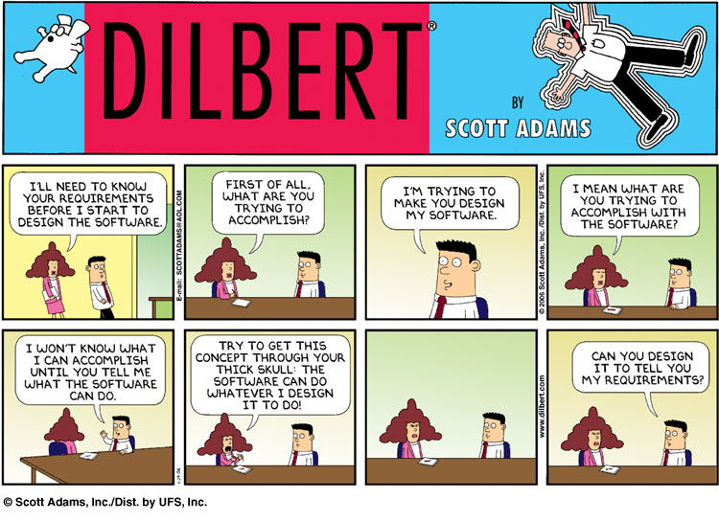

Slide 14
Requirements Elicitation and Analysis
Here we gather requirements from a variety of sources;
  Stakeholders (identified previously)
  Existing Systems
  Legal Documents
  Competing Systems
How could we go about getting Requirements?

Slide 15
Requirements Techniques
Interviews
Facilitated Meetings
Ethnography
Scenarios
Prototypes

Slide 16
Interviews
Durrrh!
Why not ask people what they require?
Well, it’s a good starting point, but,
  People might not know what they want.
  Different stakeholders have different “Views” of the problem.
  People are busy.
    Particularly if a “systems analyst” comes around!

Slide 17
Facilitated Meetings
Get people together to talk about their requirements!
Good, now we can resolve any conflicts, but,
  Again, people might not know what they want or do…
  Who’s going to argue with the boss?
  People are busy!

Slide 18
Ethnography
Observation!
If people don’t know what they want or do, why not watch them doing it? But,
  Ethnographers are usually sociologists (not computer scientists).
    Which means they have a tendency to write very long and boring documents!
  When people are being watched, they have a tendency to do things differently…

Slide 19
Scenarios
So, propose a scenario to people, and ask what the system should do in that situation.
  But, it’s a bit difficult to cover every eventuality.

Slide 20
Prototypes
Build a Prototype, and see if that would satisfy people?
  But, users tend to get carried away by how it looks, rather than what it does…
  “Can We have it in Blue?”

Slide 21
Requirements Elicitation and Analysis
We’ve just touched the subject here, and we’ll go into it in much more detail, but needless to say, it isn’t as easy as you might think.
To be thorough, we have to use all the techniques at our disposal.
And then build some system models as a visual indication of what the system should do.

Slide 22
Requirements Specification
Once we’ve gathered and analysed the requirements, the next job is to specify them.
Writing requirements is not trivial.
They should be;
  Complete,
  Unambiguous,
  Measurable,
  Consistent,
  Precise,
  …

Slide 23
Types of Requirement
Functional Requirements
Non-Functional Requirements
  Constraints

Slide 24
Functional Requirements
Functional Requirements are things that the product must do.
  i.e. functions that the product must be able to perform.
E.g.
  The system should produce a daily sales report.
  The system shall produce an amended delivery schedule when a delivery truck is in maintenance.

Slide 25
Non-Functional Requirements
Non-Functional Requirements are properties or qualities that the system should have.
  i.e. not things it should be doing.
E.g.
  Registered Users should be authenticated within 0.25 seconds.
  Inexperienced users should be able to use the system within 3 days of training.

Slide 26
Types of Non-Functional Requirements

Slide 27
Requirements Validation
Before we finish our requirements analysis, we need to validate the requirements.
  Is it complete?
  Are they all testable?
This topic includes;
  Requirement Reviews
  Often Prototyping
  Model Validations
  Acceptance Tests

Slide 28
Software Development
Software Design and Implementation
  The process of converting the system specification into an executable system
  Software design
    Design a software structure that realises the specification
  Implementation
    Translate this structure into an executable program
  The activities of design and implementation are closely related and may be inter-leaved

Slide 29
Design Process Activities
Architectural design
Abstract specification
Interface design
Component design
Data structure design
Algorithm design

Slide 30
The Software Design Process

Slide 31
Design Methods
Systematic approaches to developing a software design
The design is usually documented as a set of graphical models
Possible models
  Data-flow model
  Entity-relation-attribute model
  Structural model
  Object models

Slide 32
Data Design
For information to be valuable it should have the following characteristics:-
  Accurate
  Verifiable
  Timely
  Organised
  Accessible
  Useful
  Cost-Effective
Garbage IN – Garbage OUT

Slide 33
File Processing Systems
File processing systems, are systems where data is stored in files, using approaches like that discussed above. There are several challenges to managing file processing systems!
  Data Redundancy – each department has their own files, and so the same data may exist in more than one place – while duplicating data can be a benefit (in terms of back ups), it is largely a hindrance (it wastes space, it is harder to maintain consistency).
  Isolated Data – data isn’t related in convenient ways – if we store the list of students in the class in one file, and then information about each student in other files, we have a complicated task to send an email to each student about a class change.
Today many systems use a database to store data, and make use of a DBMS (Database Management System) to help maintain the data.

Slide 34
Hierarchy of Data
Data can be considered in a series of layers:-
  Characters – single bytes of data – i.e. a single letter, number, etc.
  Field – combination of related characters
    Fields are given a name and a type (like with variables), and also a size.
  Record – combination of related fields
    Records have a primary key to uniquely identify each record
  File – A collection of related records

Slide 35
DBMS
There are several different DBMS’s, but the objective is to provide ways to maintain and retrieve data from a database
  Normally through a query language, such as “SQL” or Structured Query Language.
The DBMS also handles security, ensuring only authorized users can access data at permitted times, and it also performs tasks such as back ups and recovery.

Slide 36
Relational Databases
Many modern databases are ‘Relational Databases’, where data is related;
  for example the data about a student will be related to the data about which courses they are studying and the data about their teachers.
This enables the querying language to make more sophisticated queries quickly, while removing the need for duplicate data.
In a relational database, data is stored in tables, where each column represents a field (or particular piece of data), and each row stores the data about a particular entity (or record) – much like in an excel spreadsheet. Each table will have a primary key, normally an ID, which uniquely identifies each record. This primary key can then be used as a foreign key in a different table to relate the data. For instance, in the table storing data about the grades for a course, the id for each student can be used as a reference.

