Slide 1
ISNE101
Dr. Ken Cosh
Week 13

Slide 2
This Week
Challenges (still) facing Modern IS
  Reliability
  Security

Slide 4
Dependability
The dependability of a system reflects the user’s degree of trust in that system – their confidence that it will operate as expected.

Slide 5
Reliability and Availability
Reliability
  The probability of failure-free system operation over a specified time in a given environment for a given purpose
Availability
  The probability that a system, at a point in time, will be operational and able to deliver the requested services
It is sometimes possible to subsume system availability under system reliability
  Obviously if a system is unavailable it is not delivering the specified system services
  However, it is possible to have systems with low reliability that must be available. So long as system failures can be repaired quickly and do not damage data, low reliability may not be a problem

Slide 6
Why is Reliability important?
Costs of downtime for a business critical system
  How much would a 15 minute failure of service cost?
  How much would a days failure cost?
  If this was an Email service?
  What percent failure is acceptable?

Slide 7
Redundancy
One way of dealing with Reliability is to use redundancy
  ‘Spare’ components, so if one fails another could be used.
  ‘Back-Ups’
Availability Math
  If a system is 98% available that means it is not available 2% of the time (i.e. about half an hour each day!!!)
  Many systems are now needed to be 99.999% available.

Slide 8
Components in Series
Component 1
98%
Component 2
98%
Component 3
98%
Component 4
98%
Component 5
98%
Consider if each component was 98% reliable, and there were 5 components in series.
.98 * .98 * .98 * .98 * .98 = 0.9, i.e. only 90% all components are running just 90% of the time.
With more components, it is increasingly less reliable

Slide 9
Components in Parallel
Now consider these components in parallel.
The probability of failure is 0.02 each time;
0.02 * 0.02 * 0.02 * 0.02 * 0.02 = 0.0000000032 !!!
Hence, redundancy is used to increase reliability. If one component fails, another can be used in it’s place.
Component 1
98%
Component 2
98%
Component 3
98%
Component 4
98%
Component 5
98%

Slide 10
Hardware vs Software
Components in Parallel is sometimes called ‘Triple Modular Redundancy’, and it has 2 key assumptions;
  Hardware components do not have common design faults.
  Components fail randomly (there is low chance of simultaneous failure)
Neither of these assumptions are true for software;
  Copying components copies design faults.
  So simultaneous failure is inevitable.

Slide 11
5 nines
99.999% Reliability?
  How about electricity?
  How about network connection?

Slide 12
Reliability
Redundancy is the Key!
  Spare components
  Components running in parallel
    Triple Modular Redundancy
  Identify unreliable components and arrange back ups.
    UPS
    Multiple ISPs

Slide 13
Security
A wide variety of threats
  Phishing
  Social Engineering
  Hacking
  Spamming
  Credit Card Fraud
  Denial Of Service
  Malware
  Trojans
  Virus / Worm

Slide 14
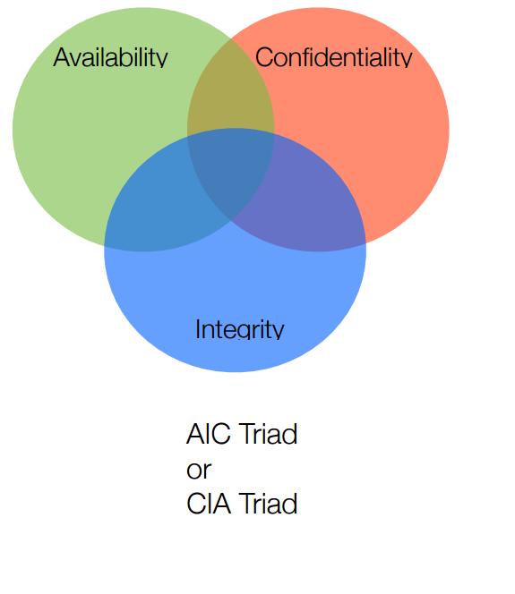
Fundamental Principles of Security

Slide 15
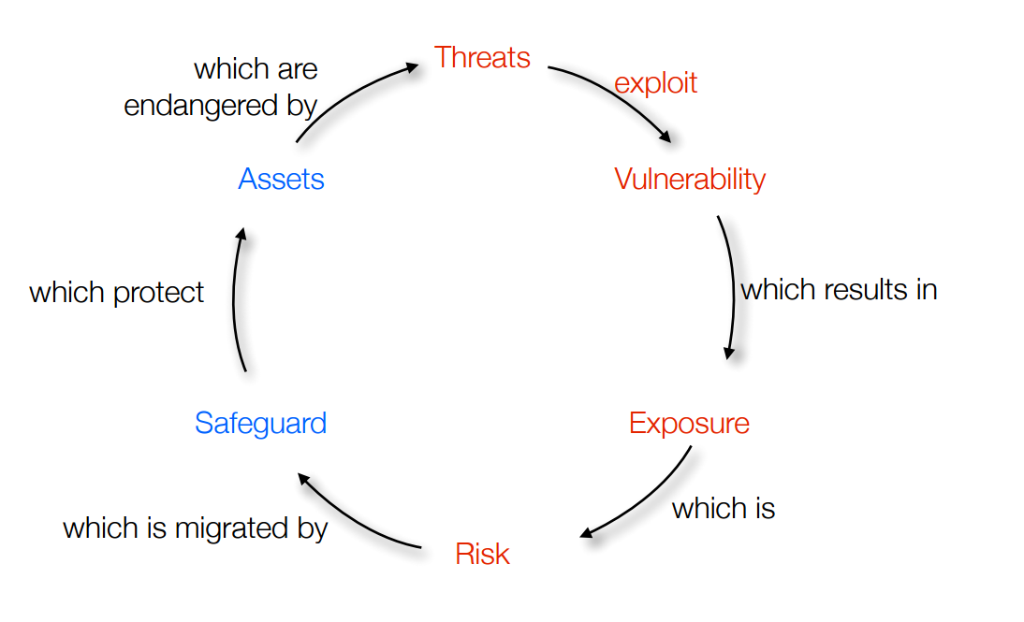
Risk

Slide 16
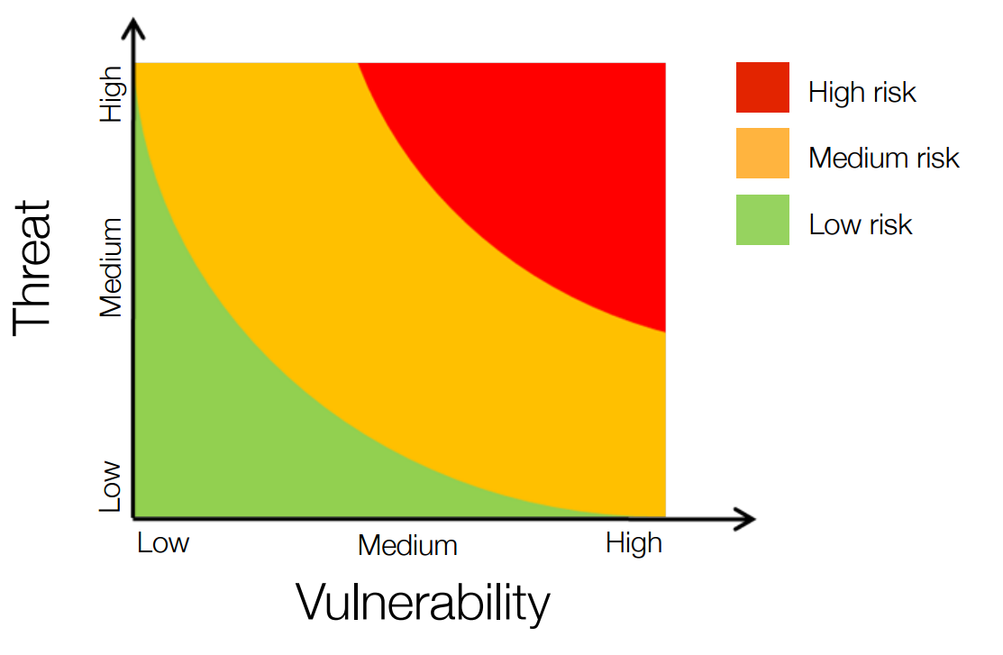
Risk Terminology

Slide 17
Potential Threats
Intrusion
Viruses / Worms
External Attacks
Intrusion
Viruses / Worms
Interception

Slide 18
Threats
Intrusion
  Gaining Access to internal infrastructure
Viruses / Worms
  Replicating Software
External Attacks
  Denial of Service.
Interception
  Catching communication while en route between sender and receiver.

Slide 19
Intrusion
Gaining access to internal infrastructure;
  Stealing Mobile Phone
  Guessing Passwords
  Hacking into private spaces
Once a hacker has access to an account, they have the same rights as the account owner.
  Problem 1: Preventing hacker from accessing account.
  Problem 2: Finding out what someone may have done while they had access.

Slide 20
Viruses / Worms
Virus
  Software Program that replicate itself on more PC’s – in a similar way to viruses spread between people.
    Viruses need another program to piggyback off, e.g. a macro in a spreadsheet, or document.
    Are often spread using email
Worms
  A small piece of software that uses security loopholes to replicate.
    E.g. finds a loophole in Windows, scans network for another PC with a similar loophole and copies itself to the new PC etc.

Slide 21
External Attacks
Attacks without gaining access to a private device.
  Denial of Service(DoS)
    Very Common Attacks
    Purpose, to use up bandwidth or service, by ‘spoof’ conversations.
      Blocking Webservers with repeated hits
      Spam emails
  Distributed Denial of Service (DDOS)
    Attacking from many addresses simultaneously.
      Code Red Worm
      Chain Letters

Slide 22
Interception
Catching communication whilst on route between sender and receiver.
  Intercepting Signals.
    Wireless Signals
    Government listening in on telephone conversations
  Normally minimised through encryption.
Accessing someone else’s service
  Using bandwidth of wireless network

Slide 23
Improving Security
Security Policies
  Limiting users access & actions
Firewalls
  Protection between network and internet
Authentication
  Passwords etc.
Encryption
  Encoding contents of communication
Patches
  Responding to security breaches

Slide 24
Security Policies
Access Control Lists (ACL)
  Limit which users can do what (e.g. update websites)
Signed agreements for service
  When allowing users onto a network, normally they sign an agreement, regarding terms of use.
    Did you sign one at CMU?
Policies could include,
  Regular password changes
  Whether personal use of service is permitted
  Antivirus updates
Can help against, external attacks, intrusion, virus / worms

Slide 25
Firewalls
Hardware and / or Software protection sitting between internal network and internet.
Can help stop viruses/worms from accessing the network,
W W W

Slide 26
Authentication
Software to ensure permission of user to access service
  Password
  Finger prints / retina scans
Helps against intrusion

Slide 27
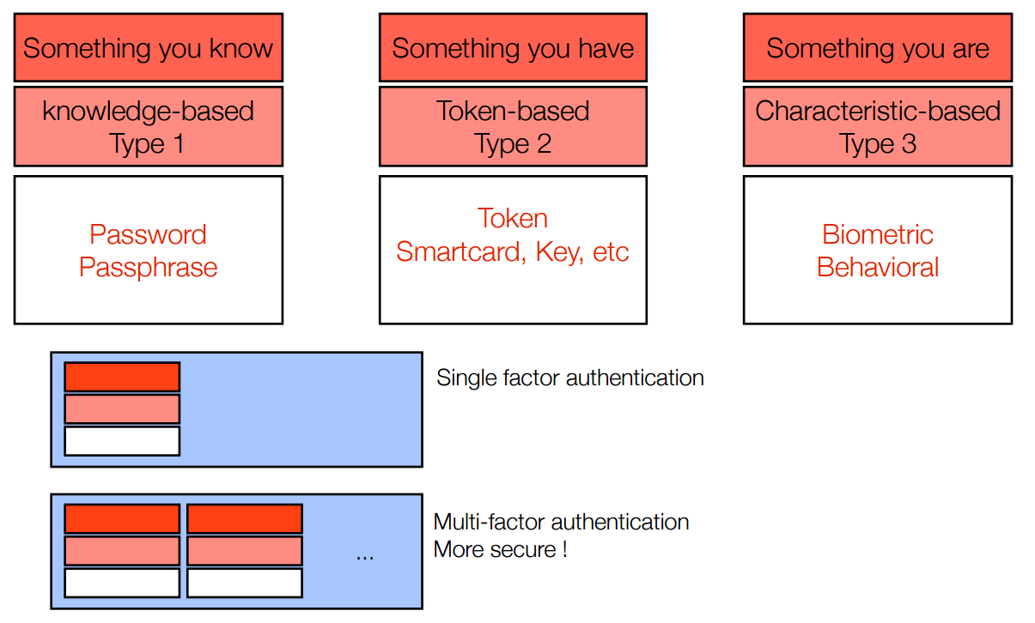
Authentication

Slide 28
Encryption
Encoding the contents of a transmission so it can’t be decrypted on route.
  Symmetric-key encryption
  Public / Private key encryption
Helps prevent interception.

Slide 29
Symmetric Key Encryption
Both sender and receiver use the same ‘code’ to encrypt and then decrypt a message.
  If I tell you to move each character back two in the alphabet, and then send you this message;
    Jgnnq Encuu
  Anyone who intercepts the message gets nothing, but you are able to decrypt it.
More interesting patterns can be created to increase security.
  Substitution
  Transposition
Key:
FANCY
Message:
eatitnihmexnetmgmedt

Slide 30
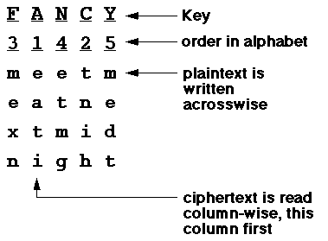
Decoding

Slide 31
Patches
Response to a virus or security breach
  Anti virus software often updates to add new virus definitions.
  Operating systems regularly update to deal with security loopholes which may allow worms to work.

