Slide 1
ISNE101
Week 5
Dr. Ken Cosh

Slide 2
Networks Recap
What were the features of:
Centralised Network
Decentralised Network
Distributed Network
Speeding Up the Network
Caching
Routing
Multiple Route Efficiencies

Slide 3
This Week
It's Time for a "Revolution"
The revolution of Social Networks and Social Media
So Lets talk about "Web 2.0"

Slide 4
Definitions
Social Networks
"Family, and friends and their families, that together create an interconnected system through which alliances are formed, help is obtained, information is transmitted, and strings are pulled. In an organizational setting, it usually constitutes the group of one's peers, seniors, and subordinates who provide privileged information on how to get things done, how the power structure operates, and who holds the strings at present."
BusinessDictionary.com

Slide 5
Definitions
Web Based Social Networks
"Any website designed to allow multiple users to publish content themselves. The information may be on any subject and may be for consumption by (potential) friends, mates, employers, employees, etc. The sites typically allow users to create a "profile" describing themselves and to exchange public or private messages and list other users or groups they are connected to in some way."
Dictionary.com

Slide 6
Definitions
Social Media
"participatory online media that utilizes the group to write and direct content, rather than a read-only media. Allows for direct contact between participants"
UrbanDictionary.com

Slide 7
Definitions
Web 2.0
"Web 2.0 (or Web 2) is the popular term for advanced Internet technology and applications including blogs, wikis, RSS and social bookmarking. The two major components of Web 2.0 are the technological advances enabled by Ajax and other new applications such as RSS and Eclipse and the user empowerment that they support."
Whatis.com

Slide 8
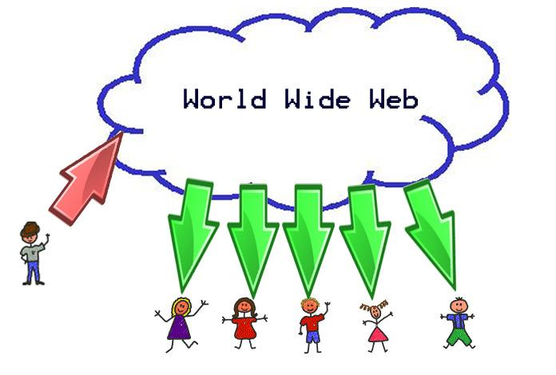
Traditional View

Slide 9
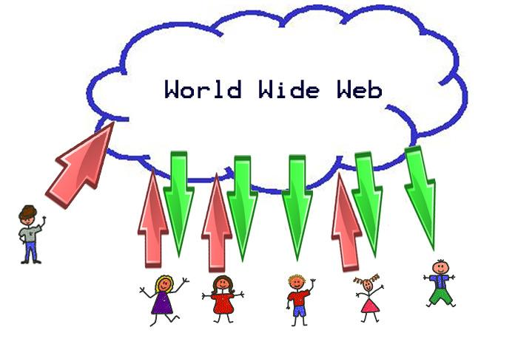
"New" View

Slide 10
Information is Changing
Information R/Evolution
Mwesch
http://www.youtube.com/watch?v=-4CV05HyAbM

Slide 11
Characteristics of Information OR
Assumptions about Information
*It is a thing
*It has a logical place
*Where it can be found
On a Shelf
In a File System
In a Category
*Managing Information is Managing Categories
*It Requires Experts
*And is still hard to find.
! ! ! Digital Information is Different ! ! !

Slide 12
It's an Information Revolution
The responsibility to
Harness
Create
Critique
Organise
Understand
is on Us
Are we Ready?

Slide 13
Information is Changing
The Machine is Us/ing Us
Mwesch
http://www.youtube.com/watch?v=NLlGopyXT_g

Slide 14
How did it happen?
XML Separates Form from Content
With Form separated from Content, users did not need to know complicated code to upload content to the web.
We'll need to rethink a few things...
copyright governance
authorship privacy
identity commerce
ethics love
aesthetics family
rhetorics ourselves

Slide 15
Assignment
How has Web 2.0, and how is Web 3.0 affecting the way we think about…
Group A: Copyright, Authorship & Identity
Group B: Ethics, Aesthetics, Rhetorics
Group C: Governance, Privacy, Commerce
Group D: Love, Family, Ourselves

Slide 16
Early Social Networks
BBS
Bulletin Board System
Late 70s / Early 80s
Complex computer language
Breeding ground for social rejects & boring, reclusive nerds!
A central node where users could connect, communicate & download files / games etc.
Dialled up connection via phone
Usually only local people, due to phone charges
Text only exchanges @ Glacial Speed!
Slowly gained popularity through to the 90s - LUBBS

Slide 17
The internet kicks in
AOL
Member profiles
Member created communities
Messenging service
Classmates.com
Originally no profiles
But could search for old school colleagues
sixdegrees.com
Create / Surf profiles, create groups, invite friends
Inviting friends was too pushy/spammy (then)

Slide 18
2002
Friendster.com
"A dating site that isn't about dating"
Connecting people through common bonds
LinkedIn.com (2003)
Serious, sober approach
Not a playground for former classmates
A business networking resource
MySpace.com (2003)
Hipper / Cooler than Friendster
Attracting many friendster's with music & videos

Slide 19
Facebook
2004 - Harvard Only product peddling
2006 - General public
Massive investment
Easy to use
Lots of features

Slide 20
Other Sites
Orkut - (Brazil / India)
Skyrock - (France, Belgium, Switzerland)
Multiply - (Philippines)
Mixi - (Japan)
Qzone - (China)
Badoo - (Europe)
Nasza-klasa - (Poland)
Odnoklassniki - (Russia)
VKontakte - (Russia)

Slide 21
Blogging
Bebo - Blog Early Blog Often (2005)
Twitter - 2006
Do we really need to know that you are drinking coke?
But, it has handled real time search in a new unique way!

Slide 22
5 Ways Social Media Changes the way we work…
Social Media Goes Company Wide
Email Use Declines as better communication channels open
Social Media command centres become mainstream
Social Media compliance becomes a priority
International & Niche Social Networks present new challenges

Slide 23
5 ways
Facebook was launched in 2004
  Evolved from dorm room to boardroom
73% of Fortune 500 active on Twitter
80% of executives believe social media engagement lead to increased sales

Slide 24
Social Media Goes Company Wide
Social Media
  a tool for the Marketing Department?
  Transaction Based -> Relationship Based?
McKinsey - $1.3 Trillion in untapped value from social networks through “improved communications & collaborations within and across enterprises”
Social Media to become the office productivity tool.
  Like Email once was

Slide 25
Social Media Goes Company Wide
HR uses Social Media to connect with Job Seekers
Sales teams generate leads, track clients as they move through the “sales funnel”
Operations & Distribution teams forecast supply chains
R&D brainstorm product ideas
Social Media is a serious business tool

Slide 26
Email use declines as better communication channels open
Email
  Great for FORMAL, ONE to ONE correspondence
  but is it great for collaboration?
Wikis?
Instant Messaging?
Why?
  Real-Time Communication
  Centralised Information Sharing

Slide 27
Email
Unproductive Tool
  How long do you spend replying to emails?
Linear – NOT collaborative
  Back and forth, not community based
Not Social
  The right tool for discussions?
The inbox Black Hole
  How big is your black hole?
Sharing Documents by Email
  Can you edit, translate…?

Slide 28
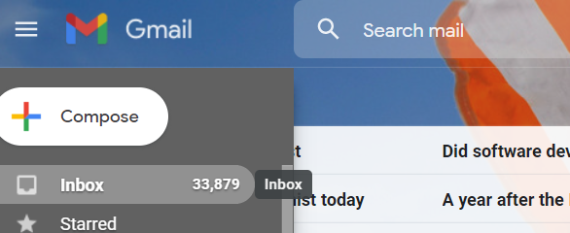
Better tools?
Yammer? Chatter?
Google Wave?
Google Docs…. (sorry)… Google Drive…
Virtual Work Groups
Centralised Message Boards
Unlock the “dark matter” in the “black hole”

Slide 29
Social Media command centres become mainstream
“BIG DATA”
  Client Behaviour
  Preferences
How do we make sense of it all?
  There is so much data generated!
Companies turn to teams of analysts tracking EVERYTHING
  responses to tweets
  likes
  customer sentiment

Slide 30
Social Media command centres become mainstream
The Smart Centres go Smart?
  Any manager, anywhere, can see real time analysis of social metrics, and react.
  Nestle tracks customer sentiment
  GE speeds up certain electrical grid repairs
  Auto industry predicts recalls
  Stock price predictions
  T-Mobile prevents customer defections

Slide 31
Social Media compliance becomes a priority
June 2012 – Morgan Stanley enters “Twittersphere”
  SEC rules govern firm communications with public & share holders
    Every tweet is a potential lawsuit
Regulations means all tweets must be “compliant”
  Storing a history of tweets
  Training staff on appropriate tweeting behavior!
Maintaining compliance – industry specific compliance

Slide 32
International and niche social networks present new challenges
Awesome!!!
  We’ve got it figured out!
  We have this facebook thing nailed, we’re doing good at twitter, and we’ve got linkedin and google+ in the bag!
Instagram grew by 17,319%
Pinterest grew by 5,124%
“Offering deeper functionality combined with a lower technical barrier to entry will mean new leaders in social media being created in a matter of days versus weeks and months.” (James Murray, Experian)

Slide 33
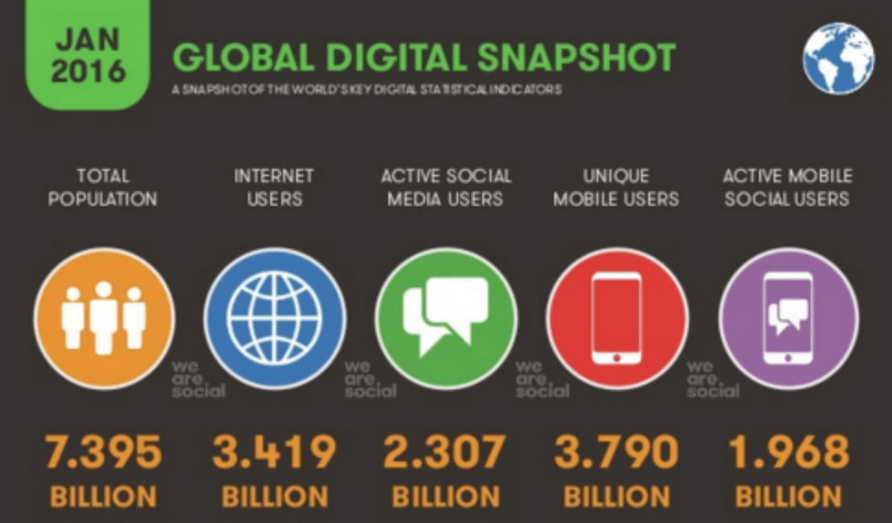
Social Media

Slide 34
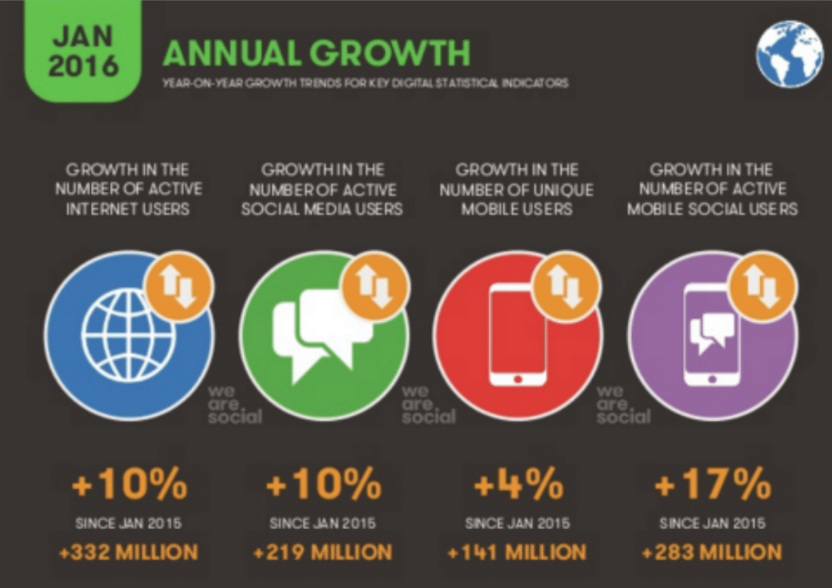
Social Media – Annual Growth

Slide 35
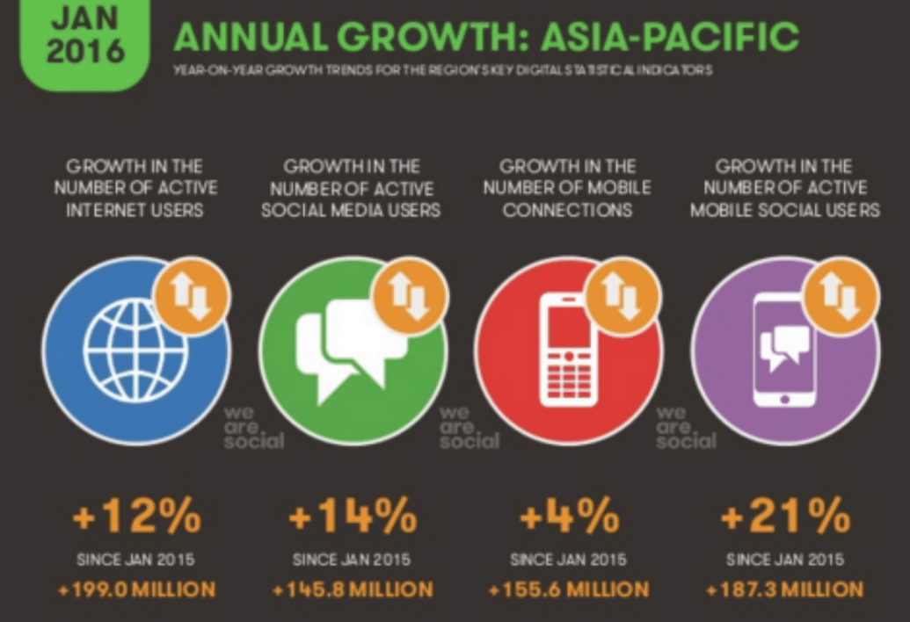
Social Media – Asia Pacific Growth

Slide 36
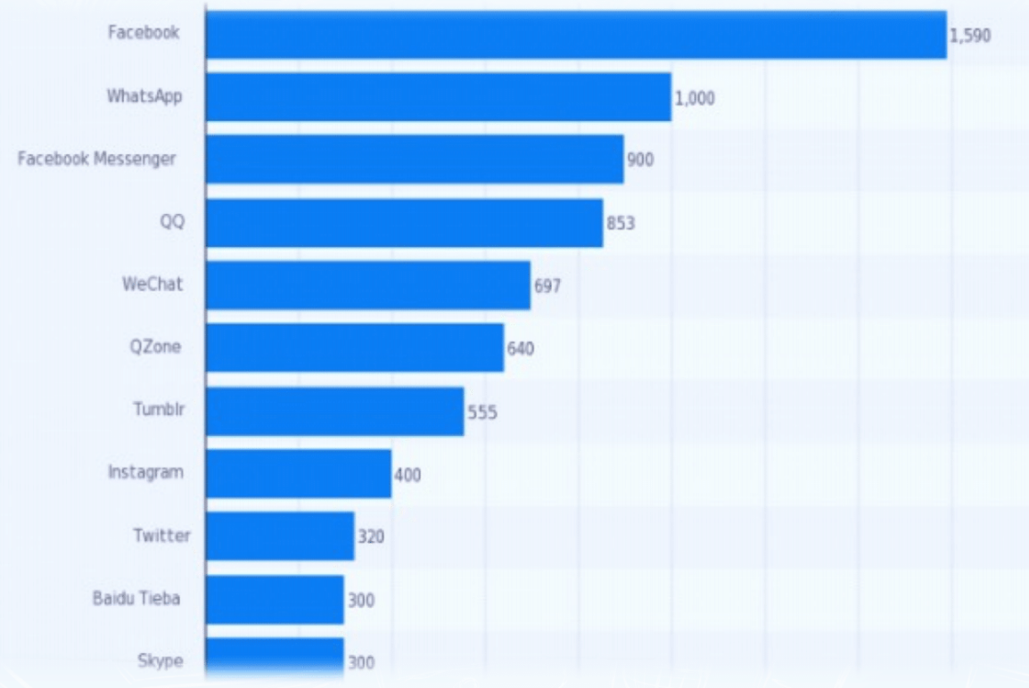
Active Users (In Millions)

Slide 37
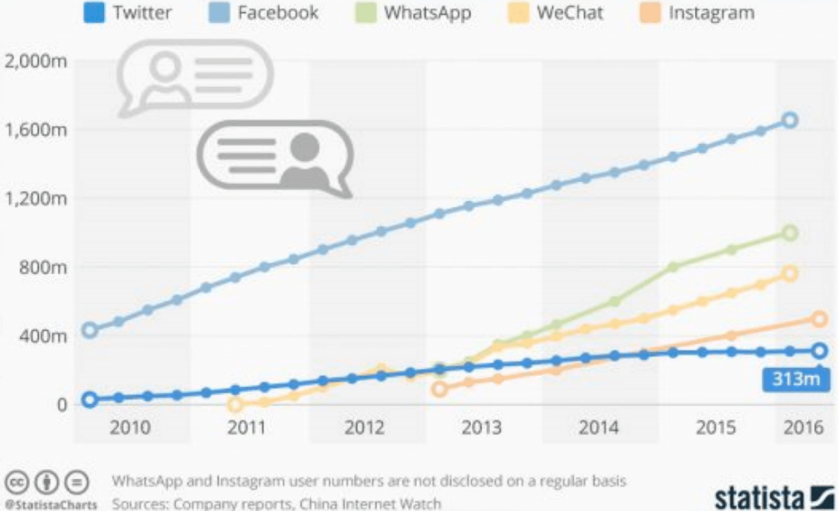
Social Network Growth

Slide 38
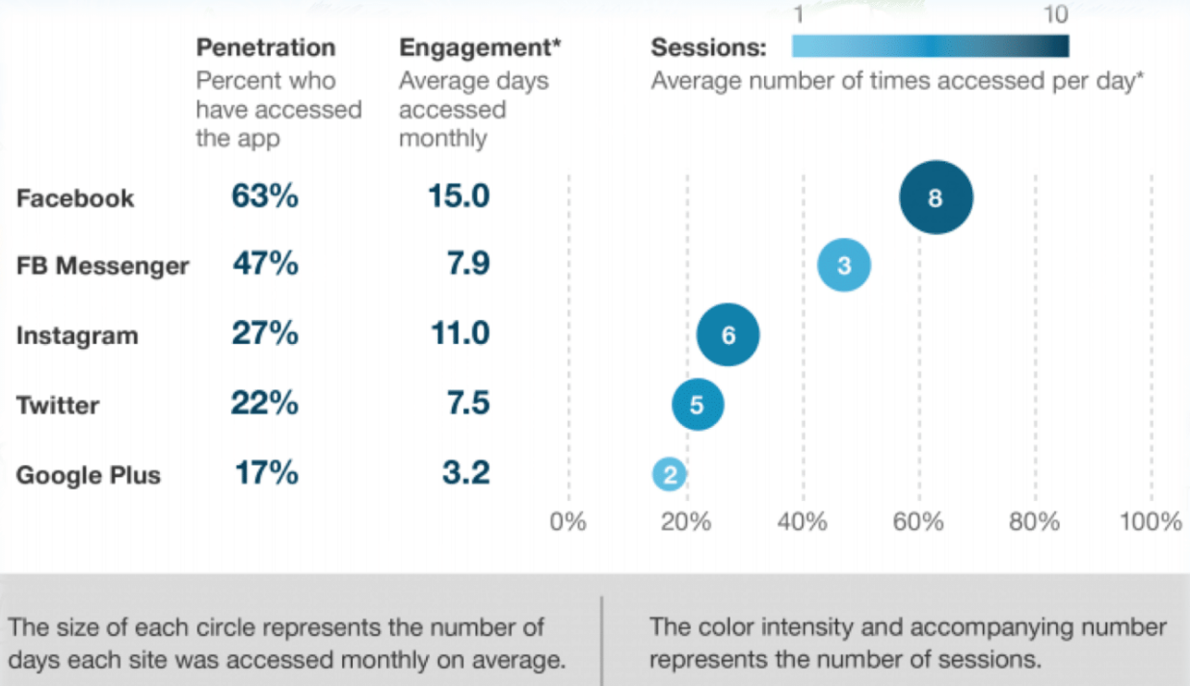
Facebook Dominance

Slide 39
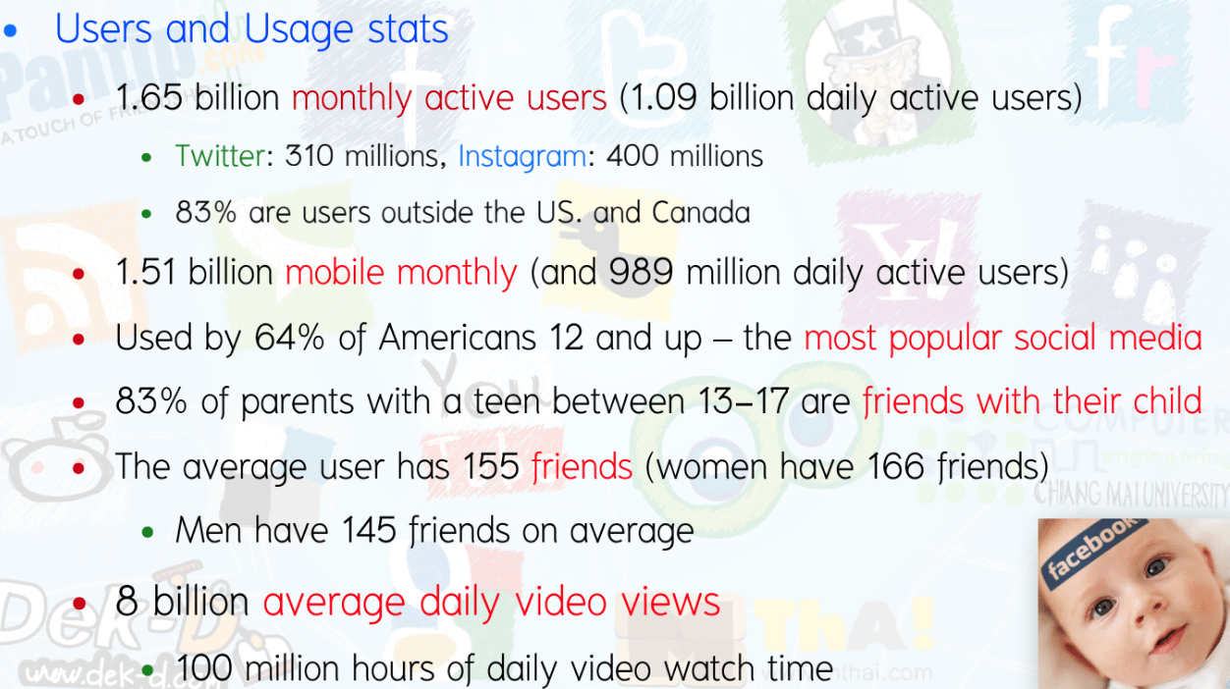
Facebook Facts

Slide 40
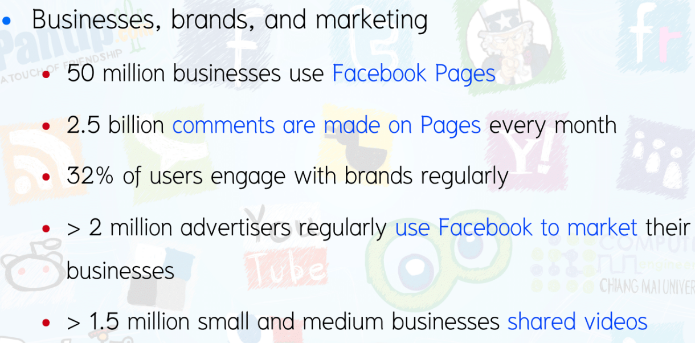
Facebook Facts

Slide 41
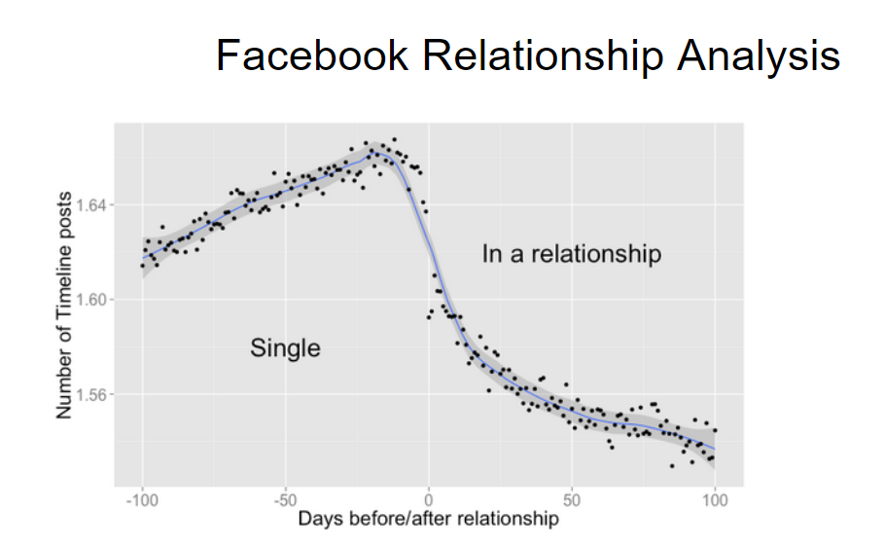

Slide 42
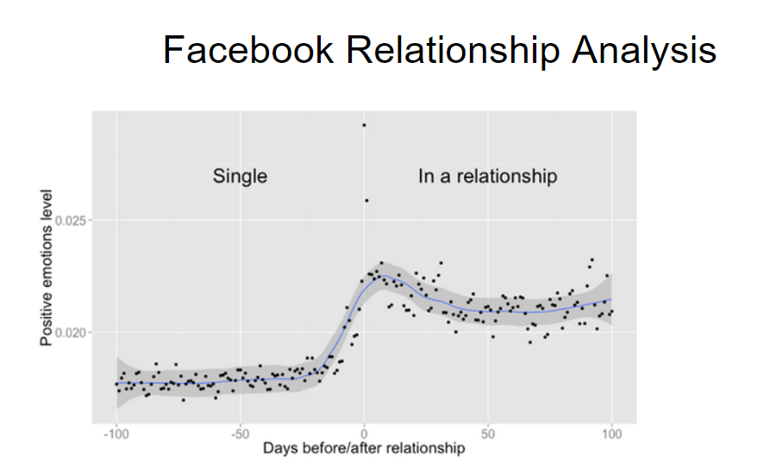

Slide 43
Social Media
What impacts is it having on our life? Our society? Our behaviour? Our Psychology?
Positive Impacts?
Negative Impacts?

