Slide 1
Web Programming Language
Week 13
React 4

Slide 2
React-Router
So far the apps have been “Single Page Apps” (SPA)
React can also be used to create full websites

Slide 3
React-router-dom
Install React Router in a new project
  npm i -D react-router-dom
Import it into App.js
  import { BrowserRouter as Router, Route } from 'react-router-dom';

Slide 4
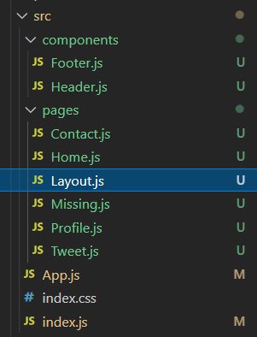
Pages
Different pages are components
Most of these can initially be basic components, but in time they can add different parts of the site

Slide 5
index.js
import React from 'react’;
import ReactDOM from 'react-dom/client’;
import './index.css’;
import App from './App’;
import Header from './components/Header’;
import Footer from './components/Footer’
const root = ReactDOM.createRoot(document.getElementById('root’));
root.render(
<React.StrictMode>
<Header />
<App />
<Footer />
</React.StrictMode>
);

Slide 6
App.js
Import React Router
import { BrowserRouter, Routes, Route } from "react-router-dom";
import Contact from './pages/Contact’;
import Home from './pages/Home’;
import Missing from './pages/Missing’;
import Profile from './pages/Profile’;
import Tweet from './pages/Tweet’;
import Layout from './pages/Layout’;
function App() {
return (
<BrowserRouter>
<Routes>
<Route path="/" element={<Layout />}>
<Route index element={<Home />} />
<Route path="contact" element={<Contact />} />
<Route path="profile" element={<Profile />} />
<Route path="tweet" element={<Tweet />} />
<Route path="*" element={<Missing />} />
</Route>
</Routes>
</BrowserRouter>
);
}
Import Pages
Set Paths for Routes

Slide 7
Layout.js
import { Outlet, Link } from "react-router-dom";
const Layout = () => {
return (
<>
<nav>
<ul>
<li>
<Link to="/">Home</Link>
</li>
<li>
<Link to="/profile">Profile</Link>
</li>
<li>
<Link to="/contact">Contact</Link>
</li>
<li>
<Link to="/tweet">Tweet</Link>
</li>
</ul>
</nav>
<Outlet />
</>
)
};
export default Layout;
Contains 2 parts,
A navigation panel
An Outlet to display each page
Link is used in place of <a href=
For internal paths
Keeps track of browsing history
<> </> is a fragment

Slide 8
Missing.js
Path was set as;
  <Route path="*" element={<Missing />} />
This traps any broken links and directs them to a 404 page for example

Slide 9
Summary
React Router can be used to create multipage sites
It handles the routes of different paths directing them to display different components

