Slide 1
261446 Information Systems
Week 12
Enhancing Decision Making

Slide 2
Week 12 Topics
Decision Making and Information Systems
Business Intelligence in the Enterprise
Business Intelligence Constituencies

Slide 3
Case Studies
Case Study #1) Big Data & IoT
Case Study #2) Is Predix GE’s future?

Slide 4
Making Decisions
How much value is there for businesses making the right decisions?

Slide 5
Types of Decision
Structured Decisions
Repetitive & routine following a definite procedure.
Unstructured Decisions
Require judgment, evaluation and insight to solve a problem. Each decision is new and important, with no understood procedure for making the decision
Semistructured Decisions
Part of the problem follows a defined procedure

Slide 6
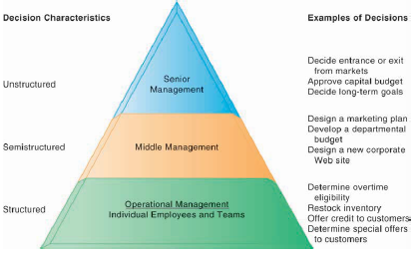
Types of Decision

Slide 7
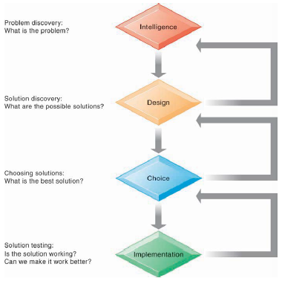
Decision Making Process

Slide 8
Managerial Roles
Classical Model of Managers (Fayol 1920-1990)
Managers have 5 functions
Planning
Organising
Coordinating
Deciding
Controlling

Slide 9
Managerial Roles
Behavioural Model of Management
5 Attributes
Managers do a lot of work, at a fast pace
Activities are fragmented – many short duration activities
Managers prefer current, specific, ad hoc information
Managers prefer oral communication
Managers maintain a diverse / complex network of contacts as an informal information system

Slide 10
Managerial Roles
Mintzberg (10 Roles in 3 Categories)
Informational
Monitor, Disseminator, Spokesperson
Interpersonal
Figurehead, Leader, Liaison
Decisional
Entrepreneur, Disturbance Handler, Resource Allocator, Negotiator

Slide 11
Wrong Decisions?
IT doesn’t always provide the information to make the right decision
Information Quality
Management Filters
Organisational Inertia & Politics

Slide 12
Wrong Decisions?
Information Quality
Accuracy
Integrity
Consistency
Completeness
Validity
Timeliness
Accessibility

Slide 13
Wrong Decisions?
Management Filters
Even with all the right information, managers can still make the wrong decision.
Humans interpret information through filters as we understand the world around us
Selective Attention
Focus on certain problems
Focus on certain solutions
A variety of biases to reject information that doesn’t conform to prior conception

Slide 14
Wrong Decisions?
Organisational Inertia & Politics

Slide 15
Business Intelligence
One definition of human intelligence refers to our ability to
take data from our environment,
understand its meaning & significance,
and act appropriately
How about Businesses?
Businesses are human environments, so why not Business Intelligence?

Slide 16
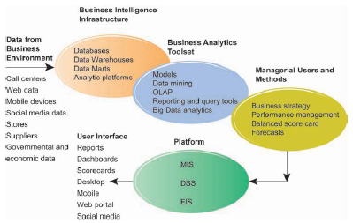
Business Intelligence Environment

Slide 17
Business Intelligence Environment
Data from Business Environment
Structured & Unstructured data, from many sources, including Big Data
Business Intelligence Infrastructure
Powerful database that captures all relevant data; relational or data warehouse / datamarts
Business Analytics Toolset
Software tools to analyse data, track performance & answer ad hoc manager questions

Slide 18
Business Intelligence Environment
Managerial Users & Methods
BI is only as intelligent as the humans using it - managers have to ask the right questions or track the right bits of data
Delivery Platform – MIS, DSS, ERP
Layer responsible for delivering information to different people at different levels in the firm, from operational level, through middle managers to senior executives
User Interface
Not just a spreadsheet! Visualisations available on multiple different devices

Slide 19
BI & Analytics Capabilities
Production Reports
Predefined reports
Parameterised Reports
User enters several parameters (e.g. region, time of day, different product sales), to produce a report, like a pivot table
Dashboards / Scorecards
Visualisations representing specified performance data
Drill down
The ability to move from high-level summaries to detailed view
Forecasts, Scenarios, Models
Linear forecasting, what-if scenarios & other statistical analysis

Slide 20
Gaining BI Capabilities
Hardware Firms (IBM, HP, Oracle (Sun Microsystems))
Want to sell a totally integrated solution – the complete deal with an integrated hardware/software solution, built to only run on their hardware
Software Firms (SAP, SAS, Microsoft)
Encourage organisations to pick the best of each part – the best database, the best data warehouse, the best intelligence & analytics, from whichever vendor is best
What do you think?

Slide 21
Risk & Reward
Totally Integrated Solution
Dependent on one firm & it’s pricing power
Only need to deal with one vendor
“Best of Breed”
Greater Flexibility & Independence
Potential compatibility difficulties in integrating software and hardware platforms

