Slide 1
ISNE 101
Week 3
Dr. Ken Cosh

Slide 2
Recap
Last week we talked about binary.
And hence encoding things into a binary form - digitisation!
Remember Huffman?
This Week
Communication and Networks

Slide 3
Important Laws
Moore’s Law
  Performance doubles every 18-24 months, while costs stay the same.
Metcalfe’s Law
  The usefulness of a network increases with the square of the number of users connected to the network.

Slide 4
Metcalfe’s Law is Wrong!
We have a winner!
https://spectrum.ieee.org/computing/networks/metcalfes-law-is-wrong

Slide 5
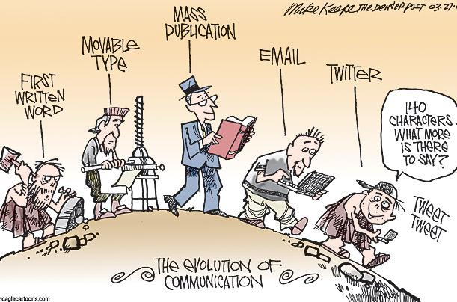
The Evolution of Communication

Slide 6
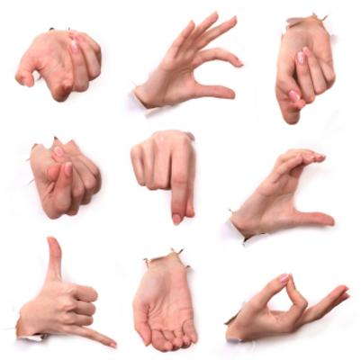

Earliest Communication

Slide 7
Speech
Sets Humans apart from animals
Estimated 1.5million-200,000 years ago
Mutation of the FOXP2 gene
Facilitated transfer of knowledge through generations
Forms the basis of written languages.

Slide 8
Progress towards Writing
Symbols
Allow message longevity but represent speech acts
Cave Paintings
Oldest date from around 30,000 BC
Petroglyphs
Around 10,000 BC carving developed to make incisions
into rock surface
Pictograms
While Petroglyphs show a single scene, Pictograms
narate a story
Ideogram
Ideograms represent concepts such as emotions

Slide 9
Writing
Around 2-3,000 BC the Sumerians developed the first writing system.
Evolved from Pictograms
Developed into Cuneiform
Around 1,000 characters -> 400 characters (Hittite
Cuneiform)
Symbols pressed into clay
Egyptian Hieroglyphs were derived from Sumerian writing.
"It is a complex system, writing figurative, symbolic, and phonetic all at once, in the same text, the same phrase, I would almost say in the same word." (Champollion)

Slide 10
Developing an Alphabet
Egyptian Hieroglyphics were logosyllabic, i.e. symbols stand for;
Words
Sounds
or to place a word in a category
The Phonetic components of Hieroglyphs were crucial to developing an alphabet.
The Egyptians developed a set of 22-24 Hieroglyphs which were used to record foreign names etc.

Slide 11
Proto-Sinaitic
Also known as Proto-Canaanite
Around 2,000-1,700 BC
Migrant workers translated Egyptian Hieroglyphs into the Canaanite language
E.g. The Egyptian "Pr" (or Per), meant house
(or Floorplan). This became "bayt", which
was Canaanite for house.
Acrophony is when a letters name begins with the letter itself.
Bayt ---> "Bet" ---> "Beta" ---> "B"

Slide 12
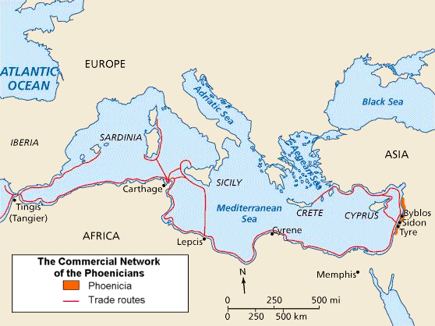
Spreading the Word

Slide 13
The Greeks
Vowels were a hindrance when writing in Pheonician, (as well as Egyptian / Hebrew).
But in Greek they were essential, and afforded equal status as consonants.
Together with the "Latins" (Romans) the alphabet evolved into this!
Other tribes evolved their alphabets differently, but most stem from the Proto-Sinaitic.

Slide 14
Communication Technology?
What technology have we discussed so far?

Slide 15
The Printing Press
105AD - Chinese invent paper
The Chinese also developed wood-block printing, and books with hard covers and movable type (circa. 1041).
However, Chinese has thousands of characters, so traditional block printing was still preferred.
~1440 - Gutenburg 'invented' the printing press
Ability to mass print books.
Whereas before it could take a monk 20 years to transcribe the bible
Gutenburg combined a variety of mechanical technologies
to perfect his invention.

Slide 16
The Printing Press
Gutenburg was named #1 person of the millennium by A&E Network & Time Life.
Ahead of;
Christopher Columbus Freud
Galileo Galilei Einstein
Shakespeare Lincoln
Newton Darwin
Da Vinci Beethoven
Why did this technology invention have such a great impact?

Slide 17
Telecommunication
Transmission of signals over a distance, for the purpose of communication.
Visual, Audio (and later electronic)
Fires
Beacons
Smoke Signals
Drums
Horns

Slide 18
Telecommunication
The Problem:
How do we use fires / beacons / smoke signals to send a message;
Consider the fire beacons in Lord of the Rings.
N0 FIRE = No Problem
FIRE = Problem!
The Solution:
Semaphore

Slide 19
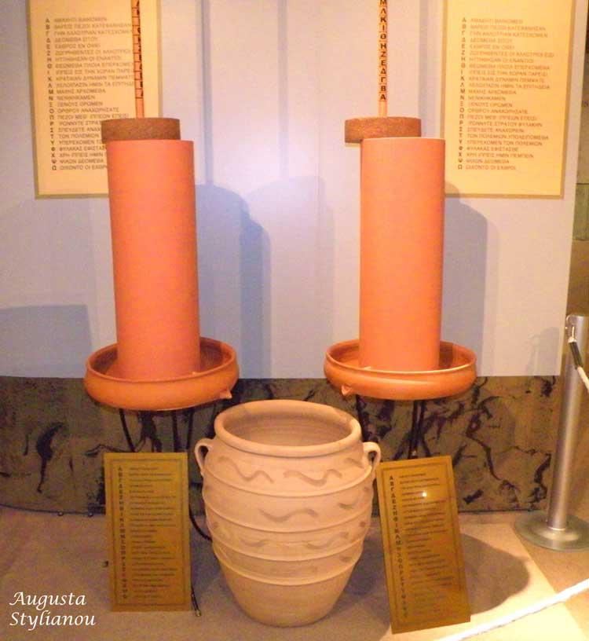
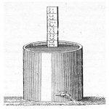
Hydraulic Telegraph
Circa 400BC

Slide 20
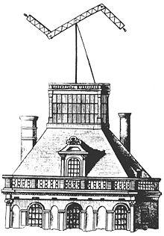
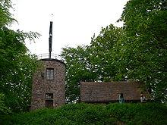
Semaphore
France 1792.
2*2m long arms with 7 positions
1*cross bar with 4 angles
7*7*4 = 196
196 different symbols
556 stations following line of sight
Total distance 4,800km
Paris to Lille = 15 stations / ~32 mins

Slide 21
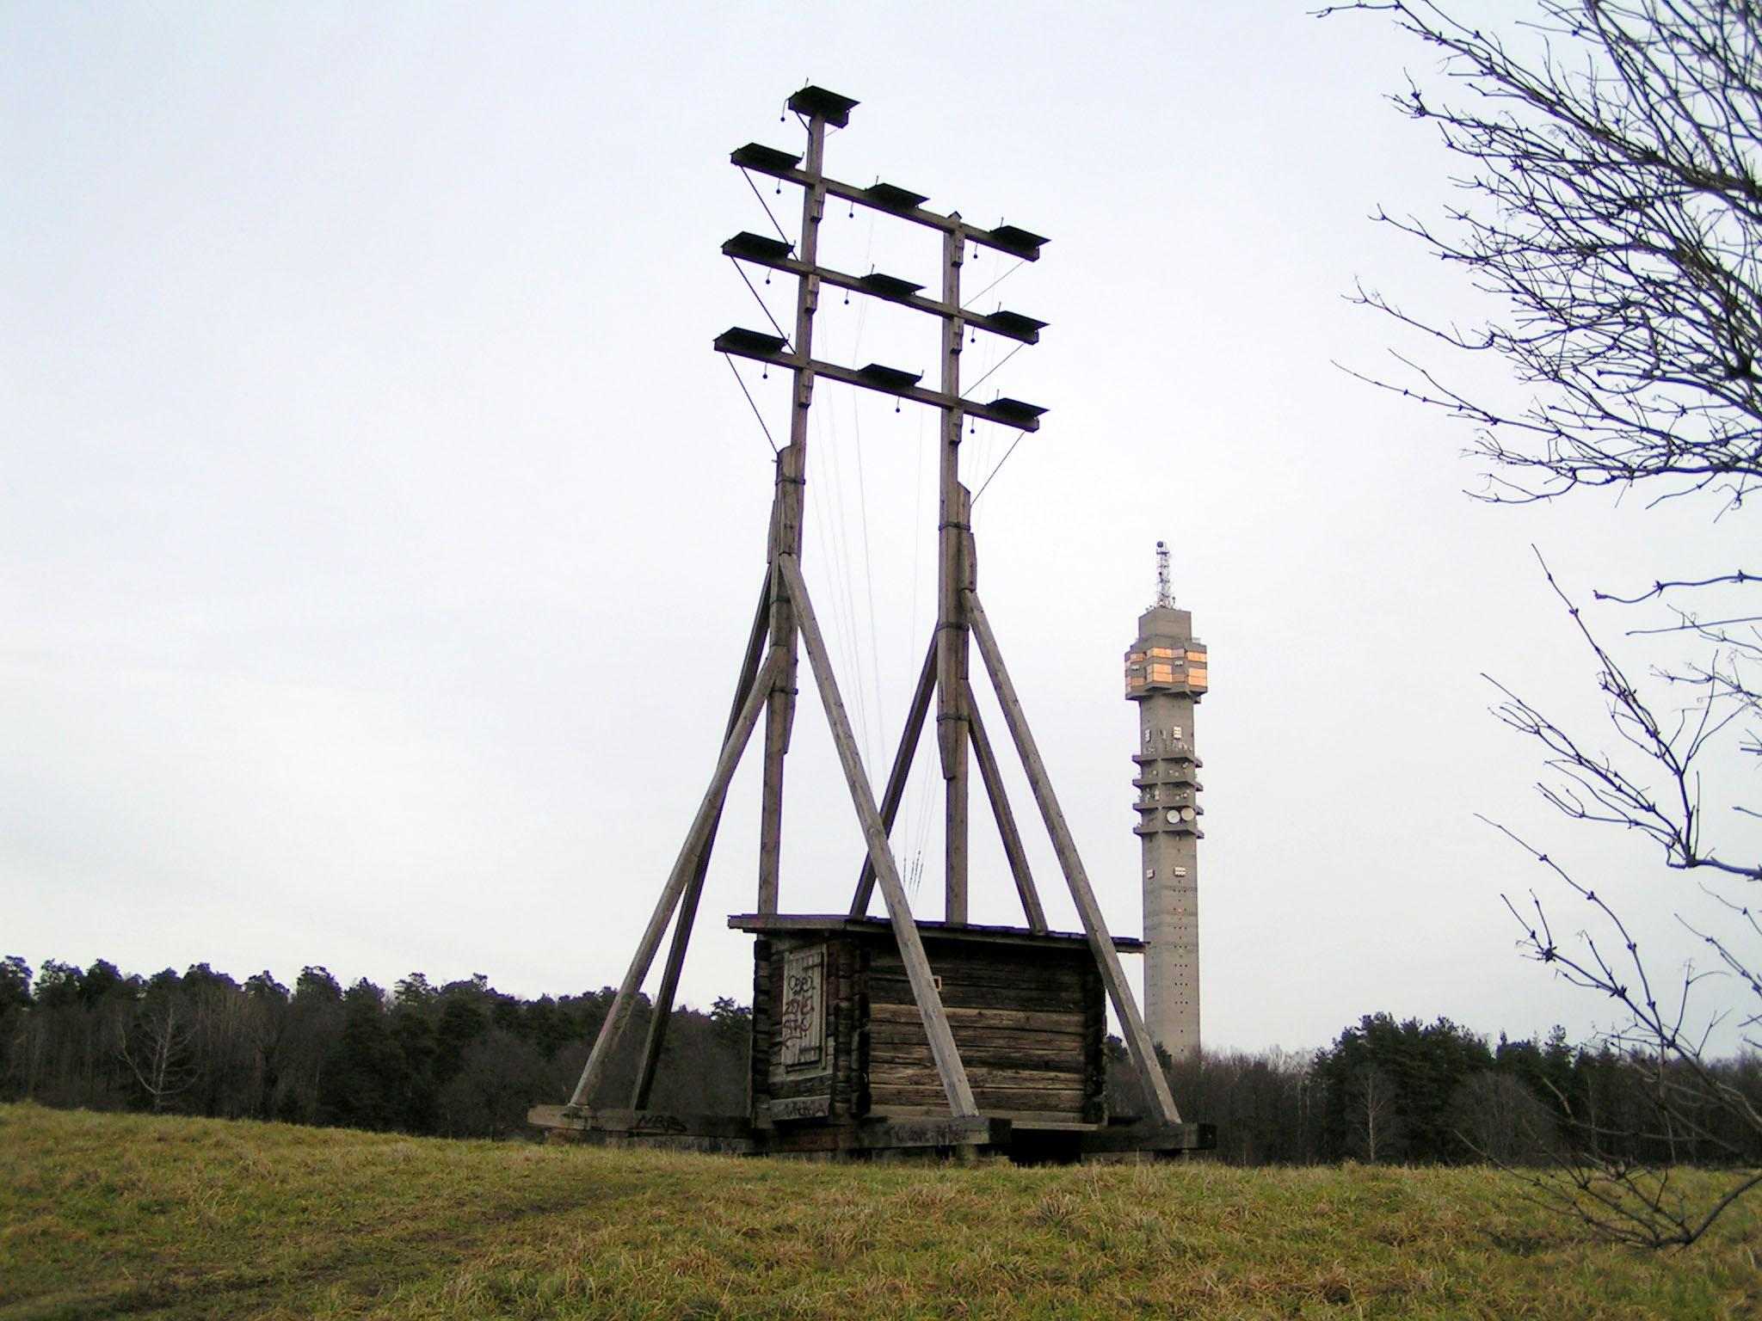
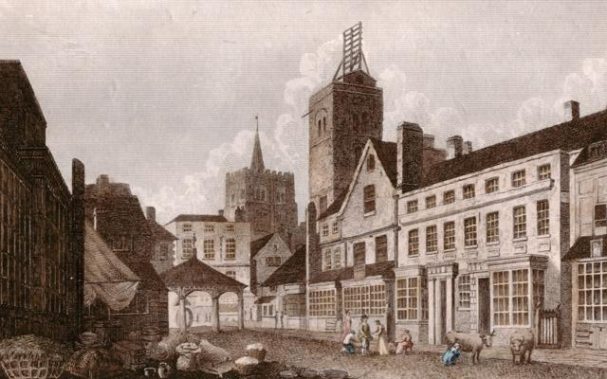
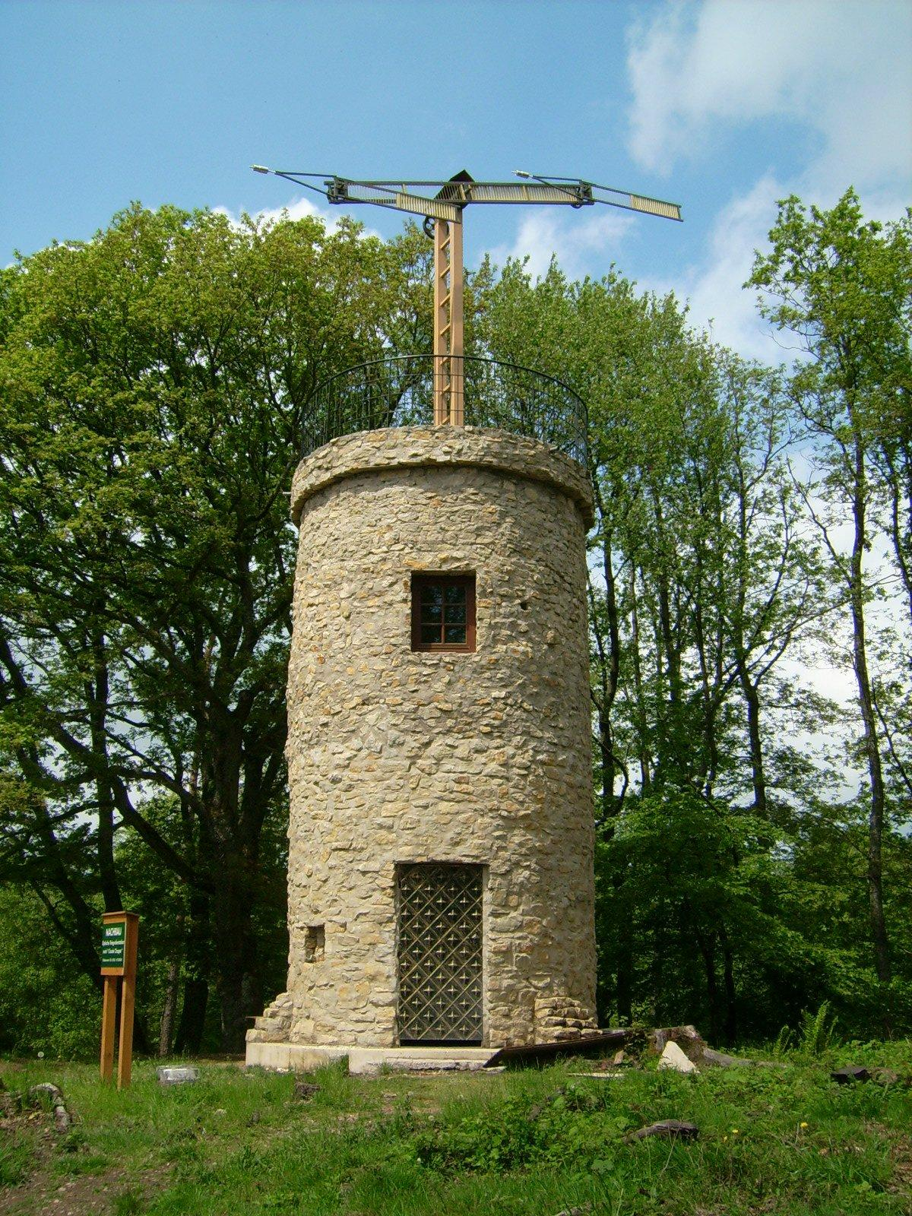
Semaphore
Sweden -->
UK
Germany -->

Slide 22
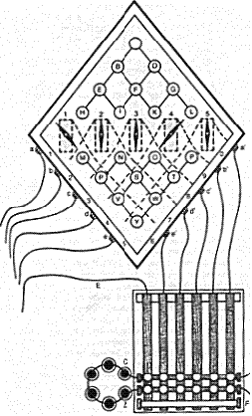
Electrical Telegraph
The presence and flow of charge
Electrons & Protons
Very Fast
Early versions used a grid like this->
Later Morse invented his code.
This pre-dates Optical Semaphore

Slide 23
Electrical Telegraph
Requires 'wires', which is a problem particularly at wartime.
Maxwell: "We have strong reason to conclude that light itself is an electromagnetic disturbance in the form of waves propagated through the electromagnetic field."
Marconi demonstrated that communication is possible wirelessly

Slide 24
Telephone, Television...
1876: Bell demonstrated the telephone
Now the wires can talk.
Combine this with Marconi, and the airwaves start to sing - we have radio.
Add some pictures & we have a TV.

Slide 25
Telecommunication Systems
Comprised of Hardware and Software arranged to transmit data from one location to another.
  Establish interface between sender and receiver
  Routes messages (packets) along most efficient paths
  Basic information processing to make sure the right message gets to the right receiver
  Basic editorial tasks, rearranging format, checking for transmission errors
  Converts message speeds (from slower cable to speed of computer).
  Controls flow of information through a network.

Slide 26
Packet Transfer
To improve the efficiency of a network, data streams are broken into packets.
Packets are smaller bundles of data.
Packets are different sizes dependent on the protocol or standard being used – the X.25 packet switching standard uses packets sized 128bytes.

Slide 27
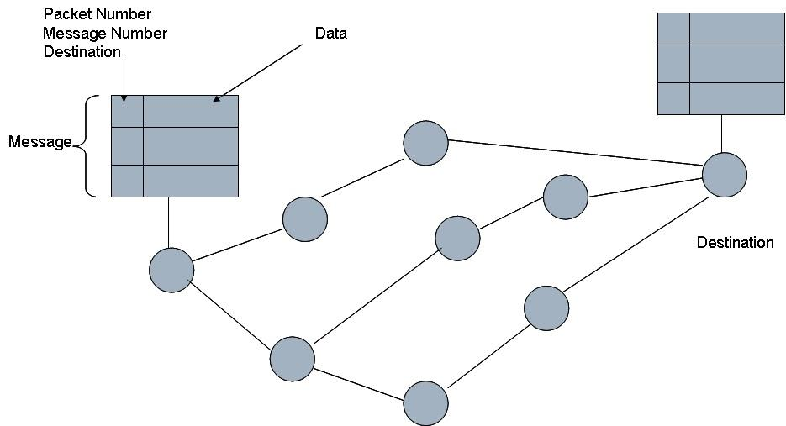
Packet Switching

Slide 28
Protocols
With telecommunications systems using a wide variety of diverse devices, a common set of rules are needed to enable them to ‘talk’ to each other.
The set of rules is called a Protocol.
  TCP/IP
  FTP
  WAP
  HTTP
Each device identifies the receivers protocol so they can send data in the right way, and to check it arrived without problem.

Slide 29
Layered Protocols
TCP/IP consists of many protocols, which are divided into layers;
Application Layer
Includes things like Bittorrent, DNS...
Transport Layer
Primarily tasked with forming data packets, adding
header information etc.
Internet Layer
Includes IP, functions such as addressing / routing
Link Layer
Deals with actual data exchange, error checking, Bit
Rate etc.

Slide 30
Internet Protocol
Every PC / Printer etc. has a unique IP address.
  IP addresses represent a 32 bit word
But, this is translated to ‘decimal-dot’ notation to make life easier! – More like a phone number.
  172.17.28.143
  Each number is between 0 and 255 (i.e. an 8 bit number in binary)
Totally 256*256*256*256 different IP addresses = 4.3 Billion!
Is that enough?
Do we still need to remember the 4 numbers?

Slide 31
Internet Protocol
There aren’t enough unique addresses!
  Various clever ways have been developed to get around this…
    Static vs Dynamic IP
    NAT – hiding many IP addresses behind one
    IPv6 – The latest version of IP
I can’t remember my IP address!
  The DNS means we don’t need to…
    Domain Name Server / Service (DNS)
    A further translation of the IP address into Natural Language
      BELTA or KCOSH or Kitchen PC or www.bbc.co.uk

Slide 32
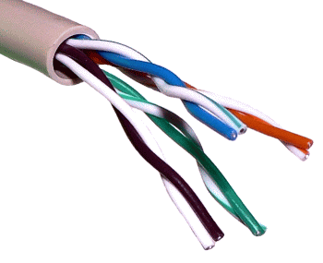
Twisted Pair Wire
+ Thin & Flexible cable
+ Cheaper than other cables

Slide 33
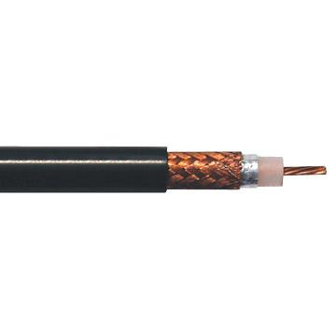
Coaxial Cable
Commonly used for Video links
Semi conductor surrounds copper wire to protect signal strength

Slide 34
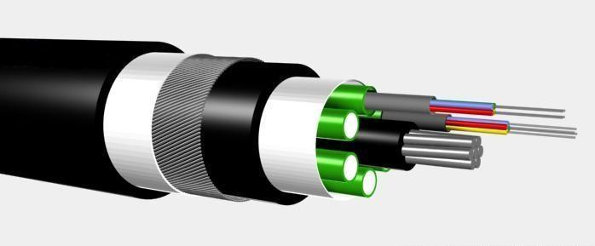
Fibre Optics
Uses medium of light
Very fast
Flexible, but comparatively expensive

Slide 35
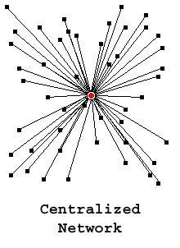
Network Topology 1
Centralised Network
  Close control
  Inefficient
  Single point of failure
  Limited by central node capacity

Slide 36
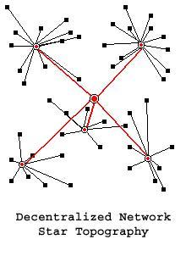
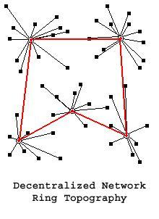
Network Topology 2
Decentralised Network
  Greater Admin Burden
  Weakened Control
  Greater Efficiency
  Robust

Slide 37
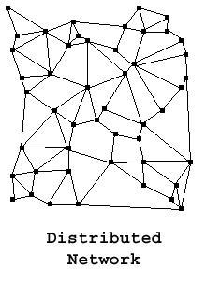
Network Topology 3
Distributed Network (P2P)
  Shortest Route Efficiency
  Multiple Route Efficiency
  Infinitely Scalable
  Robust
  Congestion
    Backbone capacity
  Admin Difficulties
    Standards and Policies

Slide 38
Increasing Network Bandwidth
Reliance on the backbone – the red lines.
Focus on Improving the speed, capacity and quality of network backbone
  For example;
    Trans Atlantic, connecting Europe with US.

Slide 39
Wireless Connection?
Still a need for Fibre optics
  Wireless connection connects to another machine which is part of the network.
  WIFI, Bluetooth
    Use Radio transmission to connect to an antennae – like a walkie talkie!
    The antennae connects through a router to the network
  IrDA
    Uses infra red to transmit between equipment
  The receiver then connects to the rest of the internet.

Slide 40
Routing
Router
  Chooses the best route through the network for each data stream to take.
  Different packets can take different routes.
We can use Tracert to find out which route we are taking

Slide 41
Caching
Caching developed to speed information transfer.
  If I want to download the football scores from BBC website.
  Maybe so does my friend John etc.
  Rather than us all connecting to BBC, via US, once I’ve downloaded the information, we can share it.
  It is stored in a cache

Slide 42
The Future?
oFaster cables
oMore connections
oMore interfaces / devices
oCheaper connections
oBetter reliability

