Slide 1
269202 Algorithms for iSNE
Dr. Kenneth Cosh
Week 3

Slide 2
Last Week
Arrays
Linked Lists
Sparse Tables

Slide 3
Linked List vs Array
Benefits of Linked Lists
Dynamic Size
No need for an upper limit, or setting an impractical upper limit
Ease of Insertion / Deletion
Flexible to add and remove elements anywhere within the LL
Drawbacks of Linked Lists
Random Access
Arrays conveniently access any location – LLs need to traverse through each element
Memory
Extra memory is required to store the pointer(s)
Cache Locality
LL nodes are not necessarily stored close to each other

Slide 4
Library Case Study
A library contains books
Each book has an author
Each author may have written several books
Each book could be checked out by a patron
Each patron may check out several books
How can we store the data for who has which book?
How can we search the catalog to find a particular book?

Slide 5
Library Case Study
We could use a huge multidimensional array
Books in one dimension
(sorted by author?)
Patrons in another dimension
When a book is checked out we could mark the cell indicating which patron had taken which book!
Clearly with a lot of books, and a lot of patrons, the array would be huge!
 | Book1 | Book2 | Book3 | Book4
Patron1
Patron 2 |  | X
Patron 3
Patron 4 | X

Slide 6
Library case Study
We could have a list of all the authors
A large list like this would be slow to search, so an array of 26 pointers could be created pointing to lists of authors whose name begins with each letter.
Each author can then have a pointer to a list of books they have written
We could then have a list of patrons
Again a large list like this can be searched more quickly using an array of alphabet pointers.
Each patron then has a pointer to a list of books they have checked out
Books can also contain a pointer indicating which patron has checked it out, (or NULL)

Slide 7
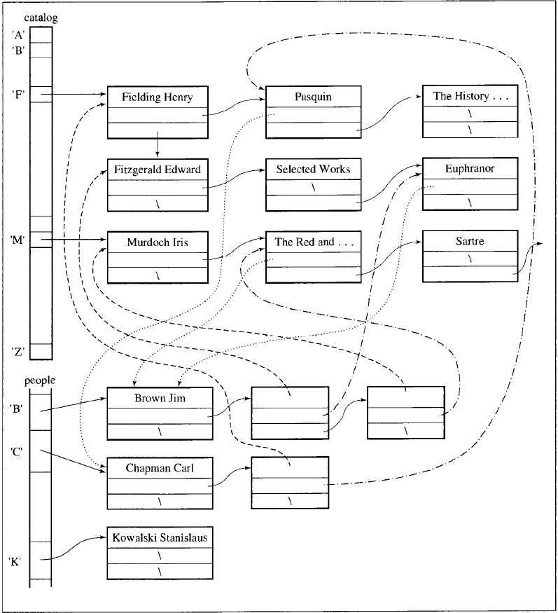
Library Case Study

Slide 8
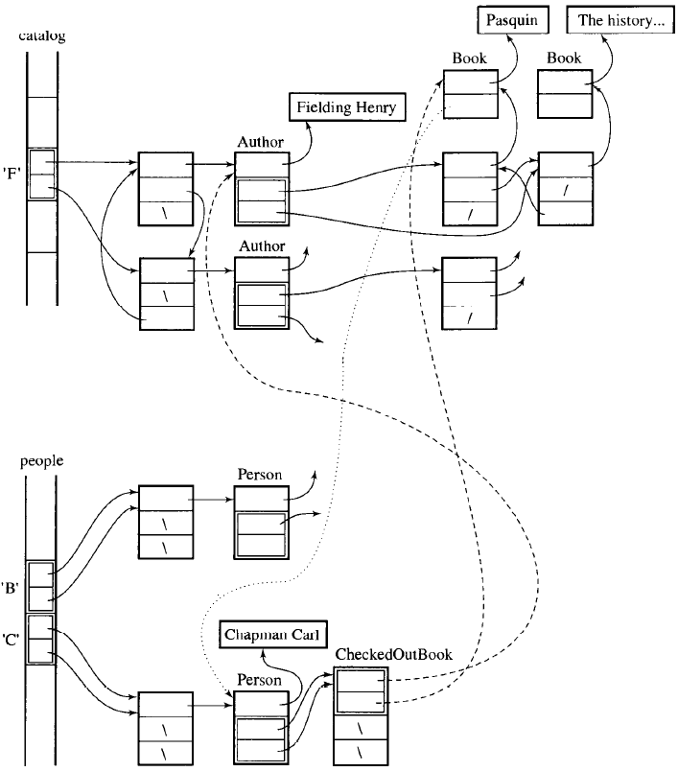
Library Case Study

Slide 9
This Week
Stacks
Queues
Priority Queues

Slide 10
Stacks
Stacks are linear data structures, that can only be accessed at one end for storing and retrieving data.
New data is added to the top of a stack, and data is also retrieved from the top of the stack.
Similar to a stack of trays in a canteen.
It is a LIFO structure (Last In First Out).

Slide 11
Stacks
Key operations;
Clear() – clears the stack
isEmpty() – Tests if the stack is empty
Push(el) – adds ‘el’ to the top of the stack
Pop() – Retrieves the top element off the stack
topEl() – Returns the top element without removing it.

Slide 12
Stack Use
Consider the problem of matching delimiters in a program;
Delimiters : [, ], {, }, (, ), /*, */
Problem; to test the delimiters have been correctly matched;
A) while(m<(n[8] + o)) {p=7; /*initialise p*/ r=6;}
B) a = b + ( c – d ) * ( e - f ))
Case A should return a success, while case B should return an error.

Slide 13
Stack Case
A) while(m<(n[8] + o)) {p=7; /*initialise p*/ r=6;}
Add to stack ( - (
Add to stack ( - ( (
Add to stack [ - ( ( [
Remove from stack [ - ( (
Remove from stack ( - (
Remove from stack ( -
Add to stack { - {
Add to stack /* - { /*
Remove from stack /* - {
Remove from stack { -

Slide 14
Implementing a Stack
Option 1) A Vector
Option 2) A Linked List
Which is better?

Slide 15
Implementing as a Vector
#ifndef STACK
#define STACK
#include <vector>
template<class T, int capacity = 30>
class Stack{
public: Stack() { pool.reserve(capacity); }
void clear() { pool.clear(); }
bool isEmpty() const { return pool.empty(); } T& topEl() { return pool.back(); }
T pop() {
T el = pool.back(); pool.pop_back(); return el; }
void push(const T& el) { pool.push_back(el); }
private:
vector<T> pool; };
#endif //STACK

Slide 16
Implementing as a Linked List
#ifndef LL_STACK
#define LL_STACK
#include <list>
template<class T>
class LLStack {
public:
LLStack() { }
void clear() { lst.clear(); }
bool isEmpty() const { return lst.empty(); }
T& topEl() {return lst.back(); }
T pop() {
T el = lst.back();
lst.pop_back();
return el; }
void push(const T& el) { lst.push_back(el); }
private:
list<T> lst;
};
#endif // LL_STACK

Slide 17
Comparison
The linked list matches the stack more closely – there are no redundant ‘capacity’.
In the vector implementation the capacity can be larger than the size.
Neither implementation forces the program to commit to the size of the stack, although it can be predicted in the vector implementation.
Pushing and Popping for both implementations is in constant time; O(1).
Pushing in the vector implementation when the capacity is full requires allocating new memory and copying the stack to the new vector; O(n).

Slide 18
STL - Stack
Stack exists in the STL, with the following key member functions;
bool empty() const – returns true if stack is empty.
void pop() – removes the top element
void push(const T& el) – insets el to the top of the stack
size_type size() const – returns the size of the stack
stack() – constructor for empty stack
T& top() – returns top element from stack

Slide 19
Queues
Queues are also linear data structures, however it is a waiting line, where both ends are used.
Data is added to one end of the line, and retrieved from the other.
Similar to a Queue in a bank etc.
It is a FIFO structure (First In First Out).

Slide 20
Queue
Key Operations;
Clear() – Clear the queue
isEmpty() – Check if the queue is empty
Enqueue(el) – Add ‘el’ to end of queue
Dequeue() – Take first element from queue
firstEl() – Return first element without removing it.

Slide 21
Queue Use
Simulating any queue;
To determine how many staff are needed in a bank to maintain a good level of service,
Or, how many kiosks to open at the motorway toll.

Slide 22
Option 1 - Array
The obvious problem with using an array is that as you remove elements from the front of the queue, space then becomes wasted at the front of the array.
This can be avoided using a ‘circular array’, which reuses the first part of the array.
?
5 6 7
5
6
7

Slide 23
Circular Array
As elements at the front of the array are removed those cells become available when the array reaches the end.
In reality a circular array is simply a one dimensional array, where the enqueue() and dequeue() functions have the extra overhead of;
Checking if they are adding / removing the element in the last cell of the array.
Checking they aren’t overwriting the first element.
Therefore the circular array is purely a way of visualising the approach.
The code on the next slides demonstrates some of the functions you might need if you chose to implement using an array.

Slide 24
Queue – Circular Array
#ifndef ARRAY_QUEUE
#define ARRAY_QUEUE
template<class T, int size = 100>
class ArrayQueue {
public:
ArrayQueue() { first = last = -1; }
void enqueue(T);
T dequeue();
bool isFull() { return first == 0 && last == size-1 || first == last -1; }
bool isEmpty() { return first == -1 }
private:
int first, last;
T storage[size];
};

Slide 25
Queue – Circular Array cont.
template<class T, int size>
void ArrayQueue<T,size>::enqueue(T el) {
if (!isFull())
if (last == size-1 || last == -1) {
storage[0] = el;
last = 0;
if (first == -1)
first = 0; }
else storage[++last] = el;
else cout << “Full queue.\n”;
}
template<class T, int size>
T ArrayQueue<T,size>::dequeue() {
T tmp;
tmp = storage[first];
if (first == last)
last = first = -1;
else if (first == size -1)
first = 0;
else first++;
return tmp;
}
#endif //ARRAY_QUEUE

Slide 26
Option 2 – Doubly Linked List
A perhaps better implementation uses a doubly linked list.
Both enqueuing and dequeuing can be performed in constant time O(1).
If a singly linked list was chosen then O(n) operations are needed to find the ‘other’ end of the list either for enqueuing or dequeuing.

Slide 27
Doubly Linked List
#ifndef DLL_QUEUE
#define DLL_QUEUE
#include <list>
template<class T>
class Queue {
public:
Queue() { }
void clear() { lst.clear(); }
bool isEmpty() const { return lst.empty(); }
T& front() { return lst.front(); }
T dequeue() { T el = lst.front();
lst.pop_front();
return el; }
void enqueue(const T& el) { lst.push_back(el); }
private:
list<T> lst;
};
#endif // DLL_QUEUE

Slide 28
STL - Queue
Queue exists in the STL, with the following key member functions;
T& back() – returns last element
bool empty() const – returns true if queue empty
T& front() – returns first element in queue
void pop() – remove first element in queue
void push(const T& el) – insert el at back of queue
queue() – constructor for empty queue
size_type size() const – returns size of queue

Slide 29
Priority Queues
Queuing is rarely that simple!
What happens when a police car approaches a toll point? Or a disabled person visits a bank? Or in fact many of the queuing situations in Thailand?
A standard queue model won’t effectively model the queuing experience.
In priority queues elements are dequeued according to their priority and their current queue position.

Slide 30
Priority Queues - Linked List Implementation
We can use a linked list to model the new queue, by simply making a simple variation. There are 2 options;
When adding a new element to the list, search through the list to place it in the appropriate position – O(n) for enqueue().
When removing an element, search through the list to find the highest priority element – O(n) for dequeue().

Slide 31
Priority Queues – 2 List Variations
An alternative would be to use 2 lists.
Unordered low priority list
Ordered high priority list
In this case, perhaps not all elements need to be sorted
The efficiency depends on size of the lists, but is in the region of O(√n)

Slide 32
Priority Queues
A better way of implementing a priority queue is using a heap
Remember Heaps?

Slide 33
Huffman’s Heap
Remember this?

Slide 34
Heaps
A kind of Binary Tree
The value of each node is greater than or equal to the values stored in each of its children
The tree is perfectly balanced, and the leaves in the last level are all in the leftmost positions

Slide 35
Priority Queue – Heap Implementation
Each node represents an element in the queue
The value represents the priority of each node
The root node is the highest priority
9
6
7
5
3
2
4

Slide 36
Priority Queue – Heap Implementation
Enqueue
Elements are added at the bottom of the heap (as leaf nodes)
They are then moved towards the root,
Swapping with their parent if they are higher priority
9
6
7
5
3
2
4
8

Slide 37
Priority Queue – Heap Implementation
Dequeue
Obviously the root node is removed as the highest priority
The heap is then restored by moving the last node (4) to the root
This node then descends towards the leaves
6
7
5
3
2
4

Slide 38
Summary
Topics
Stacks
Queues
Priority Queues
Heap Implementation (More as we study trees!)

