Slide 1
Web Programming Language
Week 9
Introducing Node

Slide 2
Introducing Node.JS
PHP vs Node.js
Setting Up Node.js
Events in Node.js
Node Package Manager (NPM)

Slide 3
Node vs PHP
PHP was created in 1994, so is a well established language for the server
  Powers around 80% of the web (around 75% now)
  Many applications built using PHP
    Wordpress, Drupal, Joomla, WooCommerce, Magento, ZenCart, Laravel, Symfony, CodeIgniter, Zend
However, Node.js (since 2009) has gained popularity, allowing “JavaScript Everywhere”

Slide 4
Standard PHP Request (Blocking)
Send the request to the server file system
Wait for the file system to open and read the file
Return the content to the client
Ready for another request

Slide 5
But, in Node.js (non-blocking)
Send the request to the server file system
Ready to handle another request
When the file system has opened the file, the server sends the content to the client

Slide 6
Setting up Node.js
Download and install Node from:-
https://nodejs.org/en/

Slide 7
Create a new file called hello.js
let http = require('http');
http.createServer(function (req, res) {
res.write('Hello World');
res.end();
}).listen(8080);

Slide 8
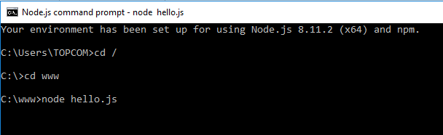
Node.js Command Prompt
Navigate to that file and add the command:-
node hello.js

Slide 9
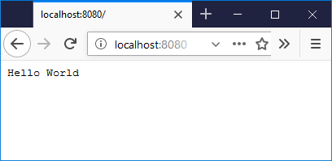
Open Browser
And go to localhost:8080

Slide 10
Hello World
let http = require('http');
http.createServer(function (req, res) {
res.write('Hello World');
res.end();
}).listen(8080);
Includes http module
Creates a server
listening on port 8080

Slide 11
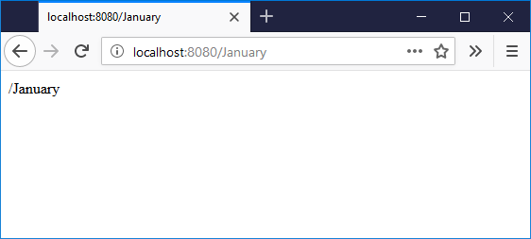
Extending
Request and Response Objects
let http = require('http');
http.createServer(function (req, res) {
res.writeHead(200, {'Content-Type': 'text/html'});
res.write(req.url);
res.end();
}).listen(8080);
Writes the request URL

Slide 12
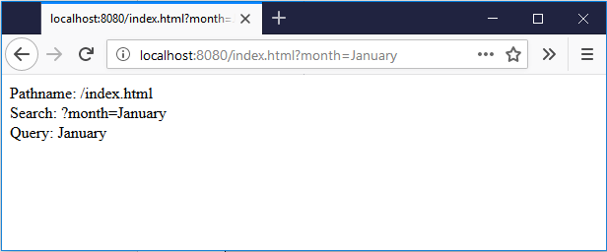
Parsing the URL
let http = require('http’);
let url = require('url');
http.createServer(function (req, res) {
res.writeHead(200, {'Content-Type': 'text/html'});
let myURL = url.parse(req.url, true);
res.write("Pathname: " + myURL.pathname + "<br>");
res.write("Search: " + myURL.search + "<br>");
let myURLData = myURL.query;
res.write("Query: " + myURLData.month);
res.end();
}).listen(8080);

Slide 13

Events in Node.js
let events = require('events’);
let eventEmitter = new events.EventEmitter();
let myEventHandler = function () {
console.log('Do Something');
}
eventEmitter.on('Go', myEventHandler);
eventEmitter.emit('Go');

Slide 14
The Node Package Manager (NPM)
Thousands of contributed modules to extend Node – Free!
  https://www.npmjs.com/
  For example:-
  https://www.npmjs.com/package/num2fraction
  npm install num2fraction

Slide 15
Number to Fraction
let http = require('http’);
let n2f = require('num2fraction');
http.createServer(function (req, res) {
res.writeHead(200, {'Content-Type': 'text/html'});
res.write(n2f(0.5));
res.end();
}).listen(8080);

Slide 16
Express.js
“A fast, unopinionated, minimalist web framework for Node.js”
Express = Framework
JQuery = Library
Node.js = Runtime Environment

Slide 17
Framework?
“Don’t Call Us, We’ll Call You”
  Generic Functionality that can be built on by the developer (rather than a collection of code to be called by the developer.
  Inversion of Control
  Default Behaviour
  Extensible, but not Modifiable

Slide 18
Getting Started
Create new folder (perhaps expressdemo)
Open node command prompt, navigate to the folder and type:
  npm init
Once Node.js creates the package.json file, type:
  npm install express

Slide 19
Getting Started II
Create a new file ‘server.js’
  const express = require('express');
  app = express();
  app.get('/', function(request,response){
  response.send("Hello World!");
  });
  app.listen(3000, function(){console.log("Express server started")});
Initialise this file in the Node.js Terminal
  node server.js
Open your browser to localhost:3000
Notice we require ‘express’ not ‘http’

Slide 20
Basic Routing
Routing is concerned with how the application endpoint handles requests from the client and the server needs to be instructed how to deal with requests correctly
  Here the application handles GET requests
    app.get('/', function(request,response){
    response.send("Hello World!");
    });
  The basic syntax for each method is:-
    app.METHOD(‘path’, callback);

Slide 21
Dealing with parameters
const express = require('express');
app = express();
app.get('/:month/:year', function(request, response){
response.send(request.params);
});
app.listen(3000,function(){console.log('Express server started')});
localhost:3000/8/2024

Slide 22
Dealing with parameters
const express = require('express');
app = express();
app.get('/login', function(request, response){
response.send("Login Page");
});
app.get('/users/ken', function(request, response){
response.send("Ken's Home Page");
});
app.get('/users/matty', function(request, response){
response.send("Matty's Home Page");
});
app.get('/users/danny', function(request, response){
response.send("Danny's Home Page");
});
app.listen(3000,function(){console.log('Express server started')});
Nice in principle, but scalable?

Slide 23
Creating a router - /router/user_router.js
const express = require('express');
router = express.Router();
router.get('/ken', function(request,response){
response.send("Ken's Home Page");
});
router.get('/matty', function(request,response){
response.send("Matty's Home Page");
});
router.get('/danny', function(request,response){
response.send("Danny's Home Page");
});
module.exports = router;
Allows this router to be used in another file

Slide 24
New server.js
const express = require('express');
app = express();
app.use('/users',require('./router/user_router'));
app.get('/login', function(request, response){
response.send("Login Page");
});
app.listen(3000,function(){console.log('Express server started.')});

Slide 25
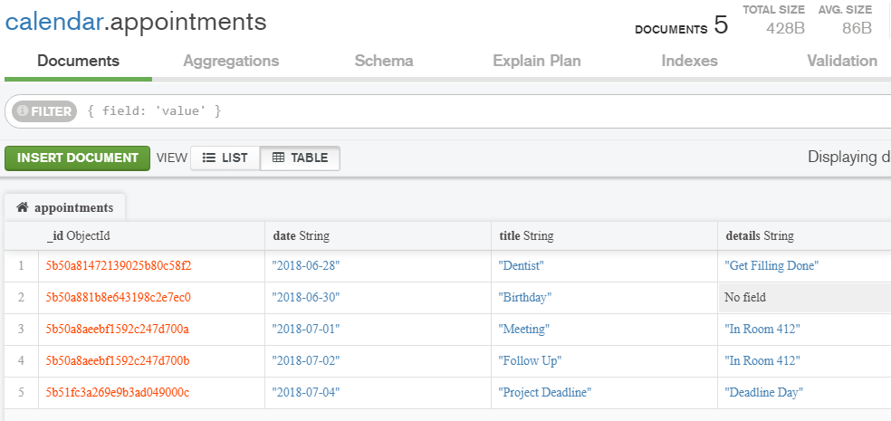
Creating an API
We can create an API to make getting data from a database more convenient.
Suppose we have calendar appointments in a mongoDB collection

Slide 26
Set up our server
To use an appointments router;
  const express = require('express');
  app = express();
  app.use('/appointments',require('./router/appointments_router'));
  app.listen(3000,function(){console.log('Express server started.')});

Slide 27
Initial Appointments Router
Beginning with 3 routes
  const express = require('express');
  api = express.Router();
  api.get('/', function(request, response){
  response.send("All");
  });
  api.get('/:month/:year', function(request, response){
  response.send(request.params);
  });
  api.post('/', function(request, response){
  response.send("Create");
  });
  module.exports=api;

Slide 28
Route 1
Needs to be edited to return all appointments from the database
  api.get('/', function(request, response){
  const MongoClient = require('mongodb').MongoClient;
  MongoClient.connect("mongodb://localhost:27017/calendar", function(err, db) {
  const myDB = db.db('calendar’);
  const collection = myDB.collection('appointments’);
  collection.find().toArray(function(err, items) {
  response.json(items);
  });
  });
  });

Slide 29
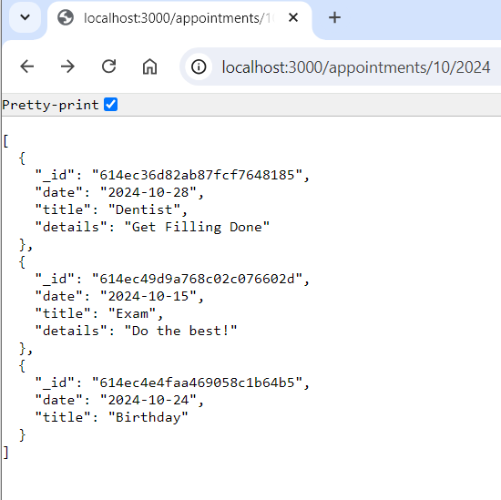
Route 2
Currently returns the request parameters
But this will be replaced with code to return all appointments from 10/2024

Slide 30
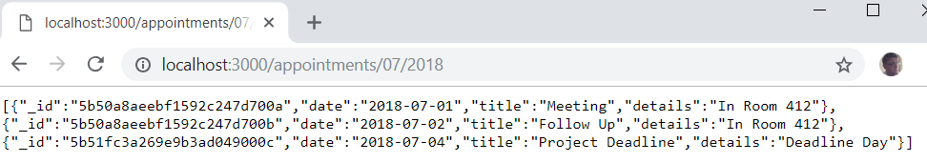
Route 2
api.get('/:month/:year', function(request, response){
const MongoClient = require('mongodb').MongoClient;
MongoClient.connect("mongodb://localhost:27017/calendar", function(err, db) {
const myDB = db.db('calendar’);
const collection = myDB.collection('appointments’);
const re = new RegExp('.*' + request.params.year + '‐' + request.params.month + ".*");
collection.find({date: re}).toArray(function(err, items) {
response.json(items);
});
});
});

Slide 31
Route 3
This route is for creating appointments, so we need a simple form;
  <form action="http://localhost:3000/appointments/" method="post">
  Date: <input type="date" name="date"><br>
  Title: <input type="text" name="title"><br>
  Details: <input type="text" name="details"><br>
  <input type="submit" value="Submit">
  </form>

Slide 32
Route 3
The 3rd route can then be set up to insert into the mongoDB collection;
  api.post('/', function(request, response){
  const MongoClient = require('mongodb').MongoClient;
  MongoClient.connect("mongodb://localhost:27017/calendar", function(err, db) {
  const myDB = db.db('calendar’);
  const collection = myDB.collection('appointments’);
  collection.insert(request.body);
  response.send("Successfully Created");
  });
  });

Slide 33
Summary
Node.js is a popular, modern server-side runtime environment written in JavaScript, which is fast due to its ability to handle requests without blocking.
Node.js can be used to handle Http requests, by creating a server and parsing the requested URL.
Node.js can be set up as a file server to return different files depending on the Http request.
The Node Package Manager (or NPM) is a large collection of modules of code that are publicly available and easily installed using npm.

Slide 34
Summary
Express.js is a minimalist framework for Node.js, which means it makes certain tasks such as routing URLs more straghtforward.
Express.js is unopinionated, allowing the developer choice in how to add modules to extend its functionality such as with body-parser and multer.
Express.js can be used to create a router to handle different Http methods and requests.
An API can be created to better handle access to data resources, such as in a MongoDB database, a full API will make it possible to retrieve, insert, update and delete database entries.

