Slide 1
261446 Information Systems
Week 1
Information Systems in Global Business Today

Slide 2
Week 1 Topics
The Role of IS in Business Today
Perspectives on IS
Contemporary Approaches to IS

Slide 3
Case Studies
#1) PCL Construction
#2) Deutsche Bank

Slide 4
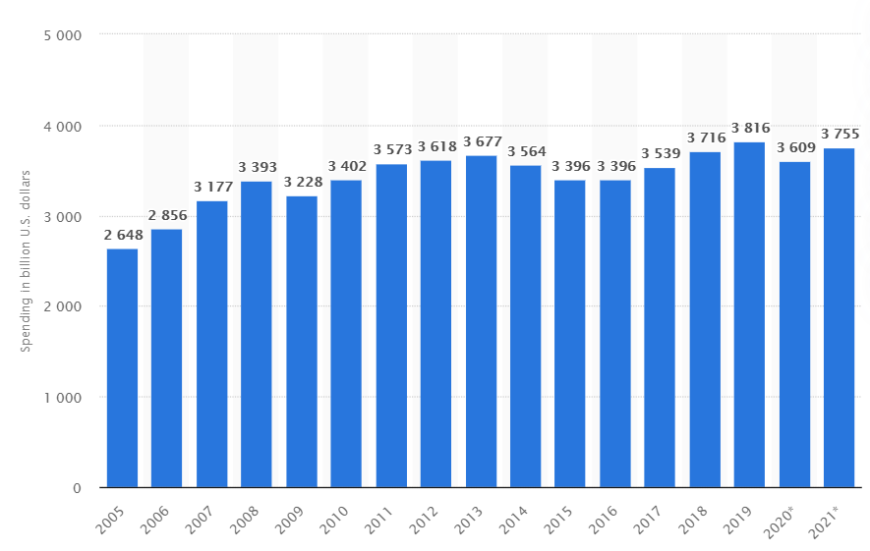
IS stats
“In 2020, IT spending worldwide is expected to reach about 3.61 trillion U.S. dollars, a decline of 5.4 percent due to the negative economic impact caused by the global coronavirus (COVID-19) pandemic.”(Statista)
2019 $4 Trillion spent on IT
  2014 – US business spends $817 billion on
  IS hardware, software & telecoms
In 1999 private business invested 14% of
their invested capital in IT, in 2013 it was 33%.

Slide 5
Gartner Research
“Worldwide IT spending is projected to grow 5.5% from 2021 to 2022, reaching $4.5 trillion, according to Gartner. Enterprise software is pegged to grow 11.5% in 2022, making it the highest growth segment.”
“Worldwide IT spending is projected to total $5.1 trillion in 2024, an increase of 8% from 2023, according to the latest forecast by Gartner, Inc.”

Slide 6
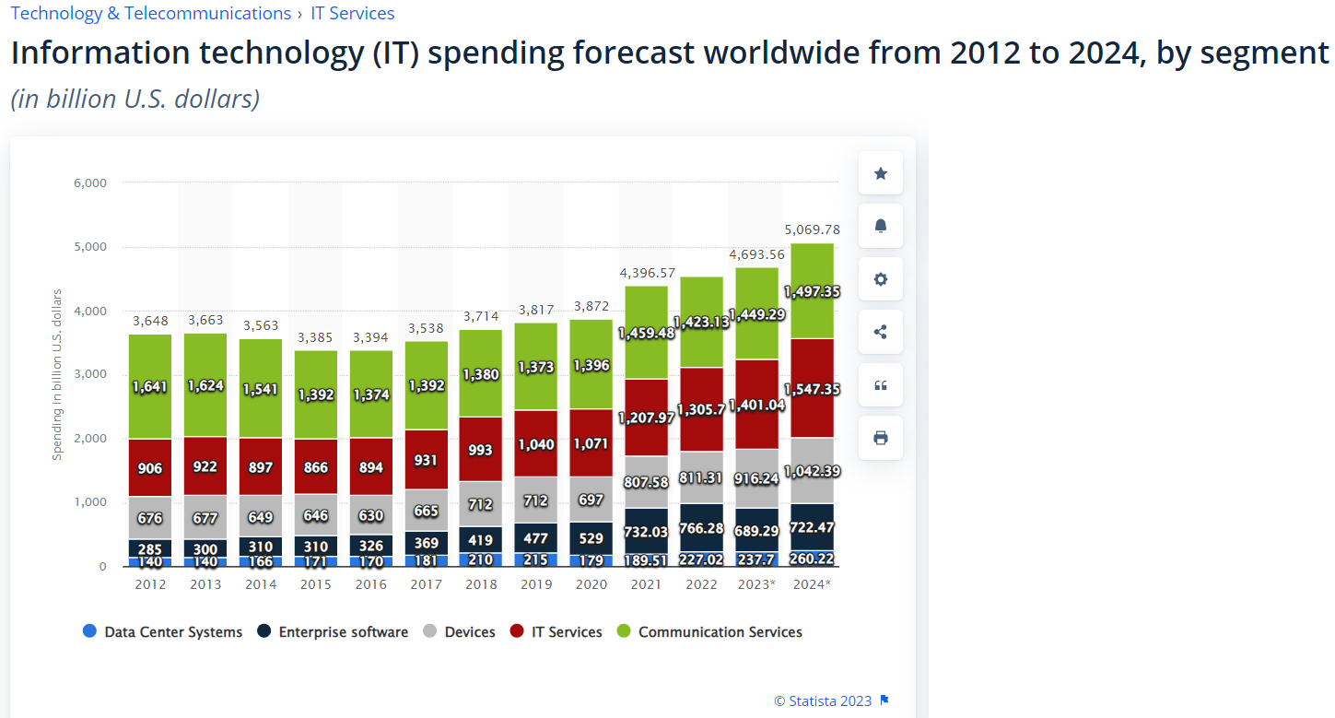

Slide 7
US stats
247 million American have mobile phones (67%)
167 million access the Internet on smart phones.
46% use tablets
172 million Americans use social networks (150 million on facebook)

Slide 8
More stats
June 2014, more than 114 million dotcom businesses
196 million Americans shop online,
  90 million researching products for purchasing online every day.
Businesses are using IS to sense and respond to rapidly changing customer demand, reducing their inventories, and becoming more efficient.
  Supply Chains are fast-paced, relying on Just In Time inventory

Slide 9
Changing Markets
Newspaper readership declines, while online media absorption increases using new forms; Videos, Blogs.
Social Networking increases authorship, with new forms of customer feedback.
Businesses are turning to social networking tools to connect employees, customers, suppliers and managers.

Slide 10
What’s New in IS?
New Technologies
New Management Usage
Changing Organisations

Slide 11
New Technology?
Cloud Computing
Big Data
Mobile Digital Platform
A.I.

Slide 12
Cloud Computing
Flexible collection of computers on the Internet performing tasks that were traditionally performed locally on corporate computers.
More business applications delivered online as Internet Services (SaaS)

Slide 13
Big Data
Businesses are searching for insights from huge volumes of data, such as Web traffic, email messages, social media content.
Technologies being used to sense and capture data, and analyse it.

Slide 14
Mobile Digital Platform
Smart Phones with hundreds of thousands of applications supporting collaboration, location based services as well as communication.
Tablet computers challenging the traditional laptops as the platform for consumer / corporate computing.

Slide 15
A.I.
New wave of intelligent automation

Slide 16
New Management Usage
Online Collaboration
Business Intelligence
Virtual Meetings

Slide 17
Online Collaboration
Social Networks used to improve coordination, collaboration & knowledge sharing
Google Apps, etc. used to support project management, online meetings & communities

Slide 18
Business Intelligence
Data Analytics
Interactive Dashboards
Real-time performance information to enhance manager decision making

Slide 19
Virtual Meetings
Video conferencing reduces travel time & cost, improving collaboration & decision making

Slide 20
Changing Organisations?
Social Business
Teleworking
Co-creation of Business Value

Slide 21
Social Business
Social Networking platforms used to deepen interactions between employees, customers & suppliers
Employees use blogs, wikis, email & messaging to interact within online communities

Slide 22
Teleworking
Internet connectivity, wireless laptops, smartphones & tablets, make it possible to work away from the traditional office
55% of US businesses have some kind of remote work program

Slide 23
Co-creation of Business Value
Source of business value shifts from products to solutions & experiences.
Shift to networks of suppliers & customers
Supply chains become more global & collaborative

Slide 24
Recurring Themes
Collaboration & Community
(Big) Data Analysis -> Decision Support

Slide 25
The Emerging Digital Firm
A firm where nearly all significant business relationships with customers, suppliers and employees are digitally enabled & mediated.
Core business processes (hiring, firing, developing new products, fulfilling orders, creating marketing plan, etc.) accomplished through digital networks spanning entire organisations or connecting organisations
Key corporate assets (IP, core competencies, financial / human assets) managed through digital means.

Slide 26
Digital Firms
Information to support key business decisions, available any time, anywhere.
Sense & Respond to environments, rather than produce and sell.
Flexible & Agile.
Time Shifting & Space Shifting; No longer constrained to the 9-5 work day, or the physical location where business is conducted.

Slide 27
Strategic Information Systems
IS is increasingly taking on a key role in deciding and driving a corporate strategy.
There is a growing interdependence between IS & business capability; changes to strategy requires changes in hardware, software, databases & telecommunications.
What an organization would like to do in 5 years is often constrained by what its systems will allow it to do.

Slide 28
Strategies
Operational Excellence
New Products, Services & Business Models
Customer & Supplier Intimacy
Improved Decision Making
Competitive Advantage
Survival

Slide 29
Operational Excellence
Improving efficiency of operations, leading to higher profitability
Walmart
  World largest retailer, with world class operations.
  Retail Link system – digitally links suppliers to every Walmart store – as soon as a customer purchases an item, the supplier knows to ship a replacement item. (SCM)
  $28 sales per square foot, compared with Target $23 & others <$12

Slide 30
New Products, Services, and Business Models
New digital products & services, as well as the models for how companies produce, deliver & sell a product or service.
Entertainment Industry
  Massively different from decades ago.
  Vinyl records, tapes & CDs -> Istore, Netflix, legal online distribution model.

Slide 31
Customer & Supplier Intimacy
Shift from Transactional Marketing to Relational Marketing.
  The key is to get to know your customers
High end hotels keep track of guests’ preferences; check in time, room temperature, frequently called phone numbers, TV shows, etc. The room then adjusts itself according to the customer’s preferences.

Slide 32
Improved Decision Making
Good information leads to better decisions
Real time information, helps make better on the spot decisions.
E.g. a telecommunications company which has precise, real time information on customer complaints, network performance etc. which can be used to allocate repair resources better.

Slide 33
Competitive Advantage
Doing things better than your competitors
Charging less for better products
Responding to customers in real-time

Slide 34
Survival
Firms have to invest in IS & IT to survive.
  Imagine a bank that doesn’t offer ATM service?
  Some industries are required to maintain digital records (e.g. toxic substances), or public accounting

Slide 35
IT or IS?
Information Technology – all the hardware, software needed to support an organization
Information Systems – A set of interrelated components that collect, process, store and distribute information to support decision making and control in an organisation

Slide 36
Data or Information
Data – Raw facts
Information – Data that is meaningful and useful for humans
A supermarket check out scans millions of pieces of data from barcodes. That data is analysed to provide useful information, such as sales totals, stock levels etc.

Slide 37
Data to Information?
Input – Collecting or capturing data
Processing – Converting data into some meaningful form
Output – Presenting that information to the people who need it
Feedback – Further output to allow people to support, evaluate or correct the system

Slide 38
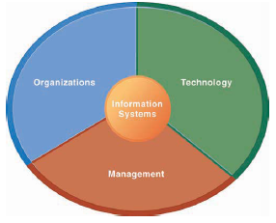
IS – More than Computers
Understanding the Information System, requires understanding the Organisation, the Management & the Technology

Slide 39
Organisations
People
Structure
Business Processes
Politics
Culture

Slide 40
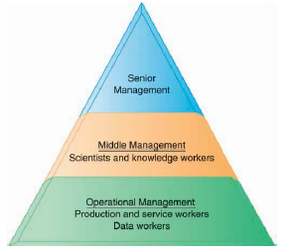
Organisations - Structure
An organization’s structure highlights the divisions of labour, authority, responsibility.
  Senior Management – Long-range strategic decisions
  Middle Management – Implementing the programs and plans
  Operational Management – Day to day monitoring

Slide 41
Business Functions
Specialised tasks
  Sales & Marketing
  Manufacturing / Production
  Finance / Accounting
  Human Resources
Each with formal rules to follow

Slide 42
Culture
Assumptions & Values – the way of doing things, accepted by most of the people.
Perhaps a mantra, or core corporate value
  “Customer Service”
  “Quality”
Everyone might not always agree with the corporate culture, which can lead to politics
And IS is impacted by culture & politics

Slide 43
Management
Make sense of business environment, make decisions, formulate action plans to solve problems
Allocate human & financial resources
Leadership
Create new products, ideas, largely driven by new knowledge & information

Slide 44
IT
Hardware
Software
Data Management
Networking & Telecomms
IT is a platform upon which IS can be built – it is the enabler.

Slide 45
Perspectives on IS
Technical Approach
  Computer Science - Physical technology, Mathematical models of computation, formal proofs of capabilities
Behavioural Approach
  Sociology, Psychology, Economics – Affects of technology on groups, individuals, society etc.
Sociotechnical Approach
  Considering; 1) the technology, 2) the business, 3) the managers / employees, 4) the environment

Slide 46
Review Questions
How are IS transforming business, and what is their relationship to globalization?
Why are IS so essential for business management today?
What is an IS? What are its components?
What academic disciplines are related to studying IS?

