Slide 1
261446 Information Systems
Week 10
E-Commerce: Digital Products, Digital Goods

Slide 2
Week 10 Topics
E-Commerce & The Internet
E-Commerce: Business & Technology

Slide 3
Case Studies
Case Study #1) Youtube
Case Study #2) Nasty ending for Nasty Gal

Slide 4
What is “E”-Commerce?
What does the “E” mean?
E-Business?
E-Learning?
E-Governance?
E-Mail?
E-…

Slide 5
E-Commerce
“Digitally enabled commercial transactions between and among organisations and individuals”
Many of which occur over the Internet and the Web
Commercial transactions?
Exchange of value
Money, products, services…

Slide 6
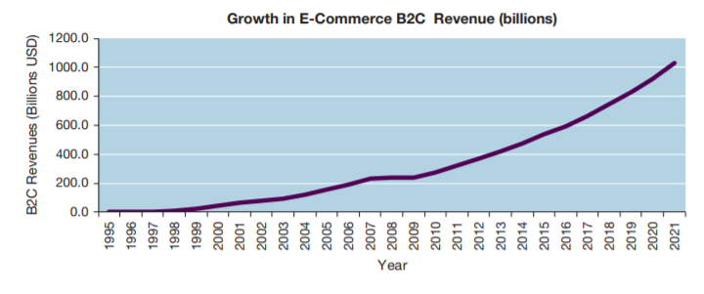
E-Commerce
Massive growth since 1995
1995 – Netscape accepted first ads, creating the idea that the Web would be a new medium for advertising & sales.

Slide 7
E-Commerce
Fastest growing form of Commerce (compared to physical retail stores, services & entertainment)
Social & Mobile commerce fastest growing forms
Wave 1 transformed the books, music & air travel markets; Wave 2 transforms marketing & advertising, telecoms, movies, TV, jewelry, real estate, online travel, bill payments, software.
Online demographic has broadened to match ordinary shoppers
Small businesses and entrepreneurs are flooding the marketplace, using the infrastructure of E-commerce giants, such as Amazon / Google.
Mobile take advantage of location-based services

Slide 8
E-Commerce
Wireless / Ubiquitous devices & connections take off
Broadband becomes standard
Social Networking offer new platform for e-commerce
New Internet models of computing emerge
Apps, Cloud computing, SaaS, Web 2.0

Slide 9
Why is E-Commerce Different?
Unique Nature of environment
Ubiquity
Global Reach
Universal Standards
Richness
Interactivity
Information Density
Personalisation / Customisation
Social Technology

Slide 10
Ubiquity
Technology available everywhere
Home, Work, using desktop and mobile devices.
The marketplace is extended beyond traditional boundaries, removed from temporal or geographic location.
Marketplace is anytime, anywhere
Customer convenience is enhanced, shopping costs reduced.

Slide 11
Global Reach
Technology breaches national boundaries
Across cultural and national boundaries, seamlessly and without modification
Potentially billions of consumers and millions of businesses

Slide 12
Universal Standards
One set of technology standards
IP
Disparate computer systems can easily communicate with each other

Slide 13
Richness
Video, audio, text messages
New media is easily integrated into a single marketing message & consumer experience

Slide 14
Interactivity
Technology works by interacting with the user
Customers are engaged in a dialog, dynamically adjusting experiences to the individual.
The consumer is a co-participant in the process

Slide 15
Information Density
Information costs are reduced, while quality raised
Information processing, storage and communication costs have dramatically dropped.
Currency, accuracy and timeliness improve.
Information is plentiful, cheap and more accurate

Slide 16
Personalisation / Customisation
Personalised messages can be delivered to individuals and groups
Advertising messages based on an individual’s characteristics

Slide 17
Social Technology
Content Generation and Social Networking
User generated content, alongside distribution.

Slide 18
E-Commerce
The Internet reduces Information Asymmetry
Where one party in a transaction has more information, relevant to the transaction, than another party.
This information influences relative bargaining power
How much do you know about how much products really cost?

Slide 19
E-Commerce
Digital Markets afford Dynamic Pricing
The price of a product can vary depending on demand characteristics, or the supply situation
Online retailers like Amazon can change prices based on time of the day, demand for the product, supply, the user’s prior visits to the site.

Slide 20
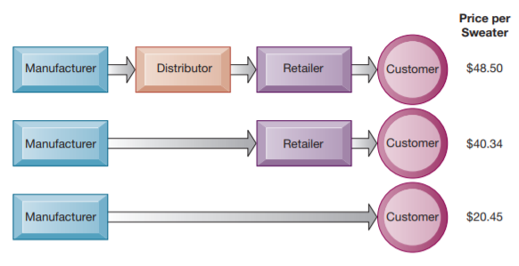
Disintermediation
Digital Markets afford suppliers to directly connect with their end-users.
This may eliminate an intermediary

Slide 21
Digital Goods?
Marginal Costs of producing another unit is about zero
It costs nothing to copy a music file
Cost of producing 1st unit is relatively high
nearly the total cost of the product, as inventory & distribution is negligible
Cost of delivery very low
What is the effect?

Slide 22
Types of E-Commerce
B2C
Business to Consumer
Retailing products to individual shoppers
B2B
Business to Business
Sales of goods & services among businesses
C2C
Consumer to Consumer
Enabling consumers to sell goods to other consumers

Slide 23
E-Commerce Business Models
There are various business models operating in E-Commerce
Portals
E-tailers
Content Providers
Transaction Brokers
Market Creators
Service Providers
Community Providers

Slide 24
Portals
Gateways to the web
Gain income through attracting large audiences, advertising, referral fees
Include Horizontal, Vertical & Affinity Portals

Slide 25
E-tailer
Online Retail Stores
From Amazon to small enterprises
Some are “Bricks & Clicks” Retailers
Others are pure virtual organisations

Slide 26
Content Providers
Providers, not necessarily the creators, of content.
Content
Any kind of Intellectual Property
Text, video, music, photos, artwork…

Slide 27
Transaction Brokers
Online transaction brokers take commissions for facilitating online transactions
Such as in the travel or financial services markets
Fees are often less than the traditional versions

Slide 28
Market Creators
Provide a platform, or digital environment, upon which buyers and sellers can meet, interact, display products, search for products, establish prices.
E-Bay, Amazon, Priceline

Slide 29
Service Providers
Hosting service providers
For websites, or for photos on social media for example
SaaS

Slide 30
Community Providers
Platforms that create digital online environments where people can transact; share interests, phots, videos; communicate; receive information; play out fantasies
Essentially social networking sites

Slide 31
E-Commerce Revenue Models
So, how does the firm earn revenues, generate profits and produce returns on investments?
Advertising Revenue Model
Eyeballs!
Sales Revenue Model
Subscription Revenue Model
Freemium Revenue Model
Transaction Fee Revenue Model
Affiliate Revenue Model

