Slide 1
261446 Information Systems
Week 11
Managing Knowledge

Slide 2
Week 11 Topics
The Knowledge Management Landscape
Enterprise-Wide Knowledge Management Systems
Knowledge Work Systems
Intelligent Techniques

Slide 3
Case Studies
Case Study #1) Machine Learning – Akershus University Hospital
Case Study #2) Can Cars Drive Themselves?

Slide 4
Knowledge Management
Useful Knowledge can be communicated and shared
  Knowledge Management is concerned with capturing useful and actionable Knowledge to share throughout an organization

Slide 5
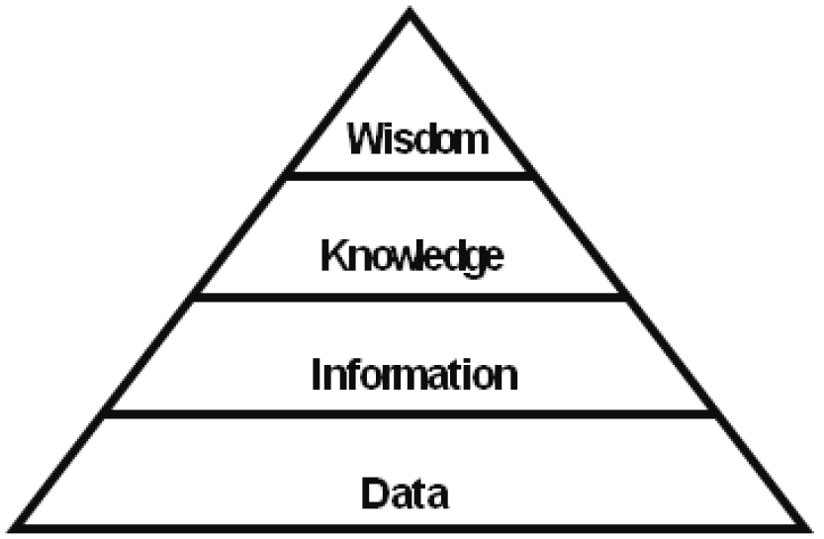
Ackoff’s Pyramid

Slide 6
Knowledge
Tacit & Explicit
  Knowledge is an event that takes place inside people’s heads.
  It’s stored in libraries, records, shared in lectures, emails, graphics, structured and unstructured documents.
Tacit
  Knowledge that resides in the minds of employees
Explicit
  Knowledge that has been documented

Slide 7
Knowledge is an Asset
But a different kind of asset to other firm assets
  It is intangible
  Transforming data into information and then knowledge takes resources
  Knowledge isn’t subject to the law of diminishing returns… - instead, unlike physical assets, network effects can increase it’s value as it is shared

Slide 8
Knowledge is an Asset
Knowledge has different forms
  Tacit or Explicit
  Knowing how, why and when to follow procedures
    Knowing when to apply a procedure is as important as knowing the procedure

Slide 9
Organisational Learning
A process of creating and gathering knowledge
  Data collection
  Measurement of planned activities
  Trial and error
  Feedback from customers
  Feedback from environment

Slide 10
Knowledge Management Value Chain
5 Key Stages
  Data & Information Acquisition
  Acquire
  Store
  Disseminate
  Apply

Slide 12
Knowledge Acquisition
Early KMS involved building repositories of documents, reports, presentations, & best practices.
  Extended to include unstructured knowledge such as E-mails.
Developing networks so “the expert” can easily be found
Finding patterns in corporate data.

Slide 13
Knowledge Storage
Once discovered, documents, patterns & expert rules must be stored
  A database?
How do we digitize and index knowledge documents, and encourage / reward employees for taking the time to update and store documents correctly?
  For example:- The sales force need to submit names and contacts of prospects so all sales personnel can identify each prospect and review stored knowledge

Slide 14
Knowledge Dissemination
Great technological tools for disseminating knowledge;
  Portals, email, messaging, wikis, social networks.

Slide 15
Knowledge Management Systems

Slide 16
Experts & Expert systems
Domain Experts
  People who know about a domain – we are experts in the University domain.
Rule representation
  We represent what we know about a domain in a set of rules that govern the domain;
    If XXX then YYY
  Rules can be Relations, Recommendations, Directives, Strategies or Heuristics.

Slide 17
Creating an Expert System
5 key roles;
  Project Manager
  Domain Expert
  Knowledge Engineer
  Programmer
  End User

Slide 18
Domain Expert
A knowledgeable and skilled person capable of solving problems in the specified domain, having the greatest expertise in that domain. This expertise will be captured by the expert system, so they must be able to communicate their knowledge and participate in expert system development. This is the most important role.

Slide 19
Knowledge Engineer
Someone capable of designing building and testing an expert system. They begin by interviewing the expert to find out how to solve a particular problem. The knowledge engineer is responsible for capturing what reasoning methods are used to handle facts and rules, and then decide how to represent it in the system.

Slide 20
The rest
Programmer
  Responsible for coding the domain knowledge.
Project Manager
  Responsible for keeping the project on track.
End User
  The people who are going to use the system once its complete.

Slide 21
Production Rules
Newell and Simon from CMU, developed the production rule system in the early 70’s.
Basically humans solve problems by applying their knowledge (or production rules) to specific problem information.
Production rules are stored in long term memory, and problem specific information is stored in short term memory.

Slide 22
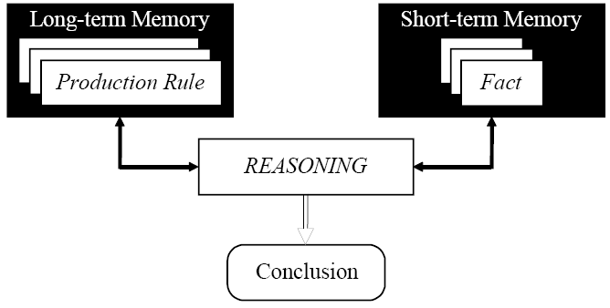
System Model

Slide 23
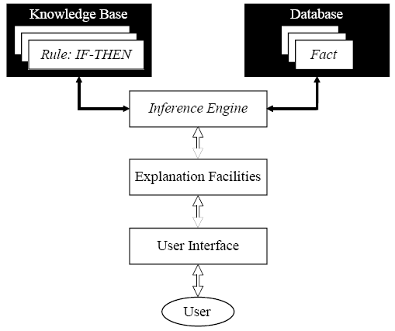
Rule Based Expert System

Slide 24
Expert System
The knowledge base contains the domain knowledge useful for problem solving – represented as rules;
  Relations, Recommendations, Directives, Strategy, Heuristic.
When the conditions of a rule are satisfied then the action part is executed.
The database contains the facts which can be matched against the conditions.

Slide 25
Expert System
The inference engine performs this reasoning, as we shall see, to reach as solution, linking rules to facts.
The explanation facilities crucially explain how the expert system reached its conclusions, to justify its advice.
The user interface is, well a user interface!

Slide 26
Expert System Efficiency
Expert Systems are designed to perform in the same way as an expert, therefore the primary concern is accuracy – it doesn’t matter how fast the system comes up with a wrong answer!
However, in many cases speed of reaching a solution is important – accurate decisions are not that useful if it is too late to apply the decisions.

Slide 27
Can they be wrong?
Of course
  Human Experts are sometimes wrong, and yet we still trust them!
  Likewise, the expert systems solutions may be wrong, but should we trust it?

Slide 28
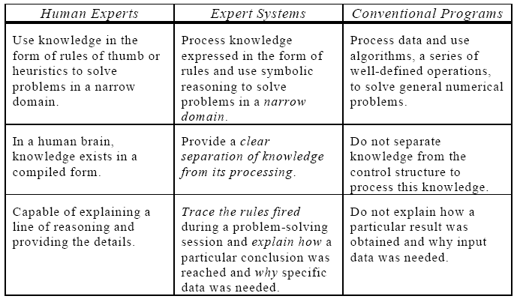
Expert Comparison

Slide 29
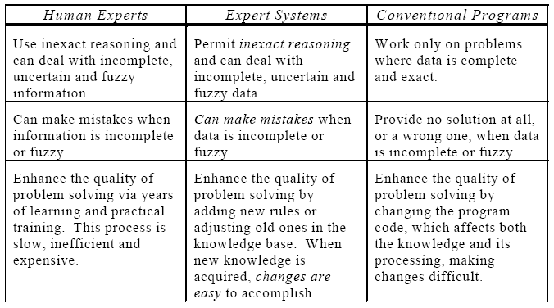
Expert Comparison 2

Slide 30
Chaining
Often the action part of a rule, creates a new fact to add to the database;
  If X is good, then Y is bad.
This would add ‘Y is bad’ to the facts in the database.
This matching can create inference chains, which illustrates how a conclusion is reached.

Slide 31
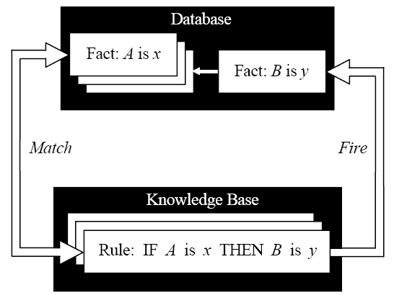
Inference cycles

Slide 32
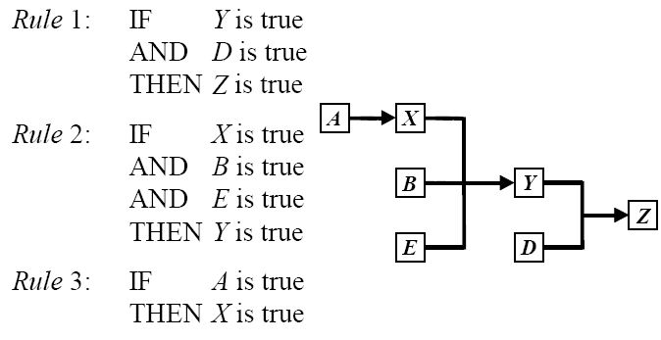
Inference Chain

Slide 33
Forward Chaining
Or, “Data Driven Reasoning”.
This is where we start from known data and proceed forward. When a rule is fired new info is added to the database, until no further rules can be fired.

Slide 34
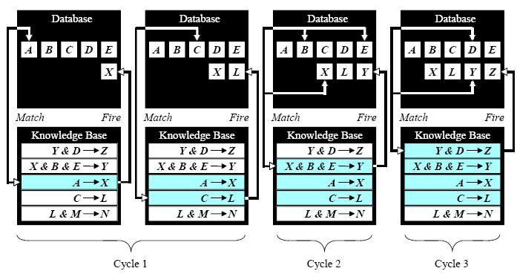
Forward Chaining

Slide 35
Forward Chaining
Technique for gathering information and inferring whatever can be inferred from it.
In forward chaining many rules are executed which may have nothing to do with the goal.
So if the goal is to infer a particular fact, forward chaining is inefficient.

Slide 36
Backward Chaining
Or “Goal Driven Reasoning”
The expert system begins with a goal, and the expert system attempts to find the evidence to prove it.
First the knowledge base is searched to find rules that might have the desired solution (the then part), and then rules that can start those are searched for, with each rule being added to a stack.

Slide 37
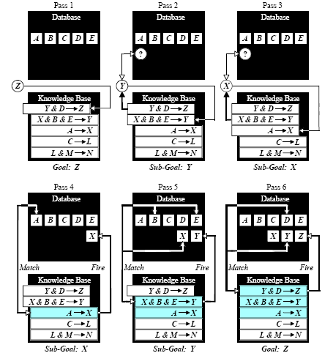
Backward Chaining

Slide 38
Forwards or Backwards?
Which is best?
  Consider if trying to find the murderer on CSI?
  or the disease on House?
  or deciding strategy on Survivor?

Slide 39
Conflict Resolution
What happens when rules contradict each other?
  Highest Priority first?
    Assuming rules can be placed in priority.
  Most Specific Rule?
    The longest matching strategy, a specific rule processes more information than a general one, so one with more antecedents is likely to be more useful.
  Most Recent Rule?
    The rule which has been fired most recently, i.e. whose antecedent uses the most recently added data.

Slide 40
Metaknowledge
Deciding which strategy to use is stored in the metaknowledge – knowledge about knowledge.
And the rule is a metarule.
  Rules supplied by experts have higher priority than those from novices.
  Rules governing the rescue of human life have highest priority.

Slide 41
Expert Systems Advantages
Natural Knowledge Representation
  Everything is stored in easy to read and understand natural language.
Uniform Structure
  The syntax can be used in many different situations.
Knowledge / Processing Separation
  Knowledge is separated from the inference engine, so different systems can be developed from the same knowledge.
Incomplete and uncertain knowledge
  Can easily be dealt with by an expert system.

Slide 42
Expert Systems Disadvantages
Opaque relations between rules.
  It is difficult to see how individual rules affect the whole system.
Ineffective searching
  Searches are exhaustive – looking through all rules everytime, which can make it slow.
Learning
  Expert systems can not learn, they can’t decide when to break the rules, or when to add a rule or modify one, as a human expert could.

Slide 43
Fuzzy Logic
Let’s consider getting a bit fuzzier!
An expert might say;
  “The Power transformer is slightly overloaded, but I can keep this load for a while.”
Experts have no trouble understanding this, but how can an expert system deal with such vagueness?
Such ‘Fuzziness’?

Slide 44
Fuzzy Logic
Fuzzy Logic is NOT Logic that is Fuzzy, but logic used to describe the fuzziness.
Fuzzy Logic is the theory of sets to calibrate vagueness.
Fuzzy Logic is based on the idea that all things have degrees;
  Temperature, Height, Speed, Distance, ‘Chairness’
When does a hill become a mountain?

Slide 45
Tradition
Boolean (conventional) logic enforces sharp distinctions, things are either a member of a set, or a non member.
  Either 0 or 1.
Tom is tall, at 181 cm, while Tim is small at 179cm.
But this is due to an arbitrary line drawn in the sand at 180cm.

Slide 46
Possibility Theory
A man who is 181cm is ‘possibly’ tall, perhaps we could say with 0.86% possibility?
  i.e. it is likely that he is tall.
Lukasiewicz, a Polish philosopher, produced work in 1930 which led to this inexact reasoning, or possibility theory.

Slide 47
Max Black (1937)
A long line of chairs.
At one end is a Chippendale.
Next to it is a near Chippendale, so near to being a Chippendale that it is indistinguishable from a Chippendale.
And so on with chairs becoming slightly less chairlike, until at the other end there is a log.
When does a chair become a log?
Well, the % of people who would call each element a chair!

Slide 48
Comparison
0 0 1 1
0 0.2 0.4 0.6 0.8 1
Boolean Logic
Fuzzy Logic

Slide 49
Zadeh 1965
“Fuzzy Logic is determined as a set of mathematical principles for knowledge representation based on degrees of membership rather than on crisp membership of classical binary logic”
Lofti Zadeh is Master of fuzzy logic.

Slide 50
Pythagoras 400BC
Q: Does the Cretan philosopher tell the truth when he asserts that ‘All Cretan’s lie’?
Boolean Logic: Contradiction!
Fuzzy Logic: The philosopher does and does not tell the truth.

Slide 51
Russell’s Paradox
The barber of a village gives a hair cut only to those who do not cut their hair themselves. Who cuts the barber’s hair?
Boolean: Contradiction!
Fuzzy Logic: The barber cuts and doesn’t cut his own hair!

Slide 52
Membership of the Tall men set
Name | Height | Degree of Membership
 |  | Crisp | Fuzzy
Chris | 208 | 1 | 1.00
Mark | 205 | 1 | 1.00
John | 198 | 1 | 0.98
Tom | 181 | 1 | 0.82
David | 179 | 0 | 0.78
Mike | 172 | 0 | 0.24
Bob | 167 | 0 | 0.15
Steven | 158 | 0 | 0.06
Bill | 155 | 0 | 0.01
Peter | 152 | 0 | 0.00

Slide 53
Tall Men
1.0
0.8
0.6
0.4
0.2
0.0
Degree
of
Membership
150 160 170 180 190 200 210
Height (cm)
1.0
0.8
0.6
0.4
0.2
0.0
Degree
of
Membership
150 160 170 180 190 200 210
Height (cm)

Slide 54
Short, Average and Tall
1.0
0.8
0.6
0.4
0.2
0.0
Degree
of
Membership
Short Average Tall
150 160 170 180 190 200 210
Height (cm)

Slide 55
Linguistic Qualifiers
Language carries with it a set of modifiers which can change the shape of a fuzzy set;
  for instance what is the relationship between ‘tall’ and ‘very tall’?
Some perform ‘concentration’, such as ‘very’
some perform ‘dilation’, such as ‘more or less’
  The set of very tall men is different from the set of more or less tall men.
How about the difference between the set of slightly hot and the set of moderately hot?

Slide 56
Graphical Representation
Short Average Tall
1.0
0.8
0.6
0.4
0.2
0.0
Degree
of
Membership
Very
Short
Very
Tall
150 160 170 180 190 200 210
Height (cm)

Slide 57
‘Very’
So how much is ‘very’? What is the power of the concentration?
  How about a square;
  i.e. if Tom has a 0.86 membership of the set ‘tall men’, then he has a 0.86*0.86 = 0.7396 membership of the set ‘very tall men’.
Similarly he has 0.86⁴ = 0.547 membership of the set ‘very, very tall men’.
We can assign the power 3 to ‘extremely’ meaning that Tom has 0.86³ = 0.6361 membership of the set ‘extremely tall men’.

Slide 58
Dilation
Similarly the dilation modifiers can be made into an equation;
‘More or Less’ is given the formula √, i.e. Tom has √0.86 = 0.9274 membership of the set ‘more or less tall men’.

Slide 59
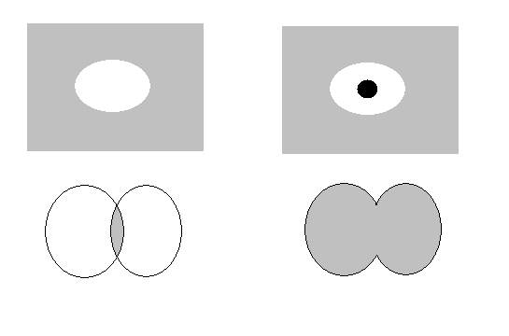
Cantor’s Sets
Cantor proposed several operations on traditional sets, but how do they translate to fuzzy sets?
A
Not A
A
B
Containment
Complement
Intersection
Union
A
B
A
B

Slide 60
Complement
Who does not belong to the set?
  The complement of a set is the opposite of a set. So if we have a set of tall men, the complement is not tall men.
  With fuzzy logic, if Tom has 0.86 membership of ‘tall men’, then he has 0.14 membership of ‘not tall men’.

Slide 61
Containment
Which set belongs to other sets?
  Well, ‘very tall men’ is a subset of ‘tall men’, which in turn is a subset of ‘men’.
  With fuzzy logic, membership values can change for different sets and subsets.

Slide 62
Intersection
Which elements belong to both sets?
  We’ve already seen how a man can be a member of ‘tall men’ and ‘average men’, simply by having a membership value for both sets.

Slide 63
Union
Which elements belong to either set?
  Tom belongs to the tall set, so he belongs to the tall or fat set!
So, crisp and fuzzy sets hold the same properties, in fact crisp sets can be considered a special case of fuzzy sets.

Slide 64
More General Set Rules
Commutativity
  A ∪ B = B ∪ A
  A ∩ B = B ∩ A
Associativity
  A ∪ ( B ∪ C ) = ( A ∪ B ) ∪ C
  A ∩ ( B ∩ C ) = ( A ∩ B ) ∩ C
Distributivity
  A ∪ ( B ∩ C ) = ( A ∪ B ) ∩ ( A ∪ C )
  A ∩ ( B ∪ C ) = ( A ∩ B ) ∪ ( A ∩ C )
Idempotency
  A ∪ A = A
  A ∩ A = A

Slide 65
More General Set Rules
Identity
  A ∪ undefined = A
  A ∩ unknown = A
  A ∩ undefined = undefined
  A ∪ unknown = unknown
Involution
  ¬(¬A) = A
Transitivity
  If (A ∈ B) ∩ (B ∈ C) then (A ∈ C)
De Morgan’s Laws
  ¬(A ∩ B) = ¬A ∪ ¬B
  ¬(A ∪ B) = ¬A ∩ ¬B

Slide 66
General Set Rules
The general set rules apply equally to fuzzy sets.
The key difference is in degree of membership, while entities are either members or not members for normal sets, they have degrees of membership for fuzzy sets.
  Set of Prime numbers : 5, 13 etc.
  Fuzzy set of tall men : degrees of membership.

Slide 67
Fuzzy Rules
If x is A, then y is B.
  Where x and y are variables, and A and B are values determined by fuzzy sets.
If Speed is >100, Then stopping_distance is long.
If Speed is <40, Then stopping_distance is short.

Slide 68
Fuzzier
If Speed is Fast, then Stopping_Distance is Long.
If Speed is Slow, then Stopping_Distance is Short.
Here perhaps speed has a numerical range 0-220 kmph, and Stopping_Distance has a numerical range 0-300m, but each has been broken into fuzzy sets (fast/slow) and (long/medium/short).

Slide 69
Reasoning
In classical reasoning, if an antecedent is true, then the consequent is true, but with fuzzy sets;
The degree of membership in the antecedent set influences the degree of membership in the consequent set.

Slide 70
Inference
If Height is Tall, Then Weight is Heavy.
From this we can estimate a mans weight dependent on their height.
1
1
degree of
membership
0
0
160 180 200 220 240
70 80 90 100 110 120
height
weight

Slide 71
How about these?
If Service is Excellent, OR Food is Delicious, then Tip is Generous.
If Project_Duration is Long AND Project_Staff is Large AND Project_Fund is Inadequate, then Risk is High.
If Temperature is Hot, then Hot_Water is Reduced (AND/OR) Cold_Water is Increased.
All of these rules are possible, with a bit more work!

Slide 72
Mamdani Inference
A simple example;
  2 Inputs
    Project_Funding (Fuzzified from crisp percentage input to inadequate, marginal and adequate)
    Project_Staffing (Fuzzified from crisp percentage input to small and large)
  1 Output
    Risk (high, normal or low)

Slide 73
Example’s Rules
3 Rules
  If Project_Funding is Adequate, OR Project_Staffing is Small, Then Risk is Low.
  If Project_Funding is Marginal AND Project Staffing is Large, Then Risk is Normal.
  If Project_Funding is Inadequate, Then Risk is High.

Slide 74
Mamdani Inference
4 Steps
  1) Fuzzification
  2) Rule Evaluation
  3) Aggregation of Rule Outputs
  4) Defuzzification

Slide 75
Fuzzification
Take crisp inputs and determine their fuzzy set memberships.
  Normally requires expert judgement.
For Example;
  Project_Funding at 35% has 0.5 membership of inadequate and 0.2 membership of marginal.
  Project_Staffing at 60% has 0.1 membership of small and 0.7 membership of large.

Slide 76
Rule Evaluation
The next step is to apply fuzzy inputs to the rule antecedents.
  Rule 1: If Project_Funding is Adequate, OR Project_Staffing is Small, Then Risk is Low.
    P_F is 0 Adequate
    P_S is 0.1 Small
    Risk is 0.1 Low.

Slide 77
Rule Evaluation
  Rule 2: If Project_Funding is Marginal AND Project Staffing is Large, Then Risk is Normal.
    P_F is 0.2 Marginal
    P_S is 0.7 Large
    There is a choice of ways to apply this, but we choose ‘min’.
    Risk is 0.2 Normal.
  Rule 3: If Project_Funding is Inadequate, Then Risk is High.
    P_F is 0.5 Inadequate
    Risk is 0.5 High.

Slide 78
Aggregation of Rule Outputs
Summary
  Risk is 0.1 Low.
  Risk is 0.2 Normal.
  Risk is 0.5 High.
Risk
Low
Normal
High
0 10 20 30 40 50 60 70 80 90 100

Slide 79
Defuzzification
Calculate the Centre of Gravity.
Risk
0 10 20 30 40 50 60 70 80 90 100
((0+10+20)*0.1+(30+40+50+60)*0.2+(70+80+90+100)*0.5)/0.1+0.1+0.1+0.2+0.2+0.2+0.2+0.5+0.5+0.5+0.5 = 67.4
So the project risk is a member of high and normal, but a bigger member of high.

