Slide 1
261446 Information Systems
Week 2
Global E-business & Collaboration

Slide 2
Week 2 Topics
Business Processes & IS
Types of IS
Systems for Collaboration & Social Business
The IS function

Slide 3
Case Studies
#1) Sanofi Pasteur
#2) Social Business

Slide 4
Business Processes
Collection of activities required to produce a good or service
  Supported by a flow of materials, information & knowledge.
The ways work is co-ordinated
Business performance often depends on how well business processes are designed and co-ordinated.
  It can be a competitive Strength, or a Weakness.

Slide 5
Functional Business Processes
Manufacturing & Production
  Assembling Product
  Quality Checks
  Producing Bills of Materials
Sales & Marketing
  Identifying Customers
  Making Customers Aware of Product (Or creating desire)
  Selling the Product

Slide 6
Functional Business Processes
Finance & Accounting
  Paying Creditors
  Creating Financial Reports
  Managing Cash
Human Resources
  Hiring Employees
  Evaluating Performance
  Managing Benefits Plans
  Training

Slide 7
Cross Functional Business Processes
Fulfilling an Order
  Sales department receives order
  They pass it to accounting to ensure customer has credit
  Production department then builds product
  Product is shipped, perhaps using a Logistics company
  Sales department then handles after sales service
Something as simple as fulfilling an order, involves co-ordination across multiple business functions

Slide 8
Business Process Re-engineering
Significant benefits can be gained by investigating, analyzing and improving Business Processes
  Formerly manual processes, automated.
New Technology can change the process
  Sequential steps occurring concurrently
  Multiple people accessing & sharing information
  New business processes invented
    Downloading a Kindle e-book, or a music track from i-Tunes

Slide 9
Information Systems
There are many interrelated Information Systems supporting many different business processes
  No single system can cover everything
Each function has their own business systems
  Sales & Marketing
  Manufacturing & Production
  Finance & Accounting
  Human Resources
And then there are the cross-functional enterprise systems

Slide 10
Marketing
Planning, promotion and sale of existing products in existing markets and the development of new products and new markets to better attract and serve present and potential customers.
Marketing
Information
Systems
Interactive
Marketing
Sales Force
Automation
Sales
Management
Market
Research &
Forecasting
Advertising
&
Promotion
C.R.M.
Product
Management

Slide 11
Interactive Marketing
Customer Focused marketing process based using the internet, intranet etc. to develop two way transactions between business and customers.
  Enabled Using;
    Internet Chat
    Discussion Groups
    Web forms / Questionnaires
    Email
  Shift to Social Media

Slide 12
Targeted Marketing
Tools to effectively target online Marketing efforts;
  Community – tailoring web advertising towards certain virtual communities
  Content – banners and billboards appearing on appropriate webpages
  Context – e.g. google’s smart ads
  Online Behaviour – Cookies, tracing links.

Slide 13
Sales Force Automation
Tools that allow the sales force to take technology into the field, connect through the internet to record sales data, communicate with clients over email, track progress on clients etc.
Inquiry
Customise
Commit
Order
Sales Lead
Configurator
Contract &
Pricing
Order Entry
Product Catalog
Available to
Promise
Proposal &
Quote
Commission
Integrated SFA Solution

Slide 14
Manufacturing Information Systems
Support the production / operations functions of business.
“Once upon a time, manufacturers operated on a simple build-to-stock model. They build 100 or 100,000 of an item and sold them via distribution networks. They kept track of the stock of inventory and made more of the item once inventory levels dipped below a threshold. Rush jobs were both rare and expensive, and configuration options limited. Things have changed. Concepts like just-in-time inventory, build-to-order manufacturing, end-to-end supply chain visibility, the explosion of in contract manufacturing and the development of web-based e-business tools for collaborative manufacturing have revolutionised plant management.” (Marc Songini)

Slide 15
Computer Integrated Manufacturing
CIM
  Simplify production processes, product designs, factory organisation etc.
  Automate production processes and business functions
  Integrate all production and support processes
Create flexible, agile manufacturing processes that produce high quality goods.

Slide 16
Manufacturing Information Systems
Manufacturing
Resource
Planning
Systems
Production
Forecasting
Manufacturing
Execution
Systems
Enterprise Resources Planning (ERP)
Shop Floor
Scheduling
Engineering
Systems
Production
Scheduling
Computer
Aided
Design
Shop Floor
Control
Material
Requirements
Planning
Computer
Aided
Engineering
Machine
Control
Capacity
Planning
Computer
Aided
Process Plan
Robotics
Control
Production
Cost
Control
Product
Simulation &
Prototyping
Process
Control
Quality
Control
Computer Integrated Manufacturing

Slide 17
Computer Aided Manufacturing (CAM)
Systems that automate the production process;
  Manufacturing Execution Systems
    Process Control
    Machine Control
    Robots Control

Slide 18
The Manufacturing System
Combines 5 key resources;
  Materials, Equipment, Personnel, Instructions and Production Facilities
  (Compare this with the IS resources)
Manufacturing Execution systems monitor, track and control these key resources, through process controls or machine controls etc.

Slide 19
Human Resources
Training and
Development
Compensation
Administration
Staffing
Human Resource Planning
Labour Force Tracking
Succession Planning
Performance Appraisal
Planning
Contract Costing
Salary Forecasting
Strategic
Systems
Labour Cost analysis and
Budgeting
Turnover Analysis
Training Effectiveness
Career Matching
Compensation Effectiveness
And Equity Analysis
Benefit Preference Analysis
Tactical
Systems
Recruiting
Workforce Planning /
Scheduling
Skills Assessment
Performance Evaluations
Payroll Control
Benefits Administration
Operations
Systems

Slide 20
Staffing the Organisation
Recruitment is done over the internet
Employee records are kept in databases
Job changes, compensation changes, hirings and terminations are all tracked by a HRMS.
Skills inventories can be kept for effective employee assignments

Slide 21
Training And Development
As well as electronic learning, HRMS helps HR departments to plan and monitor employees training and development requirements.
Computer based performance appraisals
From the skills database, succession planning can be managed.

Slide 22
Accounting Information Systems
Order Processing
  Captures and processes customers order and produces data for inventory control and accounts receivable.
Inventory Control
  Processes data reflecting changes in inventory and provides shipping and reorder information
Accounts Receivable
  Records amounts owed by customers and produces customer invoices, monthly customer statement and credit management reports

Slide 23
Accounting Information Systems
Accounts Payable
  Records purchases from, amounts owed to, and payments to suppliers and produces cash management reports
Payroll
  Records employee work and compensation data and produces paycheck and other payroll documents and reports.
General Ledger
  Consolidates data from other accounting systems and produces the periodic financial statements and reports of the business.

Slide 24
Financial Management Systems
Cash Management Systems
  Forecast and manage the cash position, monitors cash flow.
Investment Management Systems
  Online investment management systems allow portfolios of securities / short term stocks to be managed more effectively.
Capital Budgeting Systems
  Evaluate Risk/Return of capital expenditures, optimise the portfolio of ongoing capital projects
Financial Planning Systems
  Forecast financial performance and financing needs.

Slide 25
Management Information Systems
Transaction Processing Systems (TPS)
Business Intelligence Systems

Slide 26
Transaction Processing Systems
There are many transactions in a business
  Sales
  Receipts
  Cash Deposits
  Payroll
  Credit Decisions
  Flow of Materials
A TPS keeps track of all these transactions, allowing managers to ask routine questions (What are the stock levels? What happened to X’s payment?)

Slide 27
Transaction Processing Systems
Often act as an interface between the organization and the wider environment
TPS also provide data / information inputs for many other systems & business processes

Slide 28
Business Intelligence Systems
The IS discussed so far are useful for answering routine questions, predefined in advance, often repeated regularly (such as weekly reports).
Business Intelligence Systems support non-routine decision making, where the process for finding a solution may not be defined in advance.

Slide 29
Enterprise Applications
Systems which span multiple function areas, largely for executive level management.
There are 4 main enterprise applications;
  ERP
  SCM
  CRM
  KMS

Slide 30
Enterprise Application Architecture
Instead of focusing on traditional business functions, enterprise applications focus on achieving fundamental business processes in concert with customers, suppliers, partners and employees.
  ERP – efficiency of firms internal production, distribution etc.
  CRM – acquiring and retaining profitable customers
  PRM – acquiring and retaining partners who can enhance selling the firms products
  SCM – developing the most efficient sourcing and procurement processes with suppliers.
  KMS – providing firms employees with tool to support group collaboration

Slide 31
Enterprise Application Architecture
Suppliers
Employees
KMS,
Collaboration, Decision Support
Partners
SCM
Sourcing, Procurement
PRM
Selling / Distribution
ERP
Internal Business Process
CRM
Marketing, Sales, Service
Customers

Slide 32
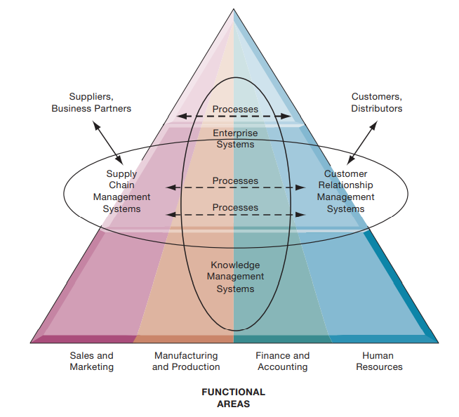
Enterprise Application Architecture

Slide 33
ERP
Enterprise Resource Planning
  Tools for managing all resources in the organization
  Store information that previously was separated in different functional units in one central location

Slide 34
SCM
Supply Chain Management
  Interorganisational Systems
  Manage information between suppliers, to minimize stock levels etc.

Slide 35
CRM
Customer Relationship Management
  Sales & Marketing tools, amongst others to develop relationships with any customers
Note relationship between SCM & CRM

Slide 36
KMS
Knowledge Management Systems
  Capturing the knowledge stored within the organisation

Slide 37
Collaboration
What is it?
  Working together to achieve shared, explicit goals.
In today’s world, there are many IT tools supporting collaboration, supporting Teamwork, and (again) changing the organization.

Slide 38
Collaboration
Changing Nature of Work
  In the pre-computer age, each stage of production happened independently of each other. Work happened in one phase and was then passed on to the next, until a finished product was ready.
  Today there is much more interaction between the various stages.

Slide 39
Collaboration
Growth of Professional Work
  There are more jobs that require substantial education, the sharing of information, and exchanging opinions to get work done.
  Often jobs in the service sector that require co-ordination (and collaboration) to get the work done.
  Each actor has their expertise, but need to work together to accomplish the job.

Slide 40
Collaboration
Changing Organisation of the Firm
  The traditional “industrial age” firm was strictly hierarchical.
    Orders come down from the boss, and responses are passed back up.
  Today, work is more often organized into teams and groups, with each team expected to develop their own methods, while senior managers observe and measure results
  Power & decision making is becoming decentralized.

Slide 41
Collaboration
Changing Scope of the Firm
  Firms are now global.
  Once, a manufacturing plant was the sole place for product development, today production facilities are spread throughout the globe

Slide 42
Collaboration
Emphasis on Innovation
  Innovations may be the inspiration of individual geniuses, but more likely innovations stem from groups sharing ideas, and developing on an idea.
  Innovations most often grow from collaboration.

Slide 43
Changing Culture of Work and Business
People working in diverse teams produce better outputs, faster.
People prefer working in teams, than on their own.
The “Crowd”
  Crowdsourcing

Slide 44
Collaboration Today (Tomorrow?)
Social Media
  Conversations
  Information Transparency
    Immediate feedback (positive & negative), to enable swift sense and respond, from the design process to the product / service delivery phase.

Slide 45
Collaboration Tools
E-mail / Messaging
Wikis
Virtual Worlds
Virtual Meeting Systems
  Telepresence
Google Apps / Cloud Storage
Lotus Notes

Slide 46
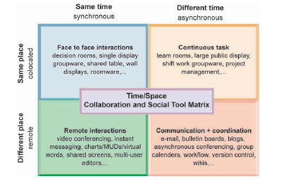
Time / Space Collaboration

Slide 47
And the IS Department?
Programmers
Systems Analysts
IS Managers
CIO (Chief Information Officer)
CSO (Chief Security Officer)
CPO (Chief Privacy Officer)
CKO (Chief Knowledge Officer)

