Slide 1
261446 Information Systems
Week 6
Foundations of Business Intelligence:
Database and Information Management

Slide 2
Week 6 Topics
Traditional Data Organisation
Databases
Using Databases to Improve Business Performance and Decision Making
Managing Data Resources

Slide 3
Case Studies
Case Study #1) Charlotte Hornets
Case Study #2) Big Data

Slide 4
Introducing Data!
High quality data is essential
  Garbage IN Garbage OUT
Access to timely information is essential to make good decisions.
Relational Databases are not new, yet still many businesses don’t have access to timely, accurate, or relevant data, due to lack of data organization and maintenance.

Slide 5
Traditional File Format
Data is stored in a hierarchy
  Bits
  Bytes
  Field
  Record
  File
A group of files makes up a database
A record describes an entity (person, place, thing, event…), and each field contains an attribute for that entity.

Slide 6
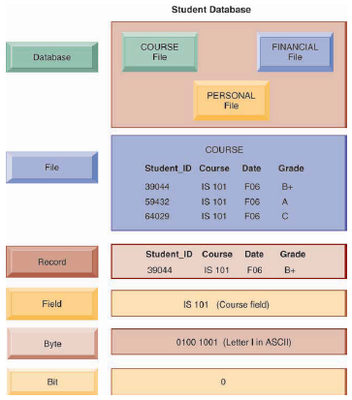
Traditional File Format

Slide 7
Traditional File Format
Systems grow independently, without a company-wide plan
  Accounting, finance, manufacturing, human resources, sales and marketing all have their own systems & data files
Each application has it’s own files, and it’s own computer programs
This leads to problems of data redundancy, inconsistency, program-data dependence, inflexibility, poor data security, inability to share data

Slide 8
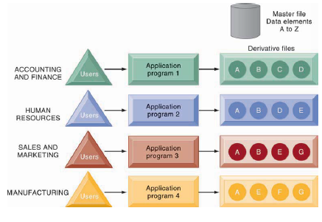
Traditional File Format

Slide 9
File Format Problems
Data Redundancy
  Duplicate data in multiple files, stored more than once, in multiple locations, when different functions collect the same data and store it independently.
  It wastes storage resources, and leads to data inconsistency;
Data Inconsistency
  When some attribute has different values in different files, or the same attribute has different labels, or if different programs use different enumerations / codings (XL / Extra Large)

Slide 10
File Format Problems
Program-Data Dependence
  A close coupling between programs and their data. Updating a program requires changing the data, and changing the data requires updating the program.
    Suppose a program requires a date format to be US style (MM/DD/YYYY), so the data gets changed, it would cause problems for a further program that requires the date format in UK style (DD/MM/YYYY)
Lack of Flexibility
  Routine reports are fine – the programs were designed for producing those reports, but producing ad-hoc reports can be difficult to produce.

Slide 11
File Format Problems
Poor Security
  No facilities for controlling data, or knowing who is accessing, making changes to or disseminating information.
Lack of Data Sharing & Availability
  Remotely located data can’t be related to each other
  Information can’t flow from one function to another
  If a user finds conflicting information in 2 systems, they can’t trust the accuracy of the data

Slide 12
Solution?
Database Management Systems (DBMS)
  Centralised data, with centralized data management (security, access, backups, etc.)
  The DBMS is an interface between the data and multiple applications.
  The DBMS separates the “logical view” from the “physical view” of the data
  The DBMS reduces redundancy & inconsistency by reducing isolated files
  The DBMS uncouples programs and data, the DBMS provides an interface for programs to access data

Slide 13
DBMS
Remember your Databases Course?
  Relational Databases
  Queries & SQL
  Normalisation & ER Diagrams

Slide 14
Databases for Business Performance & Decision Making
The Challenge of Big Data
Business Intelligence Infrastructure
Analytical Tools

Slide 15
The Challenge of Big Data
Previously data, like transaction data, could easily fit into rows & columns and relational databases
  Today’s data is web traffic, email messages, social media content, machine generated data from sensors.
  Today’s data may be structured or unstructured (or semi-structured)
The volume of data being produced is huge!
  So huge that we call it “BIG” data

Slide 16
The Challenge of Big Data
Big Data doesn’t have a specified size
  But it is big! huge! (Petabytes / Exabytes)
A jet plane produces 10 terabytes of data in 30 minutes
Twitter generates 8 terabytes of data daily (2014)
Big data can reveal patterns & trends, insights into customer behavior, financial markets, etc.
  But it is big! huge!

Slide 17
Contemporary Databases
Relational Databases were the gold standard for 30 years – Data was ‘solved’, until Big Data came along.
  NoSQL
  Cloud Databases / Distributed Databases
  Blockchain

Slide 18
Business Intelligence Infrastructure: Data Warehouses & Data Marts
Data Warehouses
  All data collected by an organization, current and historic
  Querying tools / analytical tools available to try to extract meaning from the data
Data Mart
  Subset of a data warehouse
  A way of dealing with the amount of data

Slide 19
Business Intelligence Infrastructure: In Memory Computing
As previously discussed;
  Hard disk access is slow
  Conventional databases are stored on hard disks
  Processing data in primary memory speeds query response times

Slide 20
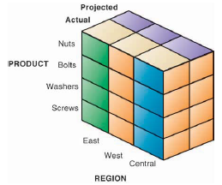
Multi-dimensional Analysis
A company sells 4 products (nuts, bolts, washers & screws)
It sells in 3 regions (East, West & Central)
A simple query answers how many washers were sold in the past quarter, but what if I wanted to look at the products sold in particular regions compared with projected sales?

Slide 21
Data Mining
Data Mining is discovery-driven
  What if we don’t know which questions to ask?
  Data mining can expose hidden patterns and rules
    Associations
    Sequences
    Classification
    Clustering
    Forecasting

Slide 22
Data Mining
Associations
  A study of purchasing behavior shows that customers buy a drink with their burger 65% of the time, but if there is a promotion, it’s 85% of the time – useful information for decision makers!
Sequences
  If a house is purchased, within 2 weeks curtains are also purchased (65% of the time), and an oven is purchased within 4 weeks

Slide 23
Data Mining
Classification
  Useful for grouping related data items – perhaps related types of customers, or related products.
Clustering
  While classification works with pre-defined groups, clustering is used to find unknown groups
Forecasting
  Forecasting is useful for predicting patterns within the data to help estimate future values of continuous data

Slide 24
Data Mining
Caesars Entertainment (formerly Harrahs)
  A casino that continually analyses data collected about its customers
    Playing slot machines
    Staying in its hotels
  It profiles each customer, to understand customer’s value to the company, preferences, and uses it to cultivate the most profitable customers, encourage them to spend more, and attract more customers that fit in the high revenue-generating profile
What do you think about that?

Slide 25
Unstructured Data
Much of the data being produced is unstructured
  Emails, memos, call center transcripts, survey responses
How to go about extracting information from unstructured data?
  Text mining
  Sentiment analysis
  Web mining

Slide 26
Discovery
Where is like Pattaya?
How could I ask the web (the machine) that question?
  It is good at search, when we know what we are looking for, but what about discovery
Can the machine intelligently suggest alternative destinations?
  Currently the machine doesn’t understand the semantics of a ‘destination’, ‘flight’ or ‘hotel’, or the properties of such entities, ‘climate’, ‘activities’, ‘geography’, nor the complex relationships between them.

Slide 27
RDF etc.
Much work has gone into developing standards & languages for representing concepts & relationships
  RDF (Resource Description Framework)
  OWL (Web Ontology Language)
But, still challenges
  Enormous complexity of web
  Vague, uncertain & inconsistent concepts
  Constant growth
  Manual effort to create ontology
    Double effort – one human readable version, one for the machine.
Can we apply some Natural Language Processing (NLP) techniques to do it automatically?

Slide 28
Wikipedia
Crowdsourced encyclopedia
  31 million articles in 285 languages
  4 million articles with 2.5 billion words in English
While it is ‘open to abuse’, it is a valuable resource for knowledge discovery, and available for fair use.
  Useful, but largely unstructured

Slide 29
Structuring Wikipedia
Templates
  Inconsistent & with missing data
The Semantic Wikipedia project
  Allows members to add extra syntax for links & attributes
    Scalable? Reliable?
    Manual…

Slide 30
This approach
From the 47,000 articles (in Wikipedia 0.8)
Create a corpus of 181 million words
  500,000 different words
Represents standard usage of words across online encyclopedia articles
  the – 11.1 million
  of – 6.1 million
  and – 4.5 million
  in – 4 million
  a – 3.1 million

Slide 31


Log Likelihood
Identifies the “Significantly Overused” words in each article by comparing it with the standard corpus.
The page about Thailand is more likely to overuse “Bangkok”, “temple” or “beach” than it is to use words like “ferret” or “gravity”.

Slide 32
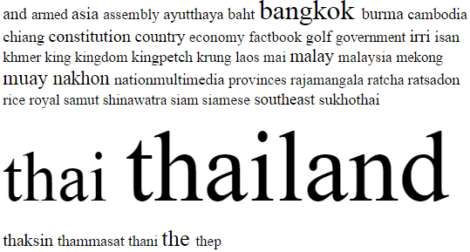
Content Clouds
Create a profile for each page in the collection
Word | Frequency | Log Likelihood
Thailand | 227 | 2617.9
Thai | 158 | 1711.9
Bangkok | 43 | 452.5
The | 790 | 312.0
Muay | 18 | 229.6
Nakhon | 15 | 197.6
Malay | 19 | 159.9
Asia | 31 | 148.1
Constitution | 28 | 144.3
Thaksin | 14 | 143.5

Slide 33
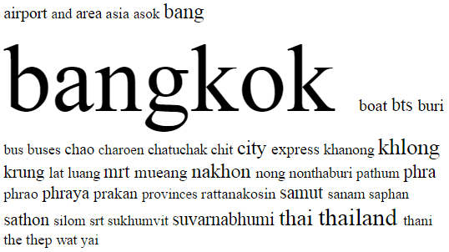
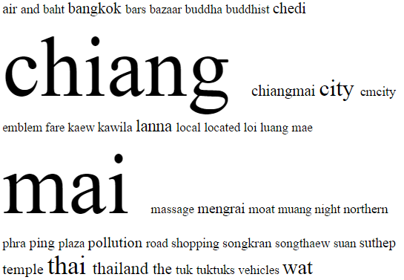
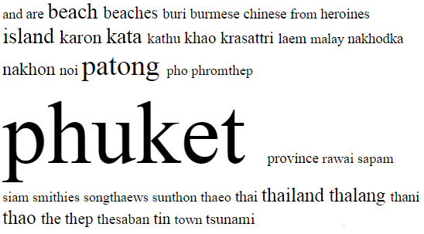
More Clouds

Slide 34
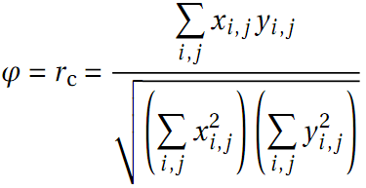
RV coefficient
Multivariate correlation to measure the closeness of 2 matrices
Articles covering similar topics should have similar profiles
  For example about Thailand:-
Page | RV Coefficient
Bangkok | 0.3190
Laos | 0.1070
Pattaya | 0.1053
Singapore | 0.0441
England | 0.0322
Cardiac cycle | 0.0175
Faces (Band) | 0.0055
Discrete cosine transform | 0.0040
Donald Trump | 0.0027
Bipolar disorder | 0.0021

Slide 35
Classifying Pages
Pages ‘belong’ in one or more categories
  Bangkok:- Place, City, Thailand
  Bob Dylan:- Person, Music, Singer, Musician, Songwriter
  Iodine:- Chemical
Manual process to create categories with >25 members.
Category | Member Count | Category | Member Count
Person | 344 | Place | 247
Music | 92 | City | 90
Region | 86 | Politician | 49
Ruler | 48 | Sportsperson | 46
Chemical | 44 | Plane | 42
Animal | 42 | Vehicle | 40
Weapon | 38 | Business | 36
Date | 35 | Musician | 34
Singer | 33 | Football Team | 32
Medical Condition | 30 | Band | 29
Movie | 27 | Footballer | 26

Slide 36
Classifying Pages
New Corpora created for each category
Log Likelihood comparison to identify the significant words in each category:-
Person:- ‘his’, ‘her’
Place:- ‘city’, ‘area’, ‘population’, ‘sea’, ‘town’, ‘region’
Music:- ‘album’, ‘band’, ‘music’, ‘rock’, ‘song’
These new ‘category profiles’ can then be used to predict which categories new articles may belong in.

Slide 37
Classifying Pages
Sample articles
Page | Category | RV Score | Category | RV Score
Hai Phong | City | 0.056 | Place | 0.034
Mitsubishi Heavy Industries | Business | 0.030 | Plane | 0.026
Monty Python Life of Brian | Movie | 0.165 | Place | 0.128
Iain Duncan Smith | Politician | 0.106 | Person | 0.071
Cuba | Place | 0.055 | Region | 0.048
Dalarna | Place | 0.116 | Region | 0.112
Scarborough, Ontario | Place | 0.059 | City | 0.058
Raja Ravi Varma | Person | 0.038 | Ruler | 0.021
Oskar Lafontaine | Politician | 0.090 | Person | 0.048
Chamonix | Region | 0.058 | Place | 0.056
Clover | Animal | 0.007 | Business | 0.002

Slide 38
Conclusions
Even with only 25 members of a category, the approach successfully placed articles in the “correct” categories.
Once articles have been placed, the categories can be mined for knowledge discovery.
  e.g. Pattaya is a place (and a city), what other places have similar profiles?

Slide 39
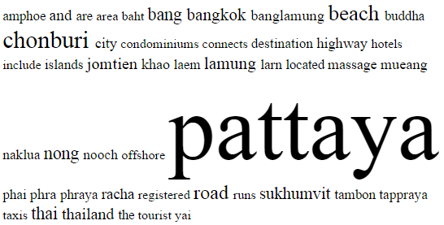
From Another study
Where is like Pattaya?
  Top Results:-
    Bangkok
    Chiang Mai
    Phuket Province
    Krabi
    Orlando Florida
    Punta Cana
    Bali
    Miami
    Singapore…

Slide 40
Further Work
Some progress has been made on developing an ontology, by exploring how categories are interrelated
  A musician is a special kind of person
Further analysis of many articles related to Thailand
  i.e. score highly for RV score.
  A country is a kind of place, countries have regions & cities, and people. People can be rulers or politicians.

Slide 41
Managing Data Resources
Establishing an Information Policy
  The organization’s rules for sharing, disseminating, acquiring, classifying information
  Who is allowed to do what with which information
Ensuring Data Quality
  A data quality audit may be needed to clean the data of incorrect, inconsistent or redundant data.

Slide 42
Using the Data: Example
Once we’ve collected all the data we can, we could derive a decision tree to understand different scenarios

Slide 43
Decision Trees
One way of deriving an appropriate hypothesis is to use a decision tree.
For example the decision as to whether to wait for a table at a restaurant may depend on several inputs;
  Alternative Choice?
  Bar?
  Fri/Sat?
  Hungry?
  No. of Patrons
  Price
  Raining?
  Reservation?
  Type of Food
  Wait Estimate.
To keep things simple we discretise the continuous variables (No. patrons, price, wait estimate)

Slide 44
Possible Decision Tree
No. Patrons
Full
None
Some
WaitEstimate?
NO
YES
<10
>60
30-60
10-30
Alternate?
Hungry?
YES
NO
No
Yes
No
Yes
Reservation?
Fri/Sat?
YES
Alternate?
No
Yes
No
Yes
No
Yes
Bar?
YES
NO
YES
YES
Raining?
No
Yes
No
Yes
NO
YES
NO
YES

Slide 45
Inducing a Decision Tree
Obviously if we had to ask all those questions the problem space grows very fast.
The key is to build the smallest satisfactory decision tree possible.
Sadly this is intractable, so we will make do with building a smallish decision tree.
A tree is induced by beginning with a set of example cases.

Slide 46
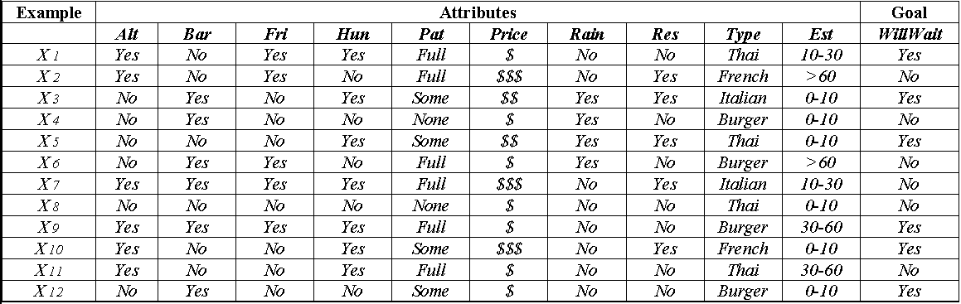
Example Cases
Sample cases for the restaurant domain.

Slide 47
Starting Variable
First we have to choose a starting variable, how about food type?
Type?
French
Thai
Burger
Italian
10
3
1
5
9
12
2
7
8
11
4
6

Slide 48
Patrons?
Patrons?
None
Full
Some
3
5
10
12
1
9
4
8
2
6
7
11
Ah, that’s better!

Slide 49
What a great tree!
Patrons?
None
Full
Some
NO
YES
Hungry?
No
Yes
NO
Type
French
Thai
Burger
Italian
YES
NO
Fri/Sat
YES
No
Yes
NO
YES
But how do we make it?

Slide 50
How to do it
Choose the ‘best’ attribute each time, then where nodes aren’t decided choose the next best attribute…
  Recurse!

Slide 51
Choosing the best
ChooseAttribute(attributes, examples)
  How do you choose the best attribute?
    ‘Patrons’ isn’t perfect, but it’s ‘fairly good’.
    ‘Type’ is really useless
  If perfect = 1, and completely useless = 0, how can we measure really useless and fairly good?

Slide 52
Choosing the Best
The best attribute leads to a shallow decision tree, by dividing the set as best it can, ideally a boolean test which splits positives and negatives perfectly.
A suitable measure therefore is the expected amount of information provided by the attribute.
Using a complex formula we can measure the amount of information required, and predict the amount of information still required after applying the attribute.

Slide 53
How good is the decision tree?
A good tree can predict unforeseen circumstances accurately, hence it makes sense to test unforeseen cases on a set of test data;
1) Collect large set of Data
2) Divide into 2 disjoint sets (training and test)
3) Apply the algorithm to training set.
4) Measure the percentage of accurate predictions in the test set.
5) Repeat steps 1-4 for different sizes of sets.

Slide 54
Alas
Unless you are going to have massive amounts of data the results might not be accurate as the algorithm shouldn’t see test data before acting as it might influence its results.

Slide 55
Further Problems
What if more than one case has the same inputs but different outputs?
  Majority rule?
  Decision tree is then not 100% consistent.
  It may choose to use irrelevant information just to divide the two sets,
    suppose if we added the variable colour of shirt?

Slide 56
More Problems
Missing Data
  How should we deal with cases where not all data is known? Where should they be classified?
Multivalued Attributes
  What about infinitely valued attributes, such as restaurant name?
Continuous values for inputs
  Should you use discretisation? A split point?
Continuous output
  Consider a formulaic response from regression.

