Slide 1
ISNE101
Dr. Ken Cosh

Slide 2
Recap
We’ve been talking about Software…
  Application vs System Software
Programming Languages
  Vs Natural Languages
  Syntax, Semantics && Ambiguity!
This week
  Introducing the SDLC

Slide 3
Why study about Software?
The economies of ALL developed nations are dependent on software
More and more systems software controlled
Software production expenditure represents a significant fraction of GNP in all developed countries
Software costs often dominate system costs. The costs of software on a PC are often greater than the hardware cost
Software costs more to maintain than it does to develop. For systems with a long life, maintenance costs may be several times development costs

Slide 4
What are the Attributes of Good Software?
Deliver required functionality and performance to user, and be maintainable, dependable, usable
Maintainability
  Software must evolve to meet changing needs
Dependability
  Software must be trustworthy
Efficiency
  Software should avoid wasting system resources
Usability
  Software must be usable by the users for which it was designed

Slide 5
What is Software Engineering?
Software engineering is an engineering discipline which is concerned with all aspects of software production
Software engineers should adopt a systematic and organised approach to their work and use appropriate tools and techniques depending on the problem to be solved, the development constraints and the resources available

Slide 6
What is a Software Process?
Set of activities whose goal is the development or evolution of software
Generic activities in all software processes are:
  Specification - what the system should do and its development constraints
  Development - production of the software system
  Validation - checking that the software is what the customer wants
  Evolution - changing the software in response to changing demands

Slide 7
What is a Software Process Model?
A simplified representation of a software process, presented from a specific perspective
Model Perspectives
  External perspective
  Structural perspective
  Behavioural perspective

Slide 8
The Software Process
A structured set of activities required to develop a software system:
  Specification
  Design
  Validation
  Evolution
A software process model is an abstract representation of a process. It presents a description of a process from some particular perspective

Slide 9
Generic Software Process Models
The Waterfall model
  Separate and distinct phases of specification and development
Evolutionary development
  Specification and development are interleaved
Reuse-based development
  The system is assembled from existing components

Slide 10
Waterfall Model

Slide 11
Waterfall Model Phases
Requirements analysis and definition
System and software design
Implementation and unit testing
Integration and system testing
Operation and maintenance
The drawback of the waterfall model is the difficulty of accommodating change after the process is underway

Slide 12
Waterfall Model Problems
Inflexible partitioning of the project into distinct stages
This makes it difficult to respond to changing customer requirements
Therefore, this model is only appropriate when the requirements are well-understood

Slide 13
Evolutionary Development
Exploratory development
  Objective is to work with customers and to evolve a final system from an initial outline specification. Should start with well-understood requirements
Throw-away prototyping
  Objective is to understand the system requirements. Should start with poorly understood requirements

Slide 14
Evolutionary Development

Slide 15
Evolutionary Development
Problems
  Lack of process visibility
  Systems are often poorly structured
  Special skills (e.g. in languages for rapid prototyping) may be required
Applicability
  For small or medium-size interactive systems
  For parts of large systems (e.g. the user interface)
  For short-lifetime systems

Slide 16
Reuse-oriented Development
Based on systematic reuse where systems are integrated from existing components or COTS (Commercial-off-the-shelf) systems
Process stages
  Component analysis
  Requirements modification
  System design with reuse
  Development and integration

Slide 17
Reuse-oriented Development

Slide 18
Process Iteration
System requirements ALWAYS evolve in the course of a project so process iteration where earlier stages are reworked is always part of the process for large systems
Iteration can be applied to any of the generic process models
Two (related) approaches
  Incremental development
  Spiral development

Slide 19
Incremental Development
Development and delivery is broken down into increments with each increment delivering part of the required functionality
User requirements are prioritised and the highest priority requirements are included in early increments
Once the development of an increment is started, the requirements are frozen though requirements for later increments can continue to evolve

Slide 20
Incremental Development

Slide 21
Incremental Development Advantages
Customer value can be delivered with each increment so system functionality is available earlier
Early increments act as a prototype to help elicit requirements for later increments
Lower risk of overall project failure
The highest priority system services tend to receive the most testing

Slide 22
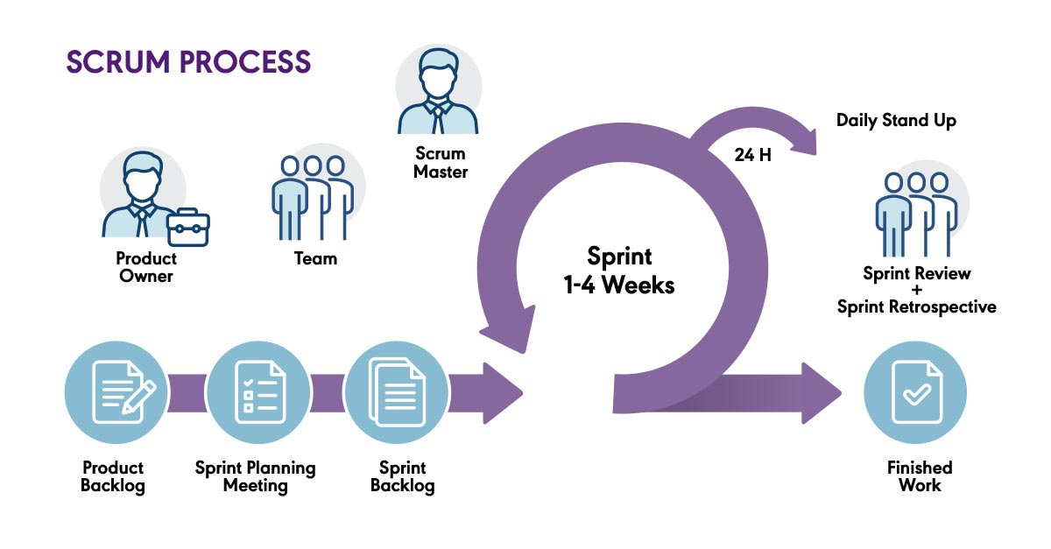

Slide 23
Extreme Programming
New approach to development based on the development and delivery of very small increments of functionality
Relies on constant code improvement, user involvement in the development team and pairwise programming

Slide 24
Spiral Development
Process is represented as a spiral rather than as a sequence of activities with backtracking
Each loop in the spiral represents a phase in the process.
No fixed phases such as specification or design - loops in the spiral are chosen depending on what is required
Risks are explicitly assessed and resolved throughout the process

Slide 25
Spiral Model of the Software Process

Slide 26
Spiral Model Sectors
Objective setting
  Specific objectives for the phase are identified
Risk assessment and reduction
  Risks are assessed and activities put in place to reduce the key risks
Development and validation
  A development model for the system is chosen which can be any of the generic models
Planning
  The project is reviewed and the next phase of the spiral is planned

