Slide 1
ISNE101 – Introduction to Information Systems and Network Engineering
Week 2

Slide 2
Recap
Counting in Base 2 - Binary
Introduction to Encoding
Morse Code
Bits Bytes and Binary Coding

Slide 3
Remember Morse?
E is ".", T is "-", but Q is "--.-"
Common letters have a short (quick!) code, while longer letters have a longer code.
•All symbols m_{i} forming the set M, have probabilities of occurrence P(m_{i}) such that P(m_{i}) + … + P(m_{n}) =1
Infrequently occurring symbols can be assigned a long code word, while short code words are reserved for frequent symbols.

Slide 4
Encoding Objectives
Each codeword corresponds to exactly one symbol.
Decoding should not require any look ahead.
–This is known as the ‘prefix’ property.

Slide 5
Prefix Property
•Symbols: A, B, C
•Codes: 1, 0, 10
•Message: 10
•Is it ‘AB’? Is it ‘C’?
In Morse code, how do we know "--.-" is Q and not "TTET"?

Slide 6
Prefix Property
•Symbols: A, B, C,
•Codes: 1, 00, 10
•Message: 1000
•Read in 1, is it an A?
•Read in 0, was it a C?
•Read in 0, Should it be AB?
•Read in 0, Ah, finally we can assume it was CB.

Slide 7
Code Optimisation
The length of a code for one symbol should not exceed the length of a less likely symbol;
– if P(m_{i})< P(m_{j}) then L(m_{i}) < L(m_{j})
There should be no unused short codes, either as stand alone encodings or as prefixs for longer codes.
– 01, 000, 001, 100, 101 is not ideal as 11 is not used.

Slide 8
Huffman Coding
Huffman coding is a method for choosing a representation for each symbol, resulting in a prefix-free code
–The bit string representing some particular symbol is never a prefix of the bit string representing any other symbol
The most common characters are expressed using shorter strings of bits than are used for less common symbols.

Slide 9
Huffman Coding
Huffman creates a "Heap" based on the frequencies of each symbol.
What is a "Heap"?
A heap is a special kind of Binary Tree!
Great! - What is a "Binary Tree"?
It's a tree where each node has at most 2 children...
Hmmm... - What is a "Tree"?
OK, lets simplify!

Slide 10
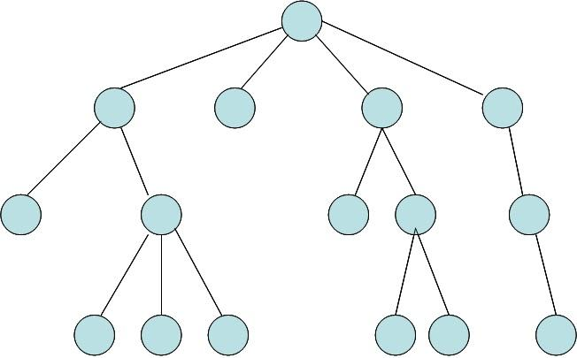
A Tree

Slide 11
A Binary Tree
A Tree where each node has 0,1 or 2 children.

Slide 12
A Heap
A Binary Tree where the root node has the highest value, and every parent's value is greater than their children.
12
4
8
1
3

Slide 13
Huffman Coding
Begins by constructing a Heap based on the frequencies of each member of the set to be encoded.
Each member is a leaf node, with parent nodes being the sum of their children.
•Take the set (with corresponding occurrence frequencies out of 120);
•
A(10) B(15) C(5) D(15) E(20) F(5) G(15) H(30) I(5)

Slide 14
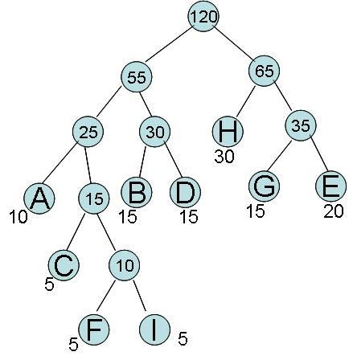
Huffman's Heap

Slide 15
Huffman Coding
Each letter's code is then read based on its position from the root - 0 for left, 1 for right.
A = 000
B = 010
C = 0010
D = 011
E = 111
F = 00110
G = 110
H = 10
I = 00111

Slide 16
Creating the Heap?
Based on frequencies, such as in the British National Corpus?
Based on frequencies within the specified text (or image etc.)
Standard Approach to Huffman
What if we don't know the frequencies?
Adaptive Huffman

