Slide 1
ISNE101 – Introduction to Information Systems & Network Engineering
Week 2

Slide 2
Last Week
Introduction
Fundamentals of Information Systems (&NE)
This Week
Looking into Digital Communication

Slide 3
To begin with...
Lets learn to Count!
1,2,3,4.... What comes next?
What happens when we reach 9?
What if we use a different base?

Slide 4
The wonderful world of Binary
Binary is Base 2
0,1,10,11,100,101,110,111...
A '0' or a '1' is a binary digit, or 'bit'.
Computers only use Binary, where each bit can have 2 states. The state of a bit can be stored as;
On/Off
Direction of magnetism
Different voltages
Different levels of light intensity

Slide 5
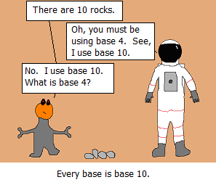
Every Base is Base 10!

Slide 6
How about Morse Code?
5 Elements
Dots
Dashes
Intra-character gap
Short gap (between letters)
Long gap (between words)
"..." = S "---" = O "... --- ..." = ???
"." = E "-" = T "--.-" = Q (not TTET!)
Why?

Slide 7
Back to Binary
2 Elements
0
1
There are no gaps, so 'gaps' would have to be represented by 0's and 1's.
In the same way as Morse Code we can 'encode' each character of the alphabet in 0's and 1's

Slide 8
Binary Encoding
0000 = A 0001 = B 0010 = C
0011 = D 0100 = E 0101 = F
0110 = G 0111 = H 1000 = I
1001 = J 1010 = K 1011 = L
1100 = M 1101 = N 1110 = O
1111 = P ...uhoh!
11101110011111011110
1101111000100000110100111110
101001001101001110000011000100000011
11101010

Slide 9
A Byte
A series of 4 bits (a nibble) isn't enough to encode all the capital letters
There are 16 different variations
Which is a single hexadecimal character!
In computing we generally store things in Bytes - a sequence of 8 bits.
That gives 256 different combinations
Enough for every small letter, capital letter, punctuation, number...

Slide 10
It's all binary
Everything on a computer is in binary...
Colour
Sound
With colour we can have a picture
With pictures, sound (and time) we can have a movie
If a colour has 3bytes, then a picture with X pixels could have 3X bytes?
If a movie has Y pictures, we have 3XY bytes!
Not quite, but correct in the principle, and that is why we need bigger and bigger hard drives (and faster connections!)

Slide 11
Digitisation
Converting 'stuff' to binary is called digitisation.
Discussion:
What are the effects of digitisation?
on Form?
on Quality?
on Value?
on Ownership?

