Slide 1
ISNE101
Week 5
Dr. Ken Cosh

Slide 2
Networks Recap
What were the features of:
Centralised Network
Decentralised Network
Distributed Network
Speeding Up the Network
Caching
Routing
Multiple Route Efficiencies

Slide 3
This Week
It's Time for a "Revolution"
The revolution of Social Networks and Social Media
So Lets talk about "Web 2.0"

Slide 4
Definitions
Social Networks
"Family, and friends and their families, that together create an interconnected system through which alliances are formed, help is obtained, information is transmitted, and strings are pulled. In an organizational setting, it usually constitutes the group of one's peers, seniors, and subordinates who provide privileged information on how to get things done, how the power structure operates, and who holds the strings at present."
BusinessDictionary.com

Slide 5
Definitions
Web Based Social Networks
"Any website designed to allow multiple users to publish content themselves. The information may be on any subject and may be for consumption by (potential) friends, mates, employers, employees, etc. The sites typically allow users to create a "profile" describing themselves and to exchange public or private messages and list other users or groups they are connected to in some way."
Dictionary.com

Slide 6
Definitions
Social Media
"participatory online media that utilizes the group to write and direct content, rather than a read-only media. Allows for direct contact between participants"
UrbanDictionary.com

Slide 7
Definitions
Web 2.0
"Web 2.0 (or Web 2) is the popular term for advanced Internet technology and applications including blogs, wikis, RSS and social bookmarking. The two major components of Web 2.0 are the technological advances enabled by Ajax and other new applications such as RSS and Eclipse and the user empowerment that they support."
Whatis.com

Slide 8
Traditional View

Slide 9
"New" View

Slide 10
Information is Changing
Information R/Evolution
Mwesch
http://www.youtube.com/watch?v=-4CV05HyAbM

Slide 11
Characteristics of Information OR
Assumptions about Information
*It is a thing
*It has a logical place
*Where it can be found
On a Shelf
In a File System
In a Category
*Managing Information is Managing Categories
*It Requires Experts
*And is still hard to find.
! ! ! Digital Information is Different ! ! !

Slide 12
It's an Information Revolution
The responsibility to
Harness
Create
Critique
Organise
Understand
is on Us
Are we Ready?

Slide 13
Information is Changing
The Machine is Us/ing Us
Mwesch
http://www.youtube.com/watch?v=NLlGopyXT_g

Slide 14
How did it happen?
XML Separates Form from Content
With Form separated from Content, users did not need to know complicated code to upload content to the web.
We'll need to rethink a few things...
copyright governance
authorship privacy
identity commerce
ethics love
aesthetics family
rhetorics ourselves

Slide 15
Assignment
How has Web 2.0, and how is Web 3.0 affecting the way we think about… Group A,E,I: Copyright, Authorship & Identity
Group B,F,J: Ethics, Aesthetics, Rhetorics
Group C,G,K: Governance, Privacy, Commerce
Group D,H,L: Love, Family, Ourselves

Slide 16
Groups A,E,I – Copyright, Authorships & Identity
A
CHIRATTIYA MOONSRI, MYAT MIN AUNG, KRITSANAPAT KHOWKET, AUNG KHANT MIN MYAT
E
MAY MYAT MIN HTUN, KITSAPAT PORNSANNUWAT, WASALSAYA AUTTARAPAYOM, TANAKIAT SUPAKAM
I
POJCHARAPON SANGKHUM, NITIPAT HARNYUT , MIN SWAN PYEI , THANAKIT TAJANAN

Slide 17
Groups B,F,J – Ethics, Aesthetics, Rhetorics
B
PREMPRACHA NAMCHAI , TEERAPHAT KULTHI , TANA KANAYART , ZHU JINHUI
F
JIRUNTORN PHOOYAEM , QIAN HAO , PAKJIRA PRASONGJEEN , EUNT MIN THAN SIN
J
TANAKORN FAIKRATOK , AUNG HPONE MYAT , JOWITA TIDA WISNIEWSKI , PATCHARAPOL SONGSAKUL

Slide 18
Groups C, G, K - Governance, Privacy, Commerce
C
APILUK BUALUANG , NUTTHIRA INTAMOON , DAVISA TANJARAT , KYAW PHYO PAING
G
GON KODAMA , PATTARADANAI MAYOON , KRITTAMETH PANTHAROT , CALEB JIREH DILIG
K
EI THANDAR BO , SHIN THANT AEIN , KIRAN JOHN ROZEMA , AUNG KHANT

Slide 19
Groups D, H, L – Love, Family, Ourselves
D
PEERAWIT MANEEKIANG , KYAW SWAR HEIN , MAY PHOO KYAW , JIRAYU ARHENGTRAKUN
H
NATNICHA PUSSARUNGSEE , CHARLES LAPHAI GUM SAN AUNG , HNIN PWINT PHYU , SWETTACHOT PEKTAPIN
L
NAWAPHAT PANYA , JIDAPHA SUWANNATHEP , KHIN CHAW SU LWIN

Slide 20
Early Social Networks
BBS
Bulletin Board System
Late 70s / Early 80s
Complex computer language
Breeding ground for social rejects & boring, reclusive nerds!
A central node where users could connect, communicate & download files / games etc.
Dialled up connection via phone
Usually only local people, due to phone charges
Text only exchanges @ Glacial Speed!
Slowly gained popularity through to the 90s - LUBBS

Slide 21
The internet kicks in
AOL
Member profiles
Member created communities
Messenging service
Classmates.com
Originally no profiles
But could search for old school colleagues
sixdegrees.com
Create / Surf profiles, create groups, invite friends
Inviting friends was too pushy/spammy (then)

Slide 22
2002
Friendster.com
"A dating site that isn't about dating"
Connecting people through common bonds
LinkedIn.com (2003)
Serious, sober approach
Not a playground for former classmates
A business networking resource
MySpace.com (2003)
Hipper / Cooler than Friendster
Attracting many friendster's with music & videos

Slide 23
Facebook
2004 - Harvard Only product peddling
2006 - General public
Massive investment
Easy to use
Lots of features

Slide 24
Other Sites
Orkut - (Brazil / India)
Skyrock - (France, Belgium, Switzerland)
Multiply - (Philippines)
Mixi - (Japan)
Qzone - (China)
Badoo - (Europe)
Nasza-klasa - (Poland)
Odnoklassniki - (Russia)
VKontakte - (Russia)

Slide 25
Blogging
Bebo - Blog Early Blog Often (2005)
Twitter - 2006
Do we really need to know that you are drinking coke?
But, it has handled real time search in a new unique way!

Slide 26
5 Ways Social Media Changes the way we work…
Social Media Goes Company Wide
Email Use Declines as better communication channels open
Social Media command centres become mainstream
Social Media compliance becomes a priority
International & Niche Social Networks present new challenges

Slide 27
5 ways
Facebook was launched in 2004
Evolved from dorm room to boardroom
73% of Fortune 500 active on Twitter
80% of executives believe social media engagement lead to increased sales

Slide 28
Social Media Goes Company Wide
Social Media
a tool for the Marketing Department?
Transaction Based -> Relationship Based?
McKinsey - $1.3 Trillion in untapped value from social networks through “improved communications & collaborations within and across enterprises”
Social Media to become the office productivity tool.
Like Email once was

Slide 29
Social Media Goes Company Wide
HR uses Social Media to connect with Job Seekers
Sales teams generate leads, track clients as they move through the “sales funnel”
Operations & Distribution teams forecast supply chains
R&D brainstorm product ideas
Social Media is a serious business tool

Slide 30
Email use declines as better communication channels open
Email
Great for FORMAL, ONE to ONE correspondence
but is it great for collaboration?
Wikis?
Instant Messaging?
Why?
Real-Time Communication
Centralised Information Sharing

Slide 31
Email
Unproductive Tool
How long do you spend replying to emails?
Linear – NOT collaborative
Back and forth, not community based
Not Social
The right tool for discussions?
The inbox Black Hole
How big is your black hole?
Sharing Documents by Email
Can you edit, translate…?

Slide 32
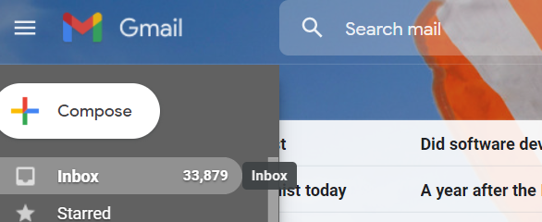
Better tools?
Yammer? Chatter?
Google Wave?
Google Docs…. (sorry)… Google Drive…
Virtual Work Groups
Centralised Message Boards
Unlock the “dark matter” in the “black hole”

Slide 33
Social Media command centres become mainstream
“BIG DATA”
Client Behaviour
Preferences
How do we make sense of it all?
There is so much data generated!
Companies turn to teams of analysts tracking EVERYTHING
responses to tweets
likes
customer sentiment

Slide 34
Social Media command centres become mainstream
The Smart Centres go Smart?
Any manager, anywhere, can see real time analysis of social metrics, and react.
Nestle tracks customer sentiment
GE speeds up certain electrical grid repairs
Auto industry predicts recalls
Stock price predictions
T-Mobile prevents customer defections

Slide 35
Social Media compliance becomes a priority
June 2012 – Morgan Stanley enters “Twittersphere”
SEC rules govern firm communications with public & share holders
Every tweet is a potential lawsuit
Regulations means all tweets must be “compliant”
Storing a history of tweets
Training staff on appropriate tweeting behavior!
Maintaining compliance – industry specific compliance

Slide 36
International and niche social networks present new challenges
Awesome!!!
We’ve got it figured out!
We have this facebook thing nailed, we’re doing good at twitter, and we’ve got linkedin and google+ in the bag!
Instagram grew by 17,319%
Pinterest grew by 5,124%
“Offering deeper functionality combined with a lower technical barrier to entry will mean new leaders in social media being created in a matter of days versus weeks and months.” (James Murray, Experian)

Slide 37
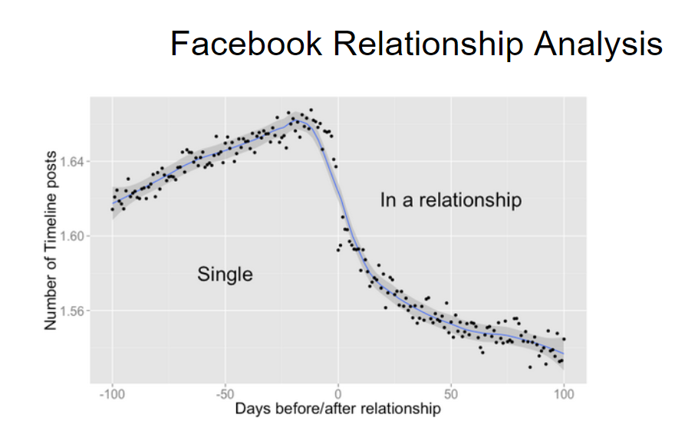

Slide 38
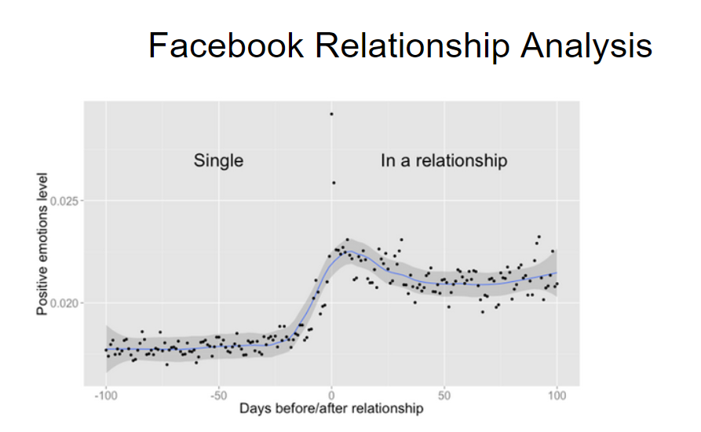

Slide 39
Social Media
What impacts is it having on our life? Our society? Our behaviour? Our Psychology?
Positive Impacts?
Negative Impacts?

