Slide 1
ISNE 101
Dr. Ken Cosh

Slide 2
Quick Quiz
1) What is an information system?
2) What are the 5 key parts of an information system?

Slide 3
Brief Review So Far
What are Information Systems?
  What are the key parts of an information system?
Remember Binary?
  And Digital Encoding?
Then we talked about the ‘Communication Network’
  And So, the web, including web 2.0…
How about the other parts of an Information System?

Slide 4
This Week - Hardware
“Physical objects that you can touch”
Computer Hardware
  Monitor
  Keyboard
  Data Storage
  Hard Disk
  Mouse
  CPU
  Motherboard
  Graphics Cards
  Etc…

Slide 5
Remember the Information System
Data
Input
Processing
Output
Storage
Information

Slide 6
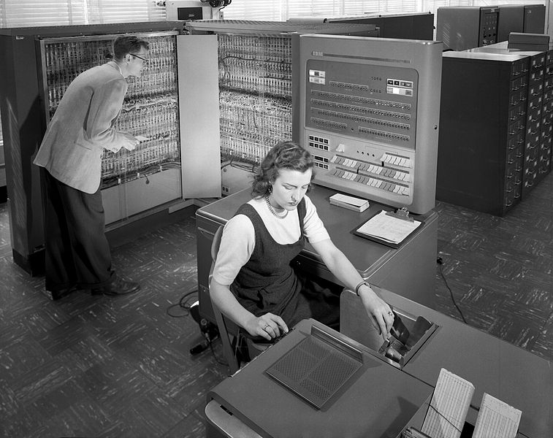
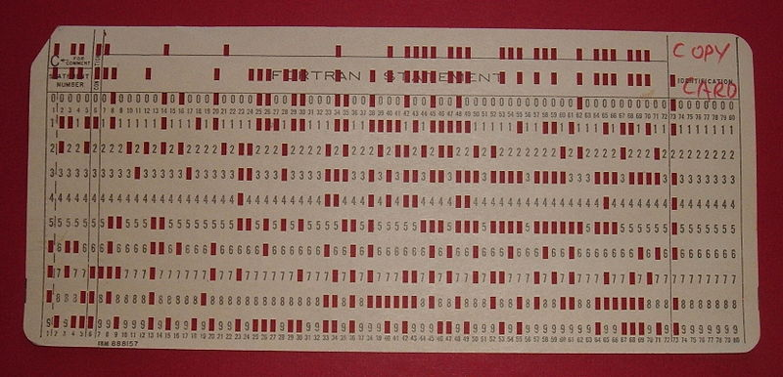
Evolution of Input Devices
Punched Cards – early 1950s

Slide 7
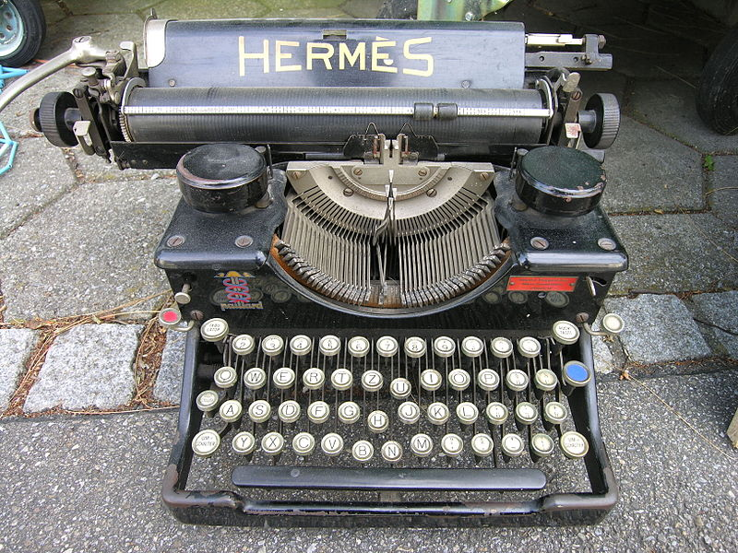
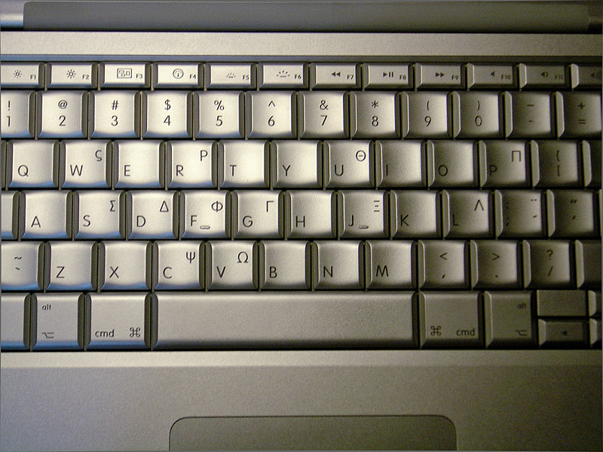
Keyboards
What is the legacy of the typewriter?

Slide 8
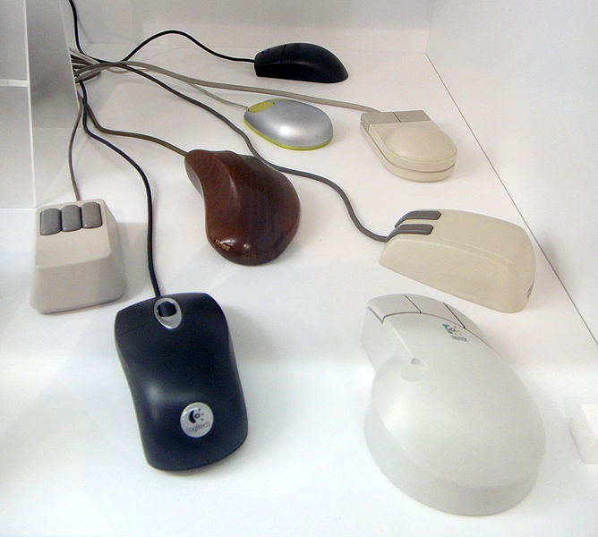

The Mouse
Direct Interaction at last!
  Evolved from mechanical wheels, to balls, to optical
The opportunity for a GUI
  WIMP
    Windows, Icons, Menu, Pointer
Sandstein

Slide 9
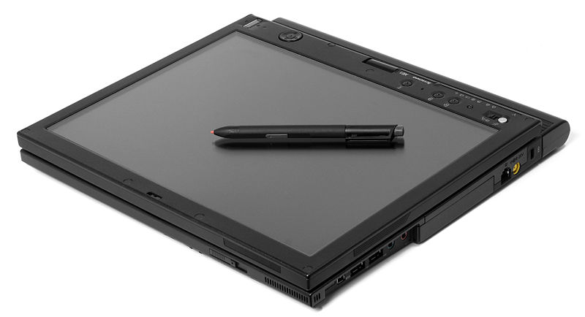
Touch Based Input
Predates Mouse
  So why did the mouse take off first?
Stylus Input
  Grown more popular with more recent tablets

Slide 10
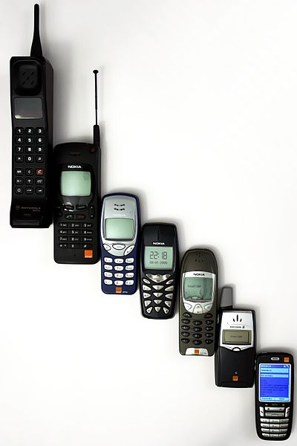
Mobile Input
1 step forward, 2 steps back!?
  Multiple Key Presses?
    Eventually T9
  Miniature keyboards?
  Predictive Text & Auto correction! LOL
  The introduction of Netspeak

Slide 11
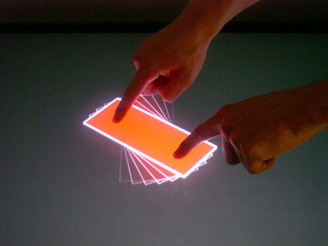
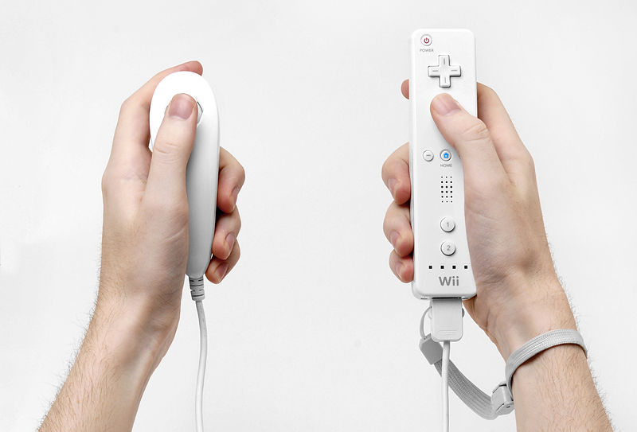
Multi-touch & Gestures!
Even more direct interaction!

Slide 12
What about now?
Non-Touch Gesture Based Interactions
  Consider Minority Report?
What next?
No need to gesture?
  Thought based interactions?

Slide 13
Movie Project
1) Pick a futuristic Movie!
  Let me know which movie, so each group chooses something different!
  (You may choose things like Black Mirror if you like)
2) Pick some futuristic technology in the movie!
3) Is it Possible?
  If so – how might it work?
  If not – why not?
4) What impacts will it have on society / life if and when it does get developed?
  Positive?
  Negative?

Slide 14
10 | 680615027 | JIRAYU | ARHENGTRAKUN | A
17 | 680615034 | NITIPAT | HARNYUT | A
27 | 680615119 | NATNICHA | PUSSARUNGSEE | A
41 | 680615521 | KHIN CHAW SU LWIN |  | A
24 | 680615116 | KITSAPAT | PORNSANNUWAT | B
19 | 680615037 | PAKJIRA | PRASONGJEEN | B
33 | 680615512 | AUNG KHANT MIN MYAT |  | B
23 | 680615113 | DAVISA | TANJARAT | B
35 | 680615515 |  | EI THANDAR BO | C
7 | 680615024 | CALEB JIREH | DILIG | C
14 | 680615031 | TANA | KANAYART | C
44 | 680615525 | MAY MYAT MIN HTUN |  | C
25 | 680615117 | KIRAN JOHN | ROZEMA | D
32 | 680615511 | AUNG HPONE MYAT |  | D
48 | 680615529 | SHIN THANT AEIN |  | D
12 | 680615029 | TANAKORN | FAIKRATOK | D
22 | 680615040 | SWETTACHOT | PEKTAPIN | E
16 | 680615033 | NAWAPHAT | PANYA | E
42 | 680615522 | KYAW PHYO PAING |  | E
34 | 680615514 | CHARLES LAPHAI GUM SAN AUNG |  | E
2 | 670615012 | PEERAWIT | MANEEKIANG | F
8 | 680615025 | JIDAPHA | SUWANNATHEP | F
4 | 670615036 | APILUK | BUALUANG | F
28 | 680615120 | TANAKIAT | SUPAKAM | F
11 | 680615028 | NUTTHIRA | INTAMOON | G
9 | 680615026 | CHIRATTIYA | MOONSRI | G
18 | 680615035 | POJCHARAPON | SANGKHUM | G
26 | 680615118 | JIRUNTORN | PHOOYAEM | G
47 | 680615528 | MYAT MIN | AUNG | H
37 | 680615517 | QIAN | HAO | H
36 | 680615516 | EUNT MIN THAN SIN |  | H
3 | 670615018 | KRITSANAPAT | KHOWKET | H
45 | 680615526 | MAY PHOO KYAW |  | I
13 | 680615030 | THANAKIT | TAJANAN | I
30 | 680615122 | PATCHARAPOL | SONGSAKUL | I
5 | 651615503 | GON | KODAMA | I
1 | 670615108 | PREMPRACHA | NAMCHAI | J
40 | 680615520 | JOWITA TIDA | WISNIEWSKI | J
20 | 680615038 | PATTARADANAI | MAYOON | J
31 | 680615510 | AUNG KHANT |  | J
46 | 680615527 |  | MIN SWAN PYEI | K
39 | 680615519 | ZHU | JINHUI | K
38 | 680615518 | HNIN PWINT | PHYU | K
15 | 680615032 | TEERAPHAT | KULTHI | K
43 | 680615523 | KYAW SWAR HEIN |  | L
6 | 680615023 | KRITTAMETH | PANTHAROT | L
29 | 680615121 | THANYANIT | PUNCHAI | L
21 | 680615039 | WASALSAYA | AUTTARAPAYOM | L

Slide 15
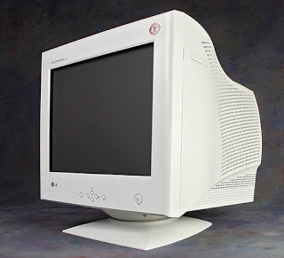
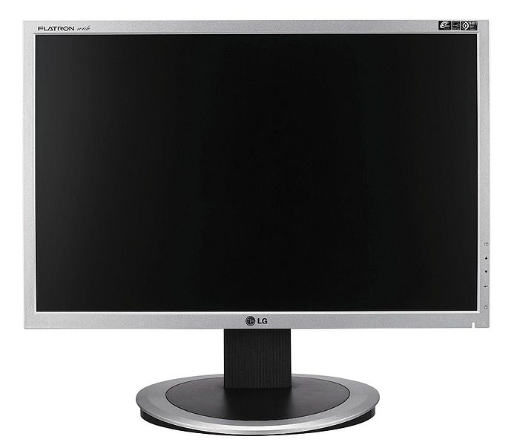
Output Evolution
From CRT to LCD to Plasma
  Desk Space
  Resolution
  Refresh Rate
  Style!
But… do we need a ‘screen’?

Slide 16

Different Size Screens
The Inch, The Foot & The Yard?

Slide 17
3D Projection
Holograms?
Retinal implants?

Slide 18
Quote
“Having tasted the benefit of interconnection, we will continue the process until virtual reality is "real reality". That is, our senses will no longer be limited to the here and now. The ultimate user interface will be a direct neural stimulation and output. Our eyes will become cameras and our ears, microphones. We will touch, taste, and smell remotely. We will share direct brain-brain links, achieving "mind-meld" with others.”
Steve Czarnecki (Lockheed Martin)

Slide 19
Non-Visual Output?
Sounds!
  Much Higher Quality Speakers!
  But how about distributing sounds?
  OR, NOT distributing sounds?
Smells?
Touch?
Taste?

Slide 20
Context Aware Computing
Sensing context from the environment to determine correct responses.
  If I walk into a room and it senses my presence
    “Where”
    “Who”
  How about sensing other things?
    When am I doing something?
    What am I doing?
    Why am I doing it?

Slide 21
Interaction Styles
Direct manipulation
Menu selection
Command language
Natural language

Slide 22
Direct Manipulation Advantages
Users feel in control of the computer and are less likely to be intimidated by it
User learning time is relatively short
Users get immediate feedback on their actions so mistakes can be quickly detected and corrected

Slide 23
Direct Manipulation Problems
The derivation of an appropriate information
space model can be very difficult
Given that users have a large information
space, what facilities for navigating around that space should be provided?
Direct manipulation interfaces can be complex to program and make heavy demands on the computer system

Slide 24
Menu Systems
Users make a selection from a list of
possibilities presented to them by the system
The selection may be made by pointing and
clicking with a mouse, using cursor keys or by typing the name of the selection
May make use of simple-to-use terminals such as touch-screens

Slide 25
Advantages of Menu Systems
Users need not remember command names as they are always presented with a list of valid commands
Typing effort is minimal
User errors are trapped by the interface
Context-dependent help can be provided. The user’s context is indicated by the current menu selection

Slide 26
Problems with Menu Systems
Actions which involve logical conjunction (and) or disjunction (or) are awkward to represent
Menu systems are best suited to presenting a small number of choices. If there are many choices, some menu structuring facility must be used
Experienced users find menus slower than command language

Slide 27
Command Interfaces
User types commands to give instructions to the system e.g. UNIX
May be implemented using cheap terminals.
Easy to process using compiler techniques
Commands of arbitrary complexity can be
created by command combination
Concise interfaces requiring minimal typing can be created

Slide 28
Problems with Command Interfaces
Users have to learn and remember a command language. Command interfaces are therefore unsuitable for occasional users
Users make errors in command. An error
detection and recovery system is required
System interaction is through a keyboard so
typing ability is required

Slide 29
Command Languages
Often preferred by experienced users because they allow for faster interaction with the system
Not suitable for casual or inexperienced users
May be provided as an alternative to menu commands (keyboard shortcuts). In some cases, a command language interface and a menu-based interface are supported at the same time

Slide 30
Natural Language Interfaces
The user types (or speaks) a command in a natural language. Generally, the vocabulary is limited and these systems are confined to specific application domains (e.g. timetable enquiries)
NL processing technology is now good enough to make these interfaces effective for casual users but experienced users find that they require too much typing

Slide 31
Siri?
Is Voice Recognition the future?

Slide 32
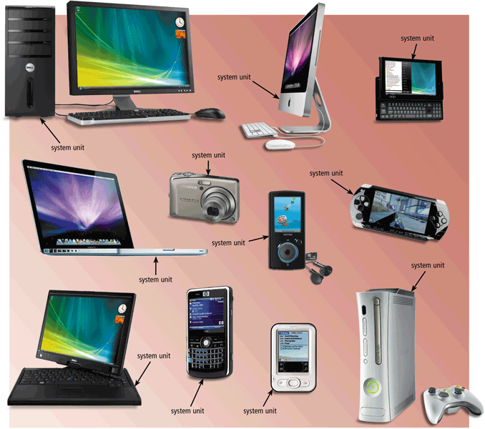
The System Unit
The system unit is a case that contains electronic components of the computer used to process data
Notes:
32

Slide 33
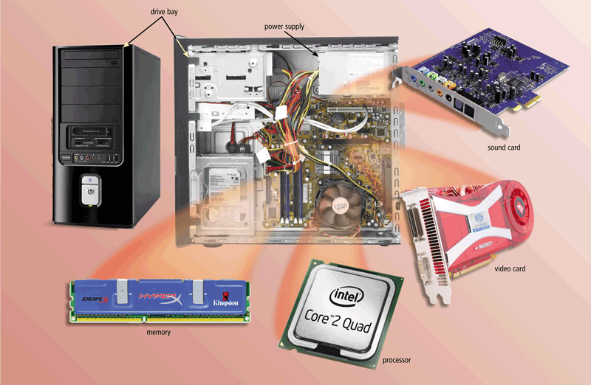
The System Unit
The inside of the system unit on a desktop personal computer includes:
Drive bay(s)
Power supply
Sound card
Video card
Processor
Memory
Notes:
33

Slide 34
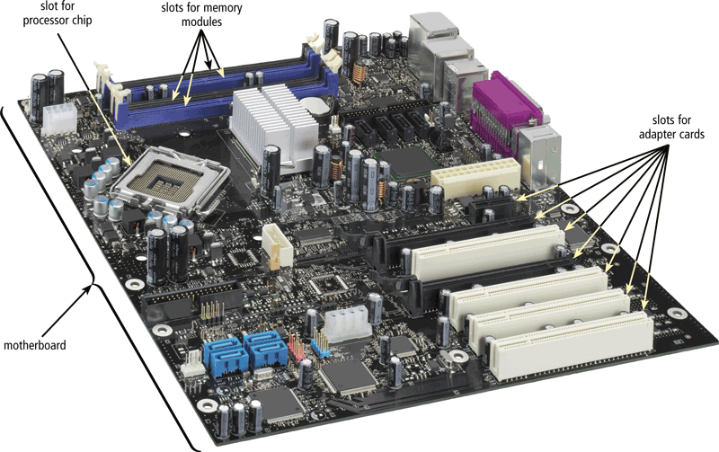
The System Unit
The motherboard is the main circuit board of the system unit
  A computer chip contains integrated circuits
Notes:
34

Slide 35
Processor
Multi-core processor
Dual-core processor
Quad-core processor
The processor, also called the central processing unit (CPU), interprets and carries out the basic instructions that operate a computer
  Contains a control unit and an arithmetic logic unit (ALU)
Notes:
35

Slide 36
Processor
The control unit is the component of the processor that directs and coordinates most of the operations in the computer
The arithmetic logic unit (ALU) performs arithmetic, comparison, and other operations
Notes:
36

Slide 37
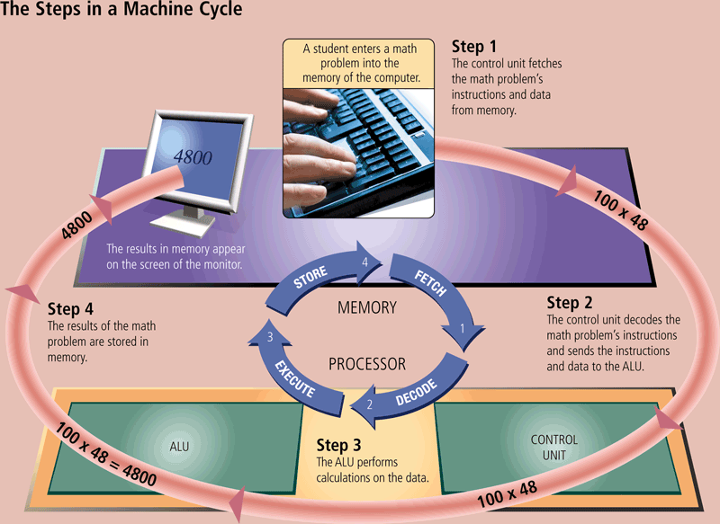
Processor
For every instruction, a processor repeats a set of four basic operations, which comprise a machine cycle
Notes:
37

Slide 38
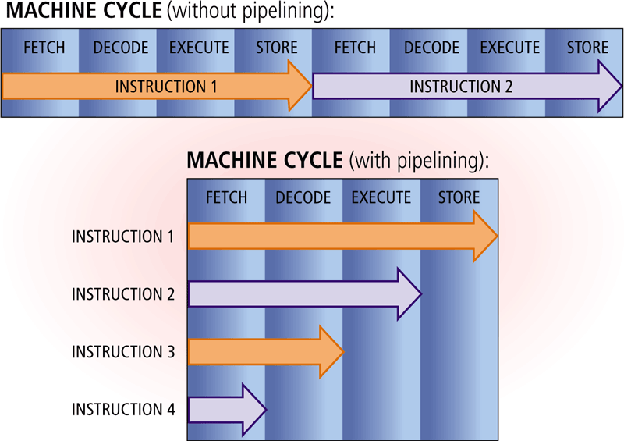
Processor
Most current personal computers support pipelining
  Processor begins fetching a second instruction before it completes the machine cycle for the first instruction
Notes:
38

Slide 39
Processor
The processor contains registers, that temporarily hold data and instructions
The system clock controls the timing of all computer operations
The pace of the system clock is called the clock speed, and is measured in gigahertz (GHz)
Notes:
39

Slide 40
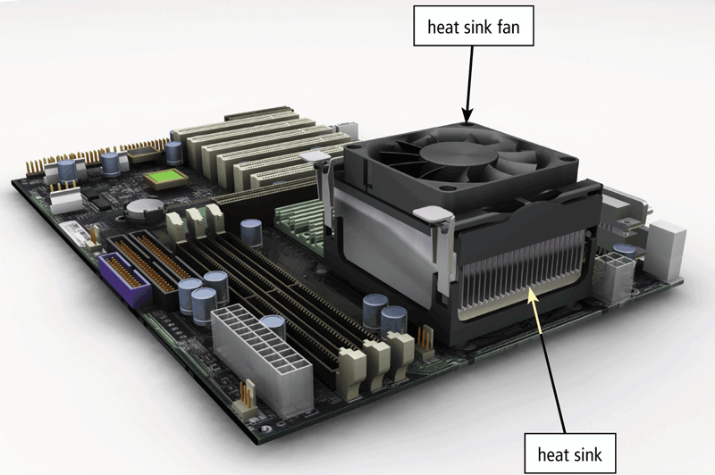
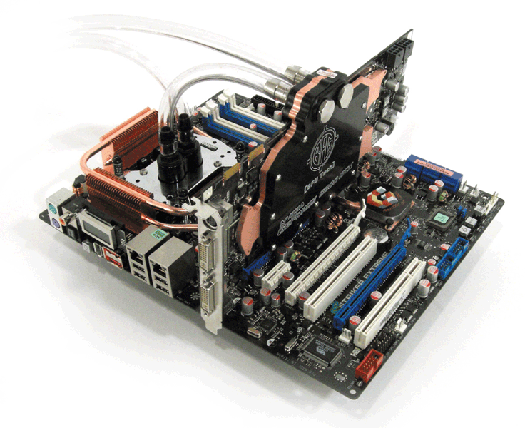
Processor
A processor chip generates heat that could cause the chip to burn up
Require additional cooling
  Heat sinks
  Liquid cooling technology
Notes:
40

Slide 41
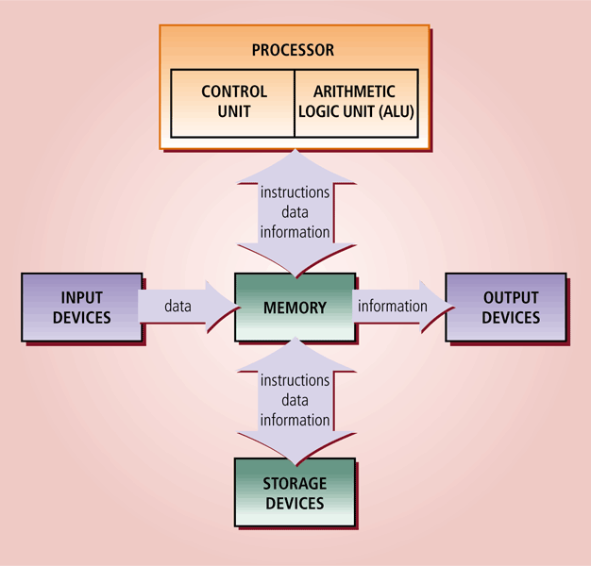
Processor
Notes:
41

Slide 42
Moores Law
“The complexity for minimum component costs has increased at a rate of roughly a factor of two per year... Certainly over the short term this rate can be expected to continue, if not to increase. Over the longer term, the rate of increase is a bit more uncertain, although there is no reason to believe it will not remain nearly constant for at least 10 years. That means by 1975, the number of components per integrated circuit for minimum cost will be 65,000. I believe that such a large circuit can be built on a single wafer.”
  Electronics Magazine 1965

Slide 43
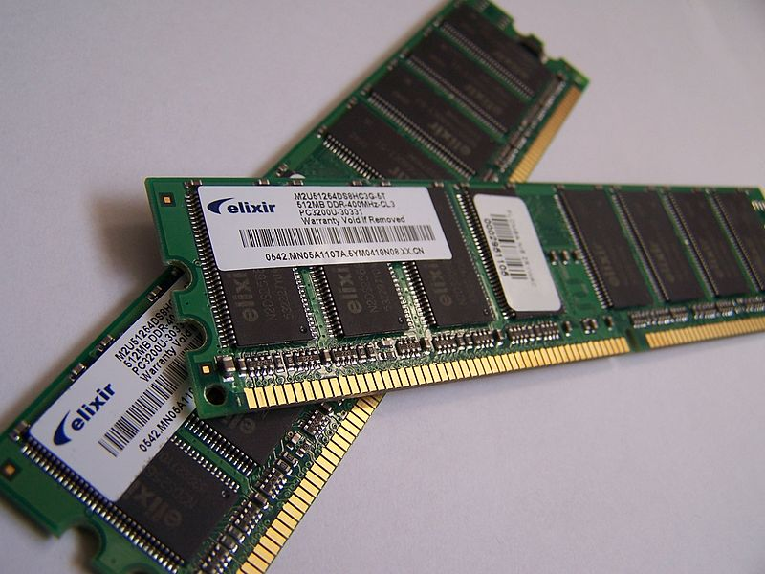
RAM
Volatile Memory
  1966 – 1 Bit = $512
  1973 – 1 KB = $128
  1988 – 1 MB = $32
  2003 – 1 GB = $8
What about today?

Slide 44
Hard Drives
Non-Volatile Memory

