Slide 1
ISNE 101
Week 7
Dr. Ken Cosh

Slide 2
This Week
The future of ICT
  What can we expect next?
Subtopics
  Ubiquitous Computing
  Augmented Realities

Slide 3
Quote
"As the century closed, the world became smaller. The public rapidly gained access to new and dramatically faster communication technologies. Entrepreneurs, able to draw on unprecedented scale economies, built vast empires. Great fortunes were made. The government demanded that these powerful new monopolists be held accountable under antitrust law. Every day brought forth new technological advances to which the old business models seemed no longer to apply. Yet, somehow, the basic laws of economics asserted themselves. Those who mastered these laws survived in the new environment. Those who did not, failed.“

Slide 4
Quote
‘If you asked a farmer 100 years ago what kind of advance he'd like to see in farming in the next century, he'd be likely to say something along the lines "a horse twice as strong that eats half as much oats".’
Anon

Slide 5
Quote
“Having tasted the benefit of interconnection, we will continue the process until virtual reality is "real reality". That is, our senses will no longer be limited to the here and now. The ultimate user interface will be a direct neural stimulation and output. Our eyes will become cameras and our ears, microphones. We will touch, taste, and smell remotely. We will share direct brain-brain links, achieving "mind-meld" with others.”
Steve Czarnecki (Lockheed Martin)

Slide 6
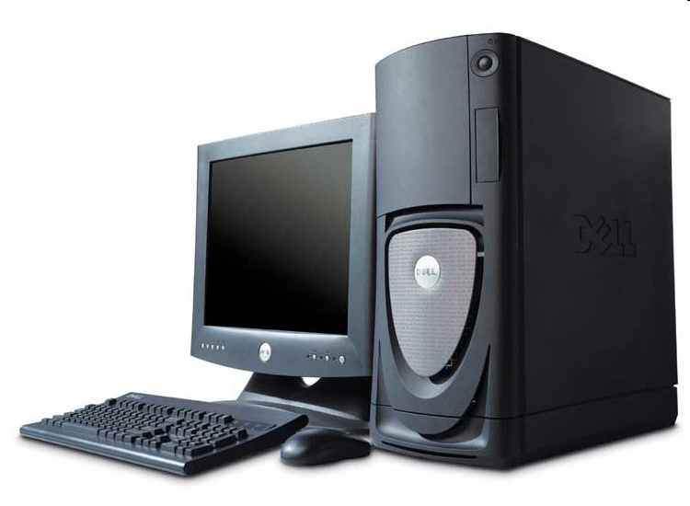
Traditional View of a Computer
Keyboard
Mouse
Box
Monitor
When we want to do some work, we find the computer

Slide 7
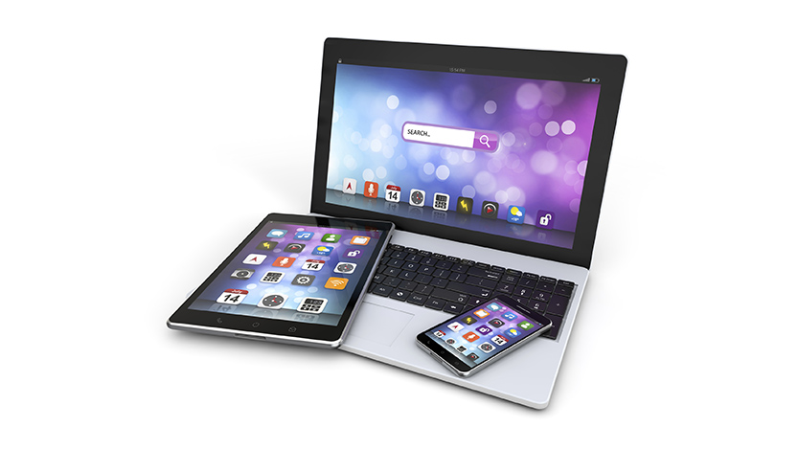
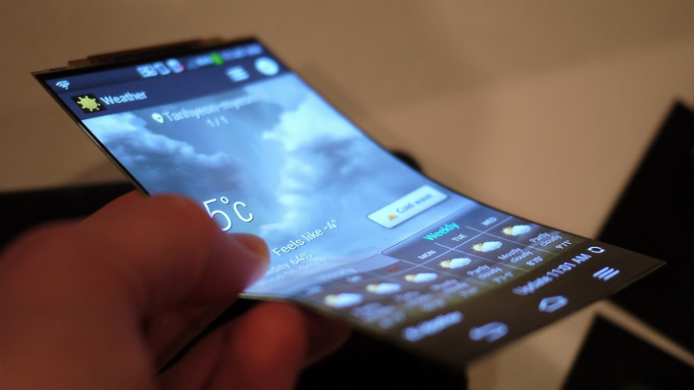
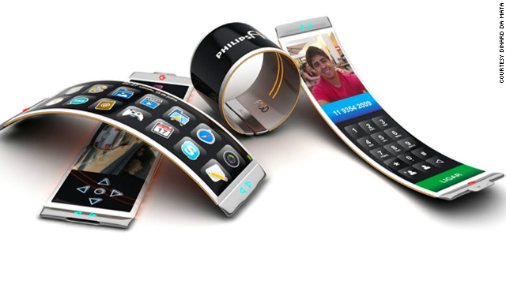
What’s Changed? (Changing)
Mobility

Slide 8
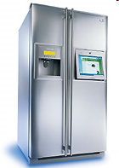
What’s Changed? (Changing)
Computing services distributed throughout physical world, and integrated into it

Slide 9
What is it?
Ubiquitous Computing (or Pervasive Computing)
  Computing devices become so commonplace, we don’t distinguish them from “normal” environment.

Slide 10
Ubiquitous Computing
“Machines that fit the human environment instead of forcing humans to enter theirs will make using a computer as refreshing as a walk in the woods.” (Weiser)
Break away from the desktop paradigm (desktop metaphor).
  Rather than forcing the user to search for the interface, make the computer locate and serve the user.

Slide 11
Weiser
“Activate the world. Provide hundreds of wireless computing devices per person per office, of all scales (from 1” displays to wall sized)… …This is different from PDAs, dynabooks, or information at your fingertips. It is invisible, everywhere computing that does not live on a personal device of any sort, but is invisible in the woodwork.”
“We wanted to put computing back in its place, to reposition it into the environmental background, to concentrate on human-to-human interfaces, and less on human-to-computer ones”

Slide 12
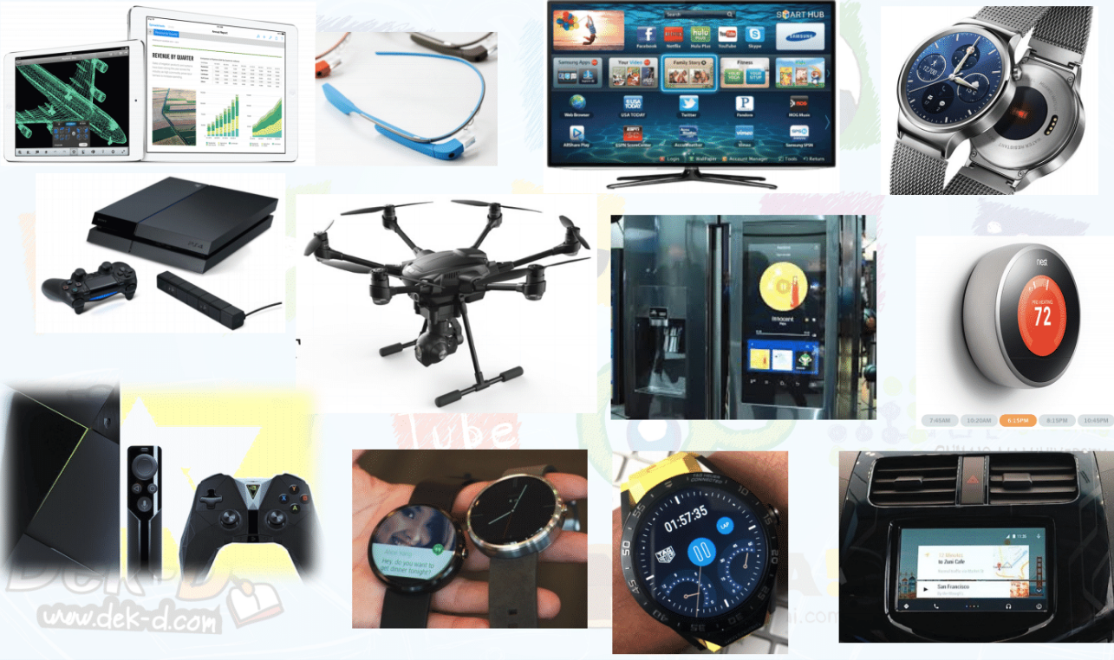
IoT – The Internet of Things

Slide 13
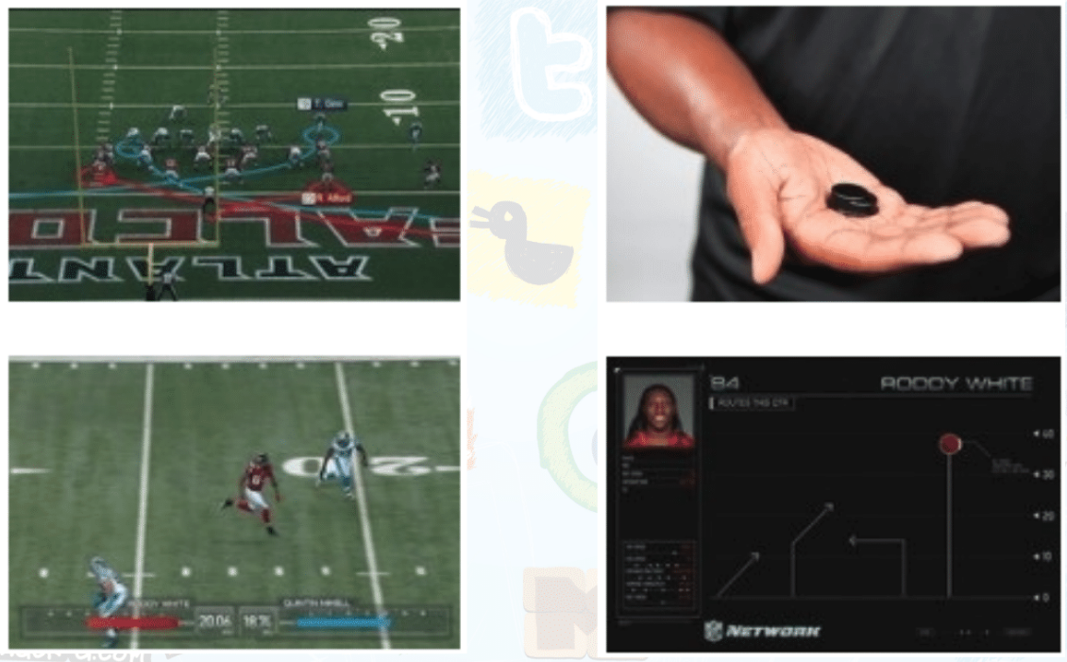
People Demand Access to More Data (Information)

Slide 14
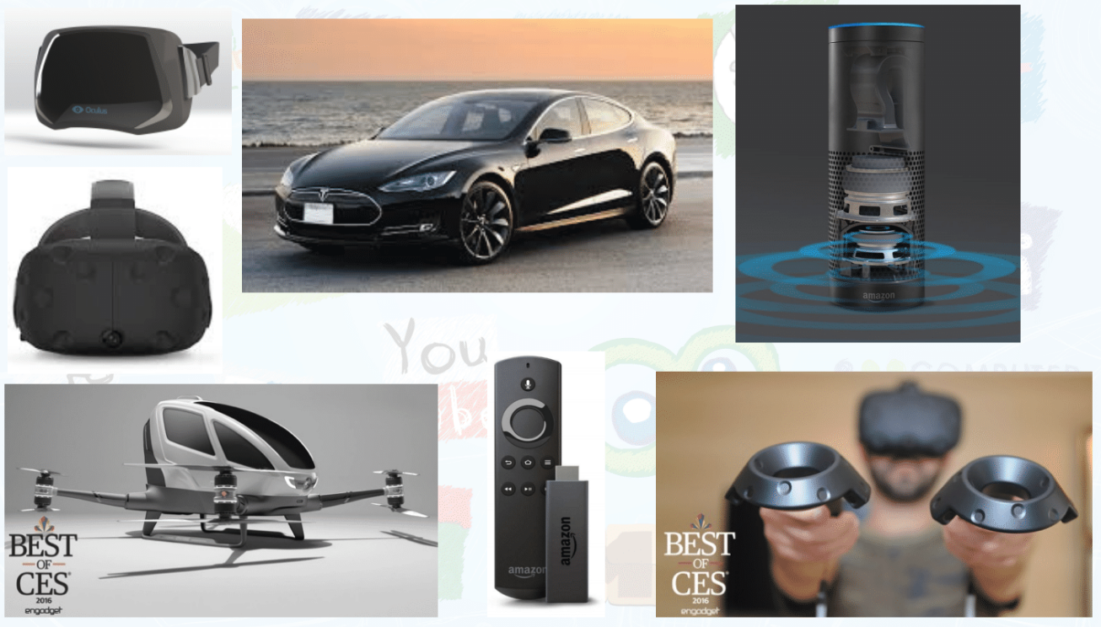
More Powerful Devices

Slide 15
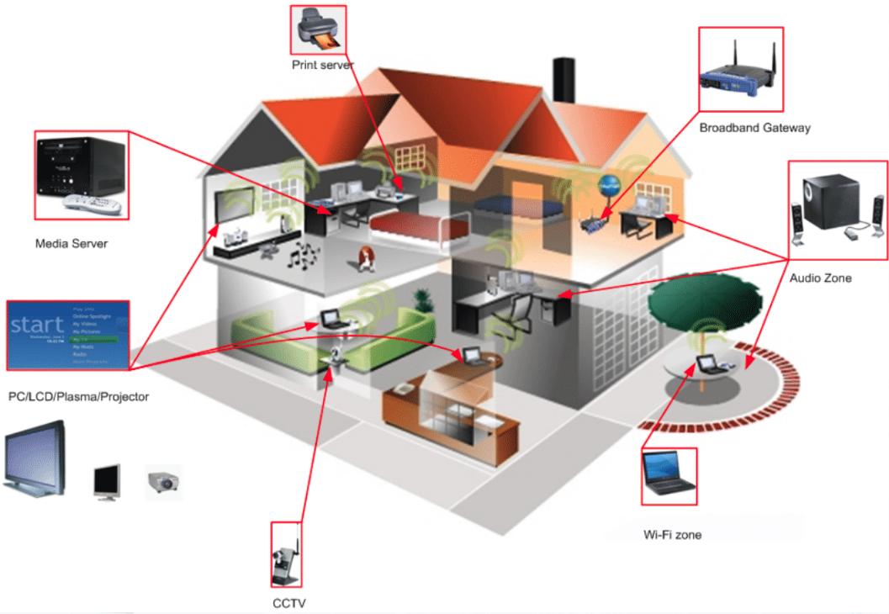
SMART Home Networking
Entertainment
  TV
  Media Server
Security
  Cameras
  Gates
Environment
  Air Conditioners
  Air Purifiers
  Fridge!

Slide 16
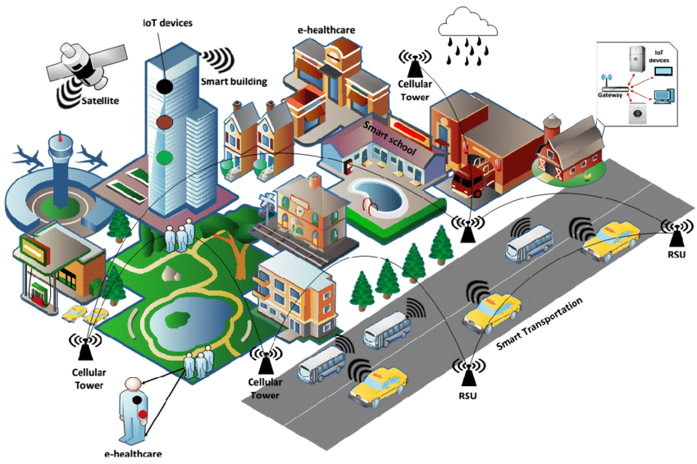
Smart Cities
Transportation
  Public Transit
  Traffic Lights
Services
  Schools
  Hospitals
  Fire / Police
Trash!

Slide 17
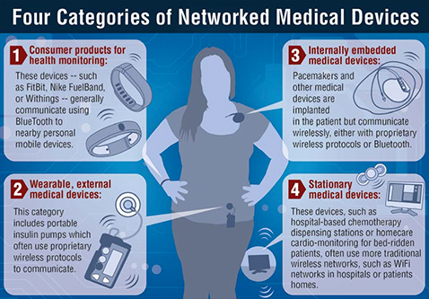
Medical IOT
Personal Health / Fitness Monitors
  GPS, Fitbit
External / Internal Wearables
  Pacemakers, Insulin Pumps
Hospital Based
  Heart rate sensors, Chemo stations
Elderly Care
  Home sensor networks

Slide 18
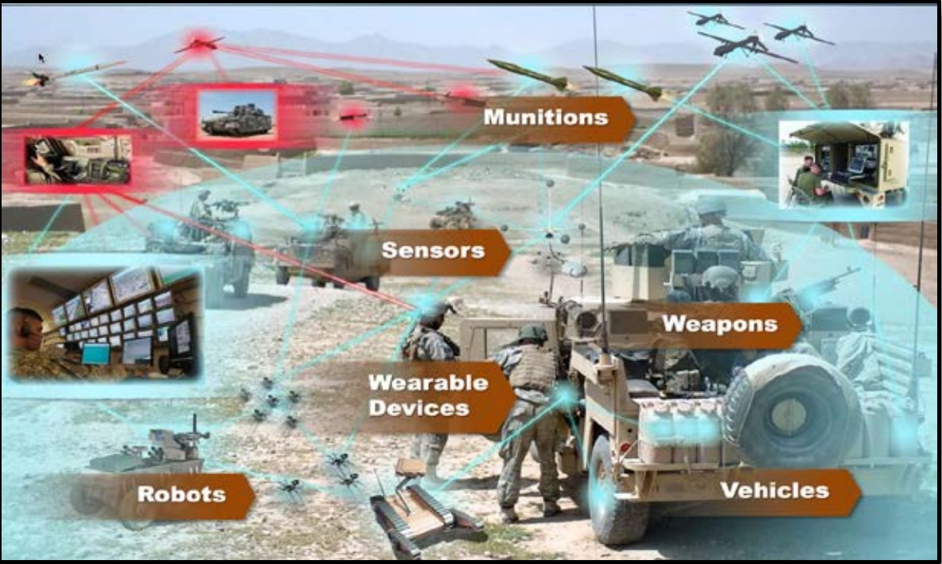
Military IOT
Drones
Sensors
Satelites
Robots

Slide 19
Some Challenges
Defining appropriate interactions
  Implicit Input
  Scalable & Distributed Output
  Seamless Integration of Physical & Virtual World

Slide 20
Implicit Input
Typing on a keyboard is ‘explicit’.
With implicit input, our natural interactions with the physical environment are enough to provide inputs
Examples:
  Walking into a space is enough announce one’s presence & identity
  Handwriting recognition
  Speech recognition
  Gesture recognition
How?
  Table top computing
  Accelerometers
  Tilt sensors
  Infrared range finders

Slide 21
Scalable & Distributed Output
The Inch, The Foot & The Yard
  Different resolutions
  Different challenges
The challenge of moving stuff
  Separating the display and the device
  Distributing output everywhere
Non-visual output?
  Distributing sounds
  Not-distributing sounds
  Smell, Touch, Taste?

Slide 22
Context Aware Computing
Sensing context from the environment to determine correct responses.
  If I walk into a room and it senses my presence
    “Where”
    “Who”
  How about sensing other things?
    When am I doing something?
    What am I doing?
    Why am I doing it?

Slide 23
Seamless Integration of Physical & Virtual World
Augmenting the World
Creating Virtual Worlds

