Slide 1
ISNE101
Dr. Ken Cosh
Week 13

Slide 2
This Week
Challenges (still) facing Modern IS
Reliability
Security

Slide 3
Dependability
The dependability of a system reflects the user’s degree of trust in that system – their confidence that it will operate as expected.

Slide 4
Reliability and Availability
Reliability
The probability of failure-free system operation over a specified time in a given environment for a given purpose
Availability
The probability that a system, at a point in time, will be operational and able to deliver the requested services
It is sometimes possible to subsume system availability under system reliability
Obviously if a system is unavailable it is not delivering the specified system services
However, it is possible to have systems with low reliability that must be available. So long as system failures can be repaired quickly and do not damage data, low reliability may not be a problem

Slide 5
Why is Reliability important?
Costs of downtime for a business critical system
How much would a 15 minute failure of service cost?
How much would a days failure cost?
If this was an Email service?
What percent failure is acceptable?

Slide 6
Redundancy
One way of dealing with Reliability is to use redundancy
‘Spare’ components, so if one fails another could be used.
‘Back-Ups’
Availability Math
If a system is 98% available that means it is not available 2% of the time (i.e. about half an hour each day!!!)
Many systems are now needed to be 99.999% available.

Slide 7
Components in Series
Component 1
98%
Component 2
98%
Component 3
98%
Component 4
98%
Component 5
98%
Consider if each component was 98% reliable, and there were 5 components in series.
.98 * .98 * .98 * .98 * .98 = 0.9, i.e. only 90% all components are running just 90% of the time.
With more components, it is increasingly less reliable

Slide 8
Components in Parallel
Now consider these components in parallel.
The probability of failure is 0.02 each time;
0.02 * 0.02 * 0.02 * 0.02 * 0.02 = 0.0000000032 !!!
Hence, redundancy is used to increase reliability. If one component fails, another can be used in it’s place.
Component 1
98%
Component 2
98%
Component 3
98%
Component 4
98%
Component 5
98%

Slide 9
Hardware vs Software
Components in Parallel is sometimes called ‘Triple Modular Redundancy’, and it has 2 key assumptions;
Hardware components do not have common design faults.
Components fail randomly (there is low chance of simultaneous failure)
Neither of these assumptions are true for software;
Copying components copies design faults.
So simultaneous failure is inevitable.

Slide 10
5 nines
99.999% Reliability?
How about electricity?
How about network connection?

Slide 11
Reliability
Redundancy is the Key!
Spare components
Components running in parallel
Triple Modular Redundancy
Identify unreliable components and arrange back ups.
UPS
Multiple ISPs

Slide 12
Security
A wide variety of threats
Phishing
Social Engineering
Hacking
Spamming
Credit Card Fraud
Denial Of Service
Malware
Trojans
Virus / Worm

Slide 13
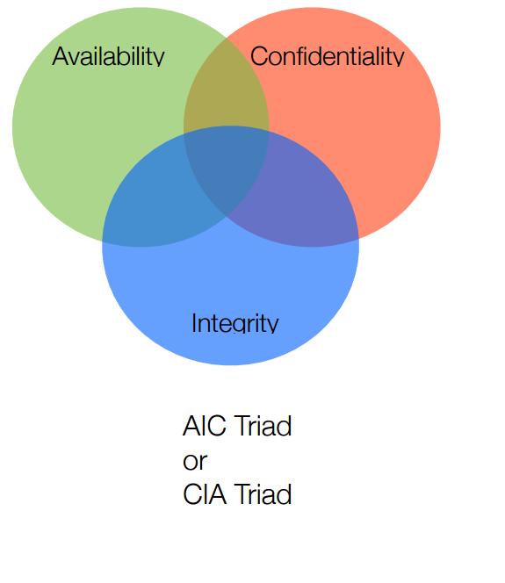
Fundamental Principles of Security

Slide 14
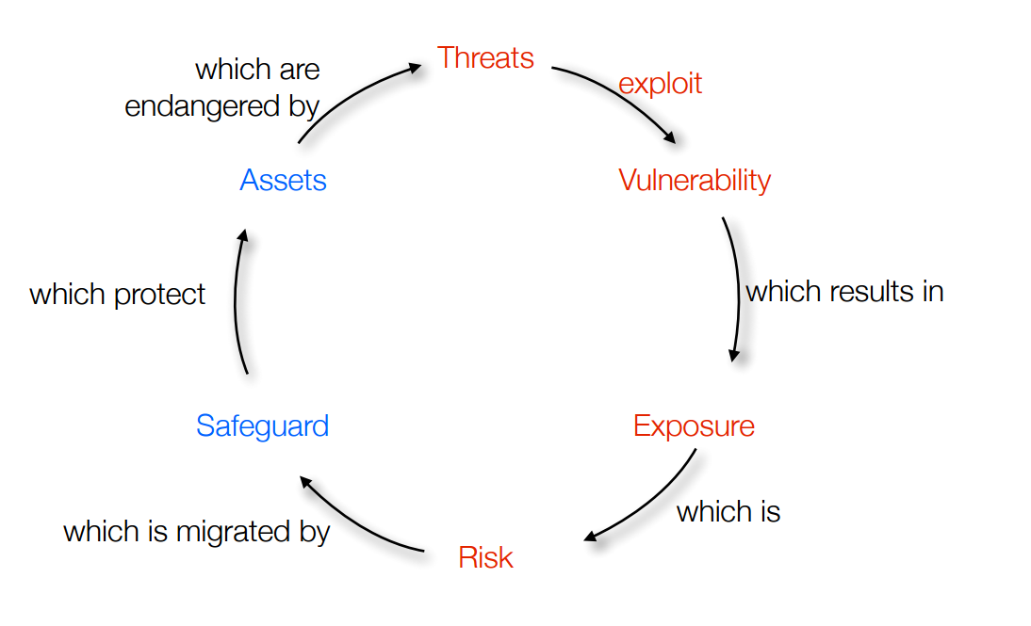
Risk

Slide 15
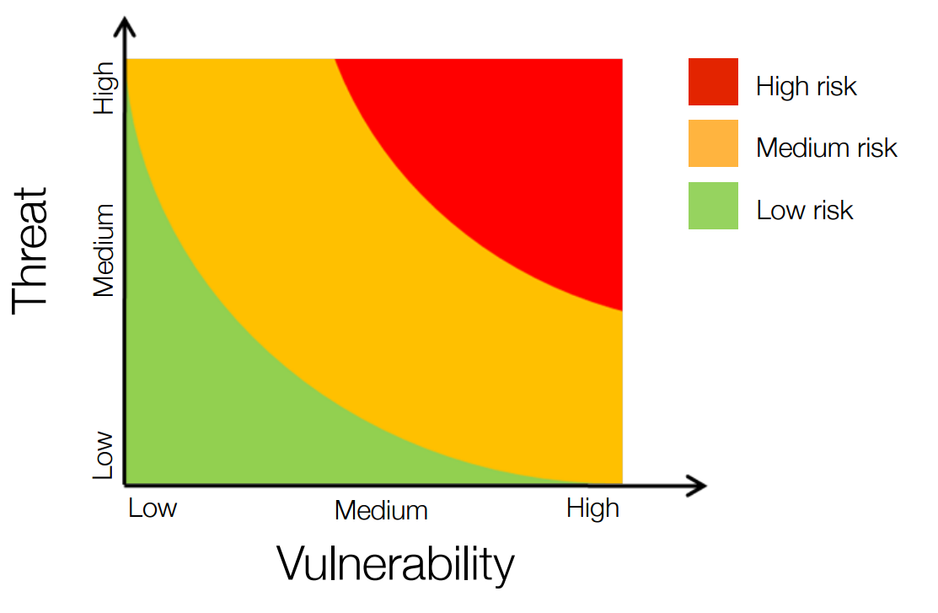
Risk Terminology

Slide 16
Potential Threats
Intrusion
Viruses / Worms
External Attacks
Intrusion Viruses / Worms
Interception

Slide 17
Threats
Intrusion
Gaining Access to internal infrastructure
Viruses / Worms
Replicating Software
External Attacks
Denial of Service.
Interception
Catching communication while en route between sender and receiver.

Slide 18
Intrusion
Gaining access to internal infrastructure;
Stealing Mobile Phone
Guessing Passwords
Hacking into private spaces
Once a hacker has access to an account, they have the same rights as the account owner.
Problem 1: Preventing hacker from accessing account.
Problem 2: Finding out what someone may have done while they had access.

Slide 19
Viruses / Worms
Virus
Software Program that replicate itself on more PC’s – in a similar way to viruses spread between people.
Viruses need another program to piggyback off, e.g. a macro in a spreadsheet, or document.
Are often spread using email
Worms
A small piece of software that uses security loopholes to replicate.
E.g. finds a loophole in Windows, scans network for another PC with a similar loophole and copies itself to the new PC etc.

Slide 20
External Attacks
Attacks without gaining access to a private device.
Denial of Service(DoS)
Very Common Attacks
Purpose, to use up bandwidth or service, by ‘spoof’ conversations.
Blocking Webservers with repeated hits
Spam emails
Distributed Denial of Service (DDOS)
Attacking from many addresses simultaneously.
Code Red Worm
Chain Letters

Slide 21
Interception
Catching communication whilst on route between sender and receiver.
Intercepting Signals.
Wireless Signals
Government listening in on telephone conversations
Normally minimised through encryption.
Accessing someone else’s service
Using bandwidth of wireless network

Slide 22
Improving Security
Security Policies
Limiting users access & actions
Firewalls
Protection between network and internet
Authentication
Passwords etc.
Encryption
Encoding contents of communication
Patches
Responding to security breaches

Slide 23
Security Policies
Access Control Lists (ACL)
Limit which users can do what (e.g. update websites)
Signed agreements for service
When allowing users onto a network, normally they sign an agreement, regarding terms of use.
Did you sign one at CMU?
Policies could include,
Regular password changes
Whether personal use of service is permitted
Antivirus updates
Can help against, external attacks, intrusion, virus / worms

Slide 24
Firewalls
Hardware and / or Software protection sitting between internal network and internet.
Can help stop viruses/worms from accessing the network,
W W W

Slide 25
Authentication
Software to ensure permission of user to access service
Password
Finger prints / retina scans
Helps against intrusion

Slide 26
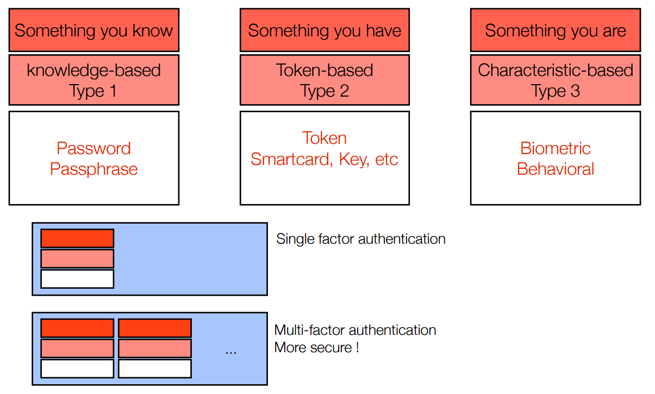
Authentication

Slide 27
Encryption
Encoding the contents of a transmission so it can’t be decrypted on route.
Symmetric-key encryption
Public / Private key encryption
Helps prevent interception.

Slide 28
Symmetric Key Encryption
Both sender and receiver use the same ‘code’ to encrypt and then decrypt a message.
If I tell you to move each character back two in the alphabet, and then send you this message;
Jgnnq Encuu
Anyone who intercepts the message gets nothing, but you are able to decrypt it.
More interesting patterns can be created to increase security.
Substitution
Transposition
Key:
FANCY
Message: eatitnihmexnetmgmedt

Slide 29
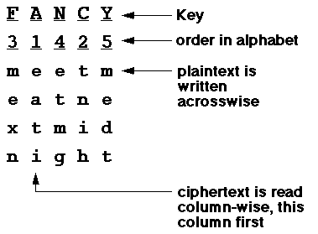
Decoding

Slide 30
Patches
Response to a virus or security breach
Anti virus software often updates to add new virus definitions.
Operating systems regularly update to deal with security loopholes which may allow worms to work.

