Slide 1
Web Programming Language
Week 12
React 3

Slide 2
Topics
UseEffect
APIs
Firebase
A To Do List

Slide 3
useEffect
Another Hook
  Allows performing ‘side effects’ in components, such as fetching data, timers, updating the DOM

Slide 4
AddTweet
Import useEffect
import React, {useState, useContext, useEffect} from 'react’;
Add a function
useEffect(() => {
console.log('Render');
});
The function will run each time the AddTweet component is rendered

Slide 5
Edit
If we want the function to only run on the first render;
useEffect(() => {
console.log('Render');
}, []);

Slide 6
A Timer
Add a counter state
const [count, setCount] = useState(0);
Add a timer
useEffect(() => {
setTimeout(() => {
setCount((count) => count + 1);
}, 1000);
console.log({count});
});

Slide 7
Dependent on state or prop values
Will run when the ‘count’ changes
useEffect(() => {
setTimeout(() => {
setCount((count) => count + 1);
}, 1000);
console.log({count});
}, [count]);

Slide 8
Dependent on state or prop values
How about this?
useEffect(() => {
setTimeout(() => {
setCount((count) => count + 1);
}, 1000);
console.log({count});
}, [tweets]);

Slide 9
Initialising data
import React, {useState, useEffect, createContext} from 'react’
export const TweetContext = createContext();
export const TweetProvider = (props) => {
const [tweets, setTweet] = useState([]);
useEffect(() => {
setTweet(JSON.parse(localStorage.getItem('tweets')));
}, [])
return (
<TweetContext.Provider value={[tweets, setTweet]}>
{props.children}
</TweetContext.Provider>
)
}
Empty Array
Get Data on first
render

Slide 10
Getting Data from an API
const API_URL = 'http://kencosh.com/calendar/calendar.php';
const [dates, setDates] = useState([]);
useEffect(() => {
const fetchDates = async () => {
try {
const response = await fetch(API_URL);
const dateList = await response.json();
setDates(dateList);
} catch (err) {
console.log(err);
}
}
(async () => await fetchDates())();
}, [])

Slide 11
Quick Project
A TO DO list
This time getting data from Firebase
(https://dev.to/devland/build-a-todo-app-with-react-and-firebase-47m1)

Slide 12
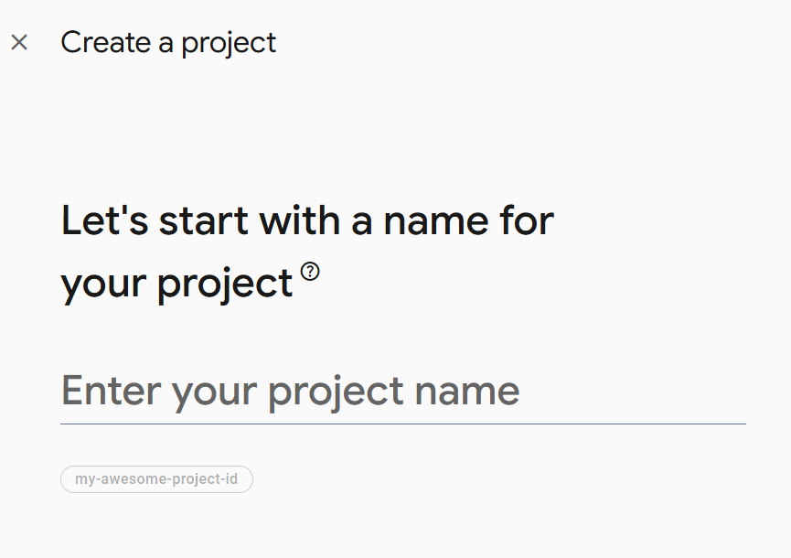
Firestore
https://firebase.google.com/
Build->Firestore
  Get started
  Create a new Firebase project

Slide 13
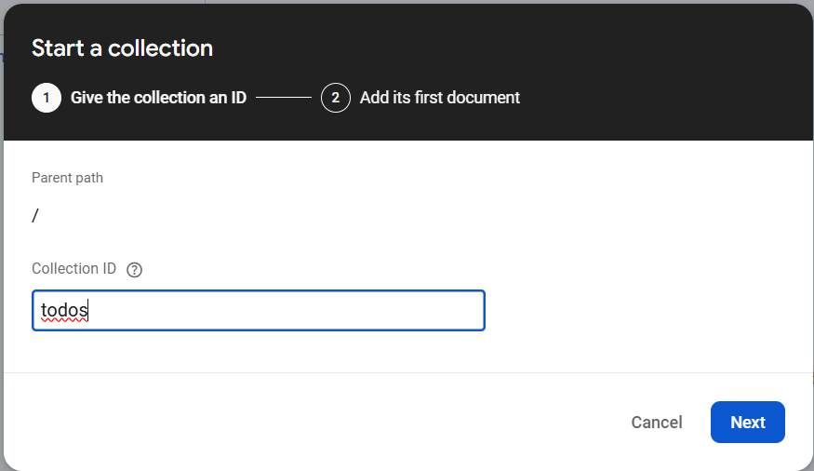
Create a database & start a collection
Create Database
Start a collection
  Called ‘todos’
  With a String field called ‘todo’
  Any random value

Slide 14
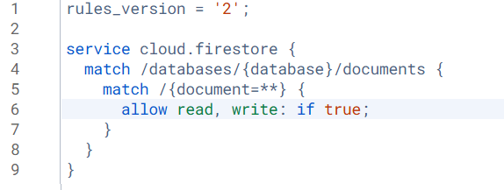
Quick Fix

Slide 15
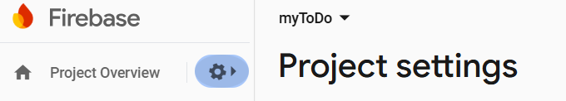
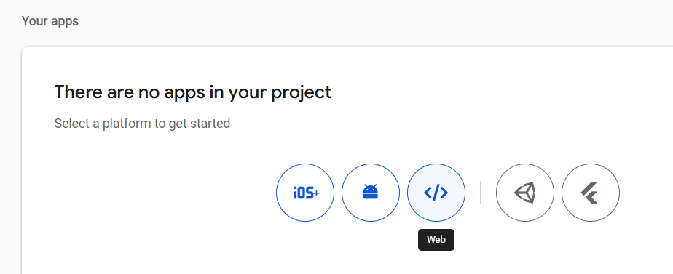
Create a Web App

Slide 16
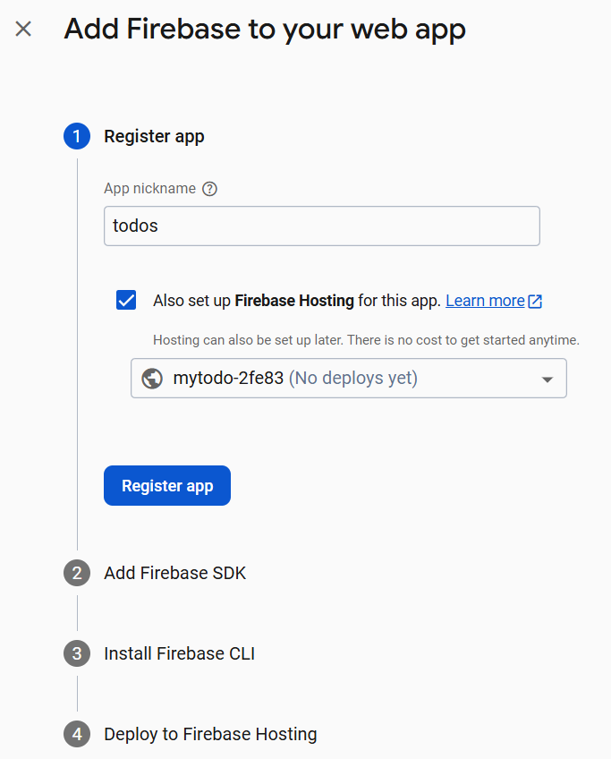
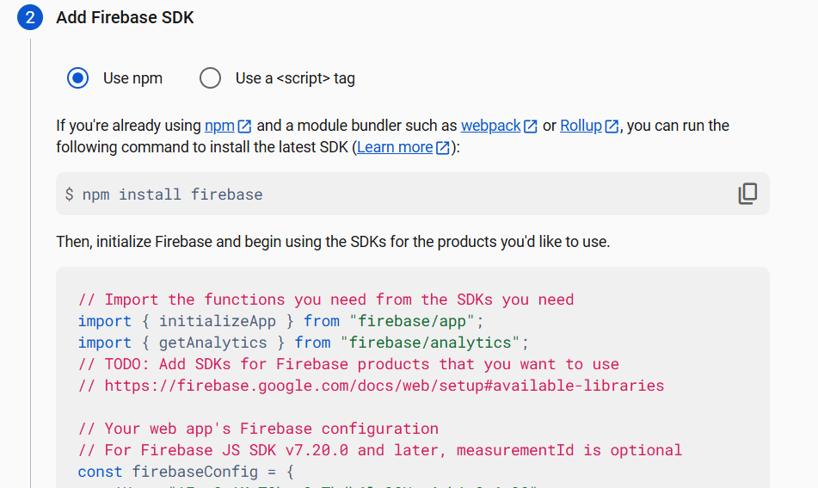
Get config to add Firebase

Slide 17
Add App
To get firebaseConfig
Looks like:-
// Your web app's Firebase configuration
const firebaseConfig = {
apiKey: “string",
authDomain: “string",
projectId: “string",
storageBucket: “string",
messagingSenderId: “string",
appId: “string"
};

Slide 18
Let’s create a new Project
npm create vite@latest my-app -- --template react

Slide 19
Set up new React App
Delete unnecessary files
Index.jsx
import React from 'react’;
import ReactDOM from 'react-dom/client’;
import './index.css’;
import App from './App';
const root = ReactDOM.createRoot(document.getElementById('root’));
root.render(
<React.StrictMode>
<App />
</React.StrictMode>
);

Slide 20
App.jsx
function App() {
return (
<div className="App">
<h2>TO DO List</h2>
</div>
);
}
export default App;

Slide 21
Material UI
A Component library of UI tools
  npm install @mui/icons-material
  npm install @mui/material @emotion/react @emotion/styled
https://mui.com/
We will also need firebase
  npm install firebase

Slide 22
Add some Todo State to App
import React, {useState} from 'react’;
import './App.css’;
function App() {
const [todos, setTodos] =useState([
'Study’,
'Sleep’,
'Party’
]);
return (
<div className="App">
<h2>To Do List</h2>
<ul>
{todos.map(todo=><li>{todo}</li>)}
</ul>
</div>
);
}

Slide 23
App.jsx – Add a Form
import React, {useState} from 'react’;
import {TextField , Button } from '@mui/material’;
import './App.css’;
function App() {
const [todos,setTodos]=useState([
'Study Algorithms’,
'Study Web’,
'Party’
]);
const [input, setInput]=useState(‘’);
const addTodo=(e)=>{
e.preventDefault();
setTodos([...todos,input]);
setInput(‘’)
};
return (
<div className="App">
<h2> TODO List App</h2>
<form>
<TextField id="outlined-basic" label="Make Todo" variant="outlined" style={{margin:"0px 5px"}} size="small" value={input} onChange={e=>setInput(e.target.value)} />
<Button variant="contained" color="primary" onClick={addTodo} >Add Todo</Button>
</form>
<ul>
{todos.map(todo => <li>{todo}</li>)}
</ul>
</div>
);
}
export default App;

Slide 24
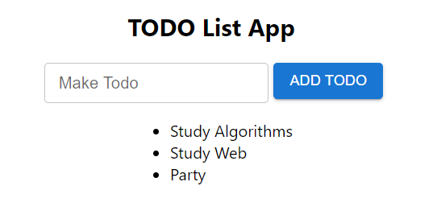
Starting To Do List
With some dummy state data

Slide 25
Connecting to firebase
firebase.jsx
import { initializeApp } from "firebase/app";
import { getFirestore } from 'firebase/firestore’;
const firebaseConfig = {
apiKey: “…",
authDomain: “…",
projectId: “…",
storageBucket: “…",
messagingSenderId: “…",
appId: “…“
};
const firebaseApp = initializeApp(firebaseConfig);
const db = getFirestore(firebaseApp);
export { db }

Slide 26
A ToDo Component
components/Todo.jsx
import { List , ListItem, ListItemAvatar, ListItemText } from '@mui/material’;
import DeleteIcon from '@mui/icons-material/Delete’;
import {db} from '../firebase.js’;
import { doc, deleteDoc } from "firebase/firestore";
import './todo.css’;
const Todo=({todo})=>{
return (
<List className="todo__list">
<ListItem>
<ListItemAvatar />
<ListItemText primary={todo} secondary={todo} />
</ListItem>
</List>
)};
export default Todo;

Slide 27
Use the ToDo Component in App.js
Remember to import the Todo component!
<ul>
{todos.map(todo=> <Todo todo={todo} />)}
</ul>

Slide 28
UseEffect to get data from firebase
import React, {useState, useEffect } from 'react’;
import {TextField , Button } from '@mui/material’;
import Todo from './components/Todo’;
import { db } from './firebase.js’;
import { collection , onSnapshot } from 'firebase/firestore’;
import './App.css’;
function App() {
const [todos,setTodos]=useState([]);
const [input, setInput]=useState(‘’);
useEffect(() => {
onSnapshot(collection(db,'todos'),(snapshot)=>{
setTodos(snapshot.docs.map(doc => doc.data()))
})
},[input]);
…
…
{todos.map(({todo})=> <Todo todo={todo} />)}

Slide 29
Tweak setTodos to use ids
useEffect(() => {
onSnapshot(collection(db, 'todos'), (snapshot) => {
setTodos(snapshot.docs.map(doc =>({
id: doc.id,
item: doc.data()
})))
})
}, [input]);
…
…
{todos.map(item => <Todo key={item.id} arr={item} />)}

Slide 30
Change Todo.jsx to accept the array
const Todo=({arr})=>{
return (
<List className="todo__list">
<ListItem>
<ListItemAvatar />
<ListItemText primary={arr.item.todo} secondary={arr.item.todo} />
</ListItem>
</List>
)};

Slide 31
Add ToDo
import { collection, onSnapshot, serverTimestamp, addDoc } from 'firebase/firestore';
const addTodo=(e)=>{
e.preventDefault();
addDoc(collection(db,'todos’),{
todo:input,
timestamp: serverTimestamp()
})
setInput(‘’)
};

Slide 32
Add a Delete Icon
components/Todo.js
import { List , ListItem, ListItemAvatar, ListItemText } from '@mui/material’;
import DeleteIcon from '@mui/icons-material/Delete’;
import {db} from '../firebase.js’;
import { doc, deleteDoc } from "firebase/firestore";
import './todo.css’;
const Todo=({arr})=>{
return (
<List className="todo__list">
<ListItem>
<ListItemAvatar />
<ListItemText primary={arr.item.todo} secondary={arr.item.todo} />
</ListItem>
<DeleteIcon fontSize="large" style={{opacity:0.7}} onClick={() => {deleteDoc(doc(db,'todos',arr.id))}} />
</List>
)};
export default Todo;

Slide 33
Add some style
Todo.css
.todo__list{
display:flex;
justify-content: center;
align-items: center;
width: 800px;
border: 1px solid lightgray;
margin-bottom: 10px !important;
}

Slide 34
App.css
.App {
display:grid;
place-items:center;
}

Slide 35
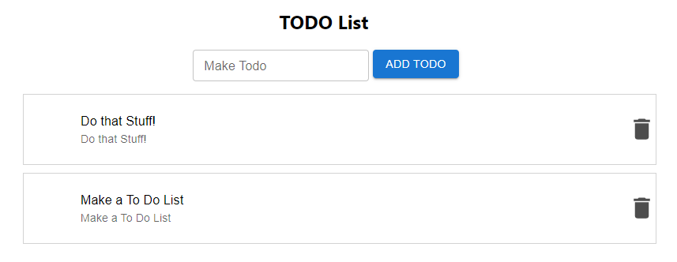
To Do!

Slide 36
Key Points
UseEffect can be used to connect to a server and collect data
Firebase is a cloud document store we can use to store our data rather than localStorage

