Slide 1
261446 Information Systems
Week 4
Ethical & Social Issues in IS

Slide 2
Week 4 Topics
Ethical & Social Issues Related to Systems
Ethics in an Information Society
The Moral Dimensions of IS

Slide 3
Case Studies
Are Cars Big Brother on Wheels?
Facebook: Your Life for Sale

Slide 4
Ethics
The principles of right and wrong that individuals, acting as free moral agents, use to make choices to guide their behaviours
IS continues to raise new ethical questions for individuals and society
  Like other technologies, (steam engines, electricity, the telephone, radio), IS can be used to achieve social progress, but also used to commit crime and threaten social values

Slide 5
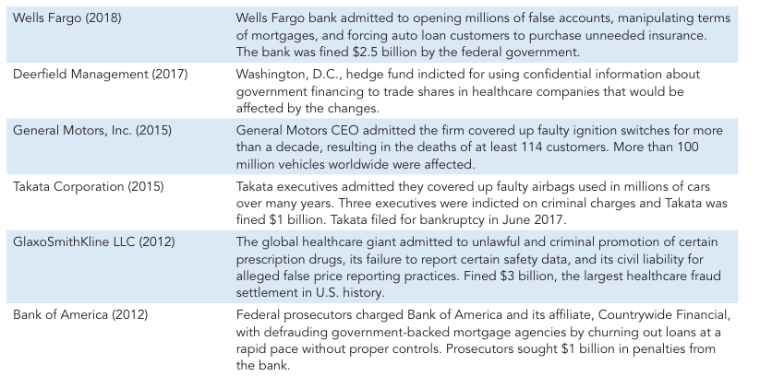
Failed Ethical Judgment

Slide 6
Failed Ethical Judgment
So they might not be IS related, but often IS was used to help cover up their tracks
You may be faced with questions such as the use of customer information, protection of personal privacy or protection of intellectual property.
What is the Ethical and Socially Responsible course of action?

Slide 7
Ethical, Social & Political Issues
These 3 issues are closely linked.
  Ethical dilemmas are reflected in society, and society in turn influences political debates.
New technology or systems sometimes confront actors with new situations not covered by existing rules / social norms.
Society may take years to develop etiquette, expectations, social responsibility, politically correct attitudes or rules.
Political institutions also take time to develop new laws, and may only be able to respond after some real harm is caused.
Until then there may be a large grey area!

Slide 8
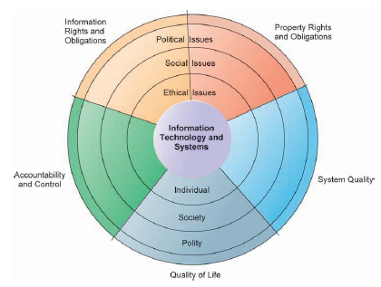
Moral Dimensions in the Information Age

Slide 9
Moral Dimensions in the Information Age
Information Rights and Obligations
  What information rights to we have? What can we protect?
Property Rights and Obligations
  How are Intellectual Property rights to be protected?
Accountability and Control
  Who is liable for harm caused to information and property rights?
System Quality
  What standards should exist to protect these rights?
Quality of Life
  What values should be preserved? Which institutions should be protected? What about cultural values?

Slide 10
Relevant Technology Trends
Computing power doubles every 18 months
Data storage costs rapidly decline
Data analysis advances
Networking advances
Mobile device growth impact

Slide 11
Moore’s Law
Computer power doubling every 18 months
  IS being used for core processes
  Increased dependence on systems
    and hence vulnerability to system errors
  Social rules / laws are yet to adjust to this dependency
    There are few standards for accuracy & reliability levels

Slide 12
Data Storage Costs
Data storage is cheap!
  So why not store data on employees, customers, potential customers…
How about individual privacy?
  Easy, and cheap to violate

Slide 13
Data Analysis
Organisations & Government Agencies can find out highly detailed personal information about individuals
Combining a large amount of digital personal information
  credit card purchases
  telephone records
  magazine subscriptions
  search history
  browsing history
  banking records
  government records
This is then used to profile individuals

Slide 14
Use of Profiling?
Double Click (owned by Google)
  Internet Advertising Broker
ChoicePoint (data broker)
  Collects data from police, criminal, car records, credit cards, employment histories, current & previous addresses, professional licenses, insurance claims, to create a profile of everyone, which is then sold.
NORA (Nonobvious Relationship Awareness)
  Powerful government profiling capability. Finds obscure hidden connections to help identify criminals or terrorists

Slide 15
Networking Advances
Greatly reduces the cost of moving and accessing large quantities of this data.
  The ability to mine large pools of data remotely on less powerful machines

Slide 16
Mobile Devices
Phones can be tracked without user consent or knowledge

Slide 17
Responsibility, Accountability & Liability
Responsibility
  You accept potential costs, duties & obligations for the decisions you make
Accountability
  Mechanisms exist to determine who took responsible action
Liability
  Damaged individuals may under the law recover damages done to them, by the liable party

Slide 18
People & IT
IT alone does nothing
IS which has an ethical impact does not have that impact by itself
The impacts are products of an institutional or individual action and behavior
  Ergo, the responsibility falls on the institution or individual

Slide 19
Ethical Analysis
Identify and describe the real facts clearly
Define the conflict or dilemma, and identify the values involved
Identify the stakeholders
Identify the options you can reasonably take
Identify the possible consequences of your options

Slide 20
Ethical Principles
The Golden Rule
  Do unto others as you would have them do unto you.
Immanuel Kant’s Categorical Imperative
  If an action is not right for everyone to take, it is not right for anyone. If everyone did this, could the organization (or society) survive?
Descartes’ Rule of Change
  If an action cannot be taken repeatedly, it is not right to take at all. The “slippery slope”, while it may only cause a small change now, what if we keep doing it?

Slide 21
Ethical Principles
Utilitarian Principle
  Take the action that achieves the greater value – assuming you can prioritise values
Risk Aversion Principle
  Take the action which causes the least harm or potential cost. Avoid high cost actions.
No Free Lunch Rule
  Assume that all tangible or intangible objects are owned by someone else, and assume that they want compensation for it

Slide 22
Moral Dimensions of IS
Information Rights: Privacy & Freedom
Property Rights: Intellectual Property
Accountability, Liability & Control
System Quality
Quality of Life

Slide 23
Information Rights: Privacy & Freedom
The claim of individuals to be left alone, free from surveillance or interference by other individuals, organisations or the state.
  In US & Canada & Germany, the claim to privacy is protected by law
  Most European privacy laws are based on “Fair Information Practices”
    Notice / Awareness
    Choice / Consent
    Access / Participation
    Security
    Enforcement

Slide 24
Fair Information Practice
If I want to partake in a transaction, I have to give up some of my private information (perhaps my name, perhaps my credit card, etc.)
  I should be notified that data is being collected about me
  I should then have a choice (how that information is used, or reused)
  I should have access to review the accuracy / completeness of the data
  The data should be kept securely
  There must be some enforcement to ensure that the principles are being adhered to

Slide 25
The Internet & Privacy
Obviously the Internet has had impacts on privacy, and behavior tracking
  Cookies
  Other tracking files
  Spyware
Google probably has the largest collection of personal data, followed by Facebook – probably more than any government

Slide 26
Property Rights : Intellectual Property
Intangible property created by individuals or corporations.
  How do we protect it when digital networks make it so easy to copy and distribute?
    Trade Secrets
    Copyright
    Patents
  How about on a global scale? (How about Thailand?)

Slide 27
Accountability, Liability & Control
If a person is injured by a machine controlled by software, who is accountable, and liable?
  What about a self driving car?
If someone posts offensive material on a forum, who is accountable?
  The host? the domain register? the (possibly anonymous) poster? the IP address of the poster?

Slide 28
Accountability, Liability & Control
In October 2011, BlackBerry users suffered disruption to their email service – a 3 day blackout.
  Effects amplified when a backlog of messages suddenly appeared and took down the system.
Who’s fault?
  The hardware? (a core switch was initially to blame)
  The software? (unable to cope with the backlog of messages)
Who is liable for the economic harm caused to individuals and businesses?
Is your cell phone service provider liable for damages when you are denied service?

Slide 29
Accountability, Liability & Control
Consider an ATM – what if that service fails?
  Customers could be inconvenienced, and perhaps harmed economically should they not be able to access funds.
  Should the bank be liable?
  Should the hardware provider be liable?
  Should the software provider be liable?

Slide 30
System Quality
What expectations should technology users have?
  When should the manager say “Enough! Stop testing, lets ship it!”
    Are they then liable for potentially foreseeable and correctable errors?
  Managers knowingly ship defective software, otherwise it would never be shipped.
    Zero defects can’t be achieved, and we can’t predict the seriousness of remaining bugs.

Slide 31
Quality of Life
Balancing Power: Center vs Periphery
  Centralised structures (single gateway, centralized mainframes) offer control and power, while decentralized structures lead to empowerment of workers, and decentralized decision making. What happens when the centralised collection and control of data shifts from the state, to private corporations?
Rapidity of Change: Expected Response Times
  If your business doesn’t respond quickly, it could be wiped out. We are living in a “Just in Time” society, what about the risks to jobs, families etc.?

Slide 32
Quality of Life
Maintaining Boundaries: Family, Work & Leisure
  Ubiquitous computing happens everywhere, under the mantra, “do anything anywhere”. Traditionally family time was separated, but these boundaries are being weakened. Family and Friends offer an important support mechanism for the individual.
Dependence & Vulnerability
  What if the system fails?

Slide 33
Quality of Life
Computer Crime & Abuse
  Increase in identity theft, malware, phishing, device theft, botnets, spam…
Employment: Re-engineering Job Loss
  Mostly we talk about the positive effects of new IS, but…. how about the millions of mid-level managers and clerical workers who have lost their jobs?

Slide 34
Quality of Life
Equity & Access
  The “Digital Divide”. Does everyone have equal opportunity to participate in the digital age?
Health Risks
  Repetitive Stress Injury (RSI), Carpal Tunnel Syndrome (CTS), Computer Vision Syndrome (CVS), Technostress…

