Slide 1
261446 Information Systems
Week 7
Securing Information Systems

Slide 2
Week 7 Topics
System Vulnerability & Abuse
Business Value of Security & Control
Establishing a Framework for Security & Control
Technologies & Tools for Protecting Information Resources

Slide 3
Case Studies
Case Study #1) US Election
Case Study #2) Equifax

Slide 4
Security & Controls
Security
  Policies, procedures and technical measures used to prevent unauthorized access, alteration, theft or physical damage to information systems
Controls
  Methods, policies and organizational procedures that ensure the safety of the organization’s assets, the accuracy and reliability of its records and operational adherence to management standards

Slide 5
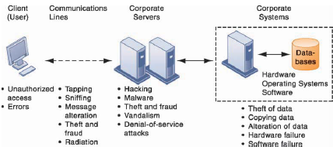
Threats

Slide 6
Threats
Unauthorised access can occur at any access point in the network
  At every layer, and in the communication between layers
When partnering with other companies, valuable information may exist on networks & computers beyond the control of the organization
With the growing popularity of mobile devices the threats increase
  Data goes mobile
  Easy to lose or steal

Slide 7
The Internet & Wireless
As systems move more onto the Internet, more data flows through machines that the organization has no control over.
Transmitting data via email or IM may leave them open to interception
Email & P2P file sharing is also vulnerable to malicious software
Connecting wirelessly (particularly via public wifi connections) also opens possibilities for hackers
Wardriving!

Slide 8
Malicious Software
Malware
  Virus - rogue software program attached to other software programs to be executed
  Worms – independent programs that copy themselves from one machine to another
  Trojan Horse – program that appears to be benign, and then does something unexpected
  Spyware – Monitor activity such as web surfing activity, and offer up advertising
  Keyloggers – record every keystroke made to steal passwords, or personal information

Slide 9
Malware
Malware goes Mobile
  Hackers can do to a smartphone just about anything they can do to any other internet device
  Kaspersky Lab found 5.7 million mobile malicious packages in 2017.
Malware goes Social Networking
  Blogs, wikis & sites like Facebook are also conduits for malware or spyware
Malware goes IoT
Malware is Increasing
  Particularly Trojans, but there are increasing amounts of malware being produced – as many as one in ten downloads contains harmful programs.

Slide 10
SQL Injections
Poorly coded Web application software to introduce malware into a company’s systems & networks
Rogue SQL queries sent to access the database from any data entry point.

Slide 11
Spoofing & Sniffing
Misrepresenting oneself
  Fake email address / website
  Redirecting a weblink
Sniffing software can be used legitimately to identify network trouble spots, or criminal activity, or can be used to steal information

Slide 12
Denial of Service Attacks
DoS attacks or DDoS attacks
  F5
Botnets make DDoS attacks easier
  Grum botnet responsible for 18% of spam traffic, having infected and controlled 560,000-840,000 computers
  The Mirai botnet infected IoT devices and then launched a DDoS attack against Dyn in October 2016, taking down Etsy, GitHub, Netflix, Shopify, Soundcloud, Twitter, Spotify…

Slide 13
Computer Crime
“Any violations of criminal law that involve knowledge of computer technology for their perpetration, investigation or prosecution”
  Nobody knows the extent of computer crime
  Many companies don’t report computer crimes, for fear their vulnerability will be exposed

Slide 14
Computer Crime
Computers as targets of crime
  Breaching confidentiality of protected data
  Accessing a computer system without authority
  Knowingly accessing a protected computer to commit fraud
  Intentionally accessing a protected computer and causing damage
  Knowingly transmitting a program, code or command that causes damage to a protected computer
  Threatening to cause damage to a protected computer

Slide 15
Computer Crime
Computers as instruments of crime
  Theft of trade secrets
  Unauthorised copying of software or IP
  Schemes to defraud
  Using email for threats or harassment
  Intentionally attempting to intercept electronic communication
  Illegally accessing stored communications
  Child Pornography

Slide 16
Identity Theft
Also increasing
  11.6 million people, losses of $18 billion (in 2011)
  17.6 million people, losses of $17 billion (in 2017)
How?
  Hacking Ecommerce website databases
  Phishing
  Evil Twins
  Pharming

Slide 17
Click Fraud
Fraudulent clicks on ads
  I could put some ads on kencosh.com, and click on them…
    or get y’all to click on them…
Or, fraudulent clicks on competitors ads, to drive up their marketing costs

Slide 18
Internal Threats: Employees
Employees have access to information
  Can you trust them?
Many employees lack the knowledge to protect themselves against security breaches
Social Engineering
  Tricking employees by pretending to be a member of the company in need of information

Slide 19
Why Spend on Security?
No tangible return on investment
No direct impact on sales revenues
But what if there IS a breach?
  Confidential records, tax reports, financial assets, medical records, performance reviews, trade secrets, new product development plans, marketing strategies.
  Government systems contain information on weapons systems, intelligences ops, military targets
And what about the Legal responsibility?

Slide 20
Legal Responsibilities?
Different countries have different legal liabilities………

Slide 21
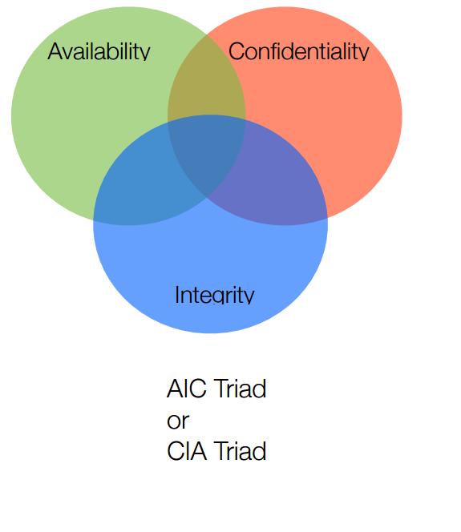
Fundamental Principles of Security

Slide 22
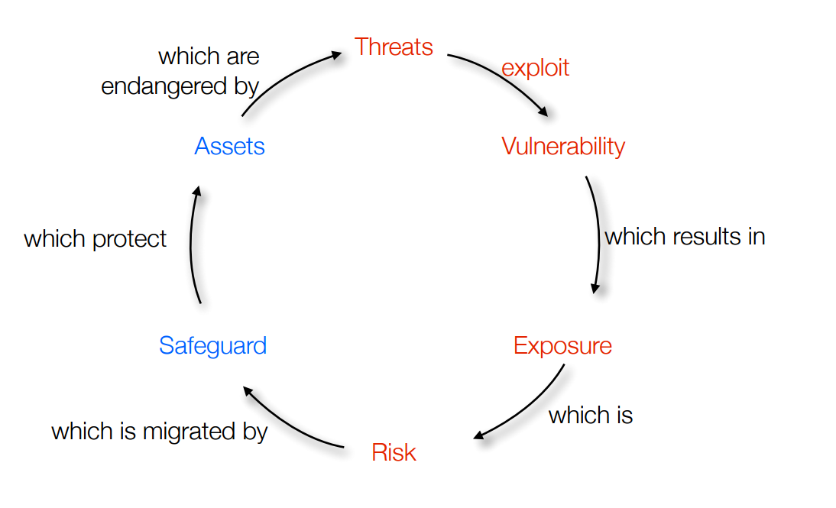
Risk

Slide 23
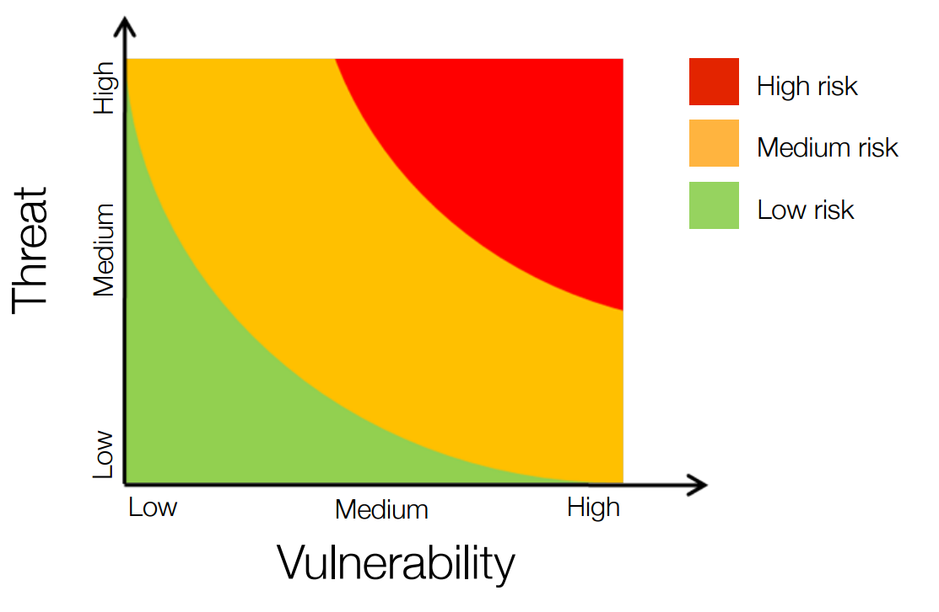
Risk Terminology

Slide 24
IS Security Protection
Identity Management & Authentication
  Keeping track of users and their system privileges.
    Passwords
      How good is your password?
    Physical Token
      Could you lose it, or leave it behind?
    Biometrics

Slide 25
IS Security Protection
Firewalls
  Hardware and software controlling incoming and outgoing network traffic
  Checks names, IP addresses, etc. against access rules
    Packet filtering examines the header of each packet, Stateful inspection tracks if packets are parts of ongoing dialogues
    Network Address Translation (NAT) conceals the true IP address of computers within the private network

Slide 26
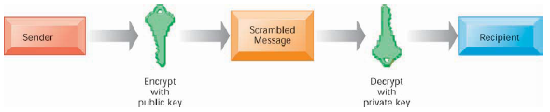
IS Security Protection
Intrusion Detection
  Monitoring vulnerable parts of a system – if there is a breach, finding out that it has happened, and what the intruder has done is not easy.
Anti-virus / Anti Spyware
Encryption & Public Key Infrastructure
  Translating plain text into cipher text that requires the encryption key to decode

Slide 27
Ensuring System Availability (Reliability)
Redundant Hardware, Software, Power Supplies, Network connections
Triple Modular Redundancy for Hardware Components
N-Version Programming for Software Components

