Slide 1
ISNE101 – Introduction to Information Systems & Network Engineering
Week 2

Slide 2
Last Week
Introduction
Fundamentals of Information Systems (&NE)
This Week
Looking into Digital Communication

Slide 3
To begin with...
Lets learn to Count!
1,2,3,4.... What comes next?
What happens when we reach 9?
What if we use a different base?

Slide 4
The wonderful world of Binary
Binary is Base 2
0,1,10,11,100,101,110,111...
A '0' or a '1' is a binary digit, or 'bit'.
Computers only use Binary, where each bit can have 2 states. The state of a bit can be stored as;
On/Off
Direction of magnetism
Different voltages
Different levels of light intensity

Slide 5
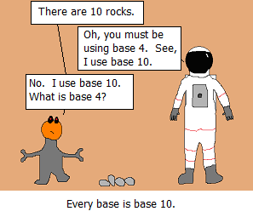
Every Base is Base 10!

Slide 6
How about Morse Code?
5 Elements
Dots
Dashes
Intra-character gap
Short gap (between letters)
Long gap (between words)
"..." = S "---" = O "... --- ..." = ???
"." = E "-" = T "--.-" = Q (not TTET!)
Why?

Slide 7
Back to Binary
2 Elements
0
1
There are no gaps, so 'gaps' would have to be represented by 0's and 1's.
In the same way as Morse Code we can 'encode' each character of the alphabet in 0's and 1's

Slide 8
Binary Encoding
0000 = A 0001 = B 0010 = C
0011 = D 0100 = E 0101 = F
0110 = G 0111 = H 1000 = I
1001 = J 1010 = K 1011 = L
1100 = M 1101 = N 1110 = O
1111 = P ...uhoh!
11101110011111011110
1101111000100000110100111110
101001001101001110000011000100000011
11101010

Slide 9
A Byte
A series of 4 bits (a nibble) isn't enough to encode all the capital letters
There are 16 different variations
Which is a single hexadecimal character!
In computing we generally store things in Bytes - a sequence of 8 bits.
That gives 256 different combinations
Enough for every small letter, capital letter, punctuation, number...

Slide 10
It's all binary
Everything on a computer is in binary...
Colour
Sound
With colour we can have a picture
With pictures, sound (and time) we can have a movie
If a colour has 3bytes, then a picture with X pixels could have 3X bytes?
If a movie has Y pictures, we have 3XY bytes!
Not quite, but correct in the principle, and that is why we need bigger and bigger hard drives (and faster connections!)

Slide 11
Digitisation
Converting 'stuff' to binary is called digitisation.
Discussion:
What are the effects of digitisation?
on Form?
on Quality?
on Value?
on Ownership?

Slide 12
Remember Morse?
E is ".", T is "-", but Q is "--.-"
Common letters have a short (quick!) code, while longer letters have a longer code.
•All symbols m_{i} forming the set M, have probabilities of occurrence P(m_{i}) such that P(m_{i}) + … + P(m_{n}) =1
Infrequently occurring symbols can be assigned a long code word, while short code words are reserved for frequent symbols.

Slide 13
Encoding Objectives
Each codeword corresponds to exactly one symbol.
Decoding should not require any look ahead.
–This is known as the ‘prefix’ property.

Slide 14
Prefix Property
•Symbols: A, B, C
•Codes: 1, 0, 10
•Message: 10
•Is it ‘AB’? Is it ‘C’?
In Morse code, how do we know "--.-" is Q and not "TTET"?

Slide 15
Prefix Property
•Symbols: A, B, C,
•Codes: 1, 00, 10
•Message: 1000
•Read in 1, is it an A?
•Read in 0, was it a C?
•Read in 0, Should it be AB?
•Read in 0, Ah, finally we can assume it was CB.

Slide 16
Code Optimisation
The length of a code for one symbol should not exceed the length of a less likely symbol;
– if P(m_{i})< P(m_{j}) then L(m_{i}) < L(m_{j})
There should be no unused short codes, either as stand alone encodings or as prefixs for longer codes.
– 01, 000, 001, 100, 101 is not ideal as 11 is not used.

Slide 17
Huffman Coding
Huffman coding is a method for choosing a representation for each symbol, resulting in a prefix-free code
–The bit string representing some particular symbol is never a prefix of the bit string representing any other symbol
The most common characters are expressed using shorter strings of bits than are used for less common symbols.

Slide 18
Huffman Coding
Huffman creates a "Heap" based on the frequencies of each symbol.
What is a "Heap"?
A heap is a special kind of Binary Tree!
Great! - What is a "Binary Tree"?
It's a tree where each node has at most 2 children...
Hmmm... - What is a "Tree"?
OK, lets simplify!

Slide 19
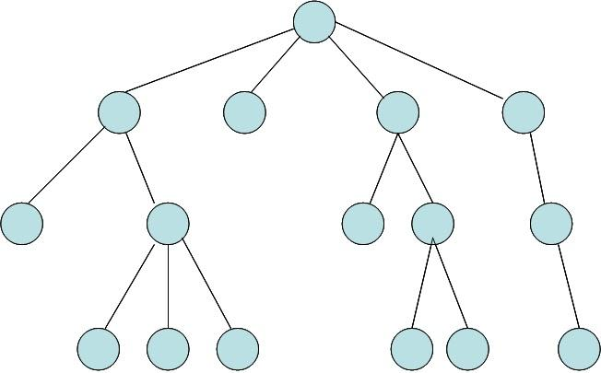
A Tree

Slide 20
A Binary Tree
A Tree where each node has 0,1 or 2 children.

Slide 21
A Heap
A Binary Tree where the root node has the highest value, and every parent's value is greater than their children.
12
4
8
1
3

Slide 22
Huffman Coding
Begins by constructing a Heap based on the frequencies of each member of the set to be encoded.
Each member is a leaf node, with parent nodes being the sum of their children.
•Take the set (with corresponding occurrence frequencies out of 120);
•
A(10) B(15) C(5) D(15) E(20) F(5) G(15) H(30) I(5)

Slide 23
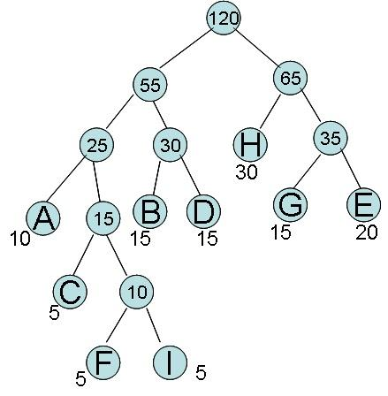
Huffman's Heap

Slide 24
Huffman Coding
Each letter's code is then read based on its position from the root - 0 for left, 1 for right.
A = 000
B = 010
C = 0010
D = 011
E = 111
F = 00110
G = 110
H = 10
I = 00111

Slide 25
Creating the Heap?
Based on frequencies, such as in the British National Corpus?
Based on frequencies within the specified text (or image etc.)
Standard Approach to Huffman
What if we don't know the frequencies?
Adaptive Huffman

Slide 26
Important Laws
Moore’s Law
  Performance doubles every 18-24 months, while costs stay the same.
Metcalfe’s Law
  The usefulness of a network increases with the square of the number of users connected to the network.

Slide 27
Metcalfe’s Law is Wrong!
We have a winner!
https://spectrum.ieee.org/computing/networks/metcalfes-law-is-wrong

