Slide 1
ISCE 101
Software

Slide 2
Review
Hardware
Evolution of Input & Output
Interaction Styles
Ubiquitous Computing and IoT

Slide 3
Software
What is Software?
  A Computer program in the form of machine-readable instructions that directs computer to perform particular operations.
  Generally divided into application software and system software.

Slide 4
Application Software
Application software consists of programs designed to make users more productive and/or assist with personal tasks
To make business activities more efficient
To assist with graphics and multimedia projects
To support home, personal, and educational tasks
To facilitate communications

Slide 5
Application Software
Available in a variety of forms
Packaged software
Custom software
Web application
Open source software
Shareware
Freeware
Public-domain software

Slide 6
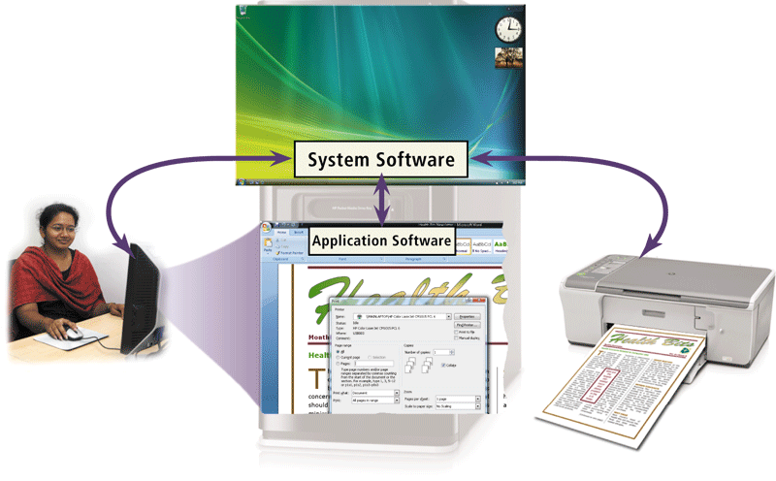
System Software
System software serves as the interface between the user, the application software, and the computer’s hardware
  Utility programs

Slide 7
Programming Languages
Computers work purely using binary – everything is converted into binary code for a computer to read and follow instructions.
If we want a computer to follow a simple instruction x + y then this needs to be converted into binary.
  If ‘x‘ was represented in binary by 0011 and ‘y‘ by 0100, the ‘+‘ might be represented by 1111 the instruction might be converted into machine language looking like 001111110100.
Fortunately we don’t need to write programs in machine language in order to instruct a computer as this would be very error prone!

Slide 8
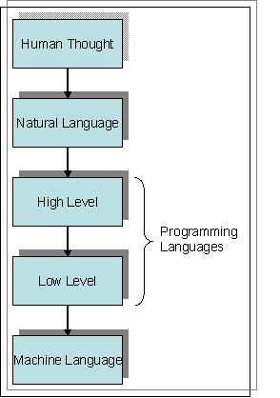
Natural Language vs
Programming Language
As humans, we use Natural Language to express our thoughts. Unfortunately it isn’t possible to instruct a computer using Natural Language, as it is prone to ambiguities in meaning (Semantics) which computers can’t identify – consider how you could define the word ‘Spring‘.

Slide 9
Natural Language vs Programming Language
Natural Language can also have problems with grammar (Syntax) - it wouldn’t be correct to say in English “Eat I now food” although we would probably understand.
Therefore, Programming Languages have been developed in between Natural Language and Machine Language as neither are suitable.
They are designed to have a more precise (unambiguous) syntax and semantics, to ensure the computer responds as intended, without using the error prone binary code.

Slide 10
Low Level vs High Level
Early programming languages were ‘low level‘ or assembly language – an example could be;
  ADD X Y Z
In Natural Language this could be “add the value in memory location x to the value in memory location y and store the result in memory location z”. This would then be converted by the computer into a binary instruction similar to the one we encountered before. ‘High level‘ languages (such as C++) use much more sophisticated instructions, and then use a ‘compiler‘ to translate the instructions into machine language.

Slide 11
Problem Solving
A computer programmer is responsible for writing computer programs that is a series of instructions written in a programming language, which a computer can follow to perform a task.
When learning their first programming language, many students believe that learning how to translate their ideas into the language a computer can understand is the difficult part of problem solving… …this is NOT true!
Learning to use a programming language, is not like learning to use a different natural language, so you shouldn’t approach it in the same way that you did when learning English, (or Thai, Japanese, etc.)
A good programmer is one who understands how to solve a problem - one who has a method of solution. If you understand how to solve a problem, it is then relatively straight forward to translate your solution into a series of instructions, in C++, or any other programming language.

Slide 12
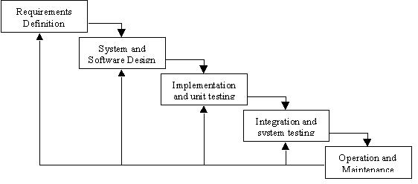
Software Development Lifecycle (SDLC)
Waterfall Model

Slide 13
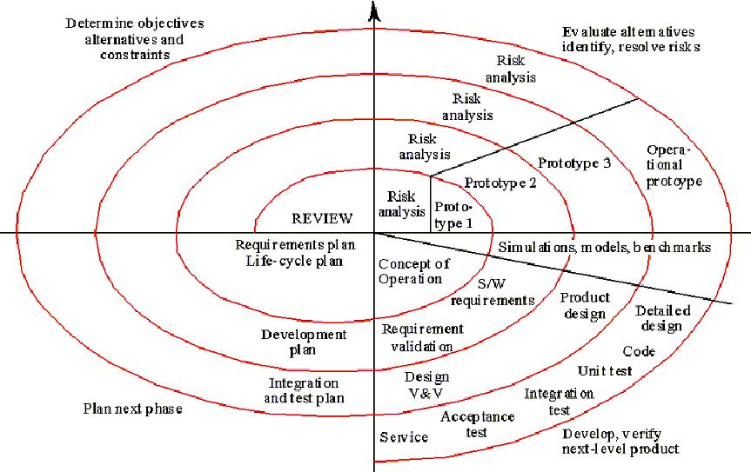
Software Development Lifecycle (SDLC)
Spiral Model (Evolutionary Development)

Slide 14
Requirements “Engineering”
The first step when considering developing a computer program is to ensure that you understand the nature of the problem (Requirements Engineering).
This may sound obvious, but many software projects have failed due to incomplete problem understanding.
Once you understand what your program needs to do you can consider how you could solve the problem(s) you are faced with.

Slide 15

Break it down!
Divide and Conquer
  “Break your problem down into smaller more manageable chunks!”

Slide 16
Algorithms
Often problem solving involves developing an algorithm, or sequence of precise instructions, which can be followed to produce the intended result.
This is breaking the problem down – taking the whole problem, and breaking it down into various parts which can be more easily managed.

Slide 17
Exercise
Consider the problem;
“I Need To Go To Bangkok”
Let’s break this down and develop an algorithm to solve this problem.

