Slide 1
ISNE101
Dr. Ken Cosh

Slide 2
Recap
We’ve been talking about Software…
  Application vs System Software
Programming Languages
  Vs Natural Languages
  Syntax, Semantics && Ambiguity!
This week
  Systems / Software Engineering
  A bit on People, and a bit on Data

Slide 3
Why study about Software?
Modern economies are critically dependent on software.
Software controls an increasing proportion of physical and digital systems.
Software and software-related activities represent a substantial part of economic activity in developed countries.
In many complex systems, software is a major — and sometimes dominant — component of total system cost.
The lifetime cost of software often greatly exceeds its initial development cost.
Long-lived software requires continual maintenance and adaptation as its environment, requirements and threats change.
  AI-assisted programming may reduce the cost of initial development without necessarily reducing the lifetime cost of software

Slide 4
What are the Attributes of Good Software?
Deliver required functionality and performance to user, and be maintainable, dependable, usable
Maintainability
  Software must evolve to meet changing needs
Dependability
  Software must be reliable, available, secure and safe
Efficiency
  Software should avoid wasting system resources
Usability
  Software must be usable by the users for which it was designed

Slide 5
What is Software Engineering?
Software engineering is an engineering discipline which is concerned with all aspects of software production
Software engineers should adopt a systematic and organised approach to their work and use appropriate tools and techniques depending on the problem to be solved, the development constraints and the resources available

Slide 6
What is a Software Process?
Set of activities whose goal is the development or evolution of software
Generic activities in all software processes are:
  Specification - what the system should do and its development constraints
  Development - production of the software system
  Validation - checking that the software is what the customer wants
  Evolution - changing the software in response to changing demands

Slide 7
Generic Software Process Models
The Waterfall model
  Separate and distinct phases of specification and development
Evolutionary development
  Specification and development are interleaved
Reuse-based development
  The system is assembled from existing components

Slide 8
Waterfall Model

Slide 9
Waterfall Model Phases
Requirements analysis and definition
System and software design
Implementation and unit testing
Integration and system testing
Operation and maintenance
The drawback of the waterfall model is the difficulty of accommodating change after the process is underway

Slide 10
Waterfall Model Problems
Inflexible partitioning of the project into distinct stages
This makes it difficult to respond to changing customer requirements
Therefore, this model is only appropriate when the requirements are well-understood

Slide 11
Evolutionary Development
Exploratory development
  Objective is to work with customers and to evolve a final system from an initial outline specification. Should start with well-understood requirements
Throw-away prototyping
  Objective is to understand the system requirements. Should start with poorly understood requirements

Slide 12
Evolutionary Development

Slide 13
Evolutionary Development
Problems
  Lack of process visibility
  Systems are often poorly structured
  Special skills (e.g. in languages for rapid prototyping) may be required
Applicability
  For small or medium-size interactive systems
  For parts of large systems (e.g. the user interface)
  For short-lifetime systems

Slide 14
Reuse-oriented Development
Based on systematic reuse where systems are integrated from existing components or COTS (Commercial-off-the-shelf) systems
Process stages
  Component analysis
  Requirements modification
  System design with reuse
  Development and integration

Slide 15
Reuse-oriented Development

Slide 16
Process Iteration
System requirements ALWAYS evolve in the course of a project so process iteration where earlier stages are reworked is always part of the process for large systems
Iteration can be applied to any of the generic process models

Slide 17
Incremental Development
Development and delivery is broken down into increments with each increment delivering part of the required functionality
User requirements are prioritised and the highest priority requirements are included in early increments
Once the development of an increment is started, the requirements are frozen though requirements for later increments can continue to evolve

Slide 18
Incremental Development

Slide 19
Incremental Development Advantages
Customer value can be delivered with each increment so system functionality is available earlier
Early increments act as a prototype to help elicit requirements for later increments
Lower risk of overall project failure
The highest priority system services tend to receive the most testing

Slide 20
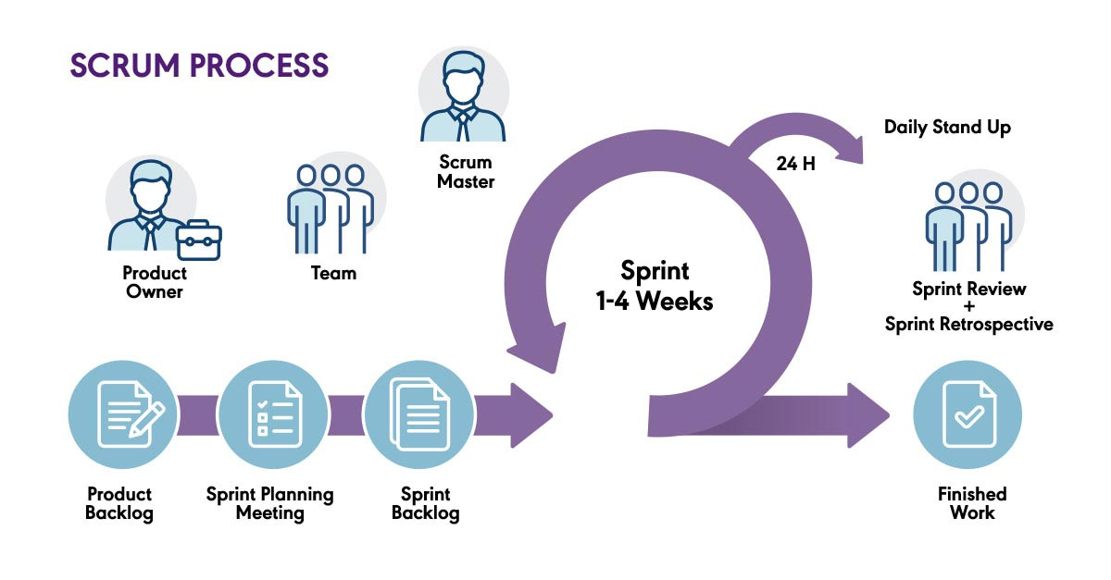

Slide 21
Extreme Programming
Development based on the development and delivery of very small increments of functionality
Emphasises continuous feedback, close collaboration with customers/users, and rapid adaptation to changing requirements.
Promotes continuous refactoring and improvement of the code.
  Pair programming
  Test-driven development (TDD)
  Continuous integration
  Small, frequent releases
  Collective code ownership
  Simple design

Slide 22
Beginning a Project
In each of these methods, the project begins with some kind of outline
Often involves getting together a group of the key project stakeholders, to discuss and define the project goals.
  “The Loftier the Building, the deeper the foundation must be laid” Kempis

Slide 23
Requirements Process

Slide 24
Feasibility
Dictionary.com
  Capable of being done, effected, or accomplished
But just because we are capable of doing something doesn’t mean we should necessarily do it!
WordNet
  Capable of being done with means at hand and circumstances as they are
That’s a bit better, but still not ideal.

Slide 25
Feasibility Studies
The first step in the Requirements Process
Questions:
  Is it possible to do this?
  Is it worthwhile to do this?
  Does it make economic sense?
  What risks are involved?
But, it is pretty difficult to answer those questions without some understanding of the requirements!

Slide 26
Feasibility Study
Actually the Feasibility Study is designed to answer one question;
  To Go or Not To Go?
And you might not be the one to answer that question.
  To answer that question, we need to estimate the answer to many other questions.
    Scoping
    Stakeholder Identification
    Cost / Benefit Assessment
    Risk Assessment

Slide 27
Feasibility Analysis
To find the answers to those questions;
  Scoping
  Stakeholder Identification
  Cost / Benefit Assessment
  Risk Assessment

Slide 28
Feasibility - Scoping
How big is the project?
Which systems / products will we replace?
Which other systems / products will we interrelate with?
The scope is the business area affected by the product.
  Where does the product fit, and what other products does it interrelate with?
This defines what “work” we will study, and what work we will NOT study.

Slide 29
Feasibility - Stakeholders
Once you have the scope, you can identify stakeholders.
  Simple – Holders of Stake, i.e. people with an interest in the project.
Potentially
  Managers
  Employees
  Customers
  …

Slide 30
Important Stakeholders
The most important stakeholders include;
  The Client
  The Customer
  The Users

Slide 31
The Client
Show me the money!
People are going to work on this project. Who is going to pay for their time? Somebody has to pay for it, and that person is the Client.
  As the client is probably paying for your time, it’s probably a good idea to keep them happy!

Slide 32
The Customer
Customers buy the product once its developed. (Note the difference between client and customer).
  Customers might walk out of a shop with your product in the future.
You may know the names of your customers in advance, or you may not
  Either way you need to understand your potential customers very well.
You need at least a representative from your potential customers to be part of your stakeholders.

Slide 33
The Users
Those who are going to operate your product.
  Perhaps people who work for your client?
  Perhaps the same people as your customers?
It’s important to get to know your users.

Slide 34
The Users
There are many different types of user, so getting to know them is difficult!
  Experience Level?
  Intellectual Capability?
  Linguistic Skills?
  Disabilities?
There are many usability issues, which I am sure you will encounter in other courses!
  Also remember that people other than the intended users may end up using the product. So identifying superfluous users could be beneficial!

Slide 35
Goals
Once Stakeholders are identified, the goals of the project may change significantly!
If the goals of the project change, then surely the scope of the project will change!
If the scope of the project changes, then surely the stakeholders will change!
And if the Stakeholders change then….
  Somebody stop this madness!!!

Slide 36
Goals, Scope and Stakeholders
Scope
Goals
Stakeholders

Slide 37
Cost / Benefit Assessment
Tricky!
  Many costs are hidden, and many benefits are hidden too.
  Many costs are unquantifiable, and many benefits are unquantifiable too.
  Many analysts are too inexperienced to assess costs and benefits
    If we knew what it would cost, we have already done it before, so we wouldn’t need to do it again!
    Many projects end up over time and over budget, because of failures at this stage.

Slide 38
Risk Assessment
What risks are involved in doing this project?
How probable are they?
How damaging are they?
What can we do to reduce the probability, or reduce the effect, of the risk? Or can we build in a contingency plan?

Slide 39
Requirements Elicitation and Analysis
Here we gather requirements from a variety of sources;
  Stakeholders (identified previously)
  Existing Systems
  Legal Documents
  Competing Systems
How could we go about getting Requirements?

Slide 40
Requirements Techniques
Interviews
Facilitated Meetings
Ethnography
Scenarios
Prototypes

Slide 41
Interviews
Durrrh!
Why not ask people what they require?
Well, it’s a good starting point, but,
  People might not know what they want.
  Different stakeholders have different “Views” of the problem.
  People are busy.
    Particularly if a “systems analyst” comes around!

Slide 42
Facilitated Meetings
Get people together to talk about their requirements!
Good, now we can resolve any conflicts, but,
  Again, people might not know what they want or do…
  Who’s going to argue with the boss?
  People are busy!

Slide 43
Ethnography
Observation!
If people don’t know what they want or do, why not watch them doing it? But,
  Ethnographers are usually sociologists (not computer scientists).
    Which means they have a tendency to write very long and boring documents!
  When people are being watched, they have a tendency to do things differently…

Slide 44
Scenarios
So, propose a scenario to people, and ask what the system should do in that situation.
  But, it’s a bit difficult to cover every eventuality.

Slide 45
Prototypes
Build a Prototype, and see if that would satisfy people?
  But, users tend to get carried away by how it looks, rather than what it does…
  “Can We have it in Blue?”

Slide 46
Requirements Elicitation and Analysis
We’ve just touched the subject here, and we’ll go into it in much more detail, but needless to say, it isn’t as easy as you might think.
To be thorough, we have to use all the techniques at our disposal.
And then build some system models as a visual indication of what the system should do.

Slide 47
Requirements Specification
Once we’ve gathered and analysed the requirements, the next job is to specify them.
Writing requirements is not trivial.
They should be;
  Complete,
  Unambiguous,
  Measurable,
  Consistent,
  Precise,
  …

Slide 48
Types of Requirement
Functional Requirements
Non-Functional Requirements
  Constraints

Slide 49
Functional Requirements
Functional Requirements are things that the product must do.
  i.e. functions that the product must be able to perform.
E.g.
  The system should produce a daily sales report.
  The system shall produce an amended delivery schedule when a delivery truck is in maintenance.

Slide 50
Non-Functional Requirements
Non-Functional Requirements are properties or qualities that the system should have.
  i.e. not things it should be doing.
E.g.
  Registered Users should be authenticated within 0.25 seconds.
  Inexperienced users should be able to use the system within 3 days of training.

Slide 51
Types of Non-Functional Requirements

Slide 52
Requirements Validation
Before we finish our requirements analysis, we need to validate the requirements.
  Is it complete?
  Are they all testable?
This topic includes;
  Requirement Reviews
  Often Prototyping
  Model Validations
  Acceptance Tests

Slide 53
Software Development
Software Design and Implementation
  The process of converting the system specification into an executable system
  Software design
    Design a software structure that realises the specification
  Implementation
    Translate this structure into an executable program
  The activities of design and implementation are closely related and may be inter-leaved

Slide 54
Design Process Activities
Architectural design
Abstract specification
Interface design
Component design
Data structure design
Algorithm design

Slide 55
The Software Design Process

Slide 56
Design Methods
Systematic approaches to developing a software design
The design is usually documented as a set of graphical models
Possible models
  Data-flow model
  Entity-relation-attribute model
  Structural model
  Object models

Slide 57
Data Design
For information to be valuable it should have the following characteristics:-
  Accurate
  Verifiable
  Timely
  Organised
  Accessible
  Useful
  Cost-Effective
Garbage IN – Garbage OUT

Slide 58
File Processing Systems
File processing systems, are systems where data is stored in files, using approaches like that discussed above. There are several challenges to managing file processing systems!
  Data Redundancy – each department has their own files, and so the same data may exist in more than one place – while duplicating data can be a benefit (in terms of back ups), it is largely a hindrance (it wastes space, it is harder to maintain consistency).
  Isolated Data – data isn’t related in convenient ways – if we store the list of students in the class in one file, and then information about each student in other files, we have a complicated task to send an email to each student about a class change.
Today many systems use a database to store data, and make use of a DBMS (Database Management System) to help maintain the data.

Slide 59
Hierarchy of Data
Data can be considered in a series of layers:-
  Characters – single bytes of data – i.e. a single letter, number, etc.
  Field – combination of related characters
    Fields are given a name and a type (like with variables), and also a size.
  Record – combination of related fields
    Records have a primary key to uniquely identify each record
  File – A collection of related records

Slide 60
DBMS
There are several different DBMS’s, but the objective is to provide ways to maintain and retrieve data from a database
  Normally through a query language, such as “SQL” or Structured Query Language.
The DBMS also handles security, ensuring only authorized users can access data at permitted times, and it also performs tasks such as back ups and recovery.

Slide 61
Relational Databases
Many modern databases are ‘Relational Databases’, where data is related;
  for example the data about a student will be related to the data about which courses they are studying and the data about their teachers.
This enables the querying language to make more sophisticated queries quickly, while removing the need for duplicate data.
In a relational database, data is stored in tables, where each column represents a field (or particular piece of data), and each row stores the data about a particular entity (or record) – much like in an excel spreadsheet. Each table will have a primary key, normally an ID, which uniquely identifies each record. This primary key can then be used as a foreign key in a different table to relate the data. For instance, in the table storing data about the grades for a course, the id for each student can be used as a reference.

