Slide 1
269202 Algorithms for iSNE
Dr. Kenneth Cosh
Week 14

Slide 2
Review
Huffman!

Slide 3
This Week
Synchronisation
  Clock Synchronisation
  Logical Clocks
  Mutual Exclusion
  Election Algorithms

Slide 4
Synchronisation
Consider sharing resources
  We can’t print simultaneously, so we need to co-operate to grant each other temporary exclusive access
Consider sequencing
  Sometimes we need to know whether message m1 was sent before or after message m2
Synchronisation is not straight forward

Slide 5
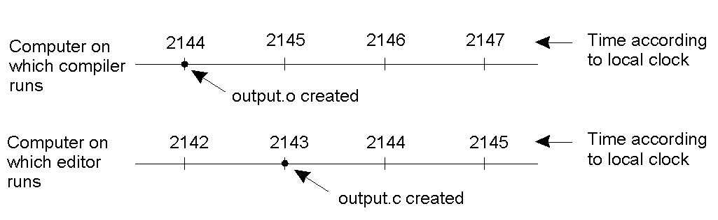
Clock Synchronisation
When each machine has its own clock, an event that occurred after another event may nevertheless be assigned an earlier time on another remote device. MAKE will not call the compiler for the newer version of the “output.c” program, even though it is “newer”.

Slide 6
Global Positioning System (GPS)
Using a GPS receiver we can triangulate our position on the earth by receiving signals sent by GPS satellites.
  We need to connect to at least 3 GPS satellites to locate a position on latitude, longitude and altitude.
  If we measure our distance from each, we can locate a unique position.
But how do we measure our distance?

Slide 7
GPS
A GPS Satellite continuously sends its position and timestamps each message with its local time
Based on how long it takes for the message to arrive, using the speed of light, we can calculate how far away from the satellite we are
Assuming… all clocks are synchronised

Slide 8
Assuming…
But,
  A very small clock error when multiplied by the very large speed of light can produce a large location error.
  1 microsecond = 300metres!
So, we can add a 4th satellite to assist with estimating the speed of light.
  This means we don’t need an accurate clock within the GPS unit
  But still we need the satellites to have synchronised clocks
  And even then there are further challenges
    Earth isn’t a sphere, inconsistent signal speeds when passing through the ionospohere…

Slide 9
The problem
Achieving agreement on time in a system that is distributed is not a trivial problem.
Is it even possible to synchronise all the clocks in a Distributed System?
With multiple computers, “clock skew” ensures that no two machines have the same value for the “current time”. But, how do we measure time?

Slide 10
What is Time?
It has over 60 definitions in dictionary.com alone!
  All of which could be described as human methods of control; a way of coordinating actions, or enabling a landlord to collect the rent.
Therefore time for humans requires some consensus.
  But even humans haven’t always agreed on time – consider the conflicts when Pope Gregory decided to remove 10 days in the year in 1582, when he developed the Gregorian calendar.

Slide 11
We have all the time in the world.
How many days in a year?
  365? Well, not according to early astrologers, and technically not even true today!
What is a year?
  The period while the earth makes a complete orbit of the sun.
What is a day?
  Traditionally the transit of the sun, i.e. the period between the sun being at its highest point.

Slide 12
We’re dragging baby…
The earths spin is slowing down, so while there was once 400 days per year, we’re making less spins per year.
Solution: the atomic clock.
  Invented in 1948, the atomic clock counts the number of transitions of a cesium 133 atom. The cesium 133 atom is very stable, and independent of the earths motion, and it enabled physicists to define a second as 9,192,631,770 transitions of the atom. (This was the number of transitions in a measured second in 1948).

Slide 13
The beginning of Time
To improve time measurements, 50 cesium clocks were placed in labs around the world, and their transitions are counted and then divided by 9,192,631,770 and periodically reported to the Bureau International de l’Heure.
Since midnight January 1st 1958 the mean result of these cesium clocks has been considered the right time; well at least the International Atomic Time (TAI).

Slide 14
International Atomic Time
There is still a problem. Currently 86,400 TAI seconds is about 3msec shorter than a solar day.
  While we can sleep soundly at night knowing that we have a precisely accurate timing system, in a few years when we wake up in the morning we might find that noon has already passed!
So, whenever the difference between TAI and solar time grows to 800msec, BIH introduces leap seconds

Slide 15
So what is the time?
Several short wave radio stations issue signals every ‘second’ with call letter WWV.
This radio receiver can be tracked and if precise time is needed it can be achieved.
If one machine in the Distributed System has a WWV receiver then the goal is keeping all other machines in sync with it.
If no machine has a WWV receiver the goal is keeping all machines together as best we can.

Slide 16
Drift
Suppose each machine has a timer, which creates an interrupt H times per second.
An interrupt handler adds 1 to the software clock, C, each time the timer ‘ticks’.
If t is the correct time, then in an ideal world;
  dC/dt = 1.
But in reality a fast clock has dC/dt = 1+ρ and a slow clock has dC/dt = 1-ρ.
So at time ∆t after sync, 2 clocks could be 2ρ∆t different.
If we need the clocks not to differ by more than δ, then they need to be resynchronised at least every δ/2ρ seconds

Slide 17
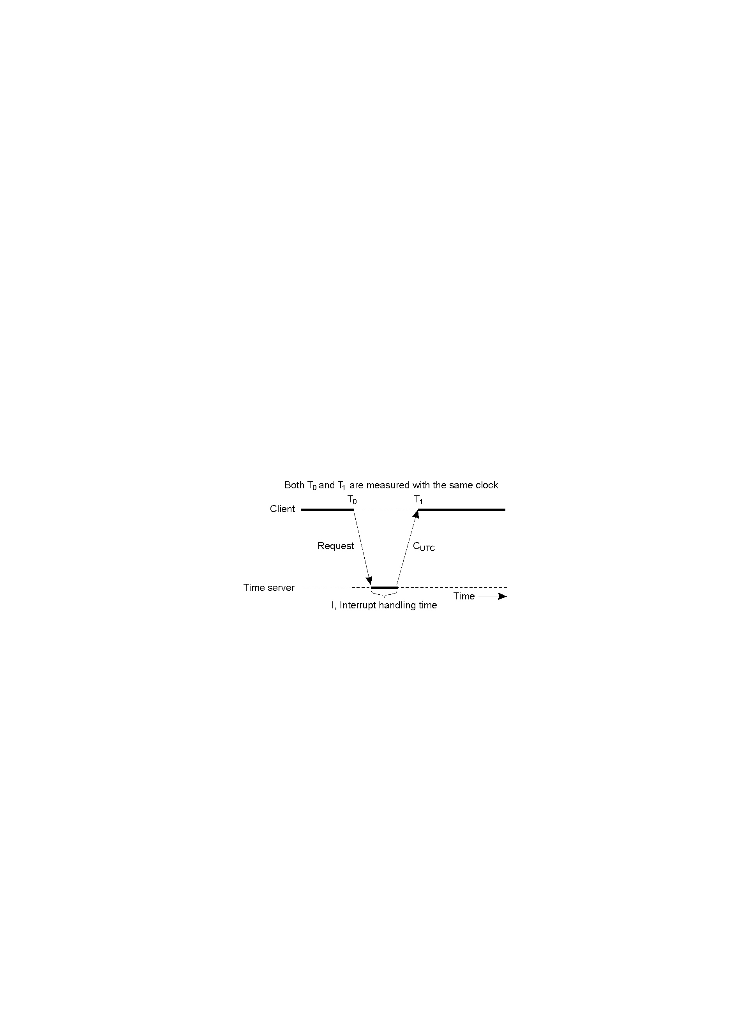
Christian’s Algorithm
Assuming we have a time server (perhaps with a WWV receiver) each machine sends a request to the time server at least every δ/2ρ seconds.

Slide 18
Christian’s Algorithm
Problem 1
  First, time can’t go backwards so a fast clock can’t simply be changed back to an earlier time – imagine the complications of 2 files being compiled sequentially, but the clock change meaning the 2nd one is time stamped before the first one.
  Normally changes to the time are introduced gradually by adding or taking from the interrupt interval.

Slide 19
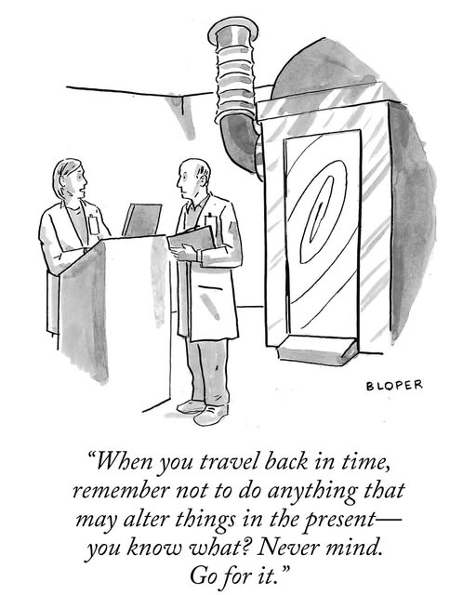

Slide 20
Christian’s Algorithm
Problem 2
  The time server request will take a nonzero amount of time which can vary according to the network load.
  Christian’s Algorithm attempts to measure this problem, by (T₁-T₀ –I)/2 where T₁ and T₀ can be measured on the same clock, and I estimated by the server.
  Taking measurements over time improves reliability.

Slide 21
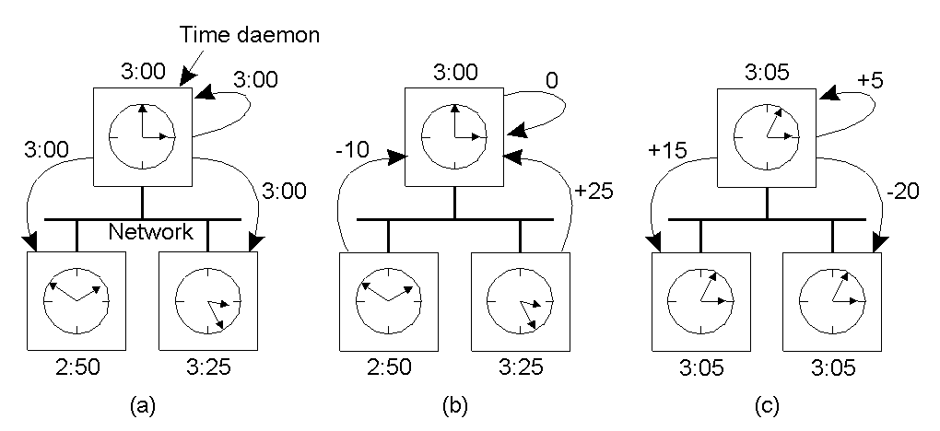
Berkeley Algorithm
While the time server in Christian’s algorithm is passive, Berkeley’s algorithm takes a different approach where the time daemon polls every machine from time to time to ask what time it is. From this ‘average time’ can be calculated.

Slide 22
Logical Clocks
All very interesting, but for many purposes the key is for a consensus or agreement about time to be reached.
  It doesn’t matter if its really ‘10:00’ if we all agree that it is ‘10:02’ or even 0101101.
What’s important is that the processes in the system agree on the ordering in which certain events occur.
Such “clocks” are referred to as Logical Clocks, based on “relative time”.

Slide 23
Lamport’s Timestamps
First point: if two processes do not interact, then their clocks do not need to be synchronized – they can operate concurrently without fear of interfering with each other.
Second (critical) point: it does not matter that two processes share a common notion of what the “real” current time is. What does matter is that the processes have some agreement on the order in which certain events occur.
Lamport used these two observations to define the “happens-before” relation (also often referred to within the context of Lamport’s Timestamps).

Slide 24
“Happens Before”
If A and B are events in the same process, and A occurs before B, then we can state that:
  A “happens-before” B is true.
  A→B
Equally, if A is the event of a message being sent by one process, and B is the event of the same message being received by another process, then A “happens-before” B is also true.
(Note that a message cannot be received before it is sent, since it takes a finite, nonzero amount of time to arrive … and, of course, time is not allowed to run backwards).

Slide 25
“Happens Before”(2)
Obviously, if A “happens-before” B and B “happens-before” C, then it follows that A “happens-before” C.
  A→B and B→C so A→C.
If the “happens-before” relation holds, deductions about the current clock “value” on each system component can then be made.
  It therefore follows that if C(A) is the time on A, then C(A) < C(B), and so on.

Slide 26
“Happens Before”(3)
Assume three processes are in a system: A, B and C.
  All have their own physical clocks (which are running at differing rates due to “clock skew”, etc.).
A sends a message to B and includes a “timestamp”.
  If this sending timestamp is less than the time of arrival at B, things are OK, as the “happens-before” relation still holds (i.e. A “happens-before” B is true).
  However, if the timestamp is more than the time of arrival at B, things are NOT OK (as A “happens-before” B is not true, and this cannot be as the receipt of a message has to occur after it was sent).

Slide 27
“Happens Before”(4)
The question to ask is:
  How can some event that “happens-before” some other event possibly have occurred at a later time??
The answer is: it can’t!
So, Lamport’s solution is to have the receiving process adjust its clock forward to one more than the sending timestamp value. This allows the “happens-before” relation to hold, and also keeps all the clocks running in a synchronised state. The clocks are all kept in sync relative to each other.

Slide 28
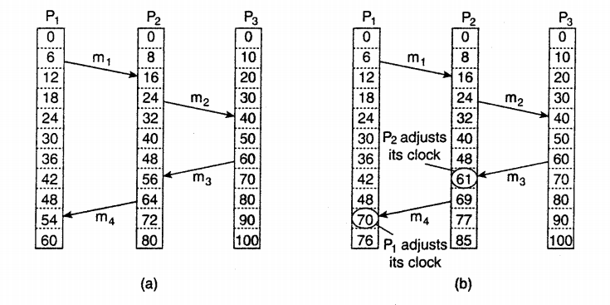
Lamport’s Clocks

Slide 29
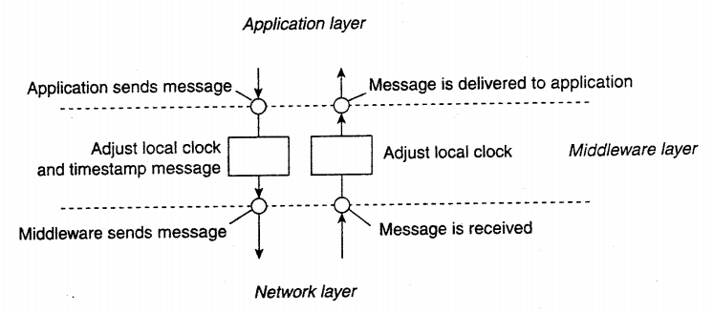
Lamport’s Clocks
Handled by Middleware

Slide 30
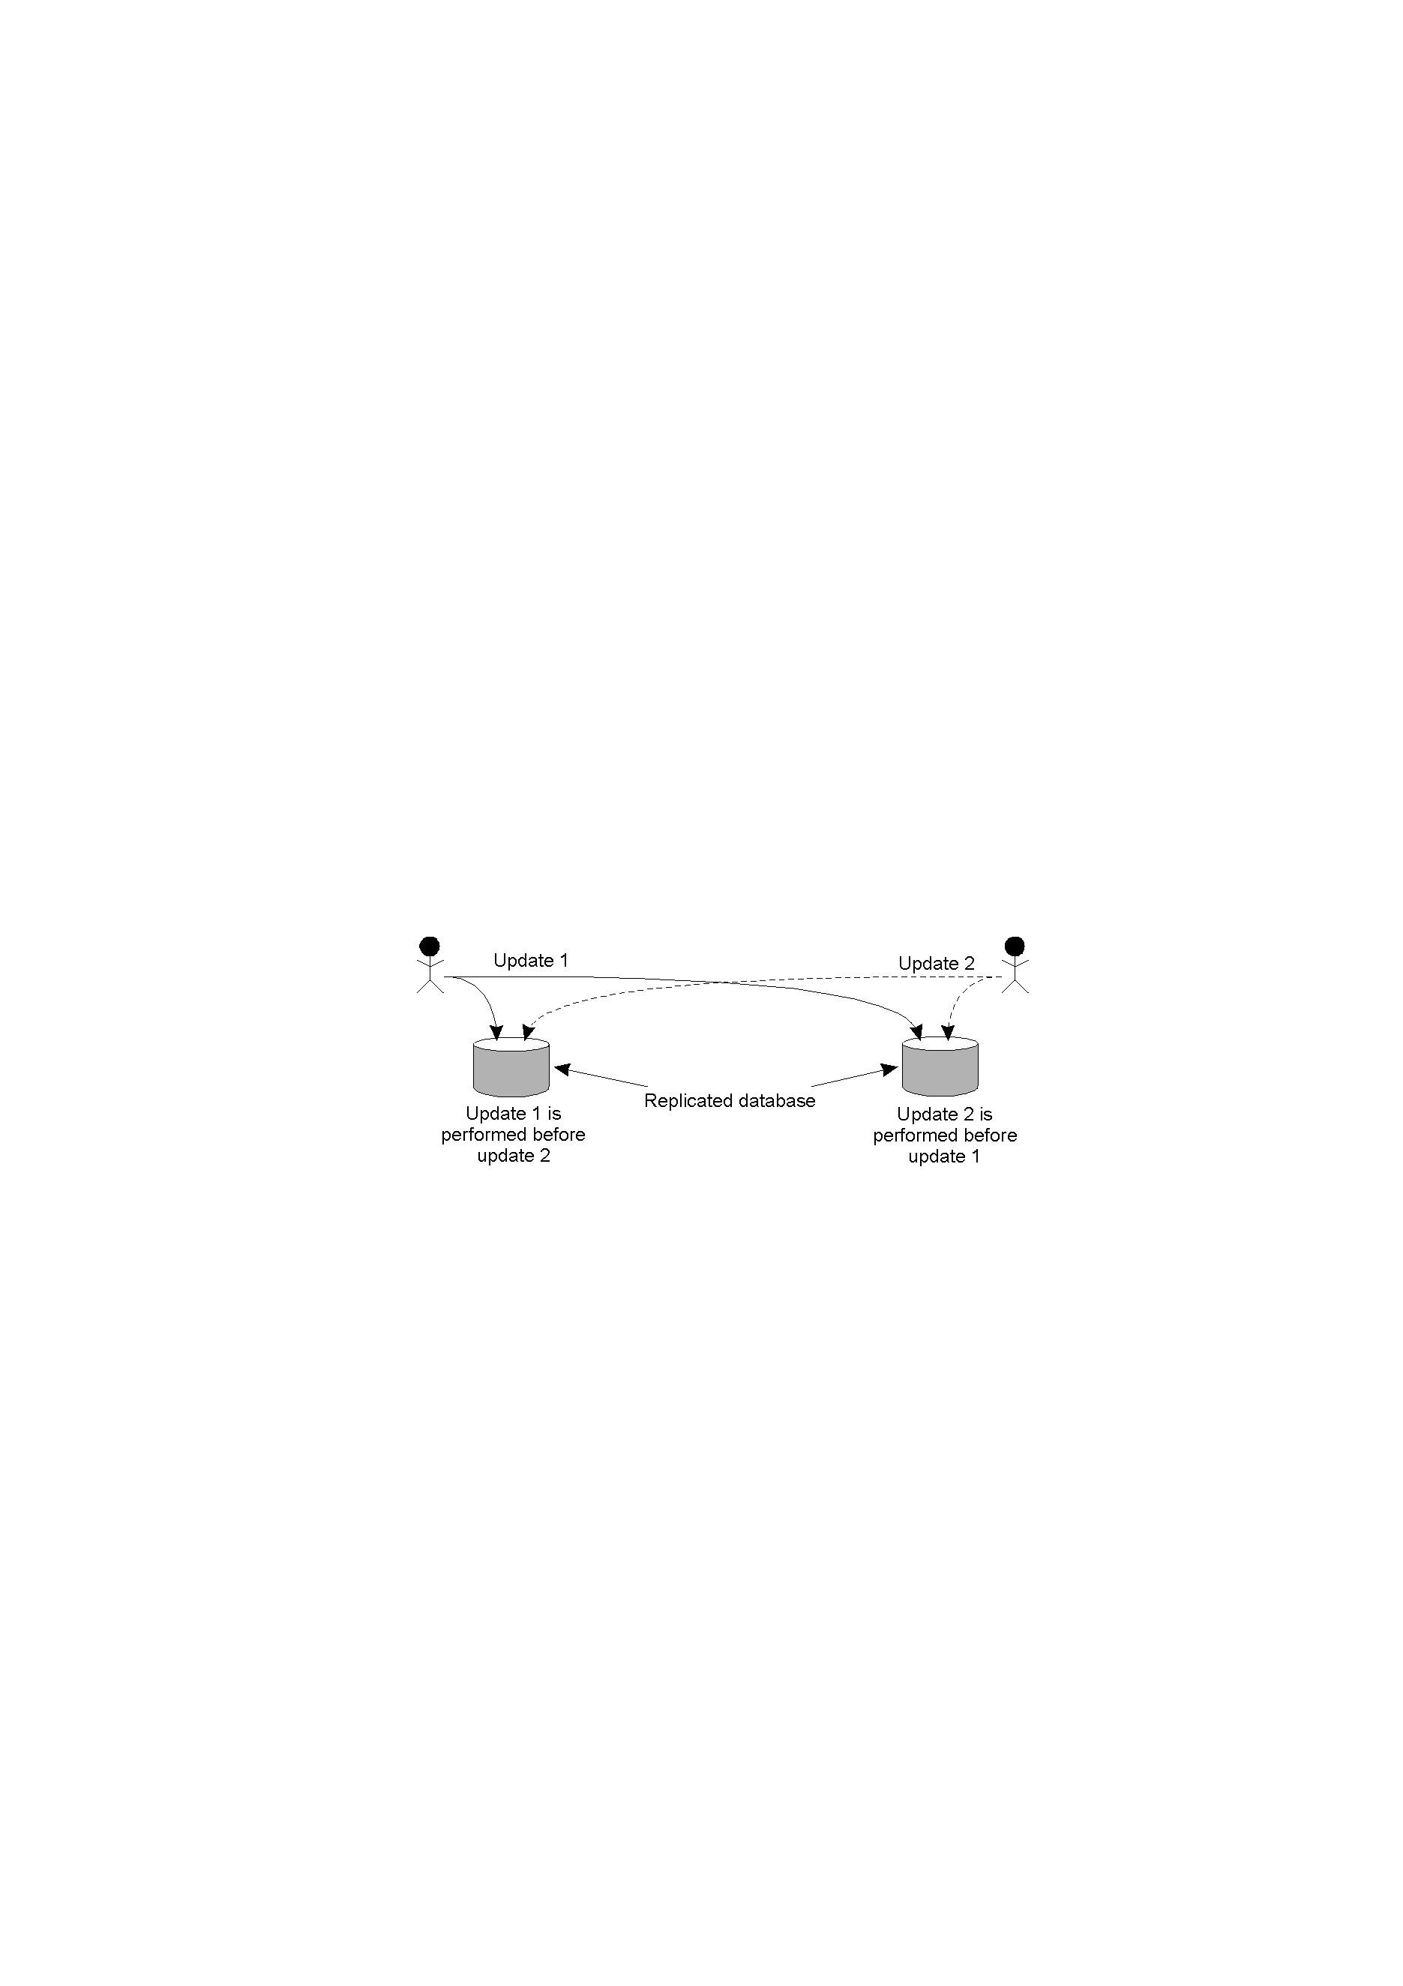
Problem
Updating a replicated database and leaving it in an inconsistent state: Update 1 adds 100 baht to an account, Update 2 calculates and adds 1% interest to the same account. Due to network delays, the updates may not happen in the correct order!

Slide 31
Solution
A multicast message is sent to all processes in the group, including the sender, together with the sender’s timestamp.
At each process, the received message is added to a local queue, ordered by timestamp.
Upon receipt of a message, a multicast acknowledgement/timestamp is sent to the group.
Due to the “happens-before” relationship holding, the timestamp of the acknowledgement is always greater than that of the original message.

Slide 32
Totally Ordered Multicasting
Only when a message is marked as acknowledged by all the other processes will it be removed from the queue and delivered to a waiting application.
Lamport’s clocks ensure that each message has a unique timestamp, and consequently, the local queue at each process eventually contains the same contents.
In this way, all messages are delivered/processed in the same order everywhere, and updates can occur in a consistent manner.

Slide 33
Totally Ordered Multicasting
  Update 1 is time-stamped and multicast. Added to local queues.
  Update 2 is time-stamped and multicast. Added to local queues.
  Acknowledgements for Update 2 sent/received. Update 2 can now be processed.
  Acknowledgements for Update 1 sent/received. Update 1 can now be processed.
(Note: all queues are the same, as the timestamps have been used to ensure the “happens-before” relation holds.)

Slide 34
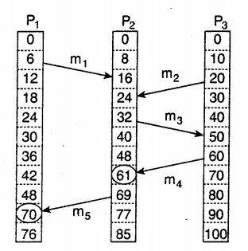
Causality?
We know that m3 was sent after receipt of m1 – causality?
How about m2?
  Sent after m1
  Causality?

Slide 35
Vector Clocks
A vector clock sends a vector of the number of events that have occurred at each process
  E.g. VC_{i}[i] is the number of processes occurred at P_{i}
By sending a vector clock along with each message, processes can keep track of the ‘local time’ of each machine.

Slide 36
Vector Clocks
Messages aren’t delivered to the application layer until;
  This message is the next message expected from that processor
  This processor has seen all the messages that the sender had seen when it sent the message

Slide 37
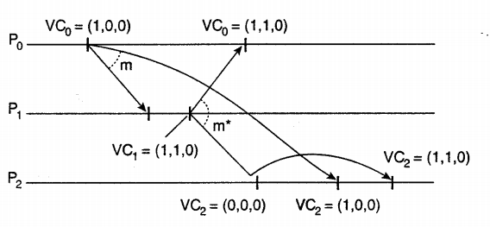
Vector Clocks

Slide 38
Middleware Causality
There are a couple of problems with allowing middleware to manage message ordering
  Only potential causality is captured
    i.e. even if two messages from the same processor aren’t causality related, they will be tagged as such – leading to potential efficiency problems
  Not all causality maybe captured
    What if there is some external causality? i.e. what if I phone you to let you know about a posting

Slide 39
Mutual Exclusion
In distributed systems it is crucial to prevent concurrent access to resources
  Prevent inconsistency, corruption, etc.
Various solutions exist
  Token based solutions
  Centralised Algorithms
  Decentralised Algorithms
  Distributed Algorithms

Slide 40
Token Based Solutions
One token available
  Whoever has it can access the resource
The token is passed from process to process (perhaps around a ring)
  Each process needs to know who is the next process,
  If they don’t need the resource, they simply pass the token along

Slide 41
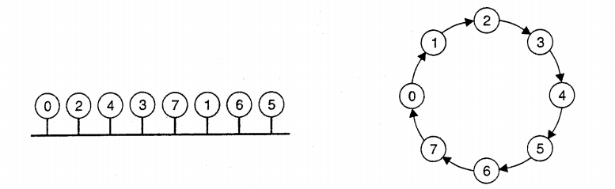
Token Based Solutions

Slide 42
Token Based Solutions
If nobody needs the resource, the token simply passes fast around the ring.
If somebody needs the resource, it must wait at most ‘n’ passes
However,
  What if the token is lost?
    E.g Process holding token goes down.
    How do we detect the token is missing, rather than still being passed around?

Slide 43
Centralised Algorithm
One process is elected the co-ordinator
If another process wants to use a resource, it sends a request to the co-ordinator
  If the resource is available, the co-ordinator grants permission
  If it isn’t available, the co-ordinator queues the request until the resource is available
    (Possibly responding with ‘permission denied’)

Slide 44
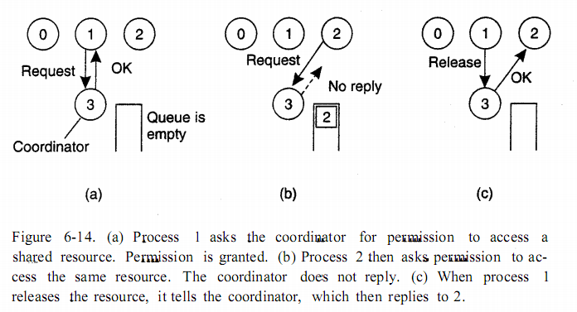
Centralised Algorithm

Slide 45
Centralised Algorithm
Successful
  Mutual Exclusion is managed by the co-ordinator
Fair
  Requests are dealt with in the order they are received
No Starvation
  No resource will end up waiting forever
Easy to implement
3 Requests per resource use
  Request, Grant, Release

Slide 46
Centralised Algorithm
Single point of failure
  What happens when the co-ordinator fails?
  What is the difference between a dead co-ordinator and permission denied?
    Requestor is still waiting for a reply i.e. blocked
Single co-ordinator creates a performance bottleneck

Slide 47
Decentralised Algorithm
Have multiple co-ordinators
  Perhaps one per replica of the resource.
If I need a resource, I can poll the co-ordinators
  And wait for a majority vote
Has the benefit of redundancy for the co-ordinator, but what if a co-ordinator fails, restarts and forgets that it has already granted permission?
  Perhaps a small probability, but still a chance of concurrent accesses

Slide 48
Distributed Algorithm
If a process needs a resource, it sends a message to all other processes, including their current logical time (and process number)
  If process isn’t using resource, responds with OK
  If process is using resource, no response, but queues request
  If another process also wants to use resource, it compares the timestamp of the request

Slide 49
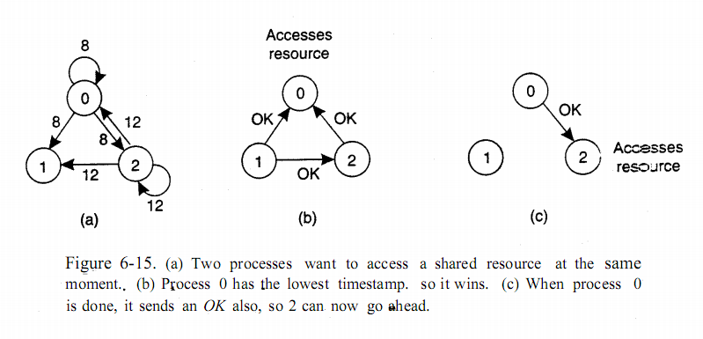
Distributed Algorithm

Slide 50
Distributed Algorithm
Mutual Exclusion is guaranteed
Number of messages = 2(n-1)
No single point of failure

Slide 51
Distributed Algorithm
Multiple points of failure!
  If any process fails – how is it different from using resource? (So processes have to respond even if they are using the resource)
A list of group membership must be maintained by all processes
All processors are expected to be capable of handling requests
So why not just use the Centralised Algorithm?

Slide 52
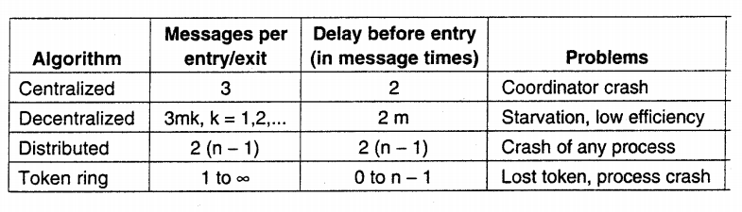
Comparisons

Slide 53
Election Algorithms
Many DS need one process to be a co-ordinator, or perform some special role
It doesn’t matter which process, but one is needed
Assuming all processes are the same, an election algorithm is used to choose which process

Slide 54
Bully Algorithm
If any process notices the co-ordinator isn’t responding, it initiates an election.
  It sends “ELECTION” to all higher numbered processes
If no-one responds, it wins the election and becomes co-ordinator
  If a ‘higher-up’ responds they take over until the highest numbered process is found to win the election.

Slide 55
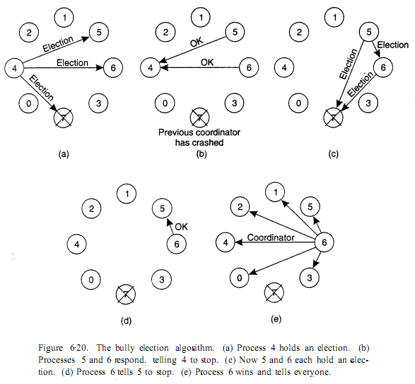
Bully Algorithm

Slide 56
Ring Algorithm
Each process knows it’s successor
When the failed process is discovered, the process sends a message to it’s successor listing it’s own process number
The message is passed around in a ring until it returns to the initiator
Any higher process number lists their number so the highest numbered process can be identified

Slide 57
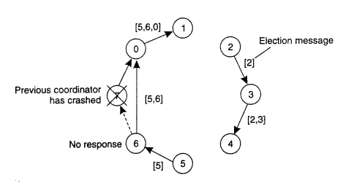
Ring Algorithm (Multiple initiators)

