Slide 1
Web Programming Language
Week 5
Javascript

Slide 2
JavaScript Part II
Objects
Classes
JSON

Slide 3
JavaScript Objects
Objects are a useful way of creating more advanced datatypes.
Objects are a set of “key”:”value” pairs.
const myPerson = { name: “Ken” };
console.log(myPerson);
console.log(myPerson.name);

Slide 4
JavaScript Objects II
Of course Objects can contain any data types
const myPerson = {
name: “Ken”,
awake: true,
pulseRate: 80
};
How would you access each bit of data?

Slide 5
JavaScript Objects III
Including Arrays
const myPerson = {
name: “Ken”,
awake: true,
pulseRate: 80,
activities: [“Running”, “Eating”, “Sleeping”]
};

Slide 6
JavaScript Objects IV
Including Objects
const myPerson = {
name: “Ken”,
awake: true,
pulseRate: 80,
activities: [“Running”, “Eating”, “Sleeping”],
drink: {
morning: “Coffee”,
afternoon: “Water”
}
};

Slide 7
Accessing Objects
There are multiple ways to access object data!
  Dot Notation
  console.log(myPerson.awake);
  console.log(myPerson.activities[0]);
  console.log(myPerson.drink.morning);
  Brackets
  console.log(myPerson[“awake”]);
  console.log(myPerson[“activities”]);
  console.log(myPerson["activities"][0]);
  console.log(myPerson["drink"]);
  console.log(myPerson["drink"]["morning"]);

Slide 8
JavaScript Object Functions
JavaScript Objects can also contain functions
const myPerson = {
greeting: function () {
return “Hello”;
}
};
console.log(myPerson.greeting());

Slide 9
JavaScript Object Functions
These functions can access the object’s data using ‘this’
const myPerson = {
name: "Ken",
greeting: function () {
return "Hello " + this.name;
}
}
console.log(myPerson.greeting());

Slide 10
JavaScript Object Functions
Using a Template Literal
  Delimited with backtick, allowing multi-line strings, string interpolation (without + operator) & embedded expressions
const myPerson = {
name: "Ken",
activities: ["Running", "Eating", "Sleeping"],
greeting: function () {
return `You should enjoy ${this.activities["0"]}`;
}
}
console.log(myPerson.greeting());
backtick

Slide 11
JavaScript Object Functions
Another example
const myPerson = {
name: "Ken",
drink: {
morning: "Coffee",
afternoon: "Water"
},
greeting: function () {
return `${this.name}, fancy a ${this.drink.morning}`;
}
}
console.log(myPerson.greeting());
Consider – how could you do this without a template literal?

Slide 12
JavaScript Object Inheritance
Base Object
const food = {
serving: 1,
response: function () {
return "Delicious";
}
};
console.log(food.response());

Slide 13
JavaScript Object Inheritance
Inheritance
const food = {
serving: 1,
response: function () {
return "Delicious";
}
};
const thaiFood = Object.create(food);
thaiFood.spiceLevel = 5;
console.log(thaiFood);
console.log(thaiFood.response());

Slide 14
JavaScript Object Inheritance
Redefining
const food = {
serving: 1,
response: function () {
return "Delicious";
}
};
const thaiFood = Object.create(food);
thaiFood.spiceLevel = 5;
thaiFood.response = function () { return "Spicy!";};
console.log(thaiFood.response());

Slide 15
JavaScript Object Inheritance
Getting Deeper!
const food = {
serving: 1,
response: function () {
return "Delicious";
}
};
const thaiFood = Object.create(food);
thaiFood.spiceLevel = 5;
thaiFood.response = function () { return "Spicy!";};
const somTum = Object.create(thaiFood);
somTum.spiceLevel = 10;
somTum.response = function () { return "OUCH!";};
console.log(somTum.response());

Slide 16
JavaScript Object
Object also has values & keys
const subjects = {
269200: "Web Programming",
269201: "Lab #2",
269202: "Algorithms"
};
console.log(Object.keys(subjects));
console.log(Object.values(subjects));

Slide 17
Iterating the Object
Using a “for in” loop
    const subjects = {
    269200: "Web Programming",
    269201: "Lab #2",
    269202: "Algorithms"
    };
    for (let code in subjects)
    {
    console.log(subjects[code]);
    }

Slide 18
Iterating the Object
And for the keys…
const subjects = {
269200: "Web Programming",
269201: "Lab #2",
269202: "Algorithms"
};
for (let code in subjects)
{
console.log(`${code} = ${subjects[code]}`);
}

Slide 19
Want to drop the course?
delete it!
    const subjects = {
    269200: "Web Programming",
    269201: "Lab #2",
    269202: "Algorithms"
    };
    delete subjects["269200"];
    for (let code in subjects)
    {
    console.log(`${code} = ${subjects[code]}`);
    }
Note – if our key was a string you could say
delete subjects.269200;

Slide 20
Destructuring Object
Storing the values of an object in a new variable
    const subjects = {
    269200: "Web Programming",
    269201: "Lab #2",
    269202: "Algorithms"
    };
    const {269200: favourite} = subjects;
    console.log(favourite);

Slide 21
Destructuring Object 2
Using the same name we can destructure multiple key/values
  Note changing the key to a string!
    const subjects = {
    c269200: "Web Programming",
    c269201: "Lab #2",
    c269202: "Algorithms"
    };
    const {c269200, c269201, c269202} = subjects;
    console.log(c269200);
    console.log(c269201);
    console.log(c269202);

Slide 22
Destructuring Object in Function
We can destructure an object with a function definition
    const subjects = {
    c269200: "Web Programming",
    c269201: "Lab #2",
    c269202: "Algorithms"
    };
    function drop({c269200}) { return `Dropping ${c269200}`};
    console.log(drop(subjects));

Slide 23
JavaScript Classes
A comparatively newer feature of JS
class Course {
constructor() {
this.code = "269200";
this.teacher = "Ken“;
}
details() {
console.log(`${this.code} is taught by ${this.teacher}.`)
}
}
const myCourse = new Course();
myCourse.details();

Slide 24
JavaScript Classes 2
Constructing with parameters
class Course {
constructor(code, teacher) {
this.code = code;
this.teacher = teacher;
}
details() {
console.log(`${this.code} is taught by ${this.teacher}.`)
}
}
const myCourse = new Course(269200, "Ken");
myCourse.details();

Slide 25
JavaScript Classes 3
We can change properties using the dot notation;
  myCourse.teacher = “My Dog”;
What do you think about this?

Slide 26
Setting & Getting
We can use set & get as Accessor / Mutator
set Coursecode(Coursecode) {
this.code = Coursecode;
}
get Coursecode() {
return this.code;
}

Slide 27
Setting & Getting 2
Or, if you prefer;
setCode(Coursecode) {
this.code = Coursecode;
}
getCode() {
return this.code;
}

Slide 28
Setting & Getting 3
How about an array?
class Course {
constructor(code, teacher) {
this.code = code;
this.teacher = teacher;
this.students = [];
}
setStudents(student)
{
this.students.push(student);
}
getStudents()
{
return this.students;
}
…

Slide 29
extends
Creates a subclass of Course
class Lab extends Course {
constructor(code, teacher) {
super(code, teacher);
this.TA = "Assistant";
}
details() {
console.log(`${this.code} is taught by ${this.teacher} & ${this.TA}.`);
}
}
const myLab = new Lab(269201, "ISNE Lab 2");
myLab.details();
super calls the constructor of the parent

Slide 30
Underscore Naming Convention
Problem: The properties can be still be accessed & changed directly
  class Course {
  constructor(code, teacher) {
  this._code = code;
  this._teacher = teacher;
  }
  setCode(Coursecode) {
  this._code = Coursecode;
  }
  getCode() {
  return this._code;
  }
  details() {
  console.log(`${this._code} is taught by ${this._teacher}.`);
  }
  }
  myCourse=new Course(269200, "Ken");
  myCourse.details();
The underscore indicates that the data is intended to be ‘private’, BUT…

Slide 31
But…
It doesn’t really work…
myCourse=new Course(269200, "Ken");
myCourse._teacher = "John";
myCourse.details();

Slide 32
One Solution – a Factory
This prevents the teacher being changed outside of the factory – try it out!
function courseFactory(courseCode, courseTeacher) {
const code = courseCode;
const teacher = courseTeacher;
return {
details: () => console.log(`${code} is taught by ${teacher}.`)
};
}
const myCourse = courseFactory(269200, "Ken");
myCourse.details();

Slide 33
Better still
JavaScript now supports proper private properties using ‘#’.
class Course {
#code;
#teacher;
constructor(code, teacher) {
this.#code = code;
this.#teacher = teacher;
}
setCode(Coursecode) {
this.#code = Coursecode;
}
getCode() {
return this.#code;
}
details() {
console.log(`${this.#code} is taught by ${this.#teacher}.`);
}
}

Slide 34
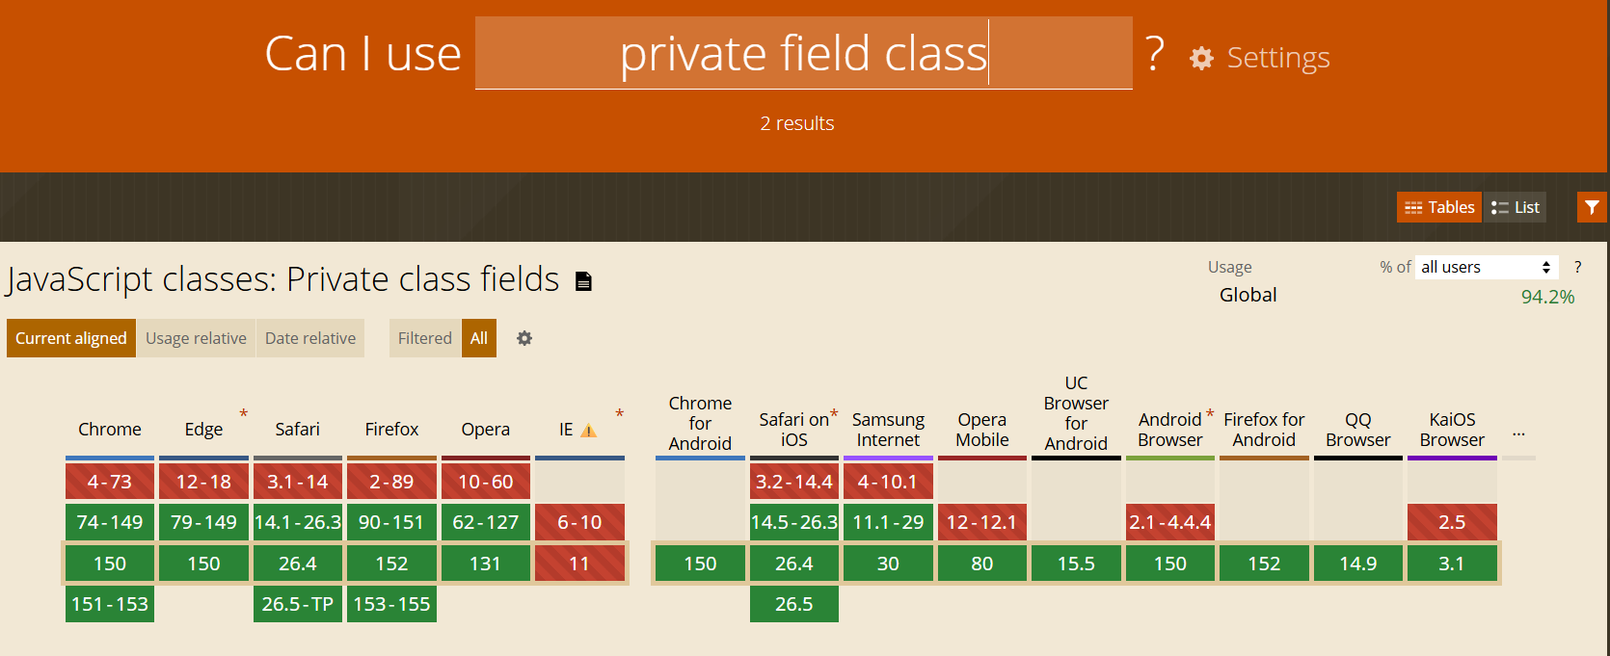
Can I Use?

Slide 35
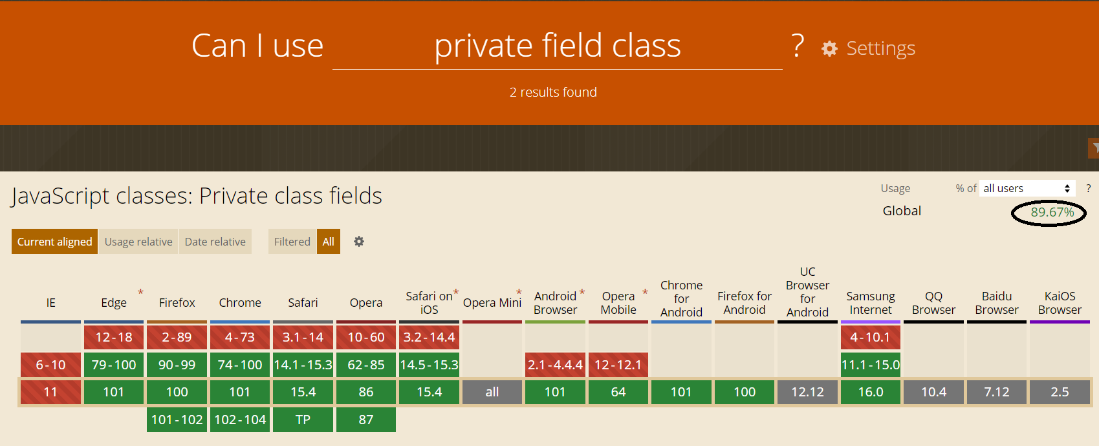
Can I Use? (2025)

Slide 36
Introducing JSON
JSON = JavaScript Object Notation
  Used to send and receive data
  A text format that is actually language independent
    Can be used by many languages
  So is used to communicate between different languages

Slide 37
JSON
Remember our object from earlier
const myPerson = {
name: "Ken",
awake: true,
pulseRate: 80,
activities: ["Running", "Eating", "Sleeping"],
drink: {
morning: "Coffee",
afternoon: "Water"
},
greeting: function () {
return "Hello";
}
};
What if I wanted to send this to a server? (Or receive it).

Slide 38
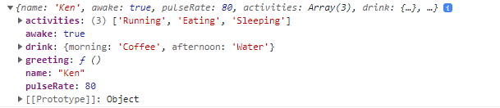
Log it in the console

Slide 39
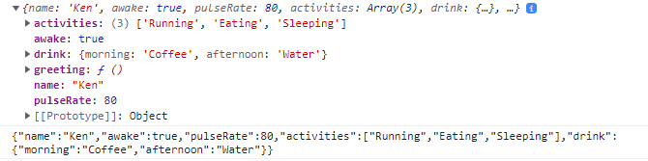
JSON.stringify()
We can convert it into JSON using stringify()
const sendJSON = JSON.stringify(myPerson);
The Result
Spot any differences?

Slide 40
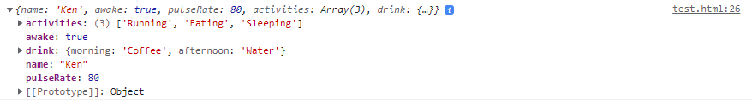
JSON.parse()
We can convert it back to an object using parse()
const receiveJSON = JSON.parse(sendJSON);
The Result

Slide 41
JavaScript – getElementById()
An important function!
Get elements from the DOM!!!
<p id="intro">Hello World</p>
<script type="text/javascript">
const el = document.getElementById("intro");
el.style.color = "blue";
</script>

Slide 42
JavaScript – getElementById()
It can be aliased
<script type="text/javascript">
function $(id)
{
return document.getElementById(id)
}
</script>

Slide 43
JavaScript – getElementById()
Aliased by $
<p id="intro">Hello World</p>
<script type="text/javascript">
$("intro").style.color = "blue";
</script>

Slide 44
JavaScript - innerHTML
innerHTML can return or change the contents of an HTML tag
<p id="intro">Hello World</p>
<script type="text/javascript">
$("intro").innerHTML = "Goodbye";
</script>

Slide 45
Key Points
JavaScript offers support for Objects & Classes
Objects are a set of key/value pairs
Objects can be destructured
Inheritance is supported
Care should be taken to make properties private

Slide 46
Form Validation
Create a Form in HTML that allows the user to input the following, and then validate it using JS.
  Username – At least 5 characters and can include numbers, _ and –
  Password – Must be at least 8 characters, containing both upper and lower case letters, numbers and symbols.
  Age – It is a 18+ website, so the age must be between 18 and 110
  Email – must be of the form abc@def.ghi
When the user clicks submit, display an alert to warn the user of any errors, or success!

